Slide 1
TOT for Dengue Case Management
Year: 2025
PH&CD Branch
Dept. of Health & Family Welfare,
West Bengal

Slide 2
Dengue- Risk Stratification, Clinical Evaluation,Laboratory Invesigation, Differential Diagnosis

Slide 3
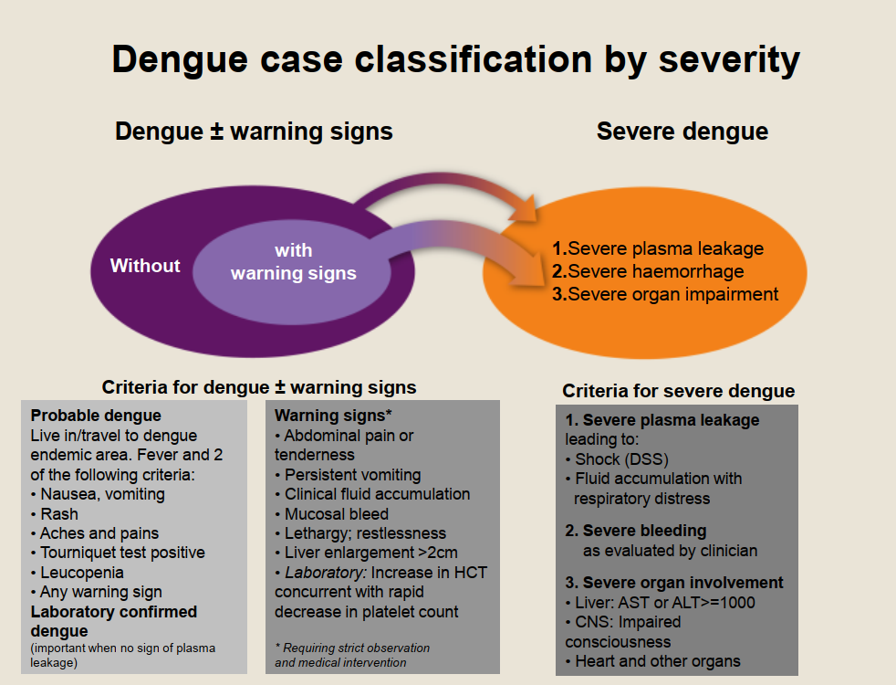
Dengue case classifica-tion by severity

Slide 4
Warning and danger signs of dengue fever
Warning signs in dengue fever
Bleeding: epistaxis, scanty haemoptysis, hematemesis, gum bleeding, black coloured stools, excessive menstrual bleeding, dark-coloured urine or haematuria.
Lethargy and/or restlessness; sudden behavioural changes
Convulsions.
Difficulty in breathing or palpitation or breathlessness.
Persistent vomiting >3 times a day.
Severe abdominal pain
Postural hypotension - dizziness.
Pale, cold clammy extremities.
Not able to drink and no urine output for 4-6 h or urine output less than 0.5 ml/kg/h.

Slide 5
Warning and danger signs of dengue fever
Additional danger signs for clinicians
  Enlarged and/or tender liver
  Rising haematocrit together with rapid fall in platelet count.
  Metabolic acidosis.
  Derangement of liver/ kidney function tests.
  Pleural effusion/ ascites/ gall bladder oedema clinically or by imaging.
KEY POINTS:
  Warning signs between days 3 and 7 of illness.
  Increased capillary permeability causing plasma leakage is the main pathophysiology.
  A rising haematocrit is the earliest sign of plasma leakage

Slide 6
Various risk factors associated with severe disease of dengue
Infant
hypertension
young children
pregnant women
elderly person
obese patient
diabetes mellitus
Immuno-compromised persons
haemolytic conditions
CLD and CKD ; Hb-pathies e.g. sickle - cell disease, and autoimmune diseases

Slide 7
Admission criteria
Warning signs | Persistent high grade fever (≥38.5º C). Any of the warning signs including sudden drop of temperature
Signs and symptoms related to hypotension (possible plasma leakage) | -Dehydrated patient, unable to tolerate oral fluids -Dizziness or postural hypotension -Profuse perspiration, fainting, prostration during defervescence -Hypotension or cold extremities -Difficulty in breathing or deep sighing breaths
Bleeding Organ impairment | -Spontaneous bleeding, independent of the platelet count -Renal, hepatic, neurological or cardiac dysfunction – enlarged, tender liver, although not yet in shock – chest pain or respiratory distress, cyanosis

Slide 8
Admission criteria
Findings through further Investigations | -Rising haematocrit -Pleural effusion, -Ascites or asymptomatic gall-bladder thickening (in USG)
Co-existing conditions/ Co-morbidities (Preferably) | -Pregnancy -Co-morbid conditions e.g. diabetes mellitus, hypertension, peptic ulcer, haemolytic anaemias and others -Overweight or obese (rapid venous access difficult in emergency). -Infancy or old age
Social circumstances (Preferably) | -Living alone -Living far from health facility; -No reliable means of transport

Slide 9
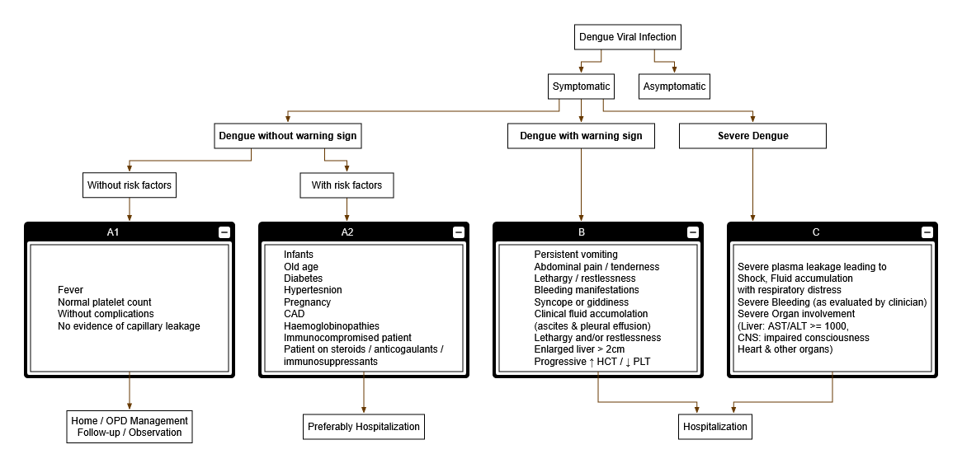

Slide 10
Case study
A 32 year old male patient has come to the medicine OPD with a history of fever for three days associated with severe headache, arthralgia and myalgia. No blood investigations have been done.
What will be your approach to this patient?

Slide 11
Clinical Evaluation
History taking
Clinical examination
Investigations
Diagnosis and assessment of disease phase & severity

Slide 12
Step 1: A patient’s history to be asked
Patient’s history to be asked
1. Date of onset of fever (date is preferable to the number of days of fever) | 6. Shortness of breath
2. A history of dengue fever among households and neighbor, living in or recent travel to a dengue endemic region | 7. Bleeding from any orifice, any bleeding spot on skin/mucosa
3. History of chills, rash and facial flush | 8. Reduced urine output, cold peripheries
4. Retro-orbital headache, arthralgia, malaise | 9. Profuse sweating, postural dizziness, blurring of vision5.
5. Persistent vomiting/diarrhea, pain abdomen | 10. Yellowish discoloration of skin and mucosa, altered sensorium

Slide 13
Assess hydration status from history | Ask 3 golden questions
 | Oral fluid intake-quantity and types of fluids
 | 2. Urine output-quantify in terms of frequency and estimated volume and time of most recent voiding
 | 3. Types of activities performed during this illness (e.g., can the patient go to school, work, market, etc.)
These questions, though not specific to dengue, give a good indication of patient’s hydration status and how well the patient copes with his illness. | • Other fluid losses -such as vomiting or diarrhea • Presence of warning signs, particularly after the first 72 hours of fever
Other Relevant History | • Medications (including non-prescription or traditional medicine) in use and the time they were last taken • Risk factors

Slide 14
Step 2: Clinical examination: Assess
Temperature | Peripheral Perfusion: Hold the patient’s hand and assess peripheral perfusion by the Color, Capillary refill time, Temperature of the extremities, Pulse Volume and Pulse Rate (CCTVR)
Blood pressure | Tachypnea/Acidotic breathing/Pleural effusion
Mental state | Abdominal tenderness/Hepatomegaly/ Ascites
Maculopapular or macular confluent Rash; Conjunctiva | Tourniquet test
Hydration status | Examine Top Sheet

Slide 15

Shock in Dengue
Compensated shock:
Systolic BP normal but there are tachycardia & tachypnoea without increased effort.
Extremities cold and capillary refill time delayed (> 2 seconds).
Pulse pressure < 20 mm Hg in children.
PCV increased due to plasma leakage.
Normal SBP and/or Narrowed Pulse Pressure alongside Delayed CRT & Increased Hematocrit: Prompt action warranted
Prevention or Correction of Dehydration at the compensated shock stage avoids many of the dengue complications

Slide 16
Shock in Dengue......contd.
Hypotensive shock:
Results from worsening of compensated shock.
Increasing tachycardia and peripheral vasoconstriction.
Limbs become mottled, cold and clammy.
Breathing becomes more rapid and deep (a compensation for the metabolic acidosis - Kussmaul’s breathing).
Change in mental state as brain perfusion declines. However, children and young adults may have a clear mental status.
Finally, decompensation, when both systolic and diastolic BPs decrease suddenly.
Prolonged hypotensive shock and hypoxia lead to severe metabolic acidosis and multiple organ failure and also DIC.

Slide 17
Hypotensive shock.......contd.
Hypotension is a late finding and it signals an imminent total cardio-respiratory collapse and hence requires urgent intervention to prevent mortality.
Prolonged hypotensive shock and hypoxia lead to severe metabolic acidosis and multiple organ failure. When major bleeding occurs, it is almost always associated with profound shock and can lead to multiple organ failure and advanced disseminated intravascular coagulation.

Slide 18
Hypotensive shock.......contd.
Massive bleeding may occur without prolonged shock in instances when NSAID or corticosteroids have been taken.
Acute liver and renal failure, encephalopathy and cardiomyopathy may be present in severe shock; or even in the absence of shock. However, most deaths from dengue occur in patients with profound and prolonged shock resulting from plasma leakage and complicated by bleeding and/or fluid imbalance.

Slide 19
Case study
A 19 year old girl is brought to the emergency at night with history of profound weakness and dizziness. On examination the patient is conscious and alert.
Blood pressure - 88/66 mmHg
Pulse – 116/min
Respiration - 28/ min
Temperature – 97º F
The relatives gave a history that she was running a temperature for the last three days. She was treated by a local doctor who had prescribed paracetamol and antibiotics. No blood investigations were advised.
What will be your approach to this patient?

Slide 20
Laboratory Investigations
Complete Blood Count (CBC) (including WBC count, platelets, Haematocrit/PCV) :
-Should be done at the first visit to establish the baseline hematocrit
-Hct in the early febrile phase can be used as the patient’s own baseline. Should be repeated after the 3rd day of illness or with warning signs and with risk factors for severe disease
-In the absence of baseline haematocrit, age-specific population haematocrit levels can be used as a surrogate during the critical phase
-HCT value of >40% in female adults and children aged <12 years and >45% in male adults should raise the suspicion of plasma leakage
-Leucopenia usually precedes the onset of the critical phase

Slide 21
Other haematological features
Leukopenia with Relative Lymphocytosis
Thrombocytopenia (< 100,000 per mm3)
(A decreasing WBC and platelet count makes the diagnosis of dengue very likely and rapid decrease in platelet count with concomitant rising haematocrit is suggestive of plasma leakage/critical phase )

Slide 22
How to interpret haemtocrit
Interpretation of Haematocrit Haemodynamic state should be the principal driver of IV fluid therapy. Haematocrit level should only be a guide.
Interpretation of rising or persistently high haematocrit
Haematocrit |  | Vitals |  | Interpretation | Action
A rising or persistently high Hct | + | Unstable vital signs | = | Active plasma Leakage | Need for further fluid replacement
A rising or persistently high Hct | + | Stable haemodynamic status | = | Does not require extra intravenous Fluid | Continue to monitor Closely. Hct should start to fall within next 24 hours as plasma leakage stops.

Slide 23
Interpretation of a decrease in haematocrit
Haematocrit |  | Vitals |  | Interpretation | Action
A decrease in Haematocrit | + | Unstable vital signs | = | Major haemorrhage | Need for urgent Transfusion
A decrease in Haematocrit | + | Stable haemodynamic status | = | Haemodilution and/ or reabsorption of extravasated fluids | IV fluids should be reduced in step-wise manner or discontinued immediately to avoid pulmonary oedema

Slide 24
Baseline tests other than CBC in dengue
Additional baseline tests should be done in the following conditions:
Patient having comorbidity
Patient having warning sign(s)
Preferably in all admitted dengue cases.
These tests should be done during ﬁrst consultation to get the baseline characteristics like Haematocrit and Complete blood count if the patient presented within 5days of fever. Follow up testing may be done on 1st afebrile day, but should be done daily once if DHF is suspected or warning signs are present.
A regular haematocrit is more important for management than the thrombocytopenia. Even in severe dengue especially with shock hourly haematocrit is crucial for management.

Slide 25
Baseline tests other than CBC in dengue…….contd.
The additional baseline tests include:
FBS
Liver function test –AST levels are higher as compared to ALT in dengue
Kidney function test – serum urea & creatinine
Coagulation profile (Prothrombin Time, INR etc.) – around Day 5 of illness (if facility exists).

Slide 26
Other Required Investigations: As per Clinical Judgement
  - Complete Blood Count -CXR (PA & Lateral Decubitus) - Blood Sugar -USG abdomen including IVC diam.
  - LFT & RFT - Serum Amylase/Lipase
  - Serum Electrolytes - Bicarbonate or lactate
  - ABG - Cardiac enzymes - ECG
Features helpful for differentiation from other viral aetiologies:
Positive Tourniquet Test
Leucopenia with Relative lymphocytosis
Thrombocytopaenia
  Aspartate Aminotransferase (AST) elevation higher than ALT elevation

Slide 27
Differential Diagnosis
Disease | Classical s/s | Differentiating feature of Dengue
Influenza | Fever, headache, myalgia, malaise, RTI | Upper respiratory symptoms like rhinitis and cough may be present in both. Patients with dengue usually have gastrointestinal symptoms (i.e. abdominal discomfort, vomiting and sometimes diarrhea) during the febrile phase.
Malaria | High fever with chill and rigor, Hepatosplenomegaly, features of complication sometimes | Splenomegaly and prolonged fever should prompt the consideration of malaria. Thrombocytopenia may be present in both, further diagnostic studies are needed.
Typhoid fever | Fever, headache, malaise, anorexia, abdominal pain, rose spots, hepatosplenomegaly, altered mental status | Splenomegaly and prolonged fever should prompt the consideration of typhoid. Severe break bone feature usually absent .Very difficult to differentiate complicated typhoid fever from DSS; diagnostic studies are needed.

Slide 28
Leptospirosis | Initial phase-fever Headache Chill Myalgia transient rash & non-purulent conjunctival discharge Second phase- meningitis, renal disease, liver failure | Jaundice more often associated with leptospirosis, but ocular pain, arthralgia and diarrhea could be present as well, whereas dengue may be associated with elevated liver enzymes and mild jaundice. Pulmonary hemorrhage is a particular form of leptospirosis without jaundice that may confuse with severe dengue though uncommon in dengue. Evidence of plasma leakage would suggest the diagnosis of dengue. Fever, thrombocytopenia, raised liver enzyme, renal involvement are common features in both.
Scrub Typhus | Fever, chill, myalgia, headache lymphadenopathy, rash - usually maculopopular. Vital organ involvement in complicated stage. | Eschar, if present, is a characteristic feature. History of living at a high endemic place can provide a clue. Some degree of thrombocytopaenia may occur in scrub typhus. However, leucocytosis is common (unlike leucopaenia in dengue). Spleen & liver may enlarge. Dry cough & pneumonitis may develop. Encephalitis is more common, as compared to dengue. IgM ELISA is confirmatory after 5 days of illness.

Slide 29
Chikungunya | Fever Rash Arthralgia Arthritis Headache | While fever, arthralgia, rash, malaise and leucopenia are common in both Chikungunya and dengue, symmetric arthritis of small joints is pathognomonic of the former and bleeding tendency and pronounced thrombocytopenia are more frequent in dengue.
Rubella | Fever, Rash, Posterior auricular or sub-occipital lymphadenopathy, Headache, Conjunctivitis, Polyarthritis | The rash associated with rubella has a particular distribution from the head to the trunk and extremities, but in dengue the rash usually first appears on the trunk and later extends to the face and extremities
Measles | Fever Maculopapular rash Sore throat RTI | The rash associated with measles has a particular distribution from the head to the trunk and extremities, but in dengue the rash usually first appears on the trunk and later extends to the face and extremities. Severe thrombocytopenia is uncommon.

Slide 30
Attending a fever case in the OPD or ER
Case of acute febrile illness
Mild URTI or mild fever without any significant symptom; no h/o close contact with covid-19 (+)ve case or travel to high incidence State; not a health care worker
Fever > mild, or fever with other significant symptoms. Or, a mild case but with h/o of close contact or travel to high incidence State or health care worker
CBC (Complete Blood Count)
Not required if fever obviously attributable to diseases like UTI, pneumonia etc.
Test for malaria i.e. RDT or Malaria Microscopy
Tests for dengue, covid-19, scrub typhus etc.
Give necessary treatment.
Advise domiciliary management.
If case fits into clinical case definition of dengue, especially in absence of respiratory symptoms / in presence of vital organ involvement
If fever exceeds 5 days and features meet the clinical criteria
If positive, treat for malaria as per protocol
Test by scrub typhus IgM ELISA
Test by Dengue NS-1 ELISA/ IgM ELISA
**Please note:
Until covid-19 test report is available, keep the patient in isolation bed of your hospital or in a Pre-Covid Hospital.
Please utilize the covid-19 diagnostic facility available in your hospital for prompt report i.e. CBNAAT or TrueNat or Rapid Antigen Test; otherwise try fast-tracking with the tie-up RT-PCR Lab.
If features point towards the possibility of covid-19 and if hospitalization is required, get test done for covid-19**
If report is negative, treat in general ward thereafter and do not refer out unless essential.
If report is positive, send to a suitable Covid Hospital
If hospitalization not required, advise test and isolation in home or Safe Home
See pdf in a separate window for a larger view

Slide 31
Expanded Dengue Syndrome (EDS)
“Unusual manifestations of patients with severe organ involvement such as liver, kidneys, brain or heart associated with dengue infection”(WHO 2011)
EDS is commoner in dengue with co-morbidities.
System | Manifestations | System | Manifestations
Neuro-logical | Encephalopathy Encephalitis ⁄ aseptic meningitis Intracranial haemorrhages⁄ thrombosis Mononeuropathies⁄ polyneuropathies, Guillain-Barré syndrome, Myelitis | Cardiac | Myocarditis Conduction abnormalities Pericarditis
GI ⁄ Hepatic | Hepatitis ⁄fulminant hepatic failure Acalculouscholecystitis Acute pancreatitis Febrile diarrhea Acute parotitis | Respira-tory | ARDS Pulmonary hemorrhage
 |  | Musculo-skeletal | Myositis Rhabdomyolysis
Lympho-reticular | Spontaneous splenic rupture, Lymph node infarction | Renal | Hemolytic uremic syndrome Renal failure

Slide 32
Case Study
23 year old male admitted with history of fever for 8 days.
At the time of admission –
  Patient a little drowsy
  Blood pressure 70/50 mmHg
  Pulse 110/min, Low volume
  Temperature 102.6⁰F
Emergency CBC report –
  Hb 13.1 gm%, PCB 39.0%
  TLC 2800/mm³
  Platelet 50000/ mm³

Slide 33
Case Study
MPDA – P.vivax
Peripheral smear – malarial parasite seen

Slide 34
Thank You

Slide 35
NOTES

Slide 36
Laboratory Diagnosis of Dengue
NS1 Antigen Detection
Serology: The study of the diagnosis of disease by measuring antibody levels in serum is referred to as serology.
  IgM-captured enzyme-linked immunosorbent assay
(MAC ELISA)
  Haemagglutination-inhibition
  Neutralization
  Indirect IgG ELISA
  Rapid test
RT-PCR and Real time RT PCR
Virus Isolation and Culture

Slide 37
Collection, storage and transportation of samples
3-5 ml clotted blood to be collected in screw capped vials or vacutainers.
Samples to be transported in cold chain (2-8℃ e.g. vaccine carrier)
Appropriate labeling is most important
Serum must be separated before transportation
No Frozen whole blood
Storage, if necessary, also in 2-8℃ (not more than 1 week)

Slide 38
Step 3 : Investigation for Diagnosis
From onset of Illness to 5 days of fever Virus detected in serum, Plasma, circulating blood cells and tissues Virus isolation Nucleic Acid Detection NS1 Antigen Detection | From 6th Day onwards Antibody Detection First antibody to appear –IgM Secondary Antibody – IgG
For practical purposes any one of the NS1Ag and IgM assays is confirmatory for diagnosis of Dengue if done through ELISA method

