Slide 1
Training of Medical Officer on NTEP Operational and Technical Guidelines

Slide 2
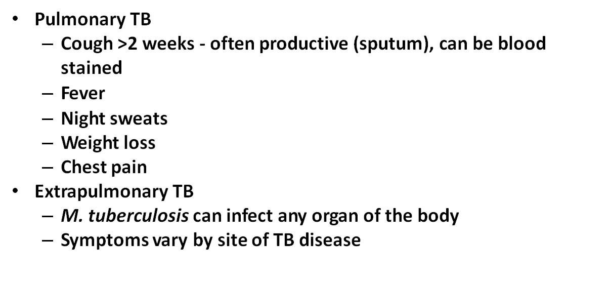
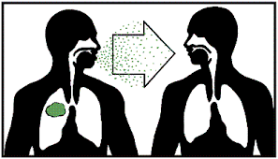
What is Tuberculosis (TB)?
Tuberculosis (TB) is an airborne infectious disease, caused by the bacterium Mycobacterium tuberculosis (M.Tb), that primarily affects the lungs (PTB), but can also affect other parts of the body (EPTB)
Bacteriologically Positive or Negative TB
  Risk factors:
  Malnutrition
  Diabetes
  HIV infection
  Poor immunity
  Severe kidney disease
  Other lung diseases
  e.g. silicosis
  Substance abuse etc.
  Overcrowding
  Inadequate ventilation
  Enclosed living /
  working conditions
  Occupational risks
  Smoking & Alcoholism
  Immunocompromised
  Stigma
All TB Patients are Notified in Ni-kshay Portal with all details
One (1) patient with infectious Pulmonary TB if untreated, can infect 10-15 persons in a year

Slide 3
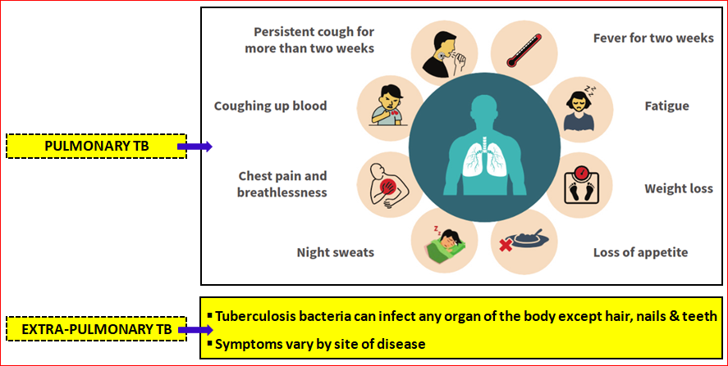
Symptoms of TB – Pulmonary & Extrapulmonary TB

Slide 4
“10S” Symptoms among Vulnerable Population will be Tested for TB by NAAT & X-Ray (to the extent possible)
10 symptoms for TB screening are as follows: “10S”
Cough for 2 weeks or more
Fever for 2 weeks or more
Weight loss. In case of children less than 5 years additionally failure to gain weight or decreased activity or playfulness
Night sweat
Haemoptysis
Chest pain
Shortness of breath
Loss of appetite
Fatigue
Swelling in neck and other Extra Pulmonary signs/symptoms

Slide 5
Key messages on TB
TB disease can happen to anyone and is completely curable.
If not treated, one person with TB can infect 10-15 people each year.
If TB is diagnosed, treatment must be initiated at the earliest for a minimum of 6 months or longer, depending on the type of TB found. Within 2-3 months of treatment, people with TB are significantly less likely to spread TB to others.
Completion of full course of TB treatment, as per the Doctor’s advice, is most important; Non-completion of TB treatment can lead to repeated episodes or even Drug-Resistant TB.
People with TB should cover their mouth and nose while coughing or sneezing and take medications as per the recommended schedule.
People with TB should dispose sputum appropriately by burying it. Should not spit here and there.
Don’t isolate or discriminate against those with TB, rather support them and their families through their recovery.
Nutritious diet (including dal, vegetables, grains, egg, fish, meats, etc.) is important to support the recovery of a person with TB.

Slide 6
Tuberculosis : Facts & Figures of India (Global TB Report, 2022)
India accounts for a quarter of global TB burden. Number falling ill with TB - one person every 11 seconds.
In 2022, WHO estimated 3.42 lakh people died due to TB in India. One person every 2 minutes is dying due to TB.
Yearly about 3 lakh children drop out from the school because of their parents had TB. And yearly more than 1 lakh women are rejected by their families because of stigma due to TB
It is estimated that about 31.4% Indian population is infected with TB bacteria, in the form of latent infection! About 5-10 percent of People with Latent TB Develops Active Tuberculosis in their lifetime!
People with weakened immune systems have a much greater risk of falling ill from TB, for example those with HIV, Malnutrition or Diabetes.
Smokers are more than twice more likely to contract TB, while alcoholics and diabetics are also at a greater risk than the general population. More than 20% of TB cases worldwide are attributable to smoking.

Slide 7
End TB by 2025 to achieve “TB Mukto Bangla”
In tune with the National target - West Bengal is committed to end TB from the state by 2025 and achieve টিবি মুক্ত বাংলা
End TB Targets to achieve by 2025 – in comparison to the baseline of 2015:
  80% reduction in annual TB incidence (new case)
  90% reduction in number of TB deaths, and
  Zero catastrophic expenditure
National TB Prevalence Survey in India - conducted from 2019 to 2021 reveals:
  Prevalence of all forms of TB among all age groups in India per 100 000 population -
    W. Bengal – 179 per 100 000 population
    India – 312 per 100 000 population
  For every 2.8 TB cases prevalent in the community, 1 case gets notified and 1.8 cases get missed. Mere symptomatic screening may lead to missed cases.
  Addition of diagnostic tests like Chest X Ray adds to the yield of TB detection.
  Patients with past h/o TB contribute significantly to the total cases (2 yrs follow – up required).

Slide 8
The 4 pillars of the State Strategic Plan (SSP 2020-25) for TB Elimination
Screen TB from every possible source including SSK/SC
Optimally use NAAT & X-Ray
Increased referral from OPDs / ART / NCD / TCC / NRC / AFHC / UPHC
Ring Survey for Active Case Finding
Notification from Pvt. Health Facilities
Screening in camps - “Duare Sarkar”
Nikshay Diwas on 3rd Monday of Month
TB Telemedicine via Swasthya Ingit
Early initiation of treatment
Manage co-morbidities
DS TB Treatment Success must be ≥90%
Assess clinical parameters at TB diagnosis for better outcome
Start post treatment follow up of TB patients – upto two years
Incentives under Nikshay Poshan Yojana
Family Care Giver as Ni-kshay Saathi
Treat
Build
Detect
Prevent
Support groups in Panchayats involving cured TB patients (TB Champions)
2 TB Champions at all Su-Swasthya Kendra
Engage Private Sector
Engage line ministries – Tribal, WCD
Use TB Aarogya Saathi App for self-reporting and monitoring
Review progress of Ending TB
TB Mukt Panchayat
Sustain COVID appropriate behavior
Enhance TB Preventive Treatment
Airborne Infection Control in Community & Health Facilities
Community Mobilization & People’s Movement - appropriate ACSM
Conduct TB Death Review
TB Preventive Treatment – INH & 3HP
Differentiated TB Care

Slide 9
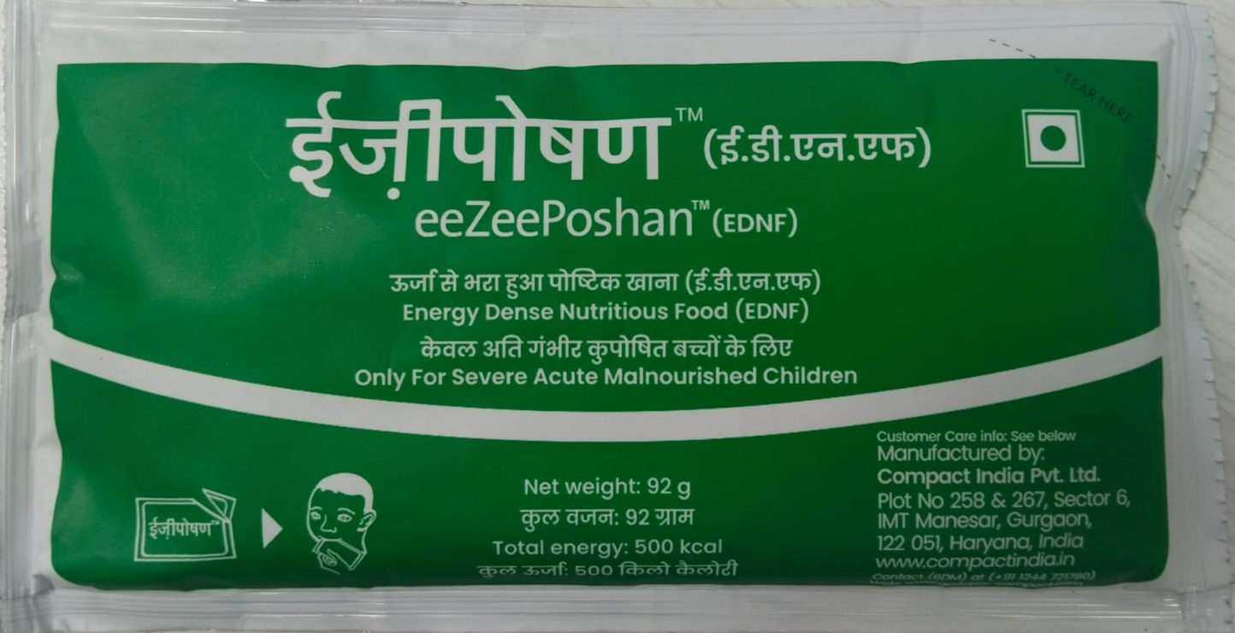
Nutrition interventions – Energy Dense Nutrition Supplement (EDNS)
Energy Dense Nutrition Supplement
To be given for initial 2 months along with ATD for patients with BMI < 18.5 kg/m²
(as and when supplied by CTD, Govt. of India)

Slide 10

Nutrition interventions – Ni-kshay Poshan Yojana (NPY)
IEC on revised NPY within community and healthcare providers
Collect bank account details of TB patients and record in Ni-kshay
Ni-kshay Poshan Yojana
Increased from Rs 500/- to Rs 1000/- month

Slide 11

Nutrition interventions – Ni-kshay Mitra initiative
IEC on revised Ni-kshay Mitra Initiative
Take consent from TB patients
Identify and approach potential Ni-kshay Mitra with advocacy to support TB patients & their families
Link TB patient & family with Ni-kshay Mitra
Engage NGOs for alternate option for distribution of Nutrition kits
Ensure regular supply of nutrition kits
Arrange felicitation of Ni-kshay Mitra for their support
PMTBMBY
Increase scope to cover all household contacts in addition to TB patients

Slide 12
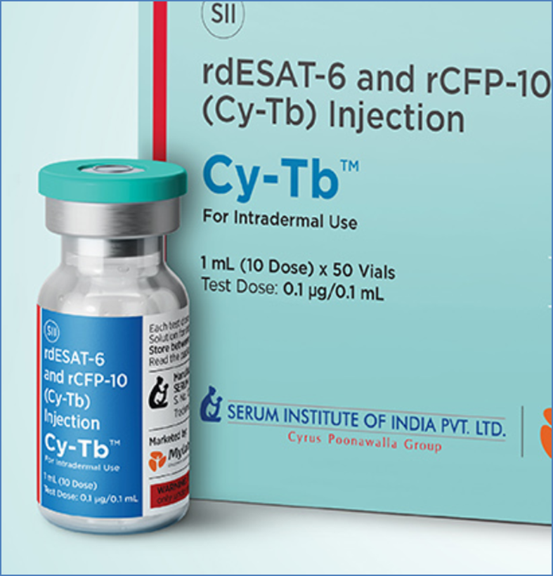
Cy-Tb Intra-Dermal Skin Test For Detection of
TB Infection (TBI)

Slide 13
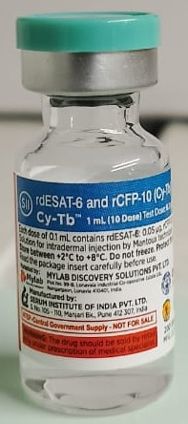
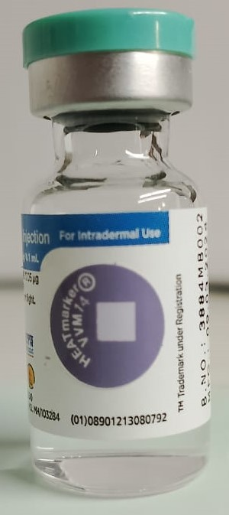
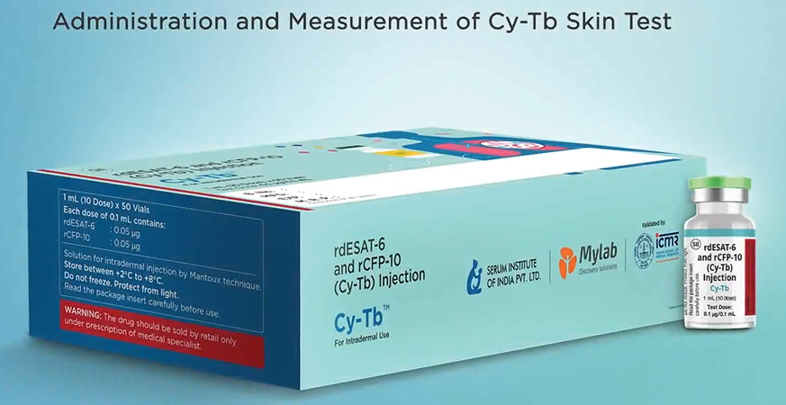
Cy – TB Intra-dermal Skin Test validated and approved by ICMR & Manufactured by Serum Institute of India, Pune
Cy-Tb Skin Test recommended for detection of TB infection before it progresses to an active TB disease.
Cy-Tb contains a 1:1 ratio of two recombinant proteins of rdESAT-6 and rCFP-10 produced by genetically modified Lactobacillus lactis.
Cy-Tb selectively detects rdESAT-6 & rCFP-10 which are Mycobacterium Tuberculosis (MTB) specific and therefore eliminates False Positivity in the previously BCG vaccinated population.
Cy-Tb is more specific compared to Tuberculin Skin Test (TST) and not influenced by earlier BCG vaccination.
Intra-dermal injection of Cy-Tb is the same like Mantoux technique.

Slide 14
Who will be given Cy-Tb for detection of TB Infection in the first phase?
Household contacts of Pulmonary Drug Sensitive TB patients
Following high risk groups –
  Person on Immuno-suppressant or Anti-TNF treatment; Silicosis; Person on dialysis; Transplant recipient
  Malnourished, Diabetes etc.
18 yrs. and above age group at present.
Exclusion criteria of Cy-Tb:
  Less than 18 yrs of age
  PLHIV / CLHIV

Slide 15
Cy – Tb : Technical information
It is stored in 2–8 degree Celsius temperature.
Cy-Tb vials can be kept in the refrigerator section of domestic fridge but should not be stored in freezer section – at peripheral health facilities.
Cy-Tb can be done easily at the point of care level - both at health facility and in the field.
Who can be given Cy-TB – For diagnosis of TB infection in the age group of 18 years and above at present.
Cy-Tb administration (dosage) – 0.1 ml intra-dermal injection with 0.1 ml AD syringe.
Cy-Tb Reading – The test should be read between 48–72 hours (Not before 48 hours or after 72 hours).
Cy-Tb Result – An induration of ≥ 5 mm is considered as a positive test result, which indicates infection with Mycobacterium tuberculosis. Such cases must be evaluated further for active TB disease as per NTEP algorithm.
Positive for Cy-Tb reflect positive for TB infection. Positive test does not mean TB disease.
If Cy- Tb is positive i.e. Induration is ≥ 5 mm, TPT to be provided as per guideline after ruling out active TB.

Slide 16
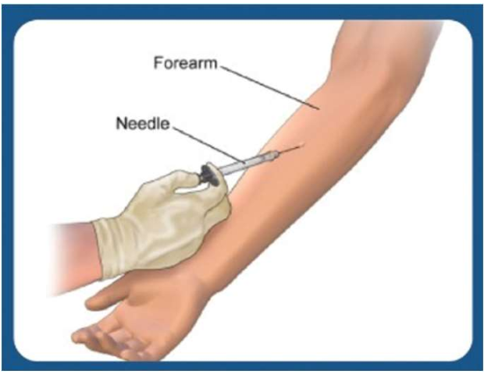
Cy – Tb : Administration of skin test
(syringes must be filled immediately prior to administration).
The administration procedure is identical to intradermal injection for Mantoux technique on forearm.
Wash your hands with soap and water.
Wear the gloves.
On a firm, well-illuminated surface, expose the person’s arm and slightly flex at the elbow.
The injection is to be administered on the palm-side-up surface of the forearm (preferably left forearm), about 2 to 4 inches below the elbow. Avoid areas of skin with veins, sores, rashes, scars or excess hair.

Slide 17
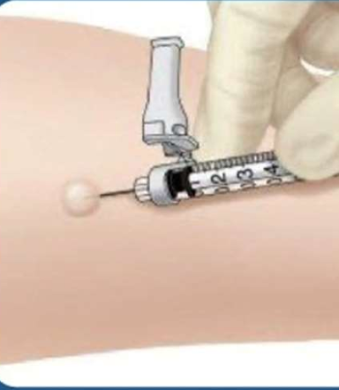
Cy – Tb : Administration of skin test
Release the stretched skin and hold the syringe in place. Slowly inject the solution, forming a 6-10 mm wheal (pale, raised area with distinct edges, has orange peel appearance and does not disappear immediately).
If no wheal forms or if it is less than 6 mm in diameter, repeat the test approximately 2 inches from the original site or on the opposite arm.
Remove the needle without massaging or pressing the area and immediately discard the used syringe in the sharp’s container.
If minor bleeding occurs, use a 2 X 2 gauze pad or cotton ball to dab the injection site.
Do not cover the site with an adhesive bandage as it could cause irritation.
Inform the person that mild itching, swelling, or irritation is normal and usually goes away within 1 week.
Explain how to care for the injection site: avoid starching the site, keep the site clean and dry and avoid creams, lotions, or adhesive bandages.
Inform the person that it is important to return within 48 to 72 hours to have the test result read.

Slide 18
Cy – Tb : Administration of skin test
Release the stretched skin and hold the syringe in place. Slowly inject the solution, forming a 6-10 mm wheal (pale, raised area with distinct edges, has orange peel appearance and does not disappear immediately).
If no wheal forms or if it is less than 6 mm in diameter, repeat the test approximately 2 inches from the original site or on the opposite arm.
Remove the needle without massaging or pressing the area and immediately discard the used syringe in the sharp’s container.
If minor bleeding occurs, use a 2 X 2 gauze pad or cotton ball to dab the injection site.
Do not cover the site with an adhesive bandage as it could cause irritation.
Inform the person that mild itching, swelling, or irritation is normal and usually goes away within 1 week.
Explain how to care for the injection site: avoid starching the site, keep the site clean and dry and avoid creams, lotions, or adhesive bandages.
Inform the person that it is important to return within 48 to 72 hours to have the test result read.

Slide 19
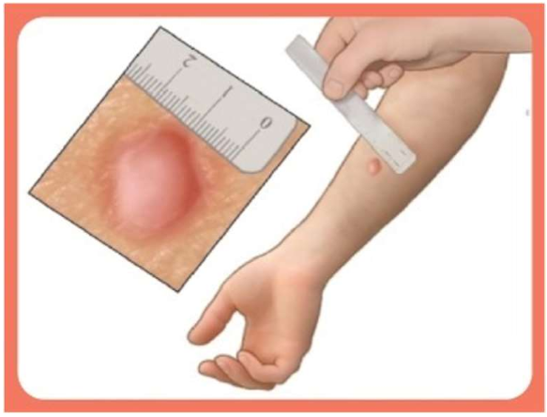
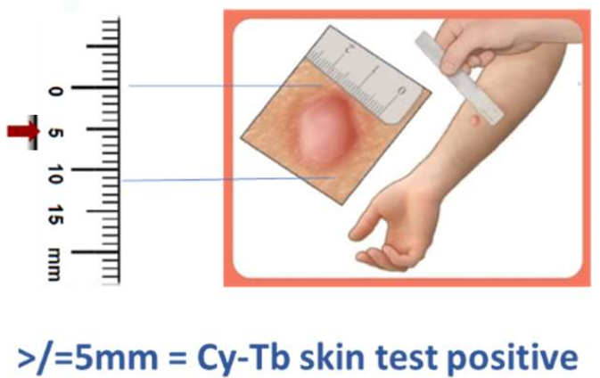
Cy – Tb : Interpretation of skin reaction

Slide 20
Ring Survey
Pitfalls of conventional bi-annual ACF, Yield of TB case finding and notification was very low (<1%)
Poor quality of case selection & sample collection- More than 50% of poor-quality sputum is being tested in each rounds
Reaching vulnerable population once or twice, in a year, as done in conventional ACF, has an inherent risk of missing TB cases in between.

Slide 21
Way-outs & State’s innovation- Ring Survey
A modified ACF in the form of "Ring Survey" will be carried out in the community, to improve TB Case detection.
Extended household contact tracing (household + extra-household contacts) is a recommended policy for TB case findings
International guidelines recommend extra-household contact screening in a concentric circles approach around a person with infectious TB disease (microbiologically confirmed pulmonary TB patients) also known as the “index case”
Guidelines also recommend Contacts should be assessed at least twice. First, at baseline (within two weeks of diagnosis of Index case) and at break of contact (at least eight weeks after the date of anti-TB treatment initiation of the index case ⁽¹⁻³⁾

Slide 22
Justifications of Ring Survey
Household contacts & neighbouring extra-household contacts are more vulnerable for getting TB.
Studies suggested that extra-household contacts are of similar risks of getting TB infection⁴
Studies also suggested that extra-household contacts are of similar risks (sometime higher risk) of getting active TB disease¹
References-
1.Nagarajan K, Muniyandi M, Palani B, Sellappan S. Tracing the potential extra-household contacts of TB patients: findings from a personal social network survey in a high TB burden setting in India. Trans R Soc Trop Med Hyg [Internet]. 2022 Feb 1 [cited 2024 Jun 25];116(2):190–2. Available from: https://pubmed.ncbi.nlm.nih.gov/34246195/
2.Hoang TTT, Nguyen VN, Dinh NS, Thwaites G, Nguyen TA, Van Doorn HR, et al. Active contact tracing beyond the household in multidrug resistant tuberculosis in Vietnam: A cohort study. BMC Public Health. 2019 Feb 28;19(1).
3.Department of Health; Government of NSW. Tuberculosis Contact Investigations NSW Guideline [Internet]. 2019 [cited 2024 Jun 25]. p. 13–4. Available from: https://www1.health.nsw.gov.au/pds/ActivePDSDocuments/GL2019_003.pdf
4.Kakaire R, Kiwanuka N, Zalwango S, Sekandi JN, Quach THT, Castellanos ME, et al. Excess Risk of Tuberculosis Infection Among Extra-household Contacts of Tuberculosis Cases in an African City. Clin Infect Dis [Internet]. 2021 Nov 1 [cited 2024 Jun 25];73(9):E3438–45. Available from: https://pubmed.ncbi.nlm.nih.gov/33064142/

Slide 23
Ring survey methodology
During the "Ring Survey", a two-member team comprising of one (1) ASHA and one (1) TB Champion or Community Volunteer will be engaged to visit 50 households around a notified Index Microbiologically confirmed Pulmonary TB patient (i.e. Sputum Positive TB patient) and screen all his/her household contacts for TB symptoms within two weeks of the diagnosis of the index case
Symptoms should be screened using 4S screening methods
Sputum samples from those household contacts having TB symptoms will be collected and transported to the nearest/linked TB diagnostic center (TDC) for examination for early detection of TB.
Sputum should be of good quality (muco-purulent). If good quality sputum is not produced by the patients, sputum should be induced as per recommended methods under NTEP.
Patients may be referred to higher center for Gastric lavage/aspirate (children) and BAL (adult).
The whole process will be repeated within two weeks of end of the treatment of index TB case

Slide 24
Scope of TB-Telemedicine services under Swasthya Ingit
Utilize the existing Telemedicine platform of "Swasthya Ingit“ for the Tuberculosis related health care services under NTEP through Hub and Spoke model with proactive involvement of:
  Community Health Officers (CHOs) at Telemedicine enabled Su-Swasthya Kendras
  Medical Officers of Primary Tier health facilities
  Specialist Doctors (Pulmonologist, Physician along with MOs of Nodal DRTB Centres, MO-DTC, MO-NTEP, Sr. MO / MO with experience of treating TB cases)
Two tier (Level 1 & Level 2) of Hub and Spoke model is proposed under "Swasthya Ingit" for TB related health care services through Tele-consultation in Audio-Video conference or Instant Chat mode

Slide 25
Level 1 & Level 2 Hub and Spoke model under "Swasthya Ingit" for TB Tele-consultation
Level | Hub | Spoke | Telemedicine consultation for
Level 1 | MO of Primary, Secondary & Tertiary level Health Facilities – in the already existing Hub from Monday to Saturday during Telemedicine hours. | CHOs / Staff Nurses at all Telemedicine enabled Su-Swasthya Kendras (SSKs). | Primary consultation for screening of presumptive TB cases, if required. For TB patients - diagnosis, treatment initiation, identification of high risk PwTB, counselling for treatment adherence and management of minor Adverse Drug Reaction (ADR), follow-up etc.
Level 2 | Specialist MO (Pulmonologist / Physician), MOs of Nodal DRTB Centres / MO-DTC / Sr. MO / MO-NTEP / MO with experience of treating TB cases at SGH / SDH / DH / SSH / MCH / TB hospital – in “HUB TUBERCULOSIS” on Tuesdays & Thursdays. | All CHOs and Staff Nurses of Telemedicine enabled SSKs or health facilities. Medical Officers of Level – 1 Hub may consult with Specialists / Sr. MO / Experienced MO through Staff Nurse’s Log-in ID using Audio-Video conference or Instant Chat mode. | Consultation for diagnostic dilemma, complicated TB patients requiring change of treatment regimen, drug dosage adjustment, co-morbidities, mild, moderate & severe Adverse Drug Reaction (ADR) etc.

Slide 26
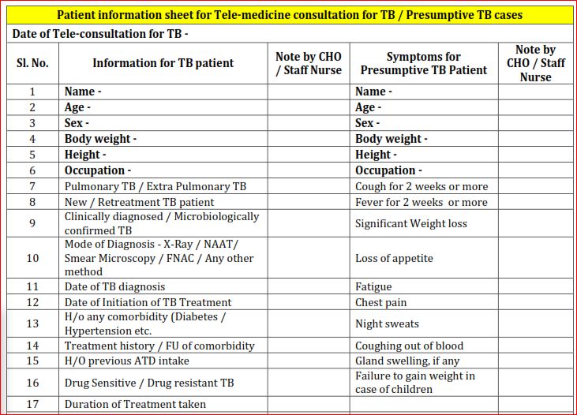

Slide 27
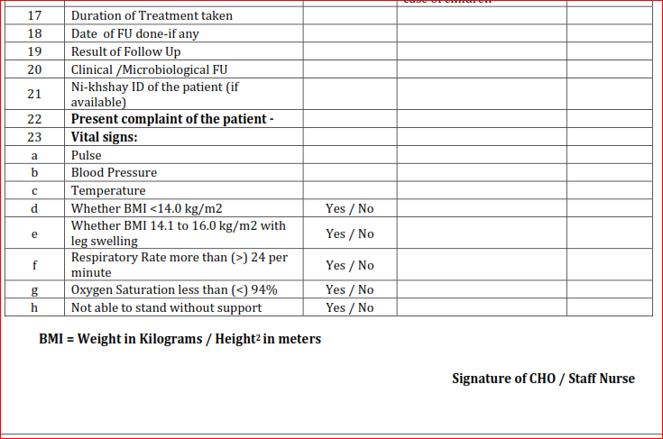

Slide 28
Difficult-To-Treat-TB-Clinic (DT3C)
DT3C is an initiative to support DR-TBCs in appropriate patient management.
It is functional at national level by collaboration of NITRD-CTD-NTF
Expected to be established at state level or NDR-TBC level
Experts involving various specialty are included in team as mentors. Information/query regarding the patient is shared in standardized format by DDR-TBC beforehand to facilitate discussions through state nodal officer.
All states should have at least one (more than one in larger states) DT3C established (Annexure 5).
Expenses for establishing/ running DT3C clinic if any may be proposed through annual PIP.

Slide 29
When do we presume TB
Presumptive TB | Presumptive EP TB | Presumptive Paediatric TB | Presumptive DR-TB
Cough for > 2 weeks Haemoptysis Fever >2 weeks Significant weight loss. Any pulmonary abnormality in chest radiograph | Refers to the presence of organ specific symptoms and signs like, Swelling of lymph node, pain Swelling in joints, neck stiffness, disorientation , etc., and/or Constitutional symptoms like significant weight loss, persistent fever for ≥ 2 weeks, night sweats. | refers to children with - Persistent fever and / or cough for more than 2 weeks - Loss of weight*/no weight gain and/or - History of contact with infectious TB case**. *History of unexplained weight loss or no weight gain in past 3 months ; (loss of weight is defined as loss of >5% body weight as compared to highest weight recorded in last 3 months.) **In a symptomatic child contact with a person with any form of active TB within last 2 years may be significant. | refers to those Tb patients who have - Failed treatment with first line drugs -TB patient who are found positive on any follow - up smear examination during treatment with first line drugs -Previously treated TB case -TB patient with HIV co- infection -Paediatric TB non-responders -TB patients who are contact of MDR-TB (or Rif resistance)
Note: In addition , contacts of microbiologically confirmed TB patients, PLHIV , Diabetics, Malnourished, cancer patients, patients on immuno- suppressants or steroids should be regularly screened for sign and symptoms of TB

Slide 30
Type of case finding
Passive Case Finding: When the Patient Voluntarily reports symptoms to the Medical Officer.
Intensified Case Finding: When the Medical Officer searches for TB symptoms among the individual seeking care in the health facility e.g., ART Centre, Diabetic Clinics, NCD Clinics.
Active Case Finding: Active Case Finding: When the Community health workers seeks for TB symptoms among the vulnerable key population. The programme encourages Active Case finding as an intervention for Ending TB (House Visits)
Congregate settings
Urban Slum
Antenatal Mothers
Patients with co-morbidities
Past history of TB
Hard to reach area

Slide 31
Screening of vulnerable population
Clinically vulnerable | Socially vulnerable
Persons with HIV Malnourishment Diabetes Compromised lung states Cancer patients Patients on dialysis Patients on immune suppressant drugs, steroids | Health care givers Contacts Prisoners Smokers, persons exposed to fuel fumes Aged Mental hospital patients/care givers, Slum dwellers, migrants Miners, crushers, persons in fabric industries
Vulnerable population is a group of people in whom the prevalence or incidence of TB is significantly higher than in the general population.
The recommended vulnerable groups to be considered for intensified case finding may be classified as follows:

Slide 32
Comprehensive diagnostic algorithm
Presumptive TB
TBI Risk Groups
NAAT (preferred)/ Microscopy + CXR/ other tests
4 S screening
Rule out active TB
Yes
No
CXR
MTB +ve, Rif Sens
MTB +ve, Rif Res
No Active TB
TST / IGRA
FL-LPA, SL-LPA and LC-DST
FL-LPA
+ve or Not available
- ve
H Sens
H Res
FQ Sens
FQ Res
CXR
CXR +ve
DS-TB
H mono/poly DR-TB
MDR/RR TB
Pre XDR/ XDR-TB
CXR -ve
+ve
No active TB
TPT
-ve or NA
Microscopy / NAAT / CXR Negative – Check other causes / clinical diagnosis

Slide 33
Screening of Presumptive Pulmonary TB patients
In a peripheral health institution (PHI), it is expected that at least 2-3% of new adult out-patients are chest symptomatic (Presumptive PTB Cases). However, this will vary widely in different settings e.g., chest clinics, Medical Colleges and TB hospitals.
Further, it is expected that on an average 5-15% of the chest symptomatic subjected for sputum examination are found to be sputum smear positive. However, it may also vary depending on the type of tests subjected (Microscopy vs NAAT)
The number of Presumptive TB patients examined can be expressed as numbers / lakh population.
There should be an increasing trend year on year commensurate with more efforts required to detect additional patients.

Slide 34
Annualized Presumptive TB cases examination rate
Numerator: Number of presumptive TB cases tested (smear microscopy + CBNAAT+TruNAAT)
Denominator:Total population of the area (In Lacs)
Data source: Monthly Annexure M and Monthly NAAT reports

Slide 35
Diagnosing TB disease
Tools for microbiological confirmation of TB under the programme:
A. Sputum Smear Microscopy (for AFB):
Zeihl-Neelsen Staining
Fluorescence staining
B. Culture:
Solid (Lowenstein Jensen) media
Automated Liquid culture systems e.g. BACTEC MGIT 960, BacT Alert or Versatrek etc.
C. Rapid molecular diagnostic tests:
Line Probe Assay (LPA) for MTB complex and detection of RIF & INH resistance (FL LPA) and FQ and SLI resistance (SL LPA)
Nucleic Acid Amplification Test (NAAT) (CBNAAT/Truenat)
D. Supportive tools for the clinical diagnosis of TB
Chest X-ray and other radiological tests
Tuberculin Skin Test (TST), Interferon Gamma Release Assay (IGRA) and other blood tests, Histopathology and other tissue-based tests.

Slide 36

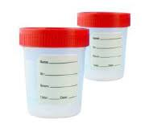
Containers used for Sample collection
Sterile screw capped conical tube
Sputum container
TO BE USED ONLY FOR MICROSCOPY
TO BE USED FOR NAAT/ LPA/ LCDST
Procurement of the containers at district/ state level
Same tube directly used for decontamination
Specimen collection container: Sterile 50 ml screw capped and graduated conical bottom polypropylene tube

Slide 37
When to collect the specimen
Diagnosis- prior to treatment initiation
Treatment monitoring- at intervals specified in treatment guidelines for DSTB and DRTB to identify progress of treatment and amplification of drug resistance
To follow up patients for relapse free cure- Long term follow up

Slide 38
Specimen collection and operational process
Specimen collection centre
Patient identification by LT or HF doctor
2 specimen (one early morning & one “supervised” spot) are collected in 50 ml conical tubes, packaged (in triple layer – as per SoP) and transported in cool chain to the NAAT facility
NAAT facility
1 specimen is processed on NAAT. If M.tb is detected (RR detected or not detected), the second specimen tubes) packaged (in triple layer – as per SoP) and transported in cool chain to C&DST
C&DST
laboratory
Second specimen is used for performing FL and/or SL LPA and further DST as applicable. If the specimen is smear negative, it is subjected to Liquid culture and LPA is performed on the culture isolate (Referring facility is informed accordingly)
NAAT result is updated and “Test ID” for tests expected at C&DST laboratory is created in Ni-kshay
Patient ID and Test ID are generated in Ni-kshay
Test results are updated in Ni-kshay and communicated to the referring facility

Slide 39




When to transport – Turn Around Time
IMMEDIATE
AT DIAGNOSTIC CENTRE
NO BATCHING OF SPECIMEN AT COLLECTION SITES
Results vary on delay

Slide 40
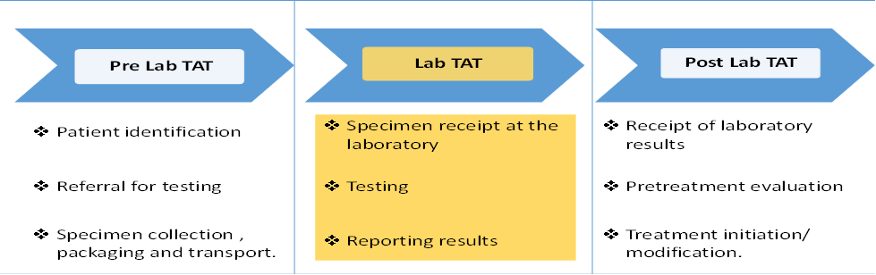
Turn Around Time (1)
Patient Turn Around Time (TAT) is defined as the elapsed time in days between identifying the eligible patient to initiating the patient on treatment based on the laboratory result.
The overall TAT (from specimen collection to receipt of the result by the clinician) may be much longer and is dependent on a number of factors including speed of referral of specimens to the laboratory and delivery of results to the clinician.
Notes:
TAT serves as a quality indicator to assess efficiency of field services as well as the diagnostic cascade in the patient pathway.

Slide 41
Turn Around Time (2)
Test | Pre Lab TAT (in Days) | Lab TAT (in Days) | Post Lab TAT (in Days) | Total Patient TAT (in Days)* | Remarks
NAAT | 1-3 | 1-2 | 3-5 | 5-10 | Pre lab TAT includes patient identification, counselling, collection and transport of 2 specimens to NAAT facility. Post lab includes accessing test results, Pretreatment investigation and treatment initiation
LPA | 3-4 | 2-3 | 2-3 | 8-12 | Pre lab TAT includes time from collection to NAAT and further transport of second specimen to CDST Labs
LC DST** | NA | Time till LPA testing – 5-7 days + *22 – 48 ( in most cases 30 days) | 2-3 | 29-58 ( in most cases 40 days) | No pre lab time, cultures are set up using decontaminated deposit. *Includes Culture and Growth days for DST set up. ** for Z DST additional 7 days will be needed.
Liquid Culture (Follow up) | 2-3 days (for tracing patient and collecting specimen for follow up culture) | 8-42 | 1- 2 | 11- 45 | Fresh sample is collected from the patient and transported.
Notes:
Laboratory TAT refers to the time taken from receipt of a specimen at the laboratory to issuing a laboratory test result.
Despite the introduction of rapid molecular tests, the overall patient turnaround time has not reduced significantly chiefly due to insufficient supervision of field level activities and the laboratory services. It is important to consistently achieve benchmark TAT and to periodically review the process indicators for achieving quality improvement.
Both these TATs need to be monitored to ensure prompt sample collection, transportation and efficient processes in the laboratories.

Slide 42
Operational plan- diagnostic services
Improve microbiological confirmation and completion of diagnostic algorithm
Effort to collect appropriate specimen for testing
Scale up of molecular TB diagnosis
  Phased transition from Microscopy to NAAT- Presently from 23% to 40%
  Assess demand vs capacity
  Customized methods to augment testing with available infrastructure
  Expansion of NAAT machines to improve access
  Effective and robust linkage of peripheral sites to NAAT facilities
  Strategic partnerships with private sector for microbiological confirmation
Microscopy to continue for treatment monitoring.
Existing Laboratory technicians to be trained and repurposed for performing NAAT.

Slide 43
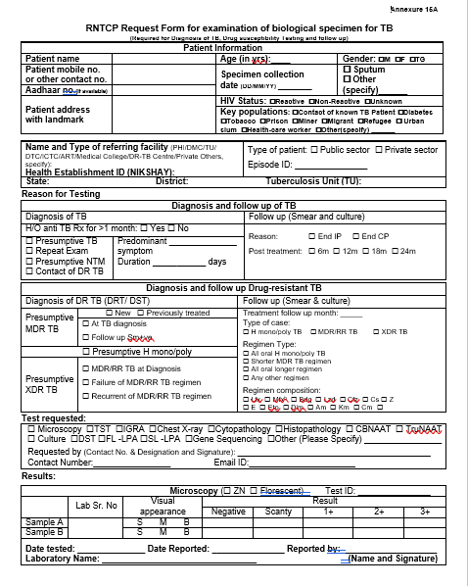
Lab Request Form (Front page)
Patient details
Ni-kshay ID
DS-TB
Reason for test
DS-TB
Test requested
Microscopy Result

Slide 44
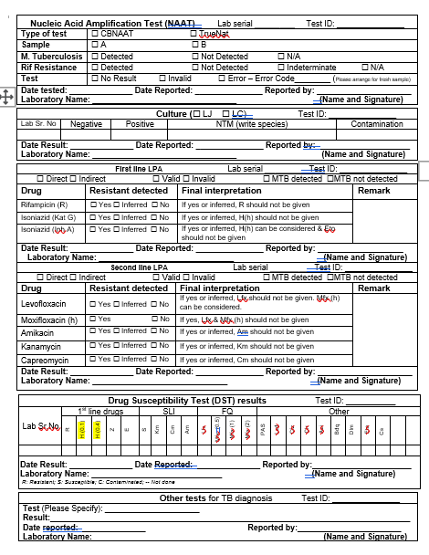
Lab Request Form (Back page)
NAAT Result
NAAT Result
1st Line
LPA Result
2nd Line
DST results
Other test results

Slide 45
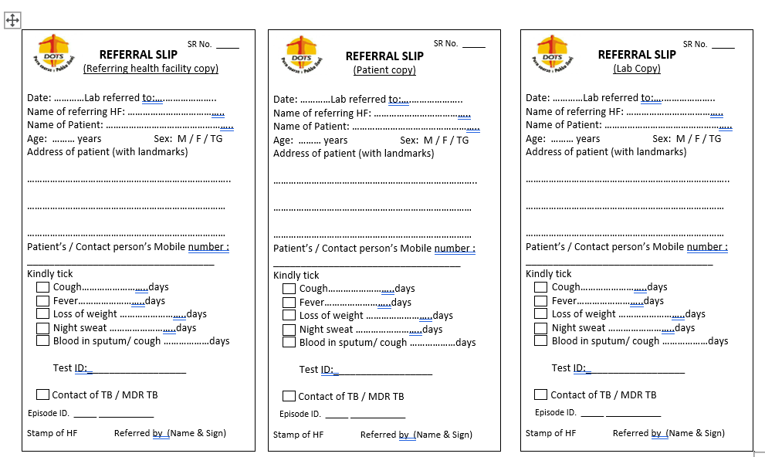
Referral Slip

Slide 46
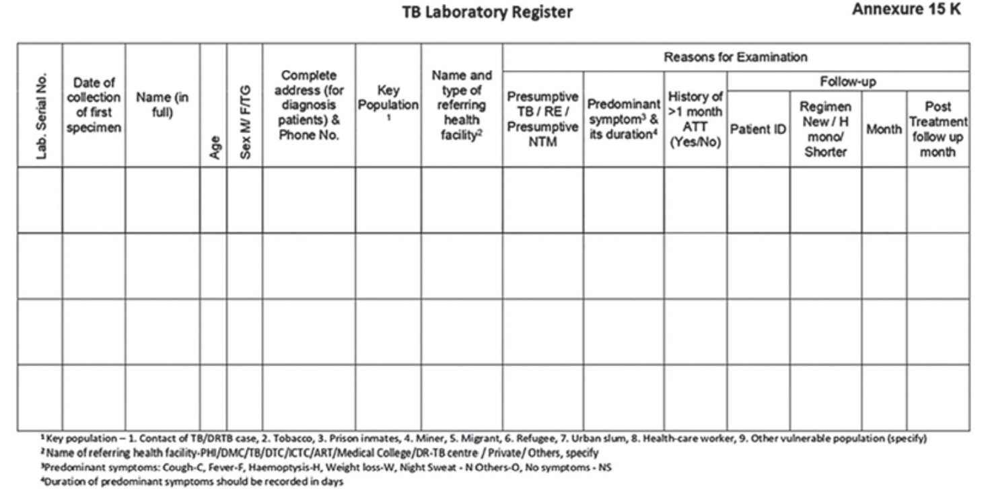
TB Lab Register (Left page)

Slide 47
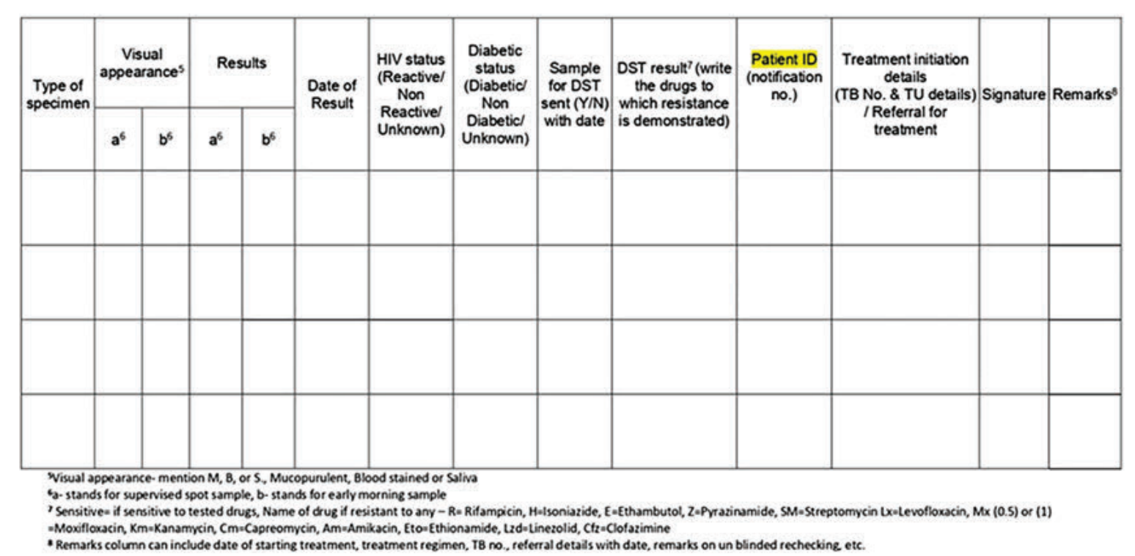
TB Lab Register (Right page)

Slide 48
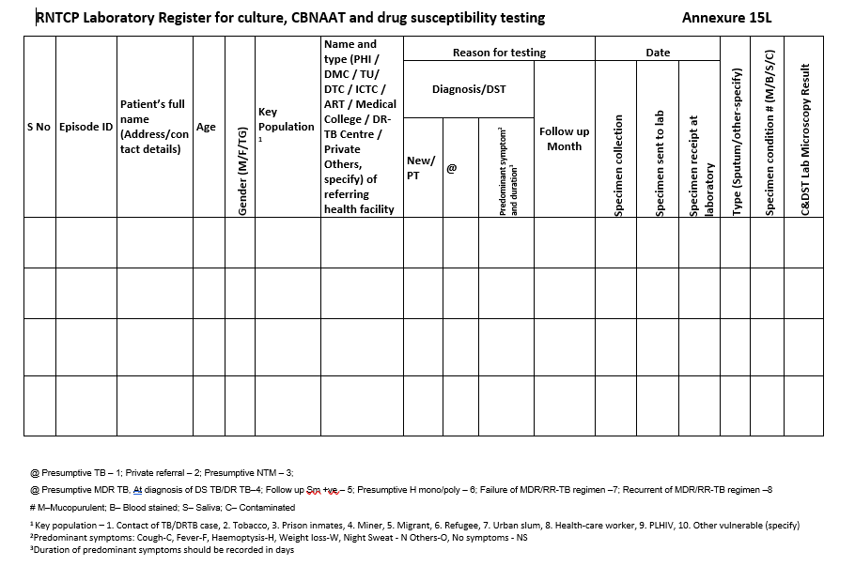
Lab Register for NAAT and CDST (Left page)

Slide 49
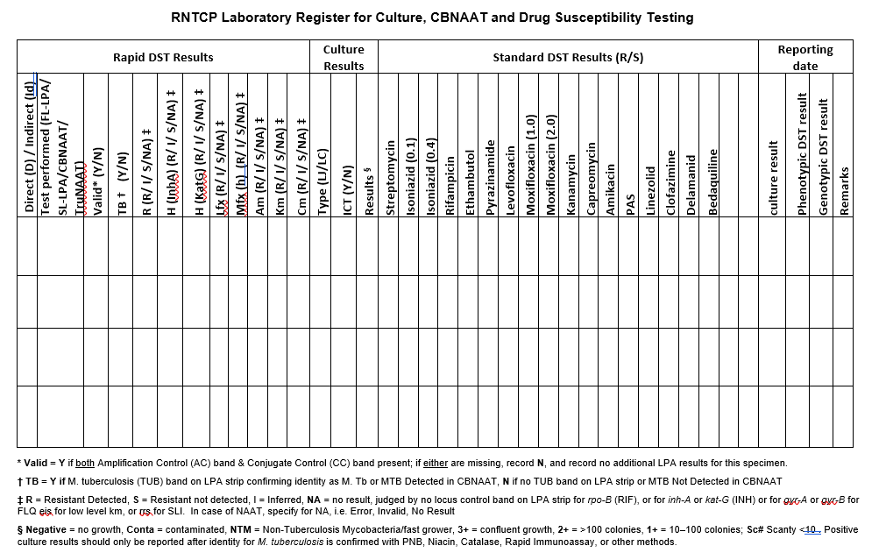
Lab Register for NAAT and CDST (Right page)

Slide 50
Treatment of Drug Sensitive TB
Type of TB Case | Treatment regimen in IP | Treatment regimen in CP
New or Previously treated | (2) HRZE | (4) HRE
The drugs are given daily
The dose of drugs are according to body weight
Fixed Dose Combination (FDC) tablets are used
Loose Drugs would be needed as substitutions in case of adverse drug reaction or with co-morbid conditions.
No need for extension of IP
CP may be extended by 12-24 weeks in certain forms of TB like CNS TB, Skeletal TB, Disseminated TB etc. based on clinical decision of the treating physician.
Extension beyond 12 weeks should only be on recommendation of experts of the concerned field.
Notes:
These slides (slide # 35 to 38 is treatment protocol)
Animation: moderate
Graphics:
Match with the theme adopted
This is a treatment regimen slide. How many drugs, which drugs and for what duration to be used and other feature of treatment of TB. A great scope of graphical enhancement and you may find video on similar theme in google/youtube. We also have animation on this

Slide 51
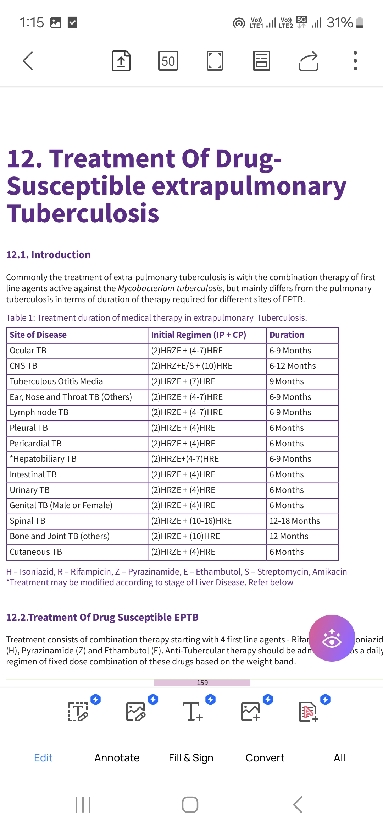

Slide 52
Treatment of TB - Adult
Weight category | Number of tablets (FDCs)
 | Intensive phase | Continuation phase
 | HRZE | HRE
 | 75/150/400/275 | 75/150/275
25-34 kg | 2 | 2
35-49 kg | 3 | 3
50-64 kg | 4 | 4
65-75 kg | 5 | 5
≥75 | 6 | 6
If weight increases or decreases by 5 kg or more, compared to baseline weight and crosses the current weight band during the course of treatment, the weight band must be changed at the time of next dispensation of drug
Tab pyridoxine for Alcoholics, Malnourished persons, Pregnant and lactating women, Patients with chronic renal failure, diabetes, HIV infection
#CP can be extended by 12 to 24 weeks in certain forms like CNS TB, Skeletal TB and Disseminated TB, based on clinical decision of the treating physician
Notes:
These slides (slide # 35 to 38 is treatment protocol)
Animation: moderate
Graphics:
Match with the theme adopted
This is a dosing slide. How many tablets for which weight band of TB patient. A great scope of graphical enhancement and you may find video on similar theme in google/youtube. We also have animation on this

Slide 53
Treatment of TB – Paediatric (0 – 18 Years)
Weight category | Number of tablets (dispersible FDCs)
 | Intensive phase |  | Continuation phase
 | HRZ | E | HR | E
 | 50/75/150 | 100 | 50/75 | 100
4-7 kg | 1 | 1 | 1 | 1
8-11 kg | 2 | 2 | 2 | 2
12-15 kg | 3 | 3 | 3 | 3
16-24 kg | 4 | 4 | 4 | 4
25-29 kg | 3 + 1A* | 3 | 3 + 1A* | 3
30-39 kg | 2 + 2A* | 2 | 2 + 2A* | 2
*A=Adult FDC (HRZE = 75/150/400/275; HRE = 75/150/275)
Change the weight band once the patient weight crosses the current weight band upper/lower limits during the course of treatment.
Notes:
These slides (slide # 35 to 38 is treatment protocol)
Animation: moderate
Graphics:
Match with the theme adopted
This is a dosing slide for children with TB. How many tablets for which weight band of TB patient. A great scope of graphical enhancement and you may find video on similar theme in google/youtube. We also have animation on this

Slide 54
Pyridoxine in TB Regimen
Tab pyridoxine not required for all TB patients
B6 is given to prevent INH related neuropathy in persons at high risk of Vitamin B6 deficiency
  Alcoholics
  Malnourished persons
  Pregnant and lactating women
  Patients with conditions such as chronic renal failure, diabetes,
  HIV infection
Notes:
Trainer’s notes:

Slide 55
Operational Guidelines for treatment initiation
After receipt of the diagnostic test results, the MO of the Peripheral Health Institution (PHI) should take the following measures:
1. Establishment of diagnosis of tuberculosis and decision on type of patient and Initiation of appropriate regimen and ensures completion of treatment.
2. Counselling:
i) Education of patient and family members about type, and mode of spread of disease and dosage schedule, duration.
ii) Common side-effects of treatment & methods to prevent them.
iii) Importance of need for regular treatment and consequences of irregular treatment or premature cessation of treatment should be given.
iv) Treatment adherence monitoring methods as in DOT manually, other ICT methods should be explained.
v) Cough etiquette and proper disposal of sputum for prevention of transmission of disease .
vi) Encourage patient to get all his close contacts (especially household contacts) screened at the earliest.
vii) Assure the patients that he/she will be supported during the entire course of treatment by the MO and peripheral health workers.

Slide 56
Operational Guidelines for treatment initiation
Clinical evaluation:
Record weight and height of the patient to assess Body Mass Index (BMI)
Assess general condition to identify patients who may need hospitalization.
Assess for comorbidities (diabetes, liver or renal diseases, neurological disorders etc) so that appropriate management measures can be taken.
Assess for substance abuse especially tobacco (in any form) & alcohol and link him/her to respective TCC(Tobacco Cessation Clinic)/ de-addiction centre.
good indicator for prognosis of disease .
initiating treatment regimen based on weight bands.

Slide 57
Operational Guidelines for treatment initiation
HIV Testing :
  All presumptive and diagnosed TB patients should be offered HIV testing.
  All HIV positive TB patients must be referred to ART centre for initiation of ART and CPT.
Assess the socioeconomic and nutritional status of the patient and link him/her with appropriate treatment support schemes.
Open a treatment card for each patient at the time of initiation of treatment. Each patient must be given TB Identity Card.
Plan appropriate treatment adherence and monitoring mechanisms.

Slide 58
Operational Guidelines for treatment initiation
Drugs should be made available at the treatment centre along with the TB treatment card and arrange for sputum containers for collection of early morning samples for follow-up examinations.
Arrange for follow up during treatment and long term follow up of TB cases.
MO should maintain TB Notification register for patients diagnosed in PHI and transferred in PHI and also ensures updating of notification register and NIKSHAY.
Clinical examination of all TB cases should be done by MO and clinically follow up the patient once in a month to early identify any adverse drug reaction and also to assess clinical improvement. Follow up should be supported by laboratory investigations whenever necessary.

Slide 59
Follow up of treatment
There are two components of follow up: Clinical follow up and Laboratory follow up.
  Clinical follow up:
  MO should clinically follow up for every patient at least monthly.
  Improvement on clinical symptoms, increase in weight etc. may indicate good prognosis.
  Control of comorbid conditions like HIV and diabetes by appropriate treatment is essential for getting a better prognosis to TB treatment.
  Symptoms and signs of adverse reactions to drugs should be specifically asked for.
  Detailed description of symptoms and signs of adverse reactions to anti-TB drug should be recorded in TB treatment card.

Slide 60
Follow up of treatment
Laboratory investigations for:
  Assessing the prognosis of disease, monitoring the treatment.
  Managing comorbidities or adverse reaction whenever needed.
In case of PTB, sputum smear microscopy should be done at the end of IP (56th dose) and end of treatment (preferably four doses before the last dose).
CP will be initiated and continued till completion.
A negative sputum smear microscopy result at the end of IP may indicate good prognosis.
At completion of treatment, a sputum smear and/or culture should be done for every patient.

Slide 61
Follow up of treatment
The follow-up sputum smear examination and culture at the end of treatment is very important for evaluating the results of treatment.
However, in the presence of clinical deterioration, the medical officer may consider repeating sputum smear microscopy even during CP.
This will provide the patient an additional opportunity to undergo drug susceptibility testing if s/he is found to be sputum smear positive.
One sputum sample is to be collected, preferably early morning. If not available, supervised spot sample can be collected.
The results of follow up sputum collected not later than two weeks of completion of treatment, should be available as early as possible so that appropriate outcome for the patient can be given in the TB Treatment Card.

Slide 62
Follow up of treatment
Chest X-ray may be a good tool to assess the progress of clinically diagnosed TB case and it is to be offered whenever required and available.
Response to treatment in extra-pulmonary TB may be best assessed clinically. Help of radiological and other relevant investigations may be taken.
NAAT should not be done for follow-up sputum examination.

Slide 63
Long term follow-up
After completion of treatment, the patients should be followed up clinically at the end of 6, 12, 18 & 24 months.
In the presence of any clinical symptoms,(e.g., cough)sputum microscopy and/or culture of the biological specimen should be considered.
Significance: This is important in detecting recurrence of TB at the earliest.

Slide 64
Treatment card
Original TB treatment card should be kept at PHI and duplicate treatment card is to be given to the treatment supporter for documentation of daily events. Information in the original TB treatment card is to be updated fortnightly.
Treatment related information:
Disease classification:Box for pulmonary or EPTB is ticked as the case may be. If extra pulmonary, the site is specified. In patients having both pulmonary and EPTB, the box for the pulmonary is ticked and site of extrapulmonary is specified.
Type of patient: New, Treatment after lost to follow up (LTFU), recurrent, treatment after failure, previously treated, is ticked as the case may be.
Basis of diagnosis: Microbiologically confirmed or clinical TB may be ticked as appropriate.
Recording: Results of Investigation before and during treatment (ZN/FM/NAAT/culture).

Slide 65
Administration and monitoring of treatment
Retrieval actions in interruptions of treatment: If a patient does not take medication as scheduled in IP or CP, s/he should be traced and given the medication as per regular schedule and complete total of 56 doses of IP/112 doses of CP.
Recording of Retrieval actions: Action taken to retrieve patients interrupting treatment has to be recorded in the space provided on the reverse of the treatment card with details of date, name of the health staff taking retrieval action, person contacted, reasons for interruption and the outcome of such efforts.
Recording of Adverse events
Details of Chest X-ray
Nutritional support: Information regarding bank details entered in Nikshay should be mentioned as ‘Yes’ or ‘No’.
Clinical, sputum examination and chest X ray findings with impression should be recorded against each scheduled follow up at 6, 12, 18- and 24-months post treatment.

Slide 66
Remarks
The following information has to be recorded in the remarks box on the bottom of reverse side of treatment card:
●Reasons for unsupervised dose(s)
●Reason for interruption (e.g. Migrated, patient transferred to another district, etc.)
●Details of hospitalization if any during the treatment
●Information on dispatch of sputum for culture & drug sensitivity test
●Any other relevant information about the patient such as pregnancy status, cause of death in case the outcome is “died” etc.
Determination of treatment outcome with date: There are seven possible treatment outcomes –viz., Cured, treatment Completed, Lost to follow-up, Failure, Died, Not evaluated and Treatment regimen changed.

Slide 67
Treatment outcome of DS-TB
Cured: Microbiologically confirmed TB patients at the beginning of treatment who was smear or culture negative at the end of the complete treatment
Treatment completed: A TB patient who completed treatment without evidence of failure or clinical deterioration BUT with no record to show that the smear or culture results of biological specimen in the last month of treatment was negative, either because test was not done or because result is unavailable.
Treatment Success: TB patients either cured or treatment completed
Failure: A TB patient whose biological specimen is positive by smear or culture at end of treatment.
Failure to Respond A case of paediatric TB who fails to have microbiological conversion to negative status or fails to respond clinically / or deteriorates after 12 weeks of compliant intensive phase shall be deemed to have failed response provided alternative diagnoses/ reasons for non‐response have been ruled out.
Lost to follow up: A TB patient whose treatment was interrupted for 1 consecutive month or more
Not Evaluated - A TB Patient for whom no treatment outcome is assigned. This includes former “transfer-out”
Treatment Regimen Changed - A TB patient who is on first line regimen and has been diagnosed as having DRTB and switched to drug resistant TB regimen prior to being declared as failed
Died: A patient who has died during the course of anti-TB treatment

Slide 68
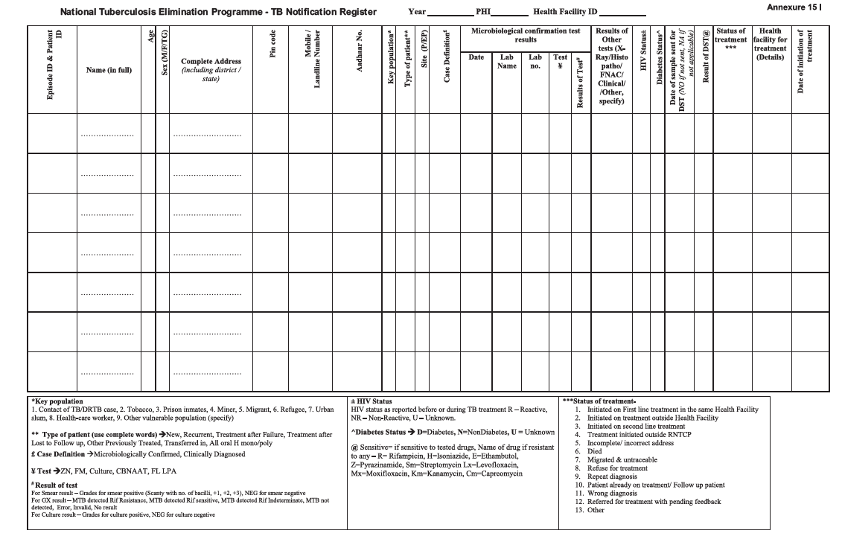

Slide 69
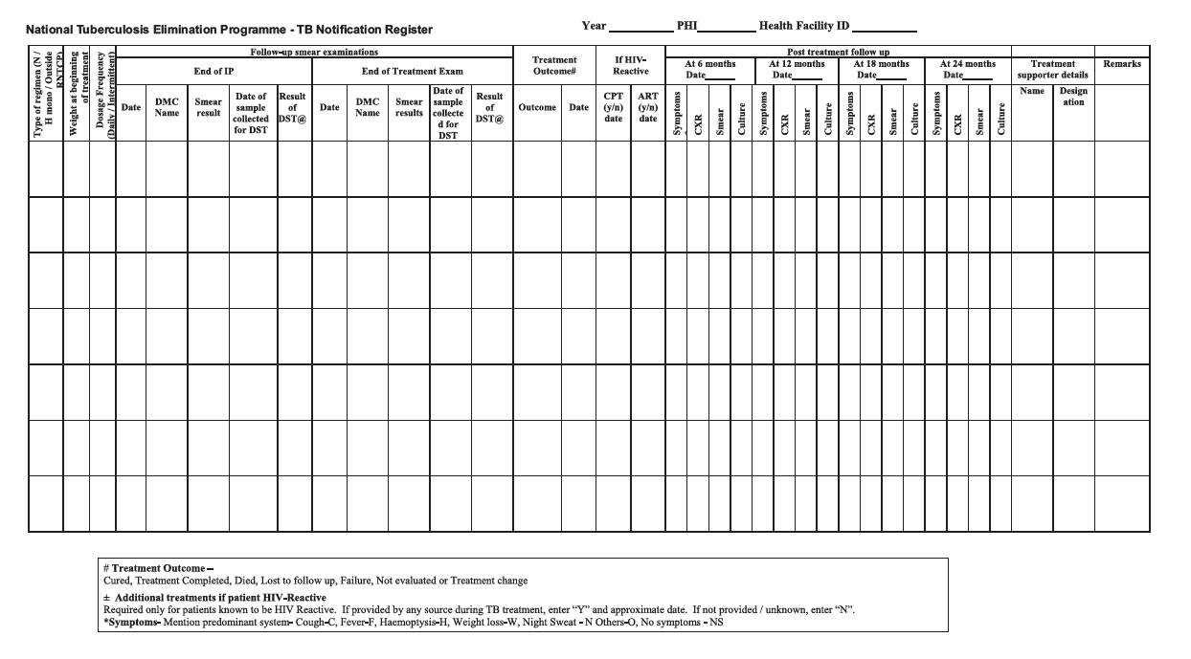

Slide 70
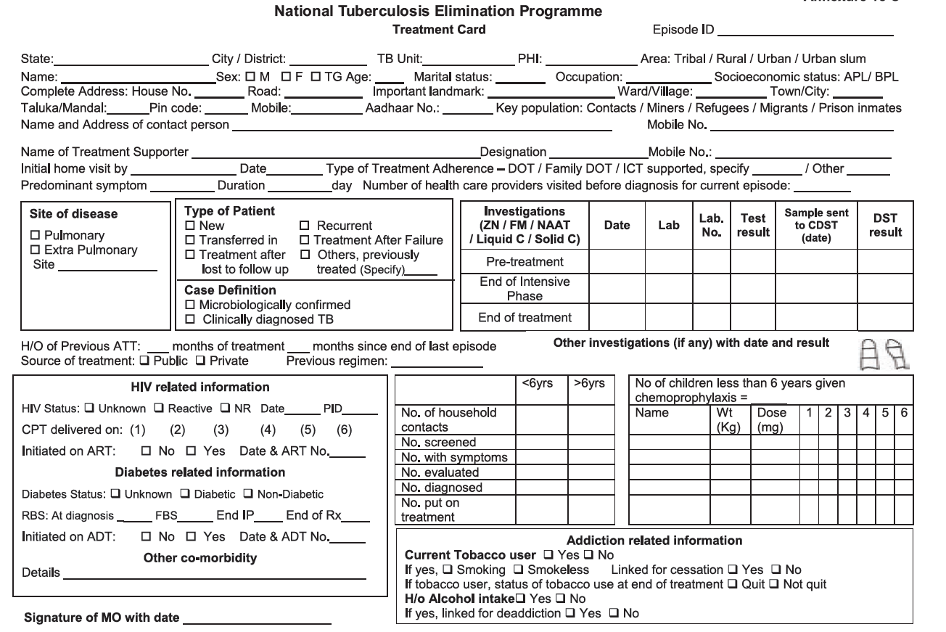

Slide 71
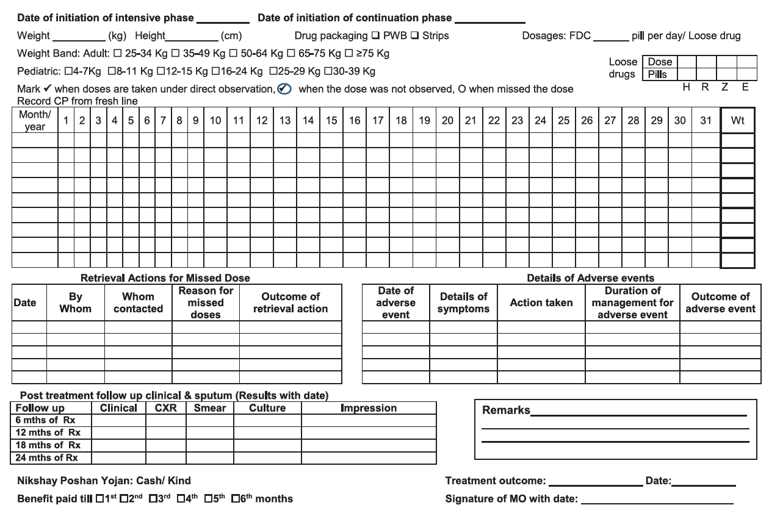

Slide 72
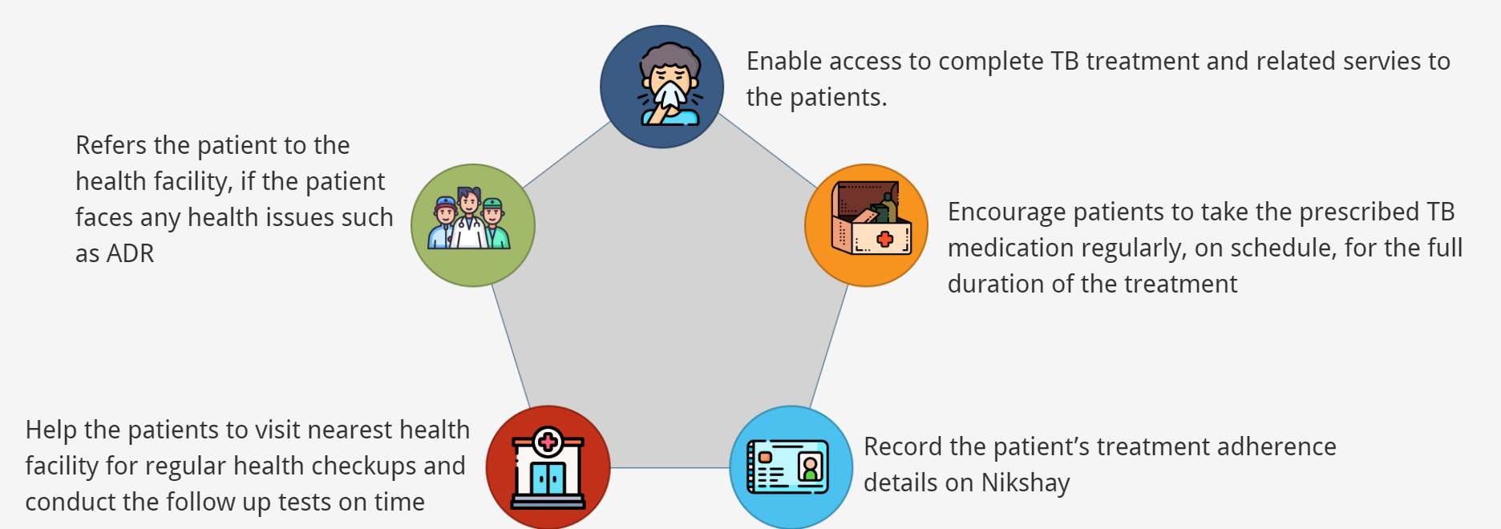
Treatment supporter
A treatment supporter can be any person working with the programme( non-salaried) – even patient’s family member
Eligible for honorarium of Rs 1000 for DSTB and H-mono/poly regimen (on update of outcome)
Treatment support to TB patient includes:

Slide 73
Common side Effects of DSTB Drugs
Side Effect | Drug | Management
Drowsiness | Isoniazid (H) | Reassure the patient
Red-orange urine, tears | Rifampicin (R) | Reassure the patient
Gastro-intestinal upset | Any oral medication | Reassure the patient Give drugs with less water Do not give drugs on empty stomach
Severe itching | Isoniazid (H) and other drugs | Reassure the patient Stop all drugs and Refer to MO
Burning in hands & feet | Isoniazid (H) | Refer to MO – to give pyridoxine 100 mg/day till symptoms subside
Severe joint pains | Pyrazinamide (Z) | Refer to MO
Impaired vision | Ethambutol | STOP treatment & refer for evaluation
Jaundice | Isoniazid (H) Rifampicin (R) Pyrazinamide (Z) | STOP treatment & refer for evaluation

Slide 74


What is an
Adverse Drug Reaction (ADR)?
Nausea and vomiting
Gastritis & pain in abdomen
Diarrhoea
Skin rashes
Adverse Drug Reaction (ADR)
Giddiness
Blurred or diminished vision
Depression
Thyroid disorders
2

Slide 75




Common ADRs
Management
Counsel and reassure the patient as the common occurring adverse effects usually resolve with time
Advise the patients not to take all the drugs together
Advise them to take a light meal (biscuits, bread, rice, etc.) before taking drugs
Inform patients that they may take drugs embedded in banana or at bed time to reduce their associated adverse effects
Encourage patients to keep themselves hydrated by increasing fluid intake
Provide ORS (Oral Rehydration Solution) to counter dehydration due to loose motions & vomiting
If acidity persists, the patient may be given Ranitidine or Omeprazole
ADR Symptoms
Nausea (uneasy feeling with inclination to vomit) and vomiting after having the drug
Loose stools/diarrhoea (2-3 in a day)
Burning sensation in lower chest region, bloating sensation, sourness in mouth
In case increased vomiting or loose motions are associated with dry skin & mouth, increased thirst, sunken eyes, weakness, decreased urine output
If acidity and upper abdominal pain do not improve with time or there is loss of appetite
Pain in upper abdominal area, loss of appetite
Refer to PHI
3
DR-TB coordinators…………..................
DTO Number…………..................
MO number…………..................
Toll free Number………….................

Slide 76






Common ADRs
Management
Reassure patients, give moisturizing cream. If there is still no improvement, give a anti-histaminic drug (Chlorpheniramine or Cetirizine) before giving anti TB drugs
In case there is no relief or increase in severity, symptoms worsen
Skin rashes with or without itching
Management
Firstly assess if emotional &
socio-economic conditions are causing feeling of sadness and depression
Refer to PHI
Feeling of sadness and unhappiness, hearing & seeing unpleasant sounds & things, etc.
Counsel the patients and also ensure frequent and regular follow up of these patients
4
DR-TB coordinators…………....................
DTO Number…………....................
MO number…………....................
Toll free Number…………....................

Slide 77
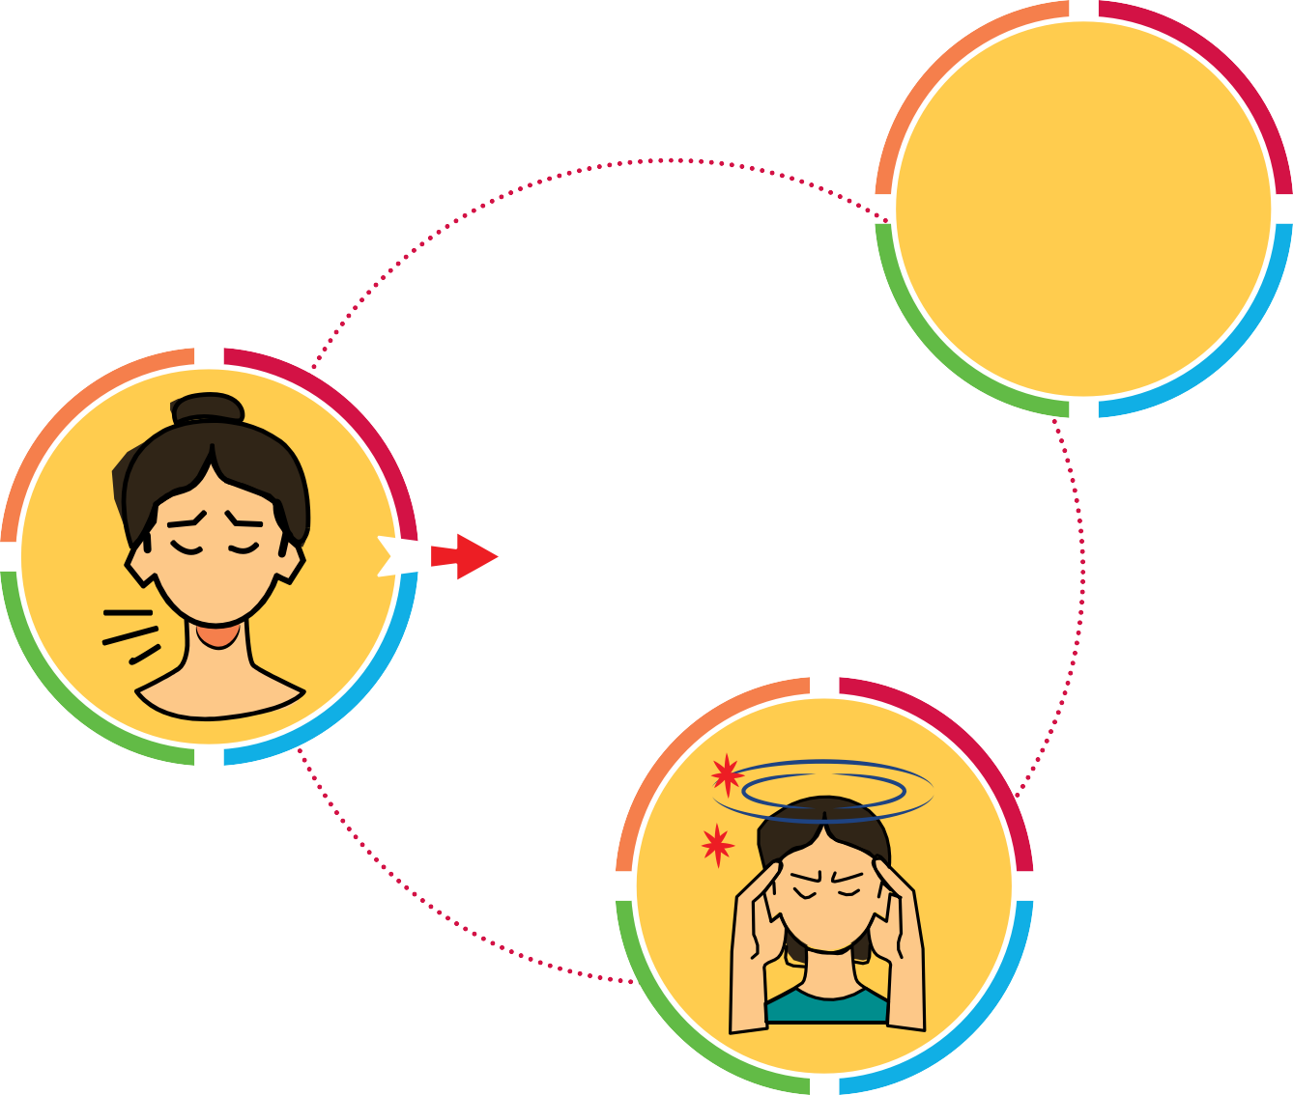






Common ADRs
which require referral
PERIPHERAL HEALTH INSTITUTE
Ringing & buzzing sounds in ears
Thyroid disorders
Giddiness
5

Slide 78
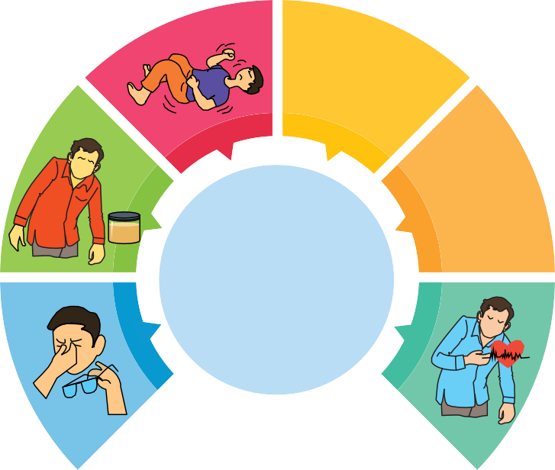






Less Common ADRs
HIGHER HEALTH CENTRE
Fits
Knee and ankle joint swelling & pain Numbness and weakness in hands and feet
Yellow discoloration of skin with dark colored urine Diminished vision
Palpitation (irregular heartbeats)
If patients complain of these symptoms
Immediately refer to higher health centre i.e. DDR-TBC, NDR-TBC, tertiary health care facility, etc.
6

Slide 79
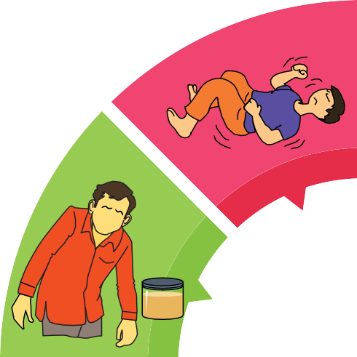







Less Common ADRs
Knee and ankle joint swelling & pain
Fits
Yellow discoloration of skin with dark colored urine
Numbness and weakness in hands and feet
HIGHER HEALTH CENTRE
Diminished
vision
Palpitation
6

Slide 80
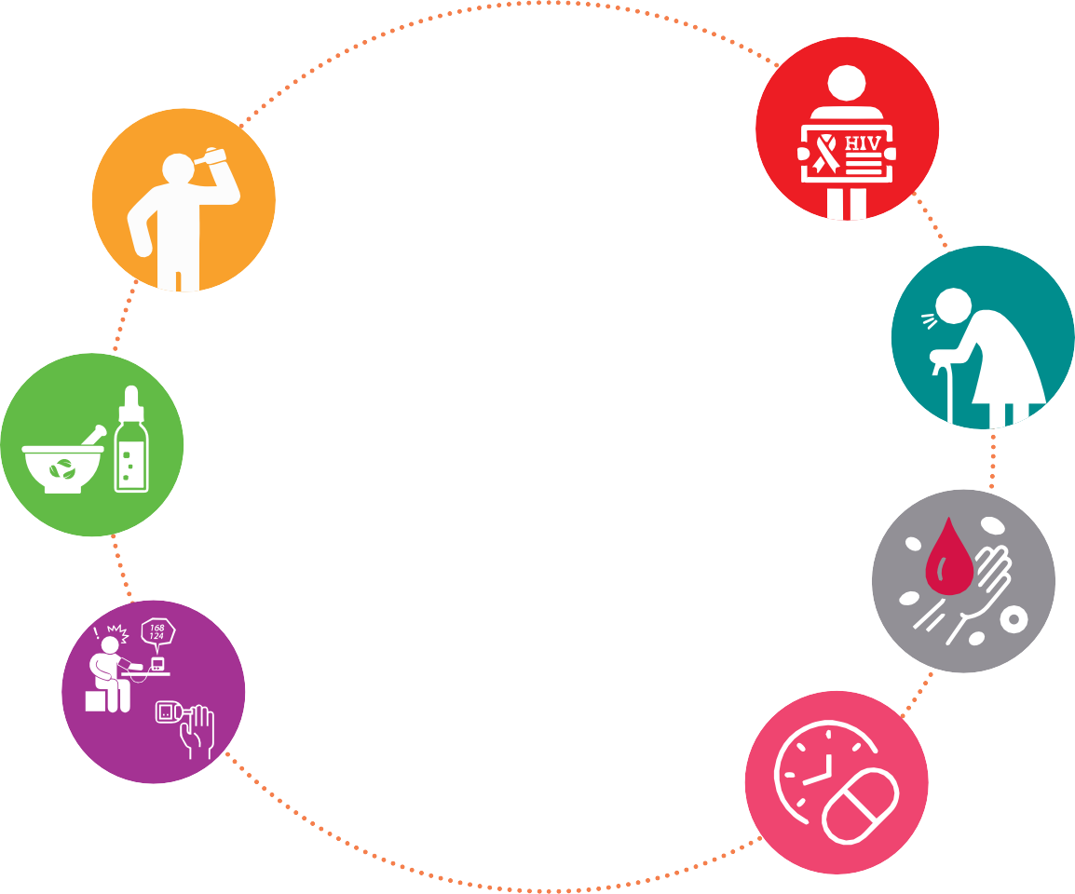
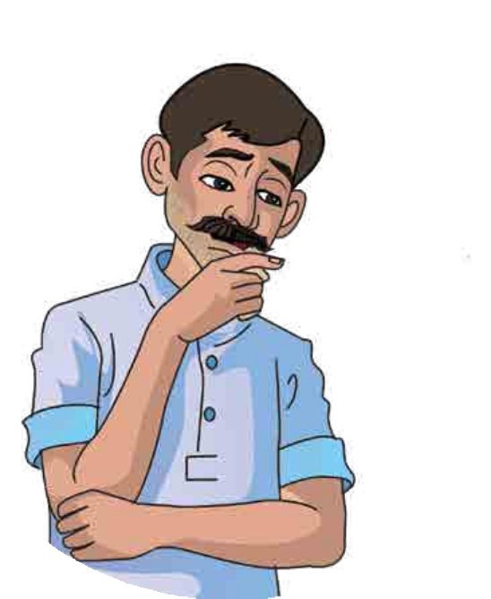
Which patients are
more prone to develop these ADRs?
TB patients living with HIV infection
Consume alcohol
Elderly TB patients
Taking other medicines
Anaemic
Suffering from other diseases
Irregular in taking medicines
7

Slide 81


Steps for
Early Identification of ADRs
Make sure that:
Pre-treatment evaluation along with baseline investigations are done for every patient prior to starting TB treatment
All TB patients are counseled in detail before starting treatment and counseling must be repeated frequently
Patients and their family members are educated about symptoms related to common ADRs and encouraged to contact treatment supporter if needed
8

Slide 82
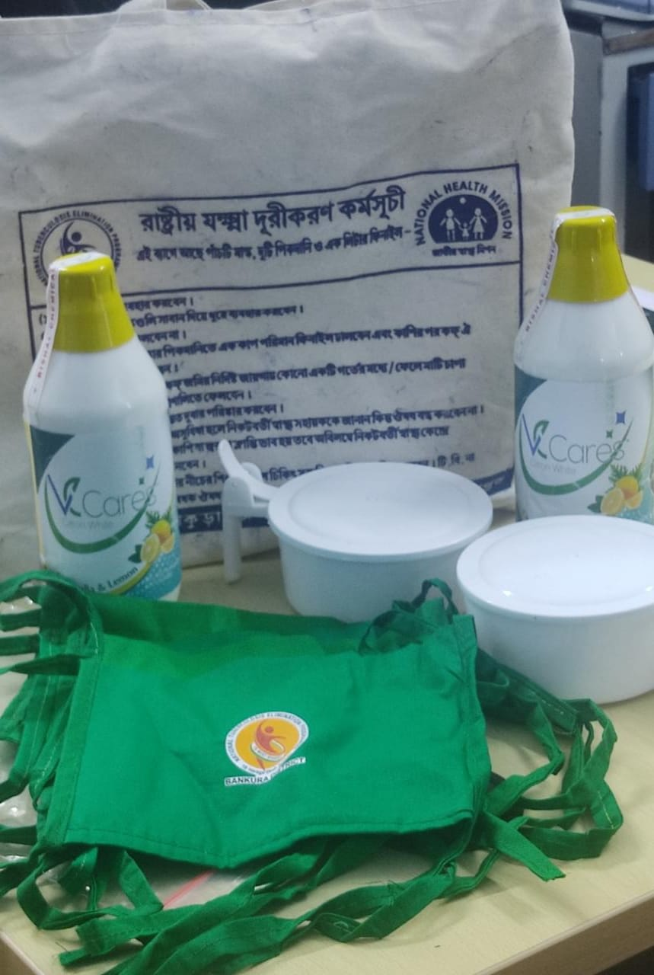
Patient Counselling on Airborne infection control (AIC)
Use AIC kits for TB patients provided by NTEP
  Clean the cloth masks with soap and water before re-use
Sensible, practical and hygienic sputum disposal
  Pour one cup of phenyl in the clean spittoon every morning
  After collecting sputum in the spittoon throughout the day, thrown the material (sputum + phenyl) in a specific hole in the ground and cover with soil
  Clean the spittoon daily!
Avoid spitting in nearby open space

Slide 83
Nutritional Counselling
Nutritional assessment of TB patients by recording the baseline weight and height of patient – followed by monthly monitoring of weight
Assess the current appetite and food intake of the patient
Encourage patient to increase frequency of food intake – 3 meals and 3 snacks
Advice addition of oil, ghee, butter to chapatti or rice – to increase energy content of the diet
Pulses, milk and eggs – to be included in diet (if possible)
Inform patient about PDS and Nikshay Poshan Yojana if patient unaware

Slide 84
Administration and monitoring of treatment
Intensive phase
Continuation phase
The recording of doses taken is similar to as in IP.
The total of 112 doses of CP should be completed before declaring treatment outcome.
In some circumstances where CP is extended by 12 to 24 weeks, the treatment outcome should be declared after completion of all the prescribed doses.

Slide 85
Administration and monitoring of treatment
Retrieval actions in interruptions of treatment: If a patient does not take medication as scheduled in IP or CP, s/he should be traced and given the medication as per regular schedule and complete total of 56 doses of IP/112 doses of CP.
Recording of Retrieval actions: Action taken to retrieve patients interrupting treatment has to be recorded in the space provided on the reverse of the treatment card with details of date, name of the health staff taking retrieval action, person contacted, reasons for interruption and the outcome of such efforts.
Recording of Adverse events
Details of Chest X-ray
Nutritional support: Information regarding bank details entered in Nikshay should be mentioned as ‘Yes’ or ‘No’.
Clinical, sputum examination and chest X ray findings with impression should be recorded against each scheduled follow up at 6, 12, 18- and 24-months post treatment.

Slide 86
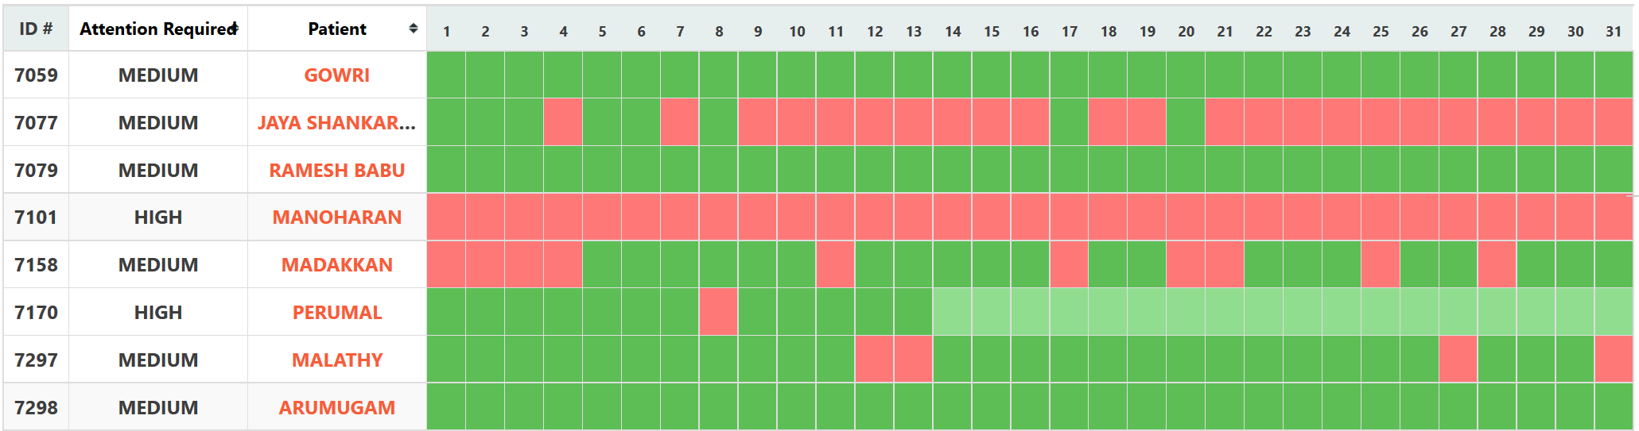
IT enabled adherence monitoring
Notes:
Animation – Moderate
Graphic
Can be enhanced. Adjust according to theme other slides

Slide 87
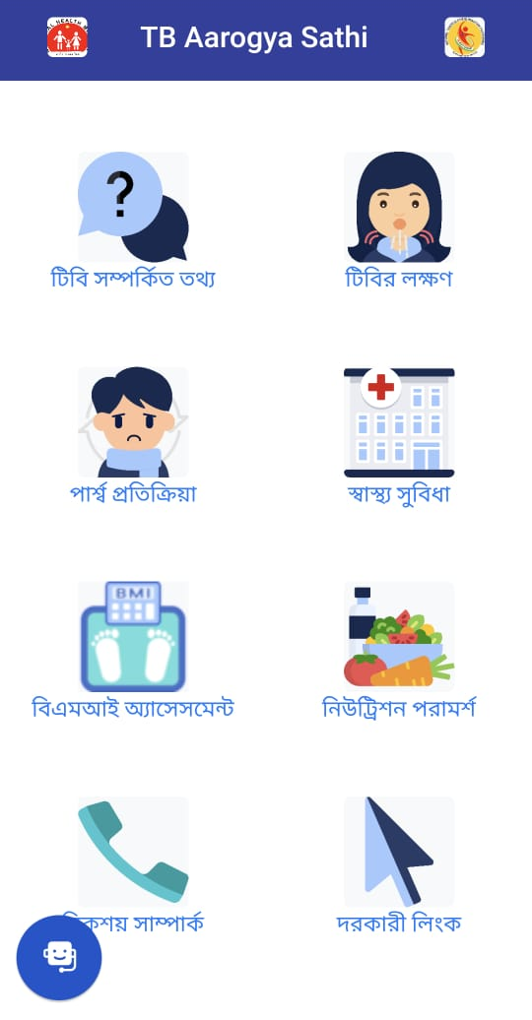
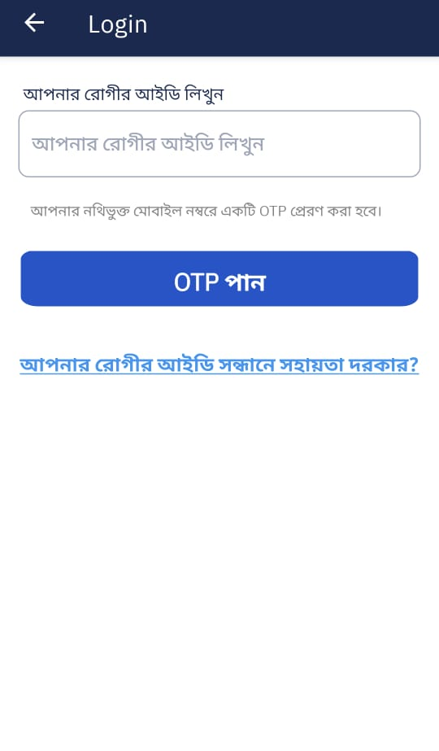
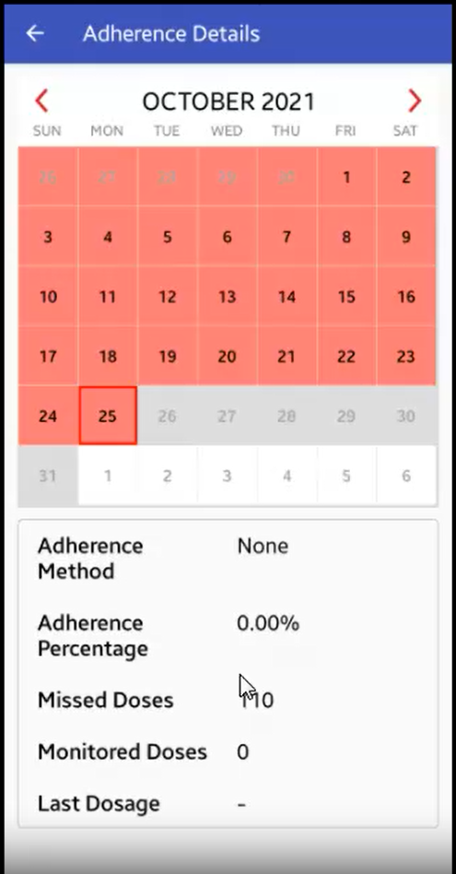
Adherence monitoring – TB Aarogya Sathi
Light green – manually reported dose
Dark green – digitally reported dose
Light red – unreported dose
Dark red – reported missed dose

Slide 88
Guidelines for
Programmatic Management of
Tuberculosis Preventive Treatment in India
National TB Elimination Programme

Slide 89
Comparison of tests for TB infection
 | TST | IGRA | Cy-Tb
Sensitivity | High | High | High
Specificity | Low in BCG vaccinated | High even in BCG vaccinated | High even in BCG vaccinated
Ease of use | Field friendly, complex test interpretation | Requires lab and infrastructure | Field friendly, single cut-off allows simple test interpretation
Cost of test | Low | High | Low
Manufacturing | Complex, old products | Complex, multiple components | Robust with high yield, well defined and completely characterised
Special populations
Children | Affected by young age | Affected by young age | More robust
PLHIV | Requires info on HIV status | Affected by HIV and low CD4 count | More robust with low CD4

Slide 90
Cost effectiveness and modelling analysis studies of 3HP and 1HP
2018 | Cost-effectiveness of Preventive Therapy for Tuberculosis With Isoniazid and Rifapentine Versus Isoniazid Alone in High-Burden Settings
2020 | Cost-effectiveness of a 12 country-intervention to scale up short course TB preventive therapy among people living with HIV
2020 | Cost-effectiveness of one month of daily isoniazid and rifapentine versus three months of weekly isoniazid and rifapentine for prevention of tuberculosis among people receiving antiretroviral therapy in Uganda
2021 | Cost-effectiveness of scaling up short course preventive therapy for tuberculosis among children across 12 countries
2021 | Economic and modelling evidence for tuberculosis preventive therapy among people living with HIV: A systematic review and meta-analysis
2022 | Prioritising attributes for tuberculosis preventive treatment regimens: a modelling analysis
2023 | Impact and cost-effectiveness of short-course TB preventive treatment for household contacts and people with HIV in 29 high-incidence countries: a modelling analysis

Slide 91
“Ruling out of active TB” most important before initiation of TPT
India demonstrated large scale intervention in NTEP.
PMDT, introduction of daily regimen etc. are the few interventions undertaken and successfully scaled-up across country in short span of time by NTEP.
Contact tracing is one of the routine activity and being conducted by the programme since 1995. Contact tracing visit is 87% (India TB Report 2024)
Accessibility of x-ray for ruling out of active TB is a challenge.
But scale-up of any intervention is a gradual process.
New ultraportable X-ray (HHXray) devices are being procured by the division would be helpful. Couple with AI-CAD would be the game changer in ruling out of active TB.
225 + 643 HHXray are approved; 50 already installed.
Additional ~200 HHXray approved in PIP, CSR and other projects.

Slide 92
TPT target group – TPT in contact of DS/DR-TB and other risk group
Target population | Strategy | TPT options
Close or household contacts below 5 years of pulmonary TB | TPT to all after ruling out active TB disease | 3 months of weekly (12 doses) isoniazid and rifapentine (3HP) in age >2 years or 6 months of daily (180 doses) isoniazid (6H)
Close or household contacts more than or equal to 5 years of pulmonary TB | Testing* for TBI and TPT after ruling out TB disease
Other risk groups Person initiating Immuno-suppressant or Anti-TNF treatment; Silicosis; Person on dialysis; Transplant recipient Malnourished, diabetes, alcohol abuse, smoker and integration with ACF
Contact of multi drug resistant TB (MDR-TB) with fluoroquinolone susceptible |  | 6 months of daily (180 doses) levofloxacin
Contact of isoniazid mono/poly resistant TB (Hr-TB) with rifampicin susceptible |  | 4 months of daily (120 doses) rifampicin
* Prioritizing pulmonary bacteriologically confirmed TB
# 3-months daily Rifampicin and Isoniazid (3RH) TPT regimen is introduced in 0-15 years individuals in 6 states
92

Slide 93
Contraindications of TPT
Active TB disease (absolute)
Acute or chronic hepatitis
Concurrent use of other hepatotoxic medications (such as nevirapine)
Regular and heavy alcohol consumption
Signs and symptoms of peripheral neuropathy like persistent tingling, numbness and burning sensation in the limbs
Allergy or known hypersensitivity to any drugs being considered for TPT

Slide 94
Counselling of eligible person and family
Need to share transparent information with the eligible person and family-
  information on TBI,
  need for TPT,
  schedule of medication,
  Adherence support and follow-up visits,
  benefits from completing the course,
  adverse events,
  actions on development of TB symptoms
NTEP national call center (NIKSHAY SAMPARK – Toll free number 1800116666) should be made available to the index TB patients, family member and TPT beneficiaries

Slide 95
Pre-TPT assessment
Medical doctor at Health facility or by CHO in tele-consultation with doctor
Personal history
Elicit relevant info.
HIV status and ART regimen;
pregnancy or family planning
assess presence of co-morbidities
History of medication
certain drug classes
ARVs, opioids, antimalarials – often affect TPT.
Liver function test (LFT)
not a mandatory
baseline testing in individuals with risk
Social and financial situation
assessment to overcome the barriers for TPT completion.
having abnormal baseline LFT results (ALT/AST is ≥ 3 times upper limit of normal [ULN] in the presence of symptoms or ≥ 5 times the ULN in the absence of symptoms), clinical judgement is required
allergy or known hypersensitivity to TB drugs (isoniazid, rifampicin, rifabutin or rifapentine).

Slide 96
Attribution of 3HP and 1HP
 | 6H | 3HP | 1HP
Medicines | Isoniazid | Isoniazid + Rifapentine | Isoniazid + Rifapentine
Duration | 6 months | 3 months | 1 months
Interval | Daily | Weekly | Daily
Doses | 180 | 12 | 28
Pill burden | 1 (180 pills) | 3 (36 FDC pills) | 2 pills
Pregnant women | Safe for use | Not known
Interaction with ART | No restriction | Contraindicated: All PIs, NVP/NNRTIs, TAF Use: Tenofovir, Efavirenzes (600 mg), DTG, RAL (without dose adjustment)

Slide 97
Dosage of 3HP regimen
Regimen | Dose by age and weight band
Three months of weekly rifapentine plus isoniazid (12 doses) (3HP) | Age 2-14 years^{c}
 | Medicine, formulation | 10–15 kg | 16–23 kg | 24–30 kg | 31–34 kg | >34 kg
 | Isoniazid, 100 mgª | 3 | 5 | 6 | 7 | 7
 | Rifapentine, 150 mg | 2 | 3 | 4 | 5 | 5
 | Isoniazid + rifapentine FDC (150 mg/150 mg)^{d} | 2 | 3 | 4 | 5 | 5
 | Age >14 years^{c}
 | Medicine, formulation | 30–35 kg | 36–45 kg | 46–55 kg | 56–70 kg | >70 kg
 | Isoniazid, 300 mg | 3 | 3 | 3 | 3 | 3
 | Rifapentine, 150 mg | 6 | 6 | 6 | 6 | 6
 | Isoniazid + rifapentine FDC (300 mg/300 mg)^{b} | 3 | 3 | 3 | 3 | 3
ª 300 mg formulation can be used to reduce the pill burden ^{b} Expected to become available in the near future ^{c} Dosage may differ among adults and children in overlapping weight-bands

Slide 98
Management of missed doses- 3HP
TPT regimen | Duration of interruption | Management steps
3HP | Weekly schedule of up to 3 doses missed | If the missed dose is remembered within 2 days of scheduled day, the person can take the dose immediately and continue to take remaining doses following the same schedule to complete the course. If the missed dose is remembered after 2 days, the person can take the missed dose immediately and change the schedule for weekly intake to the day the missed dose was taken until treatment completion. This will avoid two weekly doses being taken less than 4 days apart. If between 1–3 weekly doses are missed, treatment is continued until all 12 doses are taken, thus prolonging the treatment duration to a maximum of 16 weeks.
 | More than 3 weekly doses of 3HP missed | If 4 or more weekly doses are missed, consider restarting the full TPT course. If adherence to a weekly routine is not possible, consider discontinuing 3HP and offering an alternative (daily) regimen.

Slide 99
Treatment outcome – treatment completion
A number of endpoints are proposed that could be used to trigger a review of persons on TPT and in some instances, changes to treatment.
TB preventive treatment completion
 | Total duration in months | Expected number of doses | 80% of recommended doses (days) | Extended time for treatment completion (days) (treatment duration +33% additional time)
6H (daily) | 6 | 180 | 144 | 239
3HP (weekly) | 3 | 12 | 11* | 120
6Lfx (daily) | 6 | 180 | 144 | 239
4R (daily) | 4 | 120 | 96 | 160
1HP (daily) | 1 | 28 | 23 | 40
* 90% of recommended number of doses
Treatment completion: A person initiated on TPT who completed at least:
90% of recommended dose (11/12) consumed within 133% of planned TPT duration (120 days) for 3HP or
80% of recommended dose (23/28) consumed within 133% of planned TPT duration (40 days) for 1HP

Slide 100
Treatment outcomes- other definitions
Treatment failed: A person initiated on TPT who developed active TB disease any time while on TPT course.
Died: A person initiated on TPT who died for any reason while on TPT course.
Lost to follow-up: TPT interrupted by person for four consecutive weeks (1 month) or more for 3HP or 4R, 10 consecutive days for 1HP, eight consecutive weeks (2 months) or more for 6H or 6Lfx,.
TPT discontinuation due to toxicity: A person whose TPT is permanently discontinued by the doctor due to adverse events or drug–drug interactions.
Not evaluated: Such as records lost, transfer to another health facility without record of TPT completion.

Slide 101
Women and TPT
Pregnancy should not disqualify women for TPT
TPT can be started during antenatal and postnatal periods taking due care.
Isoniazid and Rifampicin, are considered safe for use in pregnancy.
  Pyridoxine (Vitamin B6) supplementation should be given routinely to all pregnant and breastfeeding women on TPT.
There is limited data on the efficacy and safety of Rifapentine in pregnancy.

Slide 102
Contraception and TPT
Rifampicin and Rifapentine interact with oral and hormonal contraceptive →
  risk of decreased contraceptive efficacy.
  use an alternative (such as depot medroxyprogesterone acetate (DMPA) every eighth week or higher dose oestrogen (50μ)) in consultation with a clinician;
  or use another form of contraception, a barrier contraceptive or intra-uterine device.
In women having hormonal contraceptive implants, the interval for replacing the implants may need to be shortened from 12 weeks to eight weeks.

Slide 103
Babies born to mothers with TB disease and TPT
If a newborn is not well → refer him/her to a specialist/pediatrician.
If the newborn is well (absence of any signs or symptoms presumptive of TB) TPT must be provided.
Bacille Calmette-Guérin (BCG) vaccination should not be delayed even if TPT is administered.
It is advised to administer pyridoxine at 5–10 mg/day.
If the infant is HIV-exposed (mother is HIV infected) and on nevirapine → start 6H
TPT with rifamycin based regimen cannot be given along with nevirapine prophylaxis
If the mother is taking anti-TB drugs →continue to breastfeed with appropriate practice like using a mask and cough etiquette.

Slide 104
Possible adverse event associated with TPT drugs
Drug | Known adverse events | Rare adverse events
Isoniazid | Asymptomatic elevation of serum liver enzyme concentrations Hepatitis Peripheral neuropathy (paraesthesia, numbness and limb pain) Skin rash Sleepiness and lethargy | Convulsions Pellagra Arthralgia Anaemia Lupoid reactions
Rifampicin | Gastrointestinal reactions (abdominal pain, nausea, vomiting) Hepatitis Generalized cutaneous reactions Thrombocytopenic purpura Discoloration of body fluids | Osteomalacia Pseudomembranous colitis Pseudoadrenal crisis Acute renal failure Shock Haemolytic anaemia Flu-like syndrome
Rifapentine | Gastrointestinal reactions (abdominal pain, nausea, vomiting) Hypersensitivity reactions (flu-like symptoms) Hepatitis Discoloration of body fluids | Hypotension/syncope Decrease in white blood cell and red blood cell count Decreased appetite Hyperbilirubinemia

Slide 105
Management of adverse events
Individuals receiving TPT are otherwise healthy- adverse events during TPT must be minimized and promptly managed.
If a severe adverse reaction is encountered- TPT must be immediately discontinued, and supportive medical care provided.
Mild to moderate adverse reaction- Conservative management and continuation under observation
People experiencing adverse events may need medical attention and doctor’s discretion should be exercised for management. A complete history, including concomitant medication and supplements, must be taken.
The following questions may help in the assessment and in deciding actions for management of adverse events:
How severe is the adverse event (mild, moderate, severe)?
How serious is the event (i.e. hospitalization or prolongation of hospitalization; persistent significant disability; congenital anomaly, a life-threatening experience or likely to lead to death)?
What is the immediate management (reassurance, symptomatic relief, hold/discontinue TPT, or requires a medical intervention to avert severe outcomes)?
What is the underlying cause (drug related, other factors)?
How will the adverse event affect future adherence (tolerability, consideration of substitution with an alternative regimen)?
What is the next step (continue or restart, substitute, follow up and reassess)?

Slide 106

Treatment of MDR/RR-TB.
NTEP
Date:

Slide 107
Treatment Context
Decisions as per integrated algorithm for appropriate regimens should be made based on:
patient treatment history, clinical assessment, considering the results of DST, | severity and site of the disease | risk of adverse events, patient preference,
All DR-TB patients need to be assessed at the time of treatment initiation as per the guidance document for differentiated TB care issued by the CTD
All treatment should be delivered as per standards adopted by NTEP, including patient-centred care and support, informed decision-making process where necessary, principles of good clinical practice, active drug safety monitoring and management (aDSM), & regular monitoring of patients and of DR-TB to assess regimen effectiveness

Slide 108
Treatment regimen for drug-resistant TB
Treatment regimen options for DR-TB includes:
6-9 months BPaLM shorter oral regimen.
9-11 months shorter oral MDR/RR-TB regimen
18-20 months longer oral M/XDR –TB regimen
6-9 months H mono/ poly DR-TB regimen.

Slide 109
MDR/RR- TB Regimens
In accordance with the latest recommendations, MDR/RR-TB patients are to be offered one of
the MDR/RR-TB regimens in the preference of order as per integrated algorithm (based on the
eligibility criteria) is given below:
6-9 months BPaLM shorter oral regimen.
9-11 months shorter oral MDR/RR-TB regimen
18-20 months longer oral M/XDR –TB regimen

Slide 110
BPaLM/BPaL regimen
Bedaquiline is a diarylquinoline
  inhibits mycobacterial ATP synthase.
Pretomanid(Pa), a nitroimidazooxazine
  Inhibits mycolic acid biosynthesis, blocks mycobacterial cell-wall production,
  Acts as a respiratory poison against nonreplicating bacteria after nitric oxide release under anaerobic conditions.
  Pa has been approved to use only with the BPaLM/BPaL.
Linezolid,
  an oxazolidinone that disrupts protein synthesis
Moxifloxacin,
  inhibit DNA synthesis

Slide 111
Integrated Diagnostic and Treatment Algorithm for Drug Susceptible and Resistant Tuberculosis
 | All notified TB patients not offered RR-TB test¹ |  | All presumptive TB / persons with abnormal Chest X-Ray with or without symptoms² |  | Non-responders to any regimen
Collect 2 specimen and test for resistance to R, H, FQ or other drugs as needed³
MTB +ve, R resistance detected
MTB +ve, R resistance not detected
<14 yrs
2 H R Z E / 4 H R E
≥14 yrs
Test for H resistance
Eligible for B Pa L M ⁴
No Yes
H resistance detected
H resistance not detected/ Awaited
Eligible for shorter oral
regimen ⁶
B Pa L M ⁵
6-9 Lfx R E Z
No Yes
Additional resistance⁷ or intolerance or non-availability of any drug in use
(4-6) Bdq₍₆₎ Lfx Lzd₍₂₎ Cfz Z E H^{h}
(5) Lfx Cfz Z E
H mono/poly DR-TB regimen, modify as per replacement table
Longer oral M/XDR-TB regimen, modify with replacement table as applicable
Still clinical deterioration, test for resistance amplification+ SSLPA/ follow up-
RR detected- MDR TB or
RR not detected- Probable MDR TB
Additional resistance⁷ or intolerance or non- availability of any drug in use or emergence of exclusion criteria
Person Improving, complete treatment
Complete
2 H R Z E / 4 H R E

Slide 112
Inclusion and exclusion criteria for the BPaLM (1)
Inclusion Criteria
Persons with age 14 years and above, New microbiologically confirmed RR-TB
H/o exposure
  less than one month intake of Bdq, Lzd and/ or Pa in the past
  more than one month intake of Bdq, Lzd and/ or Pa and documented sensitivity to the drugs.
  Persons who had not failed treatment with Bdq or Lzd containing shorter or longer regimen, and sensitivity to the drugs are documented

Slide 113
Inclusion and exclusion criteria for the BPaLM (2)
Inclusion Criteria continued..
QTcF in ECG is ≤ 450 ms in males and ≤ 470 ms in females, or
when serum electrolytes are abnormal and QTcF is > 450 ms in males & QTcF is > 470 ms in females in baseline ECG, after correcting the electrolytes, QTcF in repeat ECG comes ≤ 450 ms in males and ≤ 470 ms in females, then patient can be given BPaLM regimen.
Non-lactating women, lactating women but not breast-feeding, non-pregnant or pregnant women with <20 or <24 weeks gestation and who is willing for medical termination of pregnancy (as per latest MTP gazette notification, as applicable)

Slide 114
Inclusion and exclusion criteria for the BPaLM (3)
Exclusion Criteria
i. Persons with age below 14 years
ii. Person with documented resistance to Bdq, Lzd and/ or Pa.
iii. Persons with significant liver dysfunction [LFT (Liver enzymes and/ or total bilirubin) >3xUpper Limit
of Normal (ULN)]
iv. People with severe forms of extrapulmonary-MDR-TB like CNS TB, spinal/ skeletal TB or
disseminated TB (miliary TB, TB in one organ then rule out in other organs also)

Slide 115
Inclusion and exclusion criteria for the BPaLM (4)
Exclusion Criteria continued :
Persons with significant Cardiac conduction abnormalities in the heart- including structural heart disease, syncope, long QT syndrome, AV blocks, Reentry arrhythmias etc apart from asymptomatic QTcF>500ms.
  Persons currently having uncontrolled cardiac arrhythmia that requires medication
  Persons with history of additional risk factors for Torsade de Pointes, e.g. heart failure, hypokalemia, family history of long QT syndrome.
  Baseline QTcF is > 450 ms in males & QTcF is > 470 ms in females in baseline ECG, and if electrolytes are normal OR
Baseline QTcF is > 450 ms in males & QTcF is > 470 ms in females in baseline ECG, and electrolytes are abnormal and even after correcting the electrolytes QTcF in repeat ECG, does not come ≤ 450 ms in males and ≤ 470 ms in females.
  .

Slide 116
Inclusion and exclusion criteria for the BPaLM (5)
Point to be remembered:
If at baseline serum chemistry panel, hematology or urinalysis are outside the normal reference range (including above listed parameters), the patient may still be considered if the physician judges that the abnormalities or deviations from normal to be not clinically significant or to be appropriate and reasonable. Hypokalemia, hypomagnesemia and hypocalcemia should be corrected prior to a patient receiving any QTc prolonging drugs.
*PTE & Relative Contra-indications, used to decide the regimen, are mentioned in treatment session in details

Slide 117
Pre-treatment evaluation
All MDR/RR-TB patients would be subjected to a thorough pre-treatment evaluation (PTE) at the N/DDR-TB centres as per table below.
Clinical evaluation | Laboratory- based evaluation
History and physical examination (including previous drug use, alcohol/substance abuse, family planning methods etc.) Previous history of ATT taken, especially Bdq, Pa, Dlm and Lzd (defined as more than one month exposure) A thorough clinical examination Assess nutritional status [Height (m), Weight (kg), BMI] Neurological evaluation, if required Ophthalmic evaluation, visual acuity, and color vision test | Random blood sugar (RBS) HIV testing following counselling Complete blood count (Hb, TLC, DLC, platelet count) Liver function tests# Serum electrolytes (Na, K, Mg, Ca) Urine pregnancy test (in women of reproductive age group) Chest X-ray ECG.
# HBsAG and other viral markers (Hepatitis A, C and E) to be done in case of jaundice

Slide 118
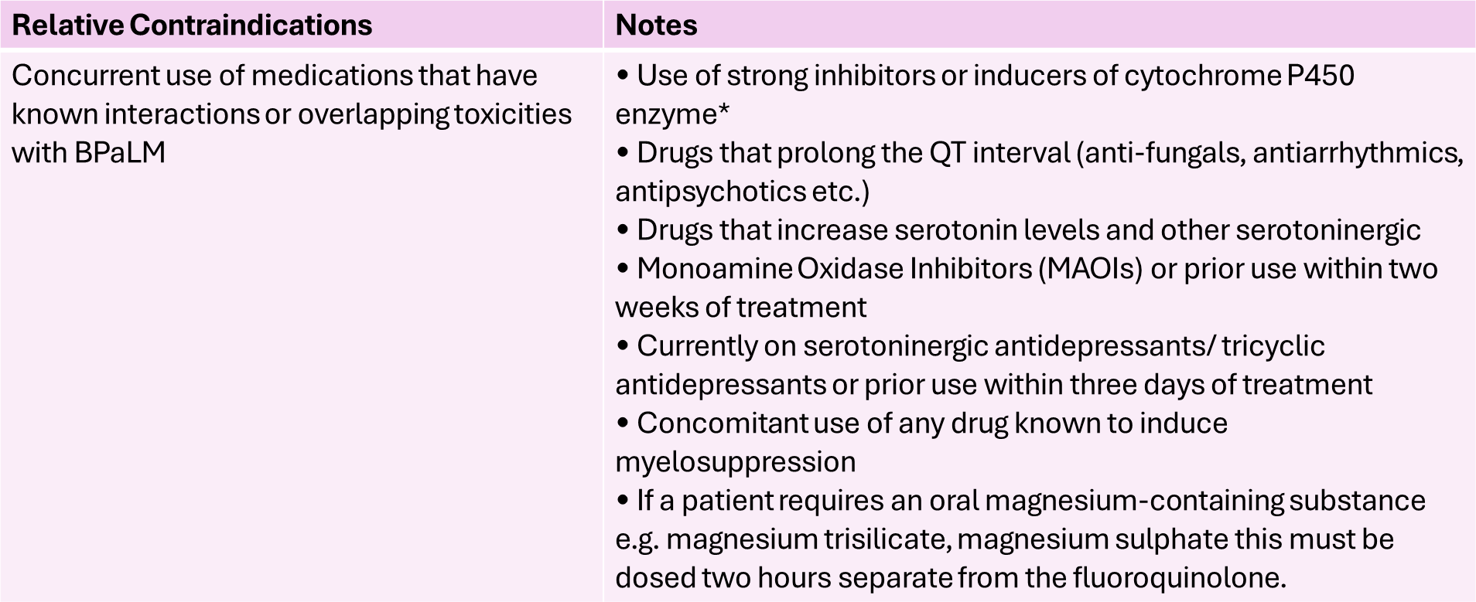
Relative contraindications for BPaLM

Slide 119
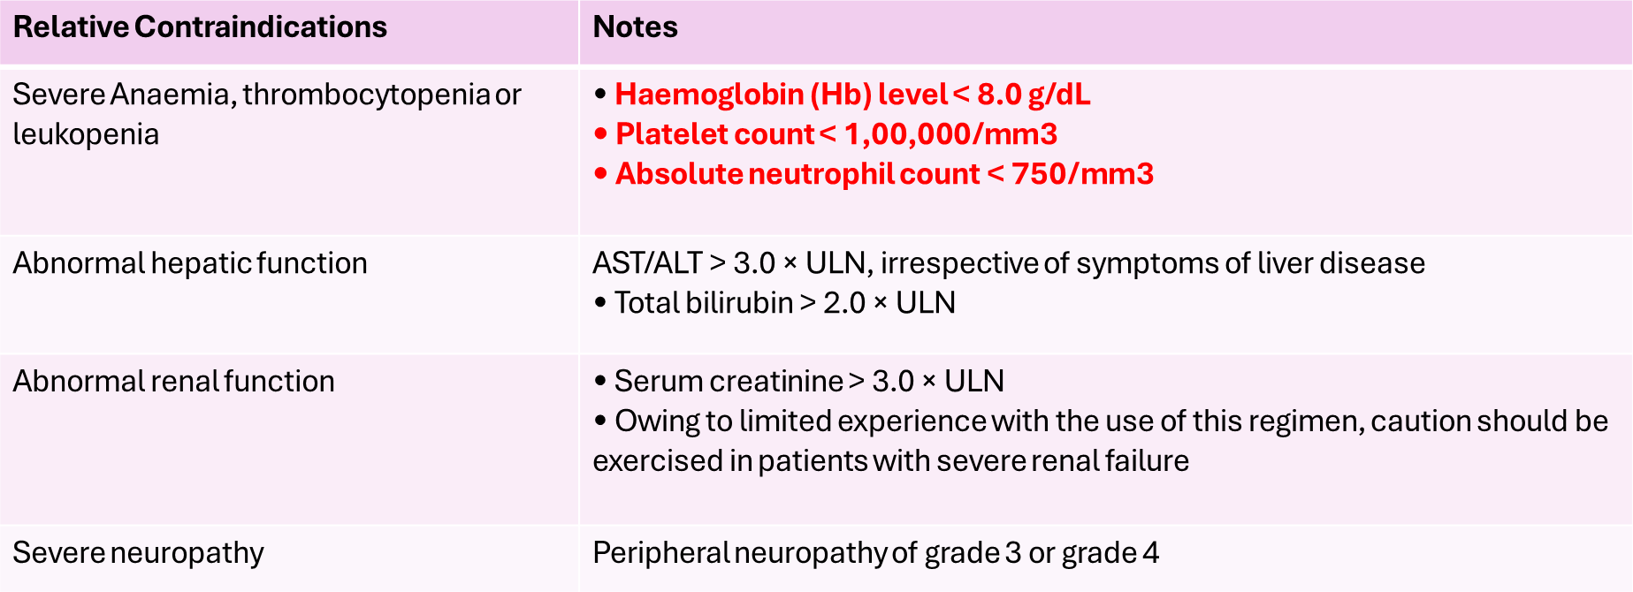
Relative contraindications for BPaLM
ALT: alanine transaminase; AST: aspartate transaminase; ULN: upper limits of normal.
* Exceptions may be made for patients that have received three days or less of one of these drugs or substances if there has
been a wash-out period before administration of Bdq to at least five half-lives of that drug or substance.

Slide 120
Regimen, dosage and administration
BPaLM regimen is to be administered orally with food and adequate water intake using dosages as
follows
  Bedaquiline
    Weeks one to two: 400 mg once daily
    Weeks 3 to 26/39*: 200 mg 3 times a week; plus
Pretomanid: - Weeks one to 26/39*: 200 mg daily; plus
Linezolid: - Weeks one to 26/39*: 600 mg once daily
Moxifloxacin: - Weeks one to 26/39*: 400 mg once daily
*Extension criteria has been described in subsequent section
All patients above 14 years of age would receive the above standard dosage.
There will be no weight bands.

Slide 121
Follow-up monitoring
Once the BPaLM/BPaL regimen is started, the patient will be monitored with regular clinical, radiological,
ECG, biochemical investigations and specialist consultation, if needed, as shown in table below
Follow-up assessments Timeline
Duration 26 weeks (extended up to 39 weeks)
Clinical review, including weight and BMI, concomitant medication, adherence, signs/symptoms suggesting adverse events
Monthly
CBC (with Hb, platelets)^, and ECG$
Day 15, 30, then monthly till month 6, and more frequently if clinically indicated
Visual acuity, and color vision test
Week 9, 13, 26 and more frequently if clinically indicated
Smear microscopy@
With culture at the C&DST lab
Culture@
Monthly from month 2 onwards. If the culture results of month 4 or later are positive, collect one repeat specimen immediately and send it for culture to rapidly ascertain bacteriological conversion or reversion and if the repeat specimen is culture negative, then collect and send the subsequent monthly or end-of- treatment specimen.

Slide 122
Follow-up monitoring
Follow-up assessments | Timeline
DST@ | NAAT MTB/XDR or FL and SL LPA (Lfx, Mfx, Am, Eto) and LC DST (Mfx 1.0, Lzd, Z, Bdq, Pa*, Dlm*) if culture +ve at the end of month 4, end of Rx and as and when clinically indicated during treatment
Urine pregnancy test | As and when clinically indicated
Chest X-ray and LFT# | At the end of month 3, the end of treatment, as and when clinically indicated
S. Electrolytes (Na, K, Mg, Ca) | As and when clinically indicated in case of any QTcF prolongation
Specialist (Ophthalmic, Neurological) consultation | As and when clinically indicated
Surgical evaluation | After culture conversion
Long term follow-up | At 6, 12, 18, and 24 months after completion of treatment (Clinical, CXR, Smear and C&DST if symptomatic) and whenever the patient returns to the health system
^ Lzd containing regimen to rule out bone marrow suppression and optic neuritis
$ In case of baseline ECG abnormality or QTcF between > 450 to 500 ms in males and > 470 to 500 ms in females, ECG must be done on a daily basis for initial three days or as suggested by a cardiologist.
Repeat ECG with long II lead after an hour to reconfirm abnormal ECG
@ During clinical follow-up if the patient deteriorates or shows no improvement at month two, send an additional specimen to the C&DST lab for a smear, set up a culture if smear is positive and test on NAAT M.tb/XDR or SL-LPA to assess amplification to FQ. All positive cultures of this time point should be preserved for such patients. Update the test results in Ni-Kshay on the same day
* DST whenever available
# HBsAG and other viral markers (Hepatitis A, C and E) to be done in case of jaundice

Slide 123
National Strategic Plan 2017-25 for Ending TB in India (DR-TB strategies)
Decentralize TB & DR-TB screening at AB-HWC levels
Scale up Molecular Diagnostics to the Peripheral Levels for early detection of TB & DR-TB
Vulnerability Mapping & Active case finding
Private Sector Engagement
Post-treatment follow-up for two years of all TB patients
Simplification of the treatment regimen for DR-TB
Injection-free treatment regimens
Scale up of newer drugs
Nutritional Support (Ni-kshay Poshan Yojana)
Ensuring adherence and successful treatment outcome
Detect
Treat
Capacity building and human resources development
Multi-sectoral collaboration
Digital interventions
Surveillance system
Involvement of Panchayati Raj leaders and community engagement
Pradhan Mantri TB Mukt Bharat Abhiyaan
Prevent
Build
Contact Tracing & TB Preventive Treatment including contacts of TB and DR-TB patients and other risk groups
Airborne Infection Control in community and health Facilities

Slide 124
Causes of DR-TB
Microbial | Programmatic |  | Clinical
Genetic mutation | Drugs (Inadequate supply or poor quality) | Providers/Programmes (Inadequate regimen) | Inadequate drug intake
Caused by random chromosomal mutations at predictable frequencies (H resistant bacilli 1 in 10⁶, R 1 in 10⁸, HR 1 in 10¹⁴) * | Non-availability of certain drugs (stock-outs or delivery disruptions) Poor quality Poor storage conditions Wrong dosages or combination | Unsupervised treatment Absence of guidelines or inappropriate guidelines Non-compliance with guidelines Inadequate training of health staff No monitoring of treatment Poorly organized or funded TB control programmes | Unobserved treatment Poor adherence Lack of information Non-availability of free drugs Adverse drug reactions Social & economic barriers Malabsorption Substance abuse disorders
*David HL. Drug-Resistance in M. tuberculosis and other mycobacteria. Clin Chest Med 1980; 1: 227-30.
*David HL. Probability distribution of drug resistant mutants in unselected population of Mycobacterium tuberculosis. Appl Mcrobiol 1970;20:810-814.

Slide 125
Definitions
Multidrug-resistant TB (MDR-TB). A TB patient, whose biological specimen is resistant to both H and R with or without resistance to other first-line anti-TB drugs. MDR-TB patients may have additional resistance to any/all FQ or any other anti-TB drug.
Pre-extensively drug resistant TB (Pre-XDR-TB). TB caused by Mycobacterium tuberculosis strains that fulfil the definition of MDR/RR-TB and are also resistant to any fluoroquinolone.
Extensively drug resistant TB (XDR-TB). TB caused by Mycobacterium tuberculosis strains that fulfil the definition of MDR/RR-TB and are also resistant to any fluoroquinolone (levofloxacin or moxifloxacin) and at least one additional Group A drug (presently to either bedaquiline or linezolid [or both]).

Slide 126
Patient turnaround time (P-TAT)
The DTO, MO-TU and the Senior DR-TB TB-HIV supervisor need to ensure that the patient turn-around time (P-TAT) from diagnosis, PTE to treatment initiation relative to the laboratory technology used should be well within the minimum acceptable timeline and monitored intensively.
Technology | Pre Lab TAT in Days* | Lab TAT in Days** | Post Lab TAT in Days*** | Total Patient TAT in Days
NAAT | 1-2 | 1-2 | 2-3 | 4-7
LPA | 1-3 | 2-3 | 2-3 | 5-9
LC DST# | NA | Time till LPA testing – 5-7 days + @22 – 48 ( in most cases 30 days) | 2-3 | 29-58 ( in most cases 40 days)
LC for follow up | 2-3 days (for tracing patient and collecting specimen) | 8-42 | 1-2 | 11-45
* Pre lab TAT for NAAT includes time from patient identification, counselling, collection and transport of 2 specimens to NAAT facility. Pre lab TAT for LPA & LC-DST includes time from collection to NAAT and further transport of second specimen to C&DST labs. ** Lab TAT includes the time from specimen receipt to results by technology. ***Post lab TAT included time from accessing test results, pre-treatment evaluation to treatment initiation. # For Z DST additional 7 days will be needed. @ Includes culture and growth days for DST set up. Fresh samples are collected from the patient and transported for follow-up on liquid culture.

Slide 127
Shorter oral Bedaquiline-containing MDR/RR-TB regimen

Slide 128
Eligibility – inclusion criteria
1. DST based inclusion criteria
2. Other inclusion criteria
Rifampicin resistance detected/inferred
MDR/RR-TB with H resistance detected/inferred based on InhA mutation only or based on KatG mutation only (not both)
MDR/RR-TB with FQ resistance not detected
Children, aged 5 years to less than 18 years of age and weighing at least 15 kg, given their special needs, in consultation with the pediatrician
No history of exposure to previous treatment with second-line medicines in the regimen (Bdq, Lfx, Eto or Cfz) for more than 1 month (unless susceptibility to these medicines is confirmed)
No extensive TB disease
No severe extra-pulmonary TB
Women who are not pregnant or lactating (further details in subsequent sections)

Slide 129
Eligibility – exclusion criteria
1. DST based exclusion criteria
2. Other exclusion criteria... Cont.
MDR/RR-TB patients with H resistance detected with both Kat G and Inh A mutation; and
MDR/RR-TB patients with FQ resistance detected
Extensive TB disease found in presence of bilateral cavitary disease or extensive parenchymal damage on chest radiography. In children aged under 15 years, presence of cavities or bilateral disease on chest radiography;
Severe EP-TB disease where there is a presence of miliary TB or TB meningitis or central nervous system (CNS) TB. In children aged under 15 years, extrapulmonary forms of disease other than lymphadenopathy (peripheral nodes or isolated mediastinal mass without compression);
Pregnant and lactating women (for further details refer 4.7.7.1); and
Children below 5 years (for further details refer 4.6.6)
2. Other exclusion criteria
If result for FL-LPA, SL-LPA and DST to Z, BDQ* & Cfz* is not available after pre-treatment evaluation is completed and it is a time to initiate the first dose of the regimen, then, exclude those with history of exposure for > 1 month to Bdq, Lfx, Eto or Cfz;
Intolerance to any drug or risk of toxicity from a drug in shorter oral Bedaquiline-containing MDR/RR-TB regimen (e.g. drug–drug interactions);

Slide 130
Pre-treatment evaluation (PTE)
In majority of MDR/RR-TB patients, PTE can be done on an outpatient basis
DTO and MO-TU can arrange PTE at N/DDR-TBC or at sub-district level health facility, wherever feasible
PTE carried out at the time of treatment initiation can be considered valid for 1 month from the date of test result and patient can be re-initiated on subsequent regimen considering the previously conducted pre-treatment tests
Active drug safety management and monitoring (aDSM) treatment initiation form needs to be completed for all DR-TB patients at the time of initiation of each new episode of treatment.

Slide 131
PTE for shorter oral Bedaquiline-containing regimen for MDR/RR-TB patients
Clinical evaluation | Laboratory based evaluation
History and physical examination | Random blood sugar (RBS)
Height | HIV testing following counselling
Weight | Complete blood count (Hb, TLC, DLC, platelet count)
Psychiatric evaluation if required | Liver function tests (including serum proteins)
 | TSH levels
 | Urine examination – routine and microscopic
 | Serum electrolytes (Na, K, Mg, Ca)
 | Urine pregnancy test (in women of reproductive age)
 | Chest X-ray
 | ECG

Slide 132
Regimen and duration
(4-6) Bdq _{(6 m),} Lfx, Cfz, Z, E, H^{h}, Eto
(5) Lfx, Cfz, Z, E
From start to end of 4 months: Bdq, Lfx, Cfz, Z, E, H^{h}, Eto
From start of 5 months to end of 6 months(If IP not extended): Bdq, Lfx, Cfz, Z, E
From start of 7 months to end of 9 months: Lfx, Cfz, Z, E
If the IP is extended up to 6 months then all 3 drugs Bdq, H^{h} and Eto are stopped together
Duration
9 – 11 months
Bedaquiline for 6 month
Continuation phase (CP): 5 months
Initial phase (IP): 4 months
IP can be extended up to 6 months
Composition or the duration of the initial or continuation phase cannot be changed

Slide 133
Treatment extension
IP should be given for at least 4 months
Negative
Positive
FL & SL-LPA and C&DST
Follow up smear microscopy at 4th month
Initiate CP with
Bedaquiline continued for another 2 months (5th & 6th months)
Extend IP
(for a maximum of 2 months)
Extend IP to 5th or 6th month based on smear result at the end of 4th and 5th month of treatment
If additional resistant detected to Z/Cfz/FQ/both InhA & KatG, Reassess patient at N/DDR-TBC for switch to longer oral regimen,
Duration of CP is fixed for 5 months

Slide 134
Follow-up monitoring (clinical)
A day may be identified by N/DDR-TBC for all monthly follow-up visits for every patient. Patients on any DR-TB regimen should be seen by a doctor trained in NTEP PMDT guidelines for clinical evaluation on a monthly basis.
The responsible doctor at N/DDR-TBC should assess clinical, bacteriological and radiological response to treatment, measure weight, assess possible adverse events and treatment adherence.
Sharing care responsibilities with a pediatrician for children on shorter oral Bedaquiline-containing MDR/RR-TB regimen is strongly advised.
The follow-up visit should result in updating of treatment cards and Nikshay.
Close monitoring of patients is necessary to ensure that the patient is adhering to treatment, progressing well and any adverse effects are recognized early by the treatment supporter.
Other relevant investigations may be done as and when clinically indicated. These investigations can be done at N/DDR-TBC or any institute as per local arrangement, however patients should not be charged for these investigations.
Patients may need to be hospitalized during treatment for medical/psychosocial reasons.

Slide 135
Follow-up monitoring (evaluations)… 1
Regimen Class | Shorter oral Bedaquiline-containing MDR/RR-TB regimen
Duration | 9 – 11 months (4-6m IP, 5m CP)
Clinical + Wt. | Monthly in IP or extended IP if previous month S+ve, quarterly in CP
Smear Microscopy | Monthly from 3rd month onwards till end of IP Monthly in extended IP only if previous month S+ve Conduct SM within 7 days, if the smear at 6 months is positive to rapidly ascertain bacteriological conversion/reversion
Culture | At the end of month 3, end of month 6 and/or end of treatment If the culture results of month 6 is positive, collect one repeat sample immediately to rapidly ascertain the bacteriological conversion/reversion If the repeat sample is culture negative, then do end of treatment specimen collection
DST | FL-SL LPA (Lfx, Mfx, Eto) and LC-DST (Z, Bdq*, Cfz*, Mfx, Lzd, Dlm*) if any culture +ve (end of month 3 or later and end of treatment) or smear +ve at end of IP, end of extended IP and end of treatment

Slide 136
Follow-up monitoring (evaluations)… 2
Regimen Class | Shorter oral Bedaquiline-containing MDR/RR-TB regimen
UPT | As and when clinically indicated
CBC | As and when clinically indicated
TSH & LFT# | At end of IP, then as and when clinically indicated
CXR | At end of IP, then as and when clinically indicated, end of treatment
ECG$ | At 2 weeks, then monthly in first 6 months, then as and when clinically indicated
S. Electrolytes (Na, K, Mg, Ca) | As and when indicated and in case of any QTcF prolongation
Specialist consultation | As and when clinically indicated
Color vision test | Once in two months (in children)
# HBsAG and other viral markers (Hepatitis A, C & E) to be done in case of Jaundice. $ In case of baseline ECG abnormality or QTcF ≥450ms with shorter oral Bedaquiline-containing MDR/RR-TB regimen that contains Bdq & Cfz, ECG must be done on daily basis for initial 3 days or as suggested by cardiologist. Repeat ECG with long II lead after an hour to reconfirm abnormal ECG * DST whenever available

Slide 137
Role of surgery
In DR-TB patients with localized disease, surgery is an adjunct to chemotherapy and can improve outcomes provided skilled thoracic surgeons and excellent postoperative care is available
Consideration of surgery in patient with unilateral resectable disease:
  Absence of clinical or bacteriological response to chemotherapy despite 6 to 9 nine months of effective TB treatment
  High risk of treatment failed or relapse due to high degree of resistance or extensive parenchymal involvement
  Morbid complications of parenchymal disease e.g. haemoptysis, bronchiectasis, broncho-pleural fistula, or empyema; and
  Relapse after completion of anti-TB treatment
WHO has recommended surgical procedures like wedge resections or lobectomy in patients with localized lesions. If surgical option is under consideration, at least six to nine months of chemotherapy is recommended prior to surgery to ensure culture conversion.
Linkages may be established with existing institutions with thoracic surgical facilities in the state (government/ private through partnership options) where patients can be referred for expert opinion and decisions taken to provide surgical options after a detailed review of the patient. AB-PMJAY is a potential national insurance that can be leveraged to cover the cost of surgery.
States need to identify institutes with capacity to conduct thoracic surgery and link up DR-TBCs to such institutes with support to the patient to cover costs involved for surgery through innovative mechanisms.

Slide 138
Adverse drug events
Patients and their family members should be encouraged to report voluntarily if the patient experiences any adverse effects,
Patients should not be asked any leading question to elicit any adverse reaction.
The treatment supporter should be trained to recognize adverse events like nausea, vomiting, diarrhoea, skin rash, loss of hearing, reduced sensation, psychiatric symptoms, and jaundice.
Severe adverse events (SAEs) should be referred to an appropriate clinical facility, which may include D/NDR-TBC coordinating care for the patient.
ADR tool kit which contains the material to build the capacity of treatment supporter to screen & manage common ADRs during the course of treatment. The toolkit comprises of a training guide for health workers; posters on common ADRs, causality assessment, grading and management protocol of common ADR; and ready reckoner for the doctor.
CHO or HF doctor may advice the patient to temporarily suspend intake of certain offending drugs; offending drugs should not be withheld continuously for more than 60 days for it to be reintroduced.

Slide 139
Longer oral M/XDR-TB regimen

Slide 140
Longer oral M/XDR-TB regimen
Recommended for MDR/RR-TB patients who are excluded from shorter oral Bedaquiline-containing MDR/RR-TB regimen including for the XDR-TB patient.
In case of additional resistance or intolerance or non-availability of any drug in use or emergence of exclusion criteria to shorter oral Bedaquiline-containing MDR/RR-TB regimen or any longer regimen, the patient would be re-evaluated and initiated on longer oral M/XDR-TB regimen at N/DDR-TBC with any modifications, if additional resistance to any second-line drugs especially Lfx, Mfx, Bdq*, Lzd, Cfz*, Dlm* and Z (*whenever available).

Slide 141
Pre-treatment evaluation (PTE)
In majority of M/XDR-TB patients, PTE can be done on an outpatient basis.
DTO and MO-TU can arrange PTE at N/DDR-TBC or at sub-district level health facility, wherever feasible
PTE carried out at the time of treatment initiation can be considered valid for 1 month from the date of test result and patient can be re-initiated on subsequent regimen considering the previously conducted tests
Active drug safety management and monitoring (aDSM) treatment initiation form needs to be completed for all DR-TB patients at the time of initiation of each new episode of treatment.
List of investigations
The list of investigations enumerated for Shorter oral M/XDR-TB regimen
Additional investigations specific to group C drugs as needed
  Blood Urea & Serum Creatinine – if Am need to be added
  Ophthalmologist opinion (for Linezolid)
  Surgical evaluation for consideration after culture conversion is achieved

Slide 142
Regimen and duration
(18-20) Lfx Bdq _{(6 month or longer)} Lzd# Cfz Cs
#dose of Lzd will be tapered to 300 mg after the initial 6–8 months of treatment
Duration: 18 – 20 months
No separate IP and CP
Bdq will be given for 6 months & extended beyond 6 months as an exception
Pyridoxine to be given to all DR-TB patients as per weight band
For Pre-XDR-TB and XDR-TB patients the duration of longer oral XDR-TB regimen would be for 20 months with appropriate modifications

Slide 143
Caution to be exercised while choosing group A and B drugs
Bdq & Cfz may lead to cardiotoxicity particularly QtcF prolongation. Hence, baseline ECG, serum electrolytes must be assessed and corrected and if QtcF is between 450 to 500 ms, a cardiologist consultation must be taken prior to treatment initiation.
Lzd may cause anaemia, thrombocytopenia, peripheral neuritis and optic neuritis. Adequate precaution may be taken accordingly.
Cs should be used carefully in pre-existing seizure disorders not adequately control with medication. Neurologist consultation should be taken prior to initiation of Cs in such patients, also psychiatrist opinion should be taken in patients with signs of severe depression as Cs can aggravate depression and lead to suicidal tendency.
Cfz also causes dark brown discoloration of the skin. Accordingly, the patient should be counselled prior to initiation of treatment.

Slide 144
Grouping* of anti-TB drugs and other consideration
Groups & steps | Medicine | Abbreviation
Group A Include all three medicines | Levofloxacin or Moxifloxacin | Lfx Mfx
 | Bedaquiline | Bdq
 | Linezolid | Lzd
Group B Add one or both medicines | Clofazimine | Cfz
 | Cycloserine or Terizidone | Cs Trd
Group C Add to complete the regimen and when medicines from Group A and B cannot be used | Ethambutol | E
 | Delamanid | Dlm
 | Pyrazinamide | Z
 | Imipenem-cilastatin or Meropenem | Ipm-Cln Mpm
 | Amikacin (OR Streptomycin) | Am (S)
 | Ethionamide or Prothionamide | Eto Pto
 | p-aminosalicylic acid | PAS
Drugs not included in Groups A–C
Kanamycin and Capreomycin:
  Associated with poorer outcomes
  No longer recommended for use in MDR-TB regimens.
Gatifloxacin
  Non availability of quality-assured preparations due to concern about dysglycaemias.
Thioacetazone
  Not available in a quality-assured formulation.
Clavulanic acid
  Only a companion agent to the carbapenems (Imp-Cln and Mpm)
  Not to be counted as an effective TB agent
* Reference: WHO Consolidated Guidelines for TB module 4: Treatment of DR-TB 2020
Annexure 11: evidences on efficacy and safety of the second-line anti-TB drugs

Slide 145
Treatment extension
After month 6 of treatment-
  The patient must be reviewed based on month 5 culture results. If month 5 culture result is not available at the end of month 6, decision to taper the dose of Lzd to 300 mg will be based on month 4 culture.
  If the month 5 or 4 culture result (whichever applicable) remains positive, the dose of Lzd (600 mg) and the regimen is extended by 1 month to month 7 and for a maximum till month 8 based on monthly culture results of month 6 and 7 respectively and clinical/radiographic response.
  If the month 8 culture is also positive, subject the culture isolate to FL-LPA and SL-LPA and C&DST. If any additional resistant to Group A, B or C drugs in use is detected, the patient needs to be reassessed at N/DDR-TBC for modification of regimen immediately on receiving the report.
Maximum duration of treatment is not more than 20 months. A treatment duration of 15–17 months after culture conversion is suggested for most patients. The duration may be modified according to the patient’s response to treatment.
Extension of Bedaquiline: beyond 6 months is to be considered in patients in whom an effective regimen cannot otherwise be designed if only 2 of 5 drugs are available from Groups A & B and adequate number of Group C drugs are not available due to high background resistance, non-availability or unreliability of DST.

Slide 146
Follow up monitoring (evaluations)
Clinical monitoring detailed earlier in section of shorter oral Bdq-containing MDR/RR-TB regimen
Regimen Class | Longer Oral M/XDR-TB Regimen
Duration | 18-20 months (no separate IP/CP)
Clinical + Wt. | Monthly up to month 6 or 7 or 8 if previous month S+ve Quarterly in from month 7 or 9 onwards
Smear microscopy | With culture at C&DST lab Conduct SM within 7 days, if any smear at 6 month or later is positive to rapidly ascertain bacteriological conversion/reversion C&DST lab to update the result on Nikshay and inform the concerned field staff of collection center on same day
Culture | Monthly from month 3 onwards to end of 6 months or 7 or 8 if the previous month’s culture is +ve Quarterly month 6 or 7 or 8 onwards based on previous month’s culture results If the culture results of month 6 or any of the quarterly culture is positive, collect one repeat specimen immediately and send it for culture to rapidly ascertain bacteriological conversion/reversion and if the repeat specimen is culture negative, then the subsequent quarterly or end of treatment specimen collection.

Slide 147
Follow up monitoring (evaluations)… 2
Regimen Class | Longer Oral M/XDR-TB Regimen
DST | FL & SL-LPA (Lfx, Mfx, Am, Eto) and LC-DST (Mfx, Lzd, Cfz*, Bdq*, Dlm*, Z) if culture +ve at the end of 6 months or any time beyond
UPT | As and when clinically indicated
CBC/platelets^ | Day 15, monthly in first 6 months, 6 or 7 or 8 if previous month S+ve, then as and when clinically indicated
TSH & LFT# | LFT quarterly, then as and when clinically indicated. TSH every 6 months
CXR | At the end of month 6, end of treatment and as and when clinically indicated
ECG$ | At 2 weeks, monthly in first 6 months and till Bdq/Mfx/Cfz/Dlm is extended, then as and when clinically indicated.
S. electrolytes (K, Mg, Ca) | As and when indicated and in case of any QTcF prolongation
^ If Lzd is part of the regimen to rule out bone marrow suppression # HBsAG and other viral markers (Hepatitis A, C & E) to be done in case of jaundice $ In case of baseline ECG abnormality or QTcF ≥450ms with longer oral M/XDR-TB regimen that contains Bdq, Mfx, Cfz or Dlm, ECG must be done on daily basis for initial 3 days or as suggested by cardiologist. Repeat ECG with long II lead after an hour to reconfirm abnormal ECG. * DST whenever available.

Slide 148
Additional monitoring during pregnancy & lactation in woman with Shorter / Longer oral MDR-TB regimen
If the basal TSH in pre-treatment evaluation is deranged, then TSH must be done monthly and once it is normal (less than 2.5) then quarterly during treatment. Check infant for early evidence of hypothyroidism.
In case PAS, Eto or Lzd is given (causes hypothyroidism or myelosuppression) and a newborn who has been exposed to a cocktail of drugs, certain baseline investigations at birth like CBC, TSH should be done.
Mothers should deliver in a tertiary care institute or at least at a place where a paediatrician is available.
USG foetal anomalies scan at 18 weeks and USG growth scan at 32 weeks.
Option of 2nd trimester MTP can be considered if the mother is fit for it, based on fetal scan of 2nd trimester.
Foetal echo to be done only if there is an abnormality on scan.
Strict active drug safety monitoring and management to be done.
More frequent ECG, serum electrolytes and CBC may be considered as clinically indicated.
ANC registration & OB/GY follow-up to be done regularly.

Slide 149
Isoniazid (H) mono/poly DR-TB regimen

Slide 150
Isoniazid (H) mono/poly DR-TB regimen
If H resistance is detected on FL-LPA (serves as a surrogate of first-line poly resistance as per NDRS),
  LPA deposit must be subjected to SL-LPA and LC-DST to Mfx, Z, Lzd, Cfz*
  Test result must simultaneously be uploaded by a microbiologist at the C&DST lab on Nikshay on the same day
  The health facility doctor and staff to login on Nikshay at least once daily to check for results and inform the patient and concerned field staff on the same day.
Appropriate clinical evaluation is conducted by the treating doctor and H mono/poly DR-TB regimen is initiated at the respective health facility itself while waiting for the results of SL-LPA and LC-DST.
These patients need not be sent to the DDR-TBC, unless deemed necessary on medical or other grounds.
As soon as the results of SL-LPA and LC-DST are available, the microbiologist at C&DST lab must upload them on Nikshay and inform the concerned health facility and DTO about the same.

Slide 151
Isoniazid (H) mono/poly DR-TB regimen
According to the results, the treating doctor may need to modify the regimen using the replacement sequence detailed later in the event of additional resistance
May also be modified due to intolerance or non-availability of any drug in use or emergence of exclusion criteria.
At any time during the treatment with DS-TB or H mono/poly DR-TB regimen, with or without modifications, if there are signs of non-response, the patient must be subjected to NAAT again to rule out amplification of rifampicin resistance and further LPA and DST at specific time points as detailed in the follow-up monitoring

Slide 152
Isoniazid (H) mono/poly regimen
Treatment algorithm
Rifampicin resistance not detected
CBNAAT or Truenat. All EP-TB specimen except FNAC of peripheral LNs & CSF to be sent directly to C&DST laboratory for further processing. For processing FNAC & CSF specimen at NAAT sites, refer to the text.
As per mutation pattern, includes resistance inferred.
Discordance in RR results between NAAT & FL-LPA to be resolved with a repeat NAAT at C-DST lab and microbiologists will provide the final decision. inhA mutation associated with Eto resistance. Use other exclusion criteria to decide regimen if FL-LPA is done on culture isolates for patients with smear negative specimen.
To assess Lfx, Mfx and Am resistance.
Start treatment based on LPA results & modify based on LC-DST results later.
Whenever DST is available.
FL-LPA ⁵
DS-TB regimen
Non-responders
No
H resistance detected⁴
Yes
Stop DS-TB regimen
NAAT³
Reflex testing for SL-LPA ⁶ + LC DST⁷ – Mfx, Z, Lzd, Cfz⁸
H mono/poly DR-TB regimen
Additional resistance or intolerance or non-availability of any drug in use or emergence of exclusion criteria
Non-responders
Modify H mono/poly DR-TB regimen as per replacement table

Slide 153
Pre-treatment evaluation (PTE)
Pre-treatment evaluation for any TB patient must include a thorough clinical evaluation by a doctor with
  History and physical examination
  Height/weight
  Random blood sugar (RBS)
  Chest X-ray
  HIV test
No additional investigations are required unless clinically indicated.
PTE carried out at the time of treatment initiation can be considered valid for 1 month from the date of test result and patient can be re-initiated on subsequent regimen considering the previously conducted tests
Active drug safety management and monitoring (aDSM) treatment initiation form needs to be completed for all DR-TB patients at the time of initiation of each new episode.

Slide 154
Inclusion, exclusion criteria and regimen & duration
Inclusion criteria
H mono/poly DR-TB with confirmed result for rifampicin resistance not detected
Exclusion criteria
No specific exclusion criteria
Regimen
(6 or 9) Lfx R E Z
Duration
6 OR 9 months
No separate IP/CP
In exceptional situations of unavailability of loose drug R or E or Z, the use of 4 FDC (HREZ) with Lfx loose tablets may be considered as an option
In exceptional situations of unavailability of loose drug R or E or Z, the use of 4 FDC (HREZ) with Lfx loose tablets may be considered as an option rather than not starting the H mono/poly DR-TB patients on treatment.

Slide 155
Follow-up monitoring (evaluations)… 1
Clinical monitoring detailed earlier in section of shorter oral Bdq-containing MDR/RR-TB regimen
Regimen class | H mono/poly DR-TB regimen
Duration | 6 or 9 months (no separate IP/CP)
Clinical + Wt. | Monthly till the end of treatment
Smear microscopy | Monthly from month 3 onwards till the end of treatment Conduct SM within 7 days, if the smear at month 4 or later is positive to rapidly ascertain bacteriological conversion/reversion
Culture | At end of month 3, end of treatment (month 6 and/or 9 if applicable) If the culture results of month 3 are positive, collect one repeat specimen for culture to rapidly ascertain bacteriological conversion/ reversion. If the repeat specimen is culture negative, then ensure specimen collection at the end of treatment
DST | NAAT, FL LPA, SL LPA (R, Eto, Lfx, Mfx) and LC DST (Mfx, Z, Lzd & Cfz*) if smear/ culture +ve at month 3, end of treatment (month 6 and/or 9 if applicable)
UPT | As and when clinically indicated

Slide 156
Follow-up monitoring (evaluations)… 2
Regimen class | H mono/poly DR-TB regimen
CBC/platelets^ | As and when clinically indicated
TSH & LFT# | As and when clinically indicated
CXR | As and when clinically indicated and at end of treatment
ECG$ | As and when clinically indicated
S. Electrolytes ( K, Mg, Ca) | As and when clinically indicated
Specialist consultation | As and when clinically indicated
Colour vision test | Once in two months (in children)
^ Lzd containing regimen to rule out bone marrow suppression # HBsAG and other viral markers (Hepatitis A, C & E) to be done in case of Jaundice $ In case of baseline ECG abnormality or QTcF ≥450ms for regimen contains Mfx(h) or Cfz, ECG must be done on daily basis for initial 3 days or as suggested by cardiologist. Repeat ECG with long II lead after an hour to reconfirm abnormal ECG. * DST whenever available

Slide 157
RNTCP PMDT Treatment Card
Annexure 15E
Episode ID
Patient ID
Name, designation of treatment supporter:
Contact no:
State: District: TB Unit: PHI:
Initial home visit: Date By: DR TB Centre: District State
Patient’s name:
Age: yrs Gender: ◻ M ◻ F ◻ TG
Address:
Marital status: Occupation: Contact No: Aadhar ID
Drug Susceptibility Test (DST) results at Diagnosis |  |  |  |  |  |  |  |  |  |  |  |  |  | Spec. coll. Date:
R | H (inhA) | H (katG) | S | E | Z | Km | Cm | Am | Lfx | Mfx (1.0) | Mfx (2.0) | FQ | SLI | SLI (eis) | Eto | PAS | Lzd | Cfz | Clr | Azi | Bdq | Dlm
Name of the lab |  |  |  |  |  |  |  |  |  |  |  |  |  | Result report date
Reason for Testing
◻ New ◻ Previously Treated
◻ Presumptive TB ◻ Contact of MDR/RR TB Presumptive NTM
Presumptive MDR TB | At diagnosis Follow up Sm+ve
Presumptive H mono/poly
Presumptive XDR TB | MDR/RR TB at Diagnosis Failure of MDR/RR-TB regimen Recurrent of MDR/RR-TB regimen
R: Resistant detected; S: Resistance not detected; C: Contaminated; -- Not done/available
Contact tracing | <6yrs | >6yrs | HIV Testing:
No of household contacts |  |  | Date: □ Reactive □ Non-reactive □ UN PID number: CPT start date: ART start date:
No of members screened
No of presumptive TB cases identified
No of presumptive TB cases evaluated
No diagnosed with TB
No of DR-TB diagnosed
No. put on treatment

Slide 158
Pre-treatment investigation
Test | Date | Result (units) | Test | Date | Result (units)
ALT (SGPT) |  |  | Chest X-Ray findings Cavities (Y/N)
AST (SGOT)
Bilirubin- Direct -Indirect
S. Albumin
WBC (TC/DC) |  |  | ECG (QTcF & other findings)
Haemoglobin |  |  | Creatinine
ESR |  |  | Creatinine Clearance
Platelet count |  |  | Blood Urea
Lactic acid |  |  | Visual acuity
RBS |  |  | Audiogram
CD4 Count |  |  | Psychiatric evaluation |  | Yes/ No
Hepatitis markers |  |  | Surgical evaluation |  | Yes/ No
TSH |  |  | Ophthalmic evaluation |  | Yes/ No
Urine (R/M)
UPT
Potassium
Magnesium
Calcium

Slide 159
TB Site: ◻ Pulmonary ◻ Extra Pulmonary
extra pulmonary, please specify
If
Drugs and Dosages
Drugs | H | R | Z | E | Km | Am | Cm | Lfx | Mfx | Bdq | Dlm | Lzd | Cfz | Cs | Eto | Amx clv | PAS
IP Dose (mg)
CP Dose (mg)
Name & Signature of Treating Physician:
Type of Case
H mono/poly TB
MDR/RR TB
XDR TB
Treatment regimen type
All oral H mono/poly TB
Shorter MDR TB regimen
All oral longer regimen
DR-TB Centre Committee – dates and decisions on regimen composition, extension of IP/ first phase; change of IP to CP or first phase to second phase; completion of treatment; severe adverse reactions; change of treatment, declaring treatment outcome stop/reintroduction/dosage adjustment of drugs at the time of ADR, change in regimen composition, patient transfer, etc
Date | Decision

Slide 160
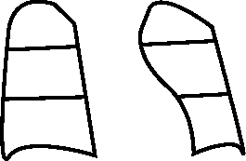
Month of Treatment | Smear/Culture Results |  |  |  | Other Investigations
 | Date | Lab No | Smear | Culture | S. Cr | LFT | ECG*-QTcF | CBC/ Platelets | Electrolyte (K, Mg, Ca) | RBS | TSH, T3, T4
2 Weeks
1
2
3
4
5
6
7
8
9
10
11
12
13
14
15
16
17
18
19
20
* If baseline ECG is normal, repeat to be done after two weeks, then monthly in IP, and when clinically indicated
Date : Finding:
Date : Finding:
Date : Finding:
Date : Finding:

Slide 161
Patient name : Initial Weight: kgs Height: cms
Weight band: ◻ <16 Kg ◻ 16-29 Kg ◻ 30-45 Kg ◻ 46-70 Kg ◻ >70 Kg
Date of starting intensive phase: Date of starting continuation phase:
DST result during course of treatment (LJ/LC/LPA/CBNAAT)
Specimen collection date
Drug | Month | Month | Month | Month
Type of test
R
H (InhA)
H (KatG)
E
Z
Km
Cm
Am
S
Lfx
Mfx (1.0)
Mfx(2.0)
FQ
SLID
SLI (eis)
Eto*
PAS*
Lzd
Cfz*
Bdq*
Dlm*
Details of change in regimen composition during treatment
Date | Changed regimen drugs | Reason for change
*Whenever available

Slide 162


ADMINISTRATION OF DRUGS (one line per month)
Patient’s Name:
Month/Yr) | Day |  |  |  |  |  |  |  |  |  |  |  |  |  |  |  |  |  |  |  |  |  |  |  |  |  |  |  |  |  |  | Weight in kg
 | 1 | 2 | 3 | 4 | 5 | 6 | 7 | 8 | 9 | 10 | 11 | 12 | 13 | 14 | 15 | 16 | 17 | 18 | 19 | 20 | 21 | 22 | 23 | 24 | 25 | 26 | 27 | 28 | 29 | 30 | 31
Mark in the boxes: 🗸= directly observed ;🗸 = Unsupervised;
= drugs not taken; X = initiation of new box; Recording of CP should start from fresh line.

Slide 163


Month/Yr | Day |  |  |  |  |  |  |  |  |  |  |  |  |  |  |  |  |  |  |  |  |  |  |  |  |  |  |  |  |  |  | Weight in kg
 | 1 | 2 | 3 | 4 | 5 | 6 | 7 | 8 | 9 | 10 | 11 | 12 | 13 | 14 | 15 | 16 | 17 | 18 | 19 | 20 | 21 | 22 | 23 | 24 | 25 | 26 | 27 | 28 | 29 | 30 | 31
Mark in the boxes: 🗸= directly observed; 🗸 = Unsupervised;
= drugs not taken; X = initiation of new box; Recording of CP should start from fresh line.

Slide 164
Date of retrieval action | By whom | Who was contacted (patient/ relative) |  | Reason for missed doses |  |  | Outcome of retrieval action
Date of clinical follow up visits
1st visit: |  | 6th visit: |  |  |  | 11th visit:
2nd visit: |  | 7th visit: |  |  |  | 12th visit:
3rd visit: |  | 8th visit: |  |  |  | 13th visit:
4th visit: |  | 9th visit: |  |  |  | 14th visit:
5th visit: |  | 10th visit: |  |  |  | 15th visit:
Treatment outcome (Cured, Treatment completed, Died, Failure, lost to follow up, Regimen Change, Not evaluated) |  |  | Date |  | Remarks (provide cause of death, reason for lost to follow up/Failure (culture non conversion, reversion, ADR, Additional drug resistance), latest TB no. in case of failure and put on treatment further)
Date of adverse drug reaction | Details of symptoms | Action taken
Comments:
Name & Signature of Treating Physician/MO (at the time of treatment outcome):
Post treatment follow up clinical & sputum (Result with date)
Follow up | Date | Clinical | Smear /Culture | CXR | Impression
6 months
12 months
18 months
24 months

Slide 165
Conditions warrant initial hospitalization
The following conditions warrant initial hospitalization of the DR-TB patient for a period of 7-14 days
Children under 5 years with DR-TB
Extensive TB disease – presence of bilateral cavitary disease or extensive parenchymal damage on chest radiography. In children aged under 15 years, presence of cavities or bilateral disease on chest radiography
Severe EP-TB disease - presence of miliary TB or TB meningitis or CNS TB. In children aged under 15 years, extrapulmonary forms of disease other than lymphadenopathy (peripheral nodes or isolated mediastinal mass without compression)
Intolerance to any drug in the shorter/longer oral MDR-TB regimen or risk of toxicity from a drug (e.g. drug–drug interactions)
Severely malnourished (HB < 7 g/dl, BMI < 16 with pedal edema, MUAC < 16cm)
Hypotension (Diastolic below 60mm)
Oxygen saturation (SpO2 below 85%)
Haemoptysis >100 ml
General condition – drowsy state of consciousness
Pregnancy related complications with DR-TB
Patients exceptionally being considered for BPaL regimen
Underlying severe co-morbid or other systemic disease (hepatitis, nephritis, underlying cardiac conditions etc.)
Any surgical intervention required in the chest for any emergency like pleural complications and elective surgeries for patients with localized lesions after bacteriological conversion.

Slide 166
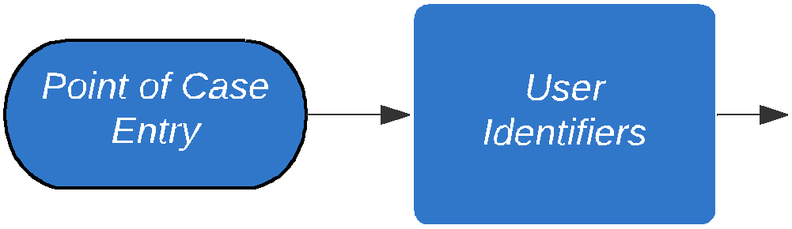
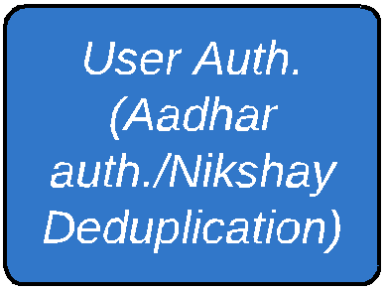

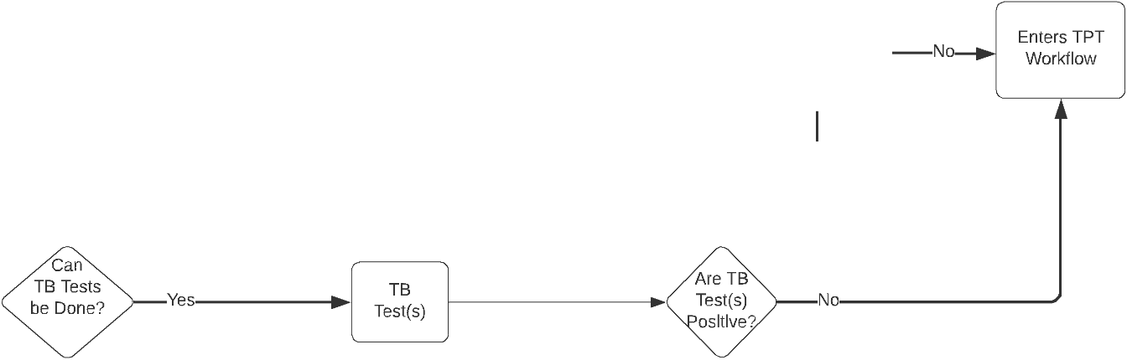
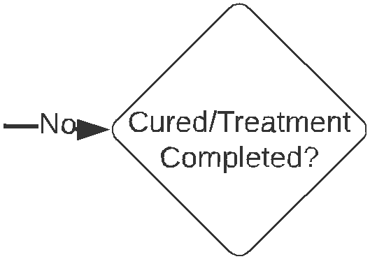
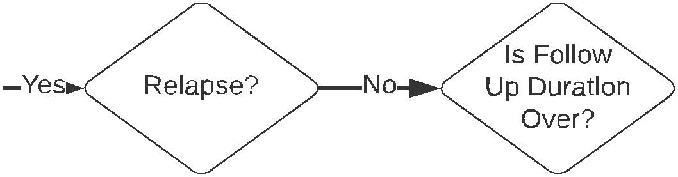

Data management of PMDT in Nikshay
Swim-lane diagram illustrates five cardinal activities in the TB patient workflow:
  Enrolment/screening
  Workflow related to TB diagnosis
  Workflow related to TB treatment
  Workflow related to TB follow-up
  Workflow related to assigning outcomes/ creating a new diagnostic episode
Each square in the diagram signifies a process and quadrangle signifies a decision point.
There are data entry points associated with each process and decision point.
Also, each of these five activities (swim-lanes) are connected to other activities (swim-lanes) in some way, which makes this flow an integrated workflow for TB patient information management.

Slide 167














Adult BCG Vaccination Programmatic Implementation Study
Orientation to Adult
BCG Vaccination
Study Protocol

Slide 168


Study Title
Eﬀect of BCG vaccination amongst vulnerable adult population on reducing TB disease: a programmatic study.
Study Design
Programmatic stratified cluster randomized parallel arm study
Study Objectives
Primary objective
Secondary objective
To evaluate the effectiveness of a strategy to vaccinate vulnerable individuals older than 18 years with BCG vaccine under programmatic settings on the occurrence of notified TB cases upto a period of 36 months post-intervention.
To determine the effectiveness of adult BCG vaccination against active tuberculosis with annual review.
To determine safety of adult BCG vaccination under programmatic settings in vaccinated individuals with annual review.
01

Slide 169






Study Settings
A restricted randomization process followed for the study with -
Out of 561 NTEP districts -
50% of the NTEP districts of the consenting State/ UT are allocated to intervention arms
281 are in intervention arm
24 states/ UTs expressed consent for participation.
280 are in comparator arm
and rest 50% of NTEP allocated to control arm.
Andaman and Nicobar Islands
Gujarat
Odisha
Andhra Pradesh
Haryana
Puducherry
Assam (2 Districts)*
Himachal Pradesh
Punjab
Chhattisgarh
Jammu & Kashmir
Rajasthan (4 Districts)*
Dadra, Nagar Haveli &
Jharkhand
Tamil Nadu
Daman & Diu (1 District)*
Delhi
Karnataka (6 Districts)*
Telangana
Goa
Madhya Pradesh
Tripura
West Bengal (7 districts)*
Maharashtra
Uttar Pradesh
ORIENTATION TO ADULT BCG VACCINATION PROTOCOL
03

Slide 170








Study Population: Inclusion Criteria
The target population is individuals aged 18 years and above, meeting any of the following criteria: (single criteria or multiple criteria's)
History of TB disease
Close contacts of TB patients
People who are reported to have at least one episode of TB in past 5 years.
Contacts of current TB patients as well as all those contacts of index TB cases enrolled in Ni-kshay from 1st January 2021
Individuals aged 60 years or above
Individuals with history of Diabetes (Self- reported). Wherever feasible, documentary evidences of diagnosis and treatment for diabetes will be obtained.
Individuals with a history of smoking tobacco (Current / Past User)- self reported
Individuals with a Body Mass Index of less than 18 kg per sq.mts
ORIENTATION TO ADULT BCG VACCINATION PROTOCOL
04

Slide 171








Study Population : Exclusion Criteria
Individual’s age < 18 years ​
Those who haven't consented or cant consent to take adult BCG vaccine​
Individuals with a known history of HIV​
Individuals with a known history of immunodeficiency or on immunosuppressive drugs or recipients of any procedure interfering with immune status or transplant or malignancy​
Pregnant or lactating women​
Individuals with a history of blood transfusion in last 3 months ​
Individuals with a history leading to high-risk of getting HIV infection
History of known severe reaction to BCG or any other vaccines administered ​
Currently sick due to any reason
ORIENTATION TO ADULT BCG VACCINATION PROTOCOL
05

Slide 172





Special consideration for Adult BCG vaccination
Individuals currently on ATT (Anti Tuberculosis Treatment) are NOT eligible for BCG vaccine.
One can get adult BCG vaccine 4 weeks after completion of current treatment.
Sick and hospitalized individuals will be vaccinated after recovery and medical advise.
Individuals on TB Preventive Treatment (TPT) would be vaccinated 4 weeks after completion of TPT as per NTEP guidelines.
4 WEEKS
Individuals who received adult BCG vaccine and eligible for TPT to be provided TPT only after 4 weeks post vaccination.
ORIENTATION TO ADULT BCG VACCINATION PROTOCOL
06

Slide 173






Preparatory Activities
In Intervention Clusters
In Control Clusters
Head count survey through public health system & follow up
Routine activities for prevention, diagnosis and treatment of TB along with its notification of TB disease and its notification as per NTEP guidelines
BCG vaccination will be administered through the public health system.
The number of individuals administered BCG vaccine will be recorded.
Adverse events following immunization (AEFI) with BCG vaccine will be reported and investigated as per AEFI surveillance guidelines published by the MoHFW.
BCG Vaccine in adults is an intervention additional to routine activities for prevention, diagnosis and treatment of TB along with its notification of TB disease and its notification as per NTEP guidelines
ORIENTATION TO ADULT BCG VACCINATION PROTOCOL
07

Slide 174




Beneficiary Consent Before Taking Adult BCG Vaccine
Adult BCG vaccine is purely voluntary.
The consent should be recorded in ANM consent register.
1
Consent Register will be kept at each vaccination site with the consent written/pasted in local language on the left page of the register and line list of beneficiaries vaccinated with their signatures on the right page of the register.
2
The ANMs are to photo document the consent page with signature of the beneficiaries and submit the digital copies to the concerned Medical Officer – Planning Unit . MO-Planning unit to preserve the consent register for 3 years post adult BCG vaccination.
ORIENTATION TO ADULT BCG VACCINATION PROTOCOL
09

Slide 175


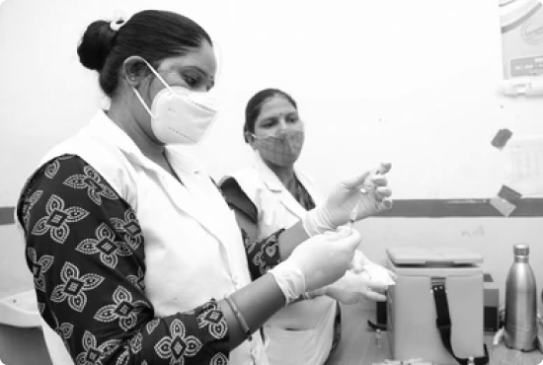







Monitoring
Safety Evaluation
Support from:
ICMR institutes
SGHS
field teams will be sought to constitute monitoring teams in all intervention as well as control clusters.
Current AEFI surveillance operational guidelines published by the MoHFW will be used.
Responsibilities include:
Data on AEFIs reported, recorded and investigated will be shared with ICMR team for safety evaluation.
1. Monitoring of immunization activities
2. Facilitating TB case notification as well as AEFI reporting
ORIENTATION TO ADULT BCG VACCINATION PROTOCOL
11

Slide 176
Public Health Measures
Treatment to be prescribed by a Doctor
Suitable treatment support method to be decided
Drug strips handed over to treatment supporter
Successful treatment outcome
Treatment support to patient & monitoring
Monthly clinical follow-up
Counselling of patients and family members
Contact investigation
Chemoprophylaxis
HIV testing
Blood sugar testing
Drug Susceptibility testing
NIKSHAY Poshan Yojana benefit
Follow up
Adherence support
Treatment outcome reporting
Notes:
Animation – Moderate
Graphics – can be enhanced considering theme of other slides
First Smart Art – are different features/ Component of Treatment support
Second Smart Art – Process of Treatment Support

Slide 177

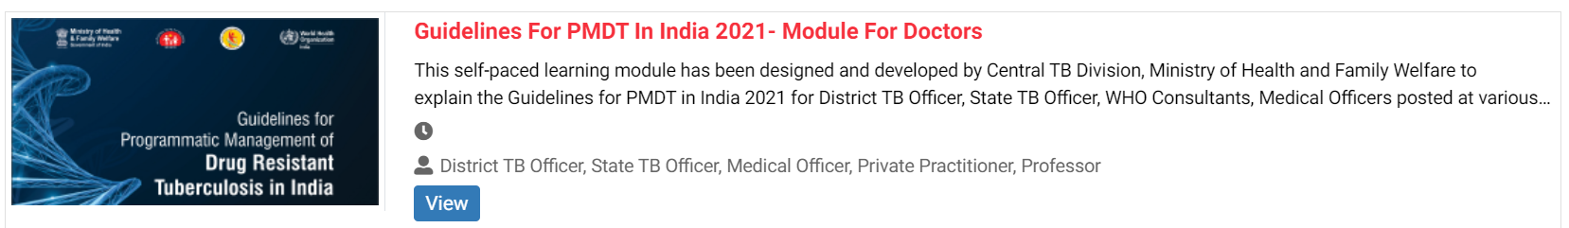
Self learning module – “Swasth e-gurukul”

Slide 178

Thank You

