Slide 1
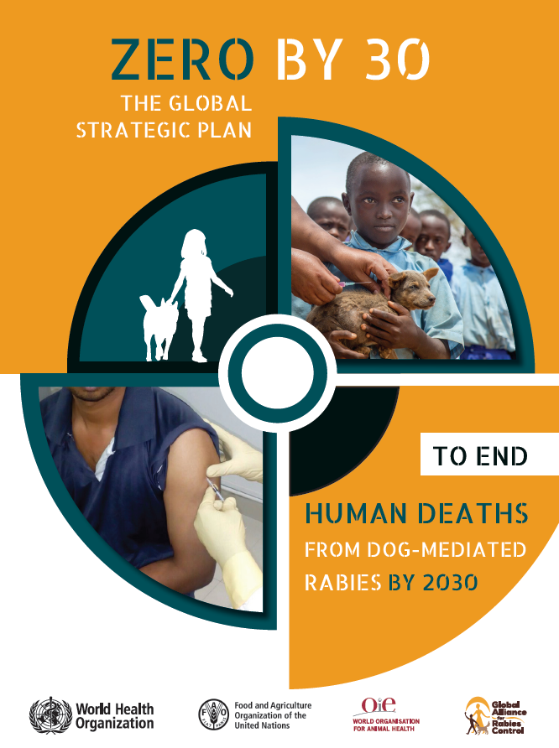
District Level Sensitization Program of Medical Officers-NRCP
Dr Deepanjan Ray
NTD-WHO

Slide 2
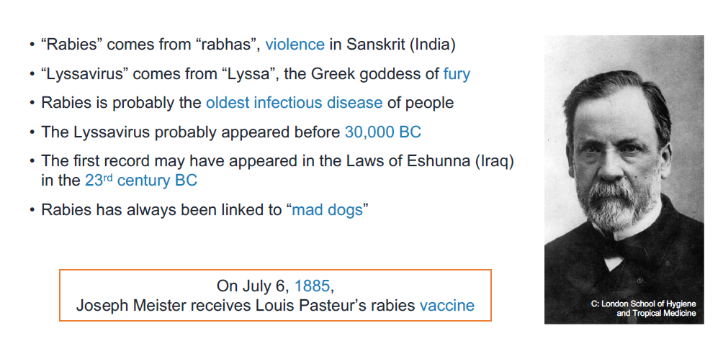
History of Rabies

Slide 3
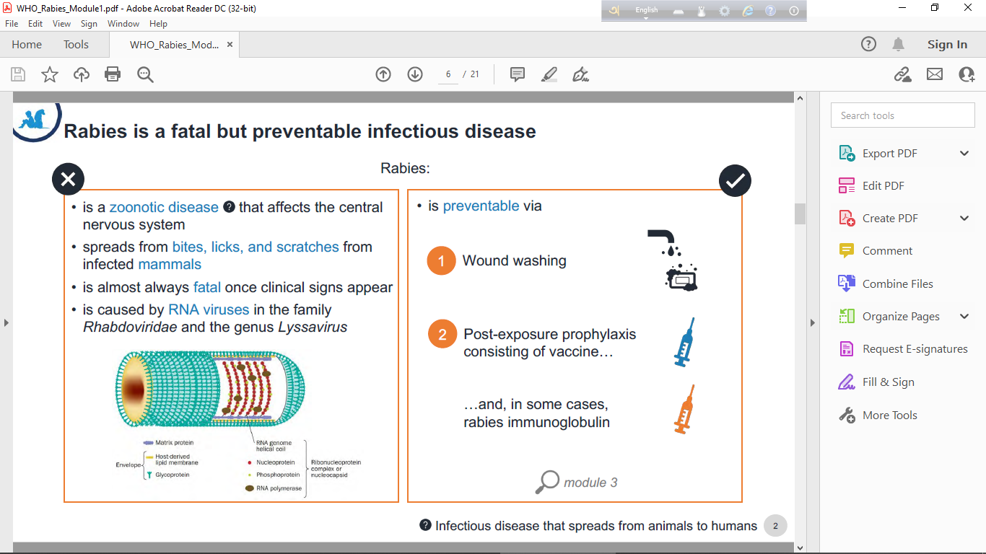
Transmission of Rabies:

Slide 4
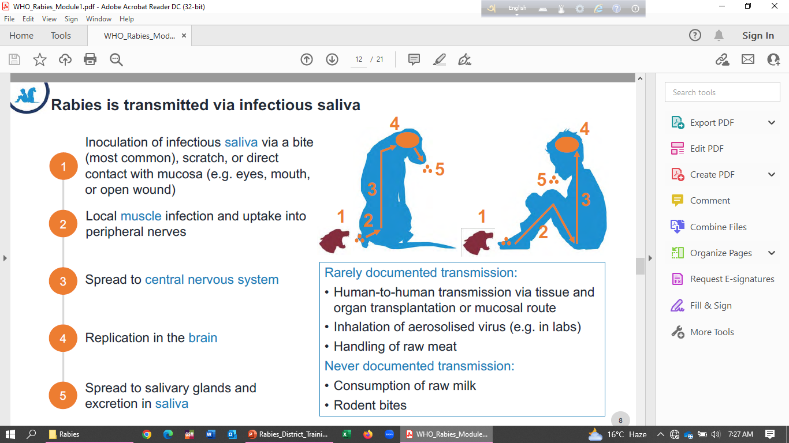
Transmission Pattern of Rabies Virus:

Slide 5
Pathogenesis
Incubation Period- 1 week to 1 year , but average incubation period-2 to 3 months.
Incubation period varies with site of bite and viral load.
Without PEP, the average probability of developing rabies following a bite by a rabid animal
  Head is 55%,
  Upper extremity 22%
  The trunk 9%
  lower limb 12%.
Virus load in the saliva of RABV-infected dogs varies during the disease and influences the risk of infection for human bite victims.

Slide 6
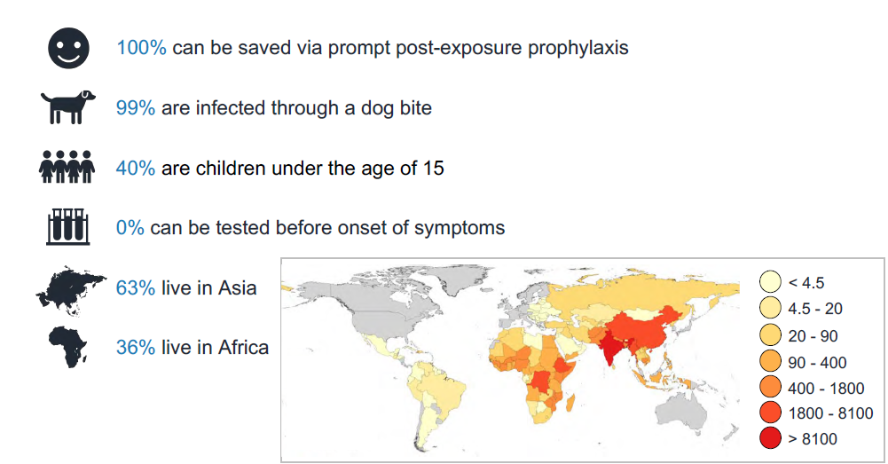
Who are affected most:

Slide 7
Incidence of Animal Bite:
Million Deaths Study 2012, India has estimated 12700 deaths due to furious rabies.
The number of Animal Bites reported under IDSP has increased from 42 lakhs in 2012 to 74 lakhs in 2018. The deaths due to suspected rabies as reported by 30 out of 36 States and UTs during 2017 were 593.
In West Bengal- Animal Bite Incidence-7,90,000 (2019). 7,29,000(2020)
Of which 59% are dog, 35% are cat , 3% are monkey and 3% other animal mediated. Majority of bites are Cat II bites (62%) followed by Cat I bite (23%) and rest 15% as Cat III.
There were 52 rabies deaths in West Bengal on 2016 which came down to 22 deaths in 2020

Slide 8
Eliminating dog-mediated human rabies is a global public good
Globally 59,000 annual human rabies deaths are estimated, 20,000 of which is from India
In India, an estimated 17.4 million animal bites occur annually, and 5 million receives PEP
Highly effective vaccines and immunoglobulin against human rabies exists but the average cost is estimated at $49 per course in Asia
Highly effective dog rabies vaccines exist at US$ 0.3 per dose
No programme
No data
No funding
With status quo:
over 1 million people will die of rabies before 2030
the demand for post-exposure prophylaxis will continue to escalate
Notes:
I don’t need to emphasize the importance of eliminating dog-mediated human rabies in this meeting.
If we continue to do a business as usual, …
As you know, unfortunately rabies surveillance remains poor in most of the endemic countries.
Having no accurate and timely data, investment from the government and partners remain limited globally to tackle rabies, not only because accurate data on burden is limited but also because without adequate surveillance and data, it will also be difficult to demonstrate impacts.
Resultantly there are still many countries that don’t have rabies control programme, despite that we have effective tools.

Slide 9
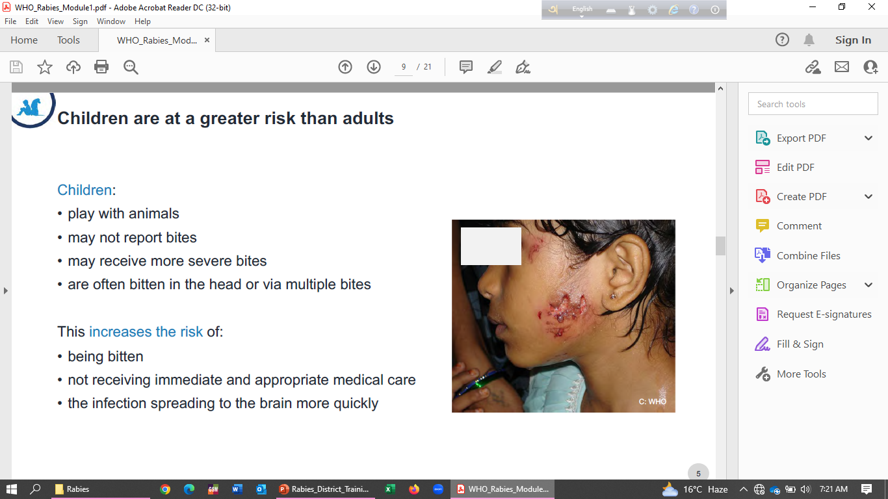
Why Children are more Vulnerable:

Slide 10
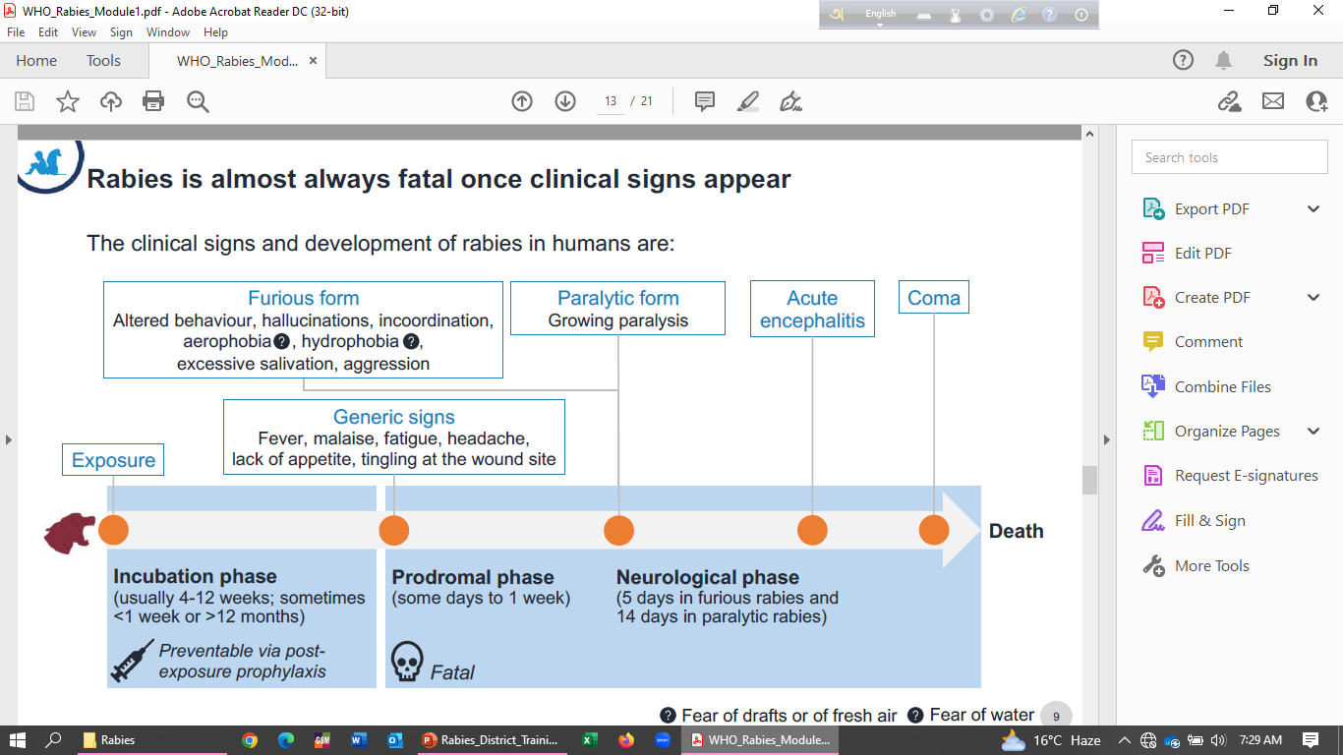
Clinical Presentation of Rabies-Human

Slide 11
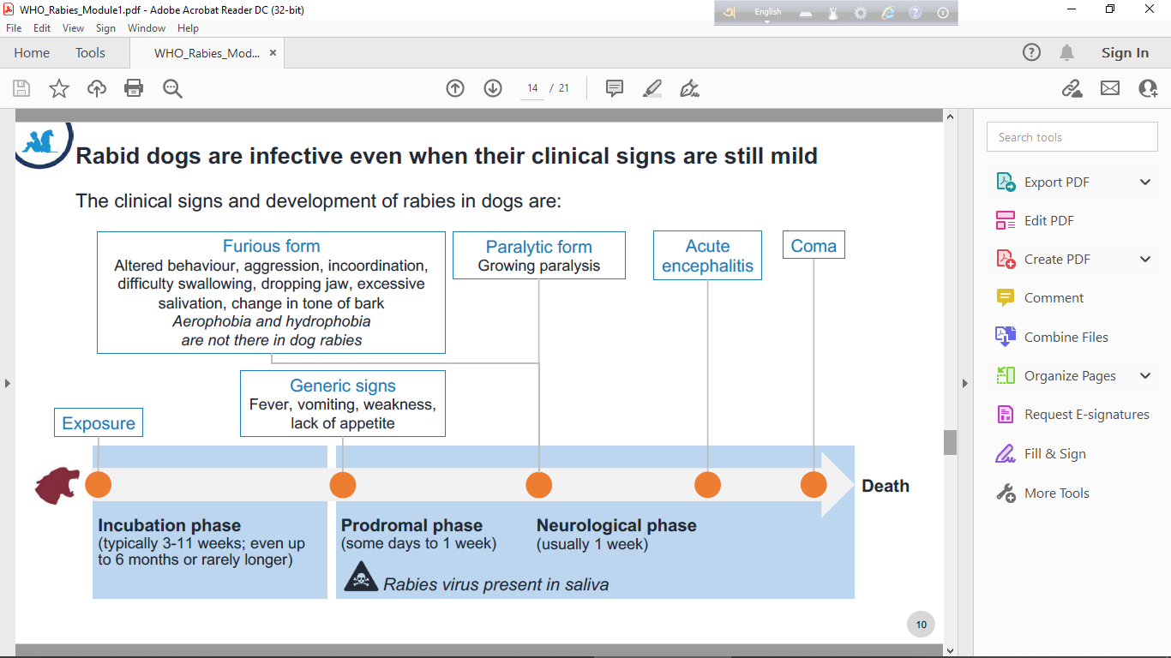
Manifestation of Rabies-Dog

Slide 12
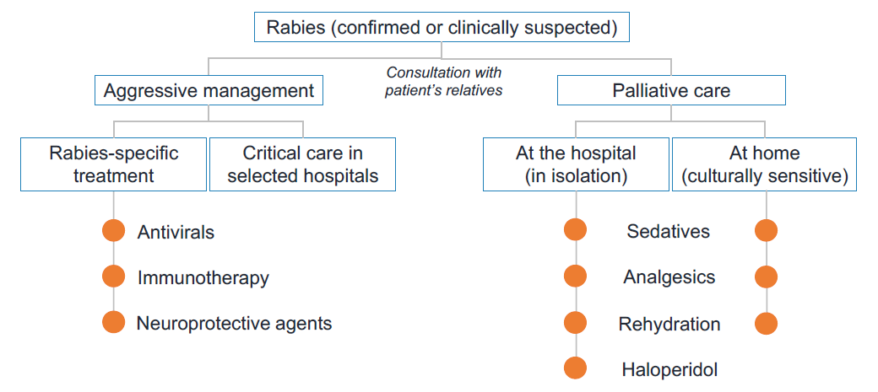
Management of Rabid patients:
Clinically Rabid patients can be managed but rarely to be cured, Antibiotics have no Role.

Slide 13
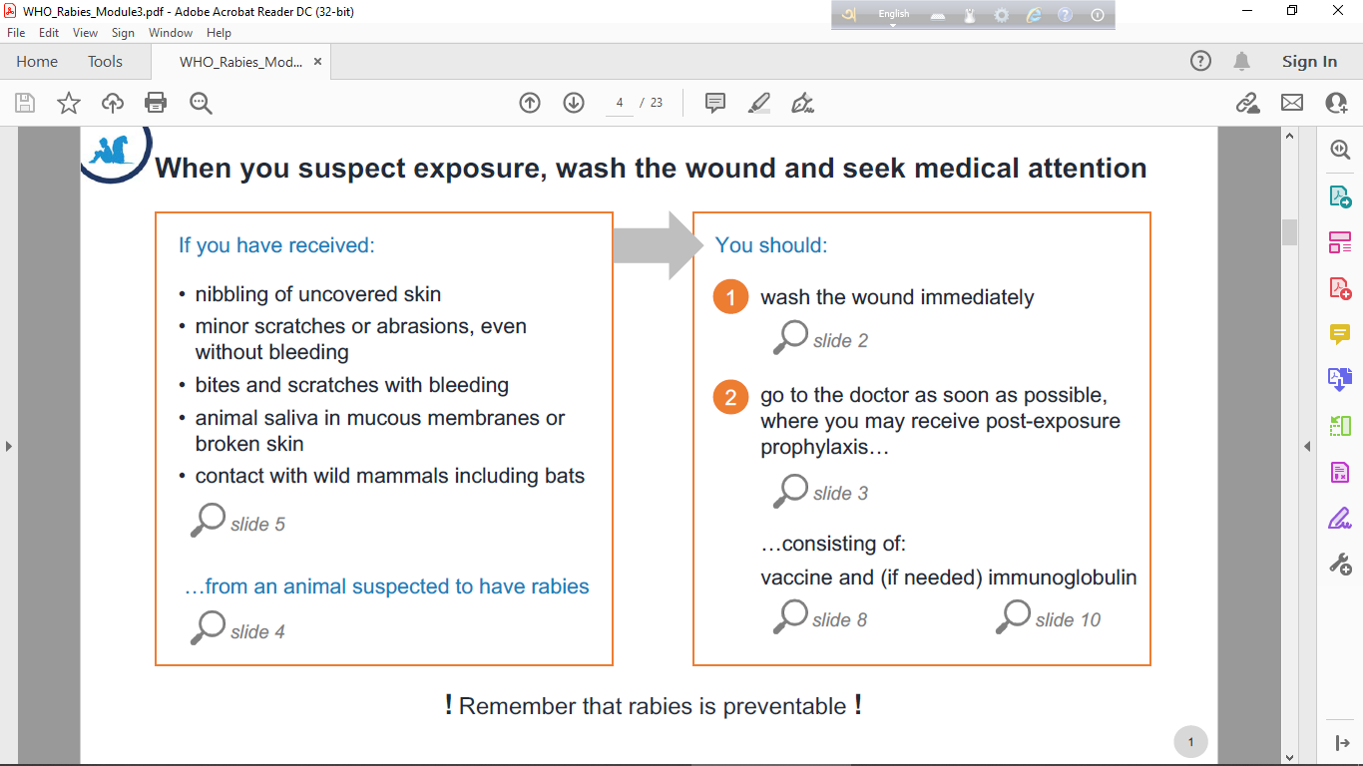
Prevention of Rabies:

Slide 14
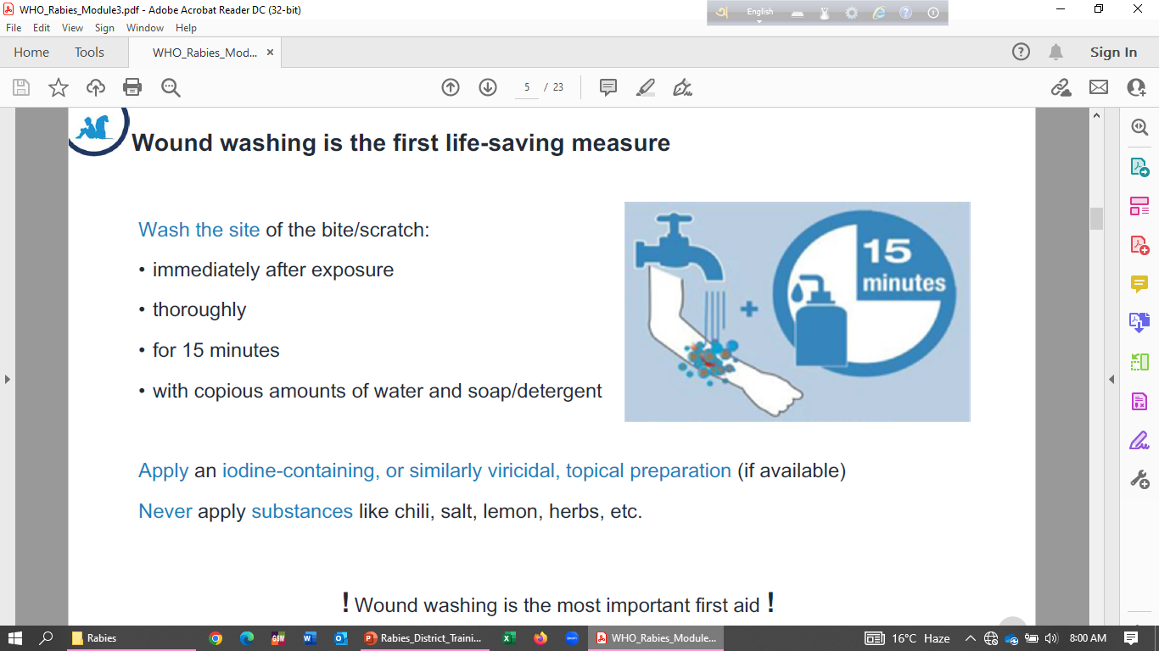
Initial Management-Washing (Important….)

Slide 15
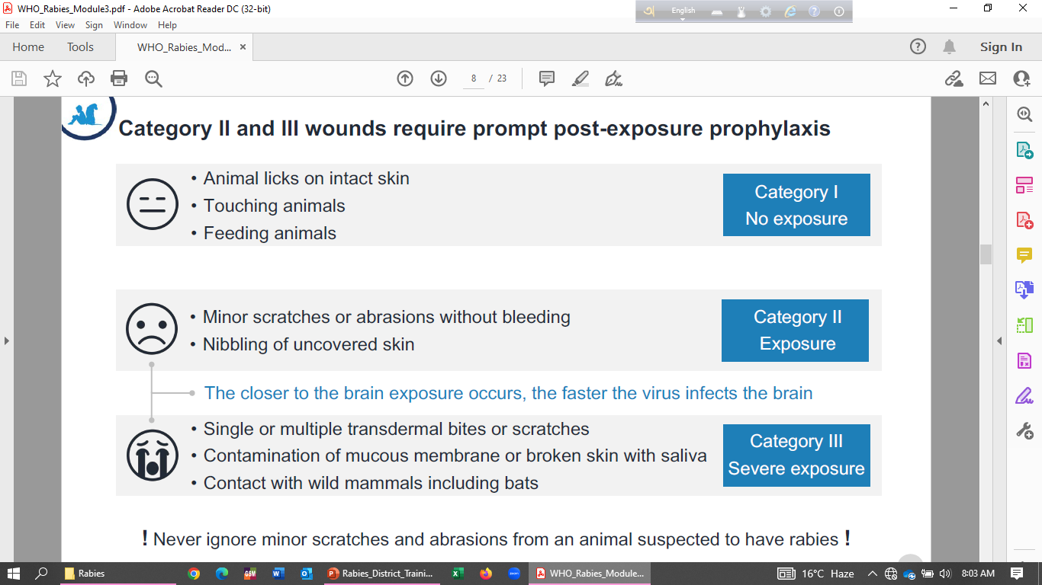
Categorization of Animal Bite:

Slide 16
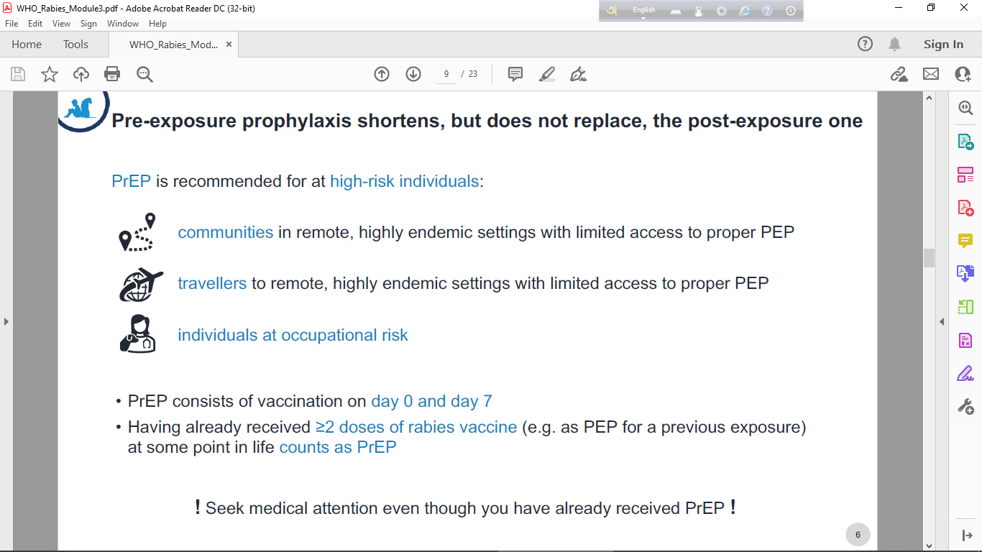
Strategy for High Risk Group:
PrEP is for High Risk group, but PrEP does not qualify for non administration of PEP.

Slide 17
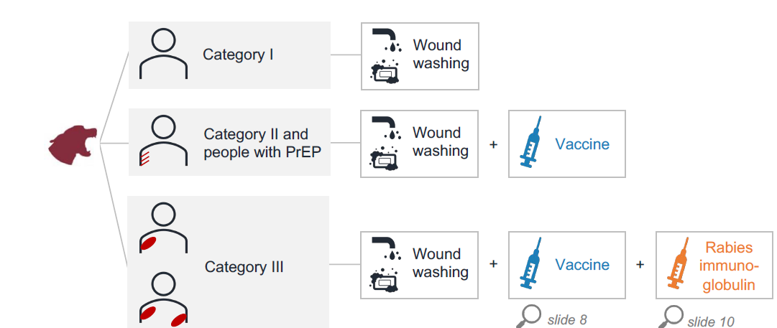
Categorization of Animal Bite and Management:

Slide 18
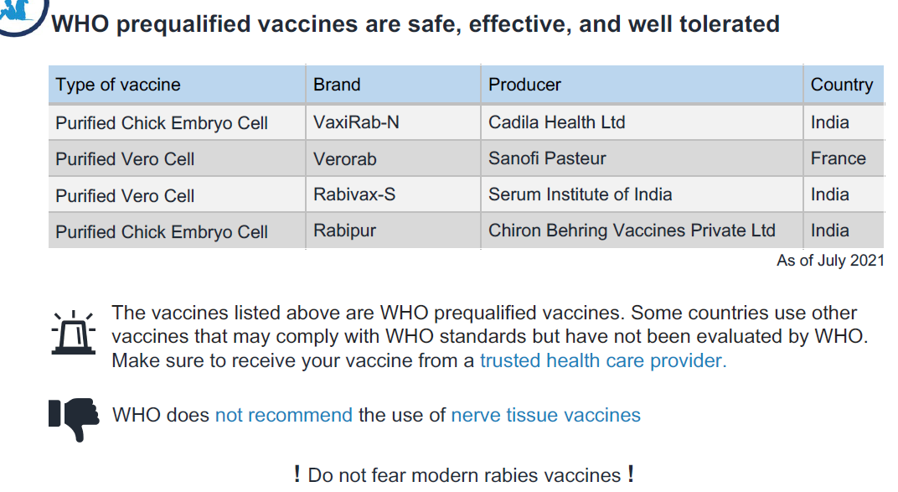
Vaccines available for PEP/PrEP

Slide 19
Post Exposure Prophylaxis
Category of Bite | Recommended Action
Category I - touching or feeding animals, animal licks on intact skin (no exposure) | Washing of exposed skin surfaces, no PEP
Category II - nibbling of uncovered skin, minor scratches or abrasions without bleeding (exposure) | Wound washing and immediate vaccination
Category III - single or multiple transdermal bites or scratches, contamination of mucous membrane or broken skin with saliva from animal licks, exposures due to direct contact with bats (severe exposure) | Wound washing, immediate vaccination and administration of rabies immunoglobulin
Increase Risk in Category II and Category III Bite-
the biting mammal is a known rabies reservoir or vector species
the exposure occurs in a geographical area where rabies is still present
the animal looks sick or displays abnormal behavior
a wound or mucous membrane was contaminated by the animal’s saliva
the bite was unprovoked
the animal has not been vaccinated.
The vaccination status of the suspect animal should not be the deciding factor when considering to initiate PEP or not when the vaccination status of the animal is questionable.

Slide 20
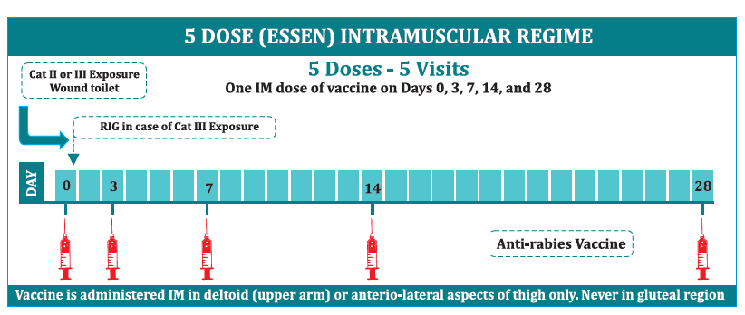
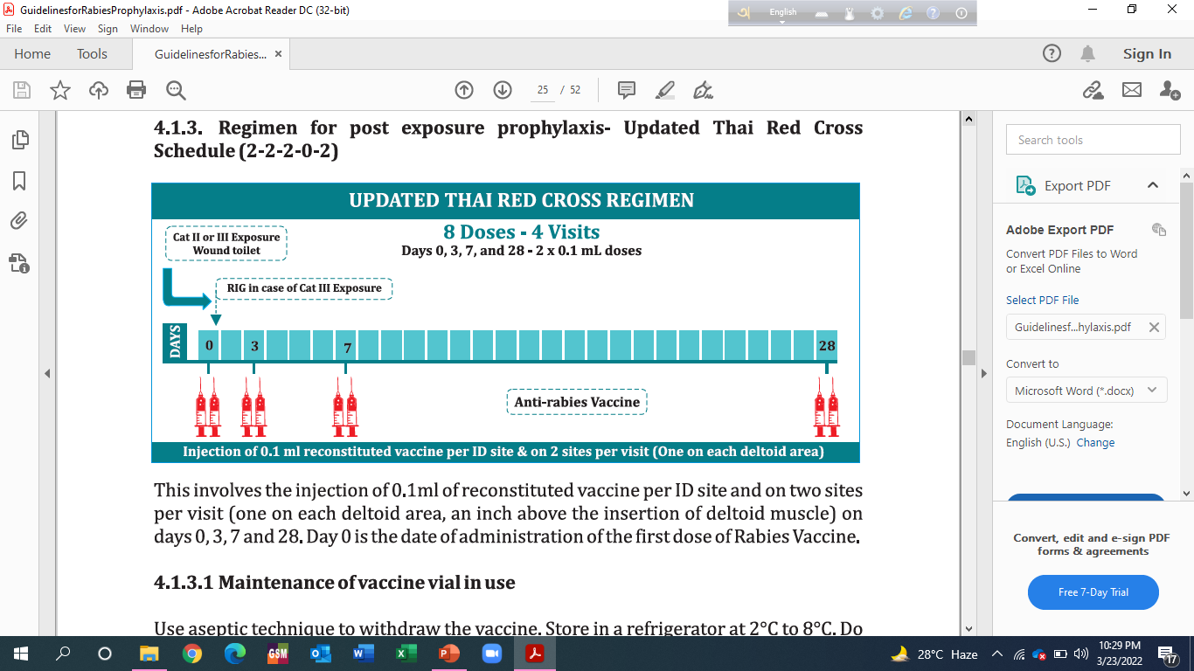
Post Exposure Prophylaxis Regimen-
Contraindicated in Immunosuppressive patients , patient receiving Steroid, or having chloroquine.

Slide 21
Key Points -PEP
Only the rabies vaccine (lyophilized vaccine along with the diluent of specified volume) approved by DCGI for ID/ IM administration should be used for ID route. The vaccine should have stated potency of ≥ 2.5 IU per IM dose. The same vaccine is used for ID administration as per the stated schedule.
A dose of 0.1 ml of vaccine, irrespective of reconstituted volume for IM route (0.5 ml or 1 ml) is administered per ID site as per the stated schedule.
Intradermal injections must be administered by staff trained in this technique.
Vaccine when given intradermally should raise a visible and palpable “bleb” in the skin.
If the ID dose is inadvertently given subcutaneously or intra-muscularly or in the event of spillage, a new dose should be given intradermally (maybe at a nearby site).
Animal bite victims on chloroquine therapy (for cure or prophylaxis of malaria) and immune-suppressed persons should be given ARV by IM route, not by ID route.

Slide 22
Day 0 is the day of 1st dose of vaccine given, not the day of bite.
Never inject the vaccine in gluteal region.
Reconstituted vaccine to be used immediately. However, in unforeseen delay the vaccine vial should be stored at 2-8○C after reconstitution and should be used within 6 hours of reconstitution.
Dose is same for all age groups.
Switching the route of administration from IM to ID or vice versa and switch over from one type of modern rabies vaccine to the other during PEP is not recommended as routine. However, whenever this is absolutely required, PEP need not be restarted, and the regimen should be continued/ resumed as per the new vaccine / route of administration (ref.- WHO recommendation and GOI Guideline for rabies prophylaxis).
As for all immunizations, animal bite victim should be kept under medical supervision for at least 15-20 minutes after administration of ARV as well as ERIG

Slide 23
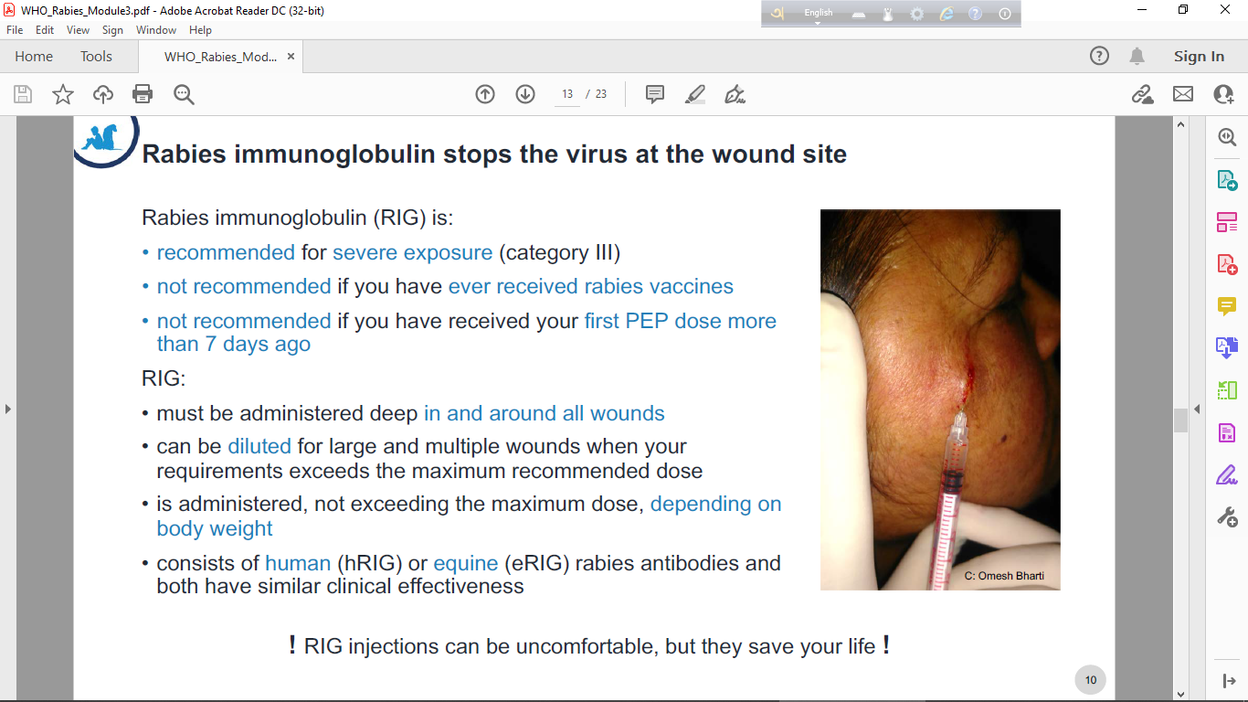
Rabies Immunoglobulin:

Slide 24
Human Rabies Immunoglobulin (HRIG): 20 IU/kg body wt, maximum 1500 IU
Equine Rabies Immunoglobulin (ERIG): 40 IU/kg body wt, maximum 3000 IU
Either of the above is to be used where indicated – i.e. all Category III exposure and also Category II exposure in case of immune-compromised persons.
  Local infiltration of rabies immunoglobulin: Infiltrate into all Category III wounds.
RIG should be infiltrated in the depth and around each of the wounds to inactivate the locally present rabies viruses. Infiltrate the entire immunoglobulin dose, or as much as possible (avoiding compression syndrome), in the depth and around the wounds.
As per the new recommendation/ guideline of WHO and GOI, injecting the remaining volume of RIG intramuscularly at a distance from the wound provides little or no additional protection against rabies as compared with infiltration of the wound(s) alone. Hence the remaining RIG can be given to other patients using separate syringe /needle.
If RIG is insufficient (by volume) to infiltrate all the wounds, dilute it with sterile normal saline to a volume sufficient to infiltrate all wounds.

Slide 25
  Wounds on tip of finger/toe, ear lobe, nose, external genitalia or around the eye can be safely injected with RIG, provided the injection is not done with excessive pressure which can cause compression syndrome.
  Suspected exposure to aerosols of rabies virus (as example accidental exposure in labs) is to be treated as category III exposure. In such cases ARV to be given as per normal schedule but RIG is to be given in IM route.
  RIG must never be given intravenously.

Slide 26
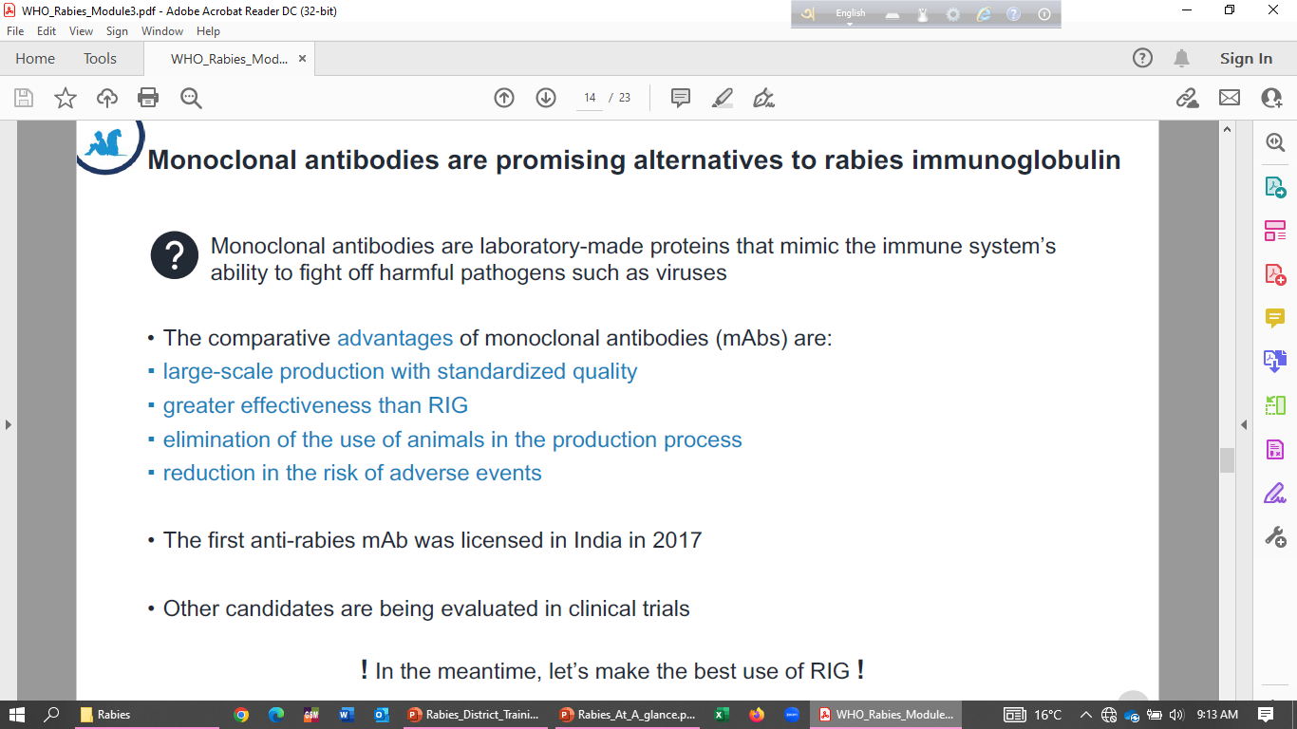
Monoclonal Immunoglobulin:

Slide 27
Management in Special Scenarios:
Management in immune- compromised patients:
Thorough wound washing and antisepsis as described above.
Local infiltration of RIG in both Category II and Category III exposure.
Complete course of ARV by IM route in Category II and III exposures.
If facilities are available, anti-rabies antibody estimation should be done 14 days after the completion of course of vaccine to assess the need of additional doses of vaccine.
HIV-infected and other potentially immunocompromised persons who are clinically monitored and well-managed, such as HIV-infected individuals receiv­ing antiretroviral therapy (ART), are not considered immunocompromised and have been shown to respond normally to rabies and other vaccines
Vaccination of pregnant and lactating women – Rabies vaccines and RIG are safe and effective in pregnant and lactating women.

Slide 28
Pre Exposure Prophylaxis:
Intramuscular regimen (entire vial x 1 site) on days 0, 7 and booster on either day 21 or 28
OR
Intradermal regimen (0.1ml x 1 site ) at day 0, 7 and booster on either day 21 or 28
Persons at high risk of exposure should get serum antibody level measured every 6 months during the initial two years period after the primary vaccination and take a booster dose if the level falls below 0.5 IU/ml. Routine booster doses are not recommended for general people.
Vaccine induced immunological memory persists in most cases for years. A booster would be recommended only if rabies virus neutralizing antibody titers have dropped to less than 0.5 IU/ ml.

Slide 29
Management of re-exposed cases after a full PEP or PrEP:
In case of re-exposure after a full course and documentation of (Pre/Post-exposure) IM or ID vaccination, irrespective of category of exposure or time since previous vaccination - Proper wound toileting should be done. Doses only on day 0 and 3 (these actually serve as booster doses). Either intramuscular (entire vaccine vial) or intra-dermal injection (0.1ml) at one (1) site. No RIG needed. If previous course of vaccination was partial/ irregular, treat it as a fresh case and give full course as usual. Re-exposure following PEP with a nerve tissue vaccine (NTV) or if previous PEP or PrEP is not clearly documented - Treat as a fresh unvaccinated case (Full schedule as per category). If the animal bite victim has documented proof of complete PEP or PrEP within last 3 months, then adequate wound washing would be required in case of re-exposure, but no vaccine or RIG is needed in such cases.

Slide 30
Deviation from recommended PEP/ PrEP vaccination schedule:
Every effort should made to adhere to the recommended PEP/ PrEP schedule, especially for the first 2 days of treatment. The recommended PEP should be informed clearly (both verbally and in a written prescription) The first three doses of the PEP (i.e. doses on day 0, day 3 and day 7) should be completed maximum within 10 days to achieve effective immunity against the rabies virus. One or two days deviation do not necessitate re-starting of the vaccination schedule. Deviation of a few days will not necessitate fresh vaccination from the beginning of the course. For most minor delay or interruptions, the vaccination schedule can be shifted and resumed as though the patient were on schedule. [See FAQ for example].

Slide 31
Type of Prophylaxis | Route of Administration | Dose of Vaccine | Day of Dose | No. of Injections | Total no. of visit | Site of Injection visit
Post Exposure Prophylaxis | Intra Dermal | 0.1 ml per dose | Day 0, 3, 7 & 28 | 2 | 4 | Adult: Deltoid Muscle Infants and small children: Anterolateral thigh
 | Intra Muscular | 1 entire vaccine vial | Day 0, 3, 7, 14 & 28 | 1 | 5
Pre Exposure Prophylaxis | Intra Dermal | 0.1 ml per dose | Day 0, 7 and booster on either day 21 or 28 | 1 | 3
 | Intra Muscular | 1 entire vaccine vial | Day 0, 7 and booster on either day 21 or 28 | 1 | 3
Re -exposure | Intra Dermal | 0.1 ml per dose | Day 0 & 3 | 1 | 2
 | Intra Muscular | 1 entire vaccine vial | Day 0 & 3 | 1 | 2

Slide 32
Logistics
      A.R.V. approved by DCGI for ID/IM route.
      Rabies Immunoglobulin
      Consumable: self-mounted insulin syringes (AD), Dressing Kits, Soap and Gloves
      IV Fluid and Emergency Drug Kit (both in ARC & ER)
    Animal Bite Exposure Register & Treatment Card
      ARC monthly reporting formats (NRCP –M03)
      Animal Bite Exposure Register
      Formats for NRCP Monthly Reporting

Slide 33
NATIONAL RABIES CONTROL PROGRAM
RABIES POST EXPOSURE TREATMENT CARD (To be retained at Anti Rabies Clinic)
Name and address of the health facility
Patient Reg. No

Slide 34
Some Interesting Facts-
RABV is not found in blood. Human-to human transmission of RABV is extremely rare and this very low risk should not hinder the care of patients.
No case of human rabies resulting from consumption of raw meat from a rabid animal has been documented.
Infectious RABV has never been isolated from milk of rabid cows and no documented human rabies case has been attributed to consumption of raw milk.
Survival from clinical rabies is extremely rare; it has been well documented in 15 cases, albeit with severe sequelae in most of those cases. Without intensive medical support, death usually occurs within 2–3 days following hospitalization

Slide 35
Frequently Asked Question:

