Slide 1
Malaria

Slide 2
First patient
53/M, resident of Kasba, Kolkata
Admitted with
  Fever (up to 103 F) with chills & rigors since 4 days
  Headache since 4 days
  Progressively increasing drowsiness
  Progressively decreasing urine output
  Shortness of breath on the day of admission

Slide 3
At the ER
O/E
  Drowsy but arousable
  Mild icterus
  Edema
  Peripheral pulses feeble 133bpm(R), BP – 100/70, CBG 100, SpO2 92% on RA, T 100 F
  Fine crackles in both bases
  Abdo. Soft
  No focal lateralizing neuro. signs, no neck rigidity

Slide 4
Investigations
Hb 11.0, TC 5600 (N74, L24, Mo1, Eo1) Plt 50,000
Urea 67, Creat 2.29, Na 131.9, K 4.32
T.Bili 4.0(Direct 2.5 ),AST 134,ALT 110,ALP 90, GGT 75, Alb.
3.5 Glob. 4.0
INR 1.16, a PTT 26
Urine R/E – 6-8 pus cells, 1-2 RBCs, granular casts, Protein ++

Slide 5
Further investigations
CXR – Hazy lung fields, small pleural effusion bilaterally
USG abdomen – small right pleural effusion, hepatosplenomegaly, contracted gall bladder

Slide 6
Differentials ?

Slide 7
Malaria
Dengue
Leptospirosis
Viral hepatitis
Scrub typhus
Sepsis
COVID 19 ??

Slide 8
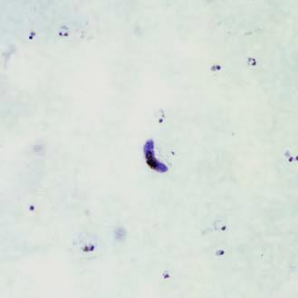

Slide 9
P.Falciparum Ag - +ve
P.falciparum ring forms, gametocytes

Slide 10
Malaria represents a medical emergency because it may rapidly progress to complications and death without prompt and appropriate treatment.
Almost all severe forms and deaths from malaria are caused by
P. falciparum.
Rarely, P. vivax or P. ovale produce serious complications, debilitating relapses, and even death

Slide 11
Severe malaria
In a patient with P. falciparum asexual parasitaemia and no other obvious cause of symptoms, the presence of one or more of the following clinical or laboratory features classifies the patient as suffering from severe malaria

Slide 12
Clinical features
Impaired consciousness or unrousable coma
Prostration, i.e. generalized weakness so that the patient is unable walk or sit up without assistance
Failure to feed
Multiple convulsions – more than two episodes in 24 h
Deep breathing, respiratory distress (acidotic breathing)
Circulatory collapse or shock, systolic blood pressure < 70 mm Hg in adults and
< 50 mm Hg in children
Clinical jaundice plus evidence of other vital organ dysfunction
Haemoglobinuria
Abnormal spontaneous bleeding
Pulmonary oedema (radiological)

Slide 13
Laboratory findings
Hypoglycaemia (blood glucose < 2.2 mmol/l or < 40 mg/dl)
Metabolic acidosis (plasma bicarbonate < 15 mmol/l)
Severe normocytic anaemia (Hb < 5 g/dl, packed cell volume < 15%)
Haemoglobinuria
Hyperparasitaemia (> 2%/100 000/μl in low intensity transmission areas or
> 5% or 250 000/μl in areas of high stable malaria transmission intensity)
Hyperlactataemia (lactate > 5 mmol/l)
Renal impairment (serum creatinine > 265 μmol/l).

Slide 14
Parasitological diagnosis
Prompt parasitological confirmation by microscopy, or RDTs, is recommended in all patients suspected of malaria before treatment is started.
Treatment solely on the basis of clinical suspicion should only be considered when a parasitological diagnosis is not accessible.

Slide 15
Specific antimalarial treatment of severe malaria
Severe malaria is an emergency and treatment should be given promptly.
Parenteral artemisinin derivatives should be used as specific antimalarial therapy.
Intravenous route should be preferred over intramuscular.

Slide 16
Adjustment of dosing in renal failure or hepatic dysfunction
The dosage of artemisinin derivatives does not need adjustment in vital organ dysfunction.
Dosage adjustments are not necessary if patients are receiving either haemodialysis or haemofiltration.

Slide 17
Artesunate
Artesunate: 2.4 mg/kg body weight)( 3 mg/kg for children) i.v. or i.m. given on admission (time=0), then at 12 and 24 hours, then once a day
(Care should be taken to dilute artesunate powder in 5% Sodium bi-carbonate provided in the pack).

Slide 18
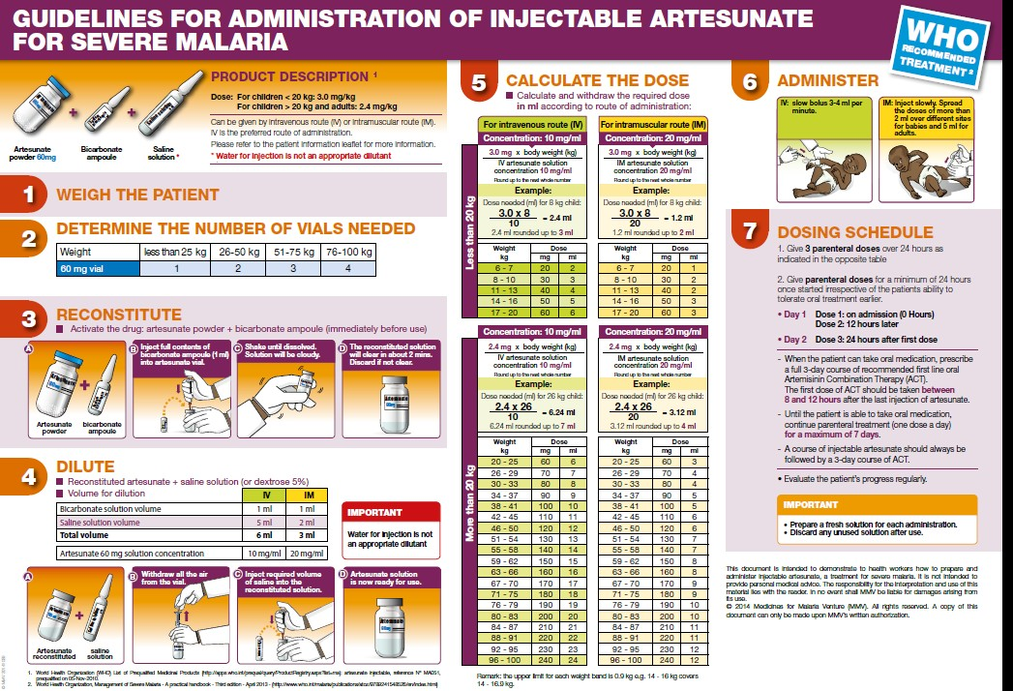

Slide 19
Once patient tolerates oral therapy or after at least 24 hours of parenteral therapy, further follow-up treatment should be with a full course of oral ACT(first dose of ACT started 8-12 hours after the last Artesunate injection) .

Slide 20
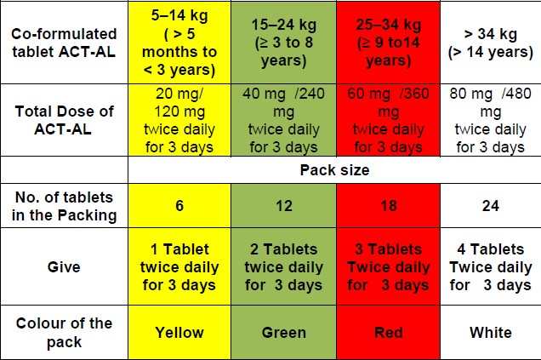
In North-Eastern States (NE States)
+ Primaquine*: 0.75 mg/kg body weight on day 2

Slide 21
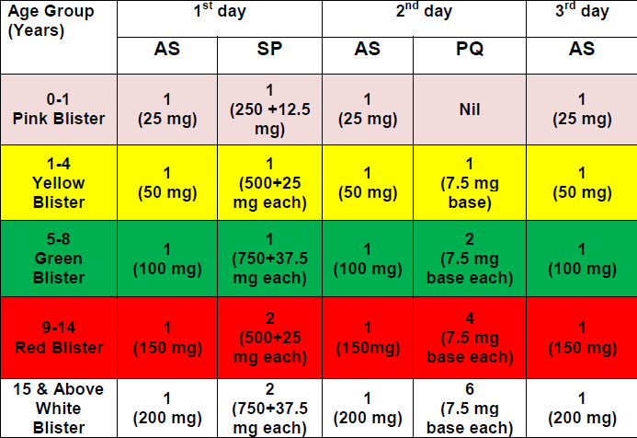
In other States

Slide 22
Use of antibiotics
In adults-those who present with a clinical syndrome compatible with serious bacterial infection (meningitis, malnutrition or severe pneumonia)/concomitant severe sepsis or septic shock
All children presenting with severe malaria in areas of intermediate and high malaria transmission should be given broad spectrum antibiotics in addition to antimalarial drugs.

Slide 23
Severe malaria in pregnancy : Maternal risk
Hypoglycaemia
Acute pulmonary oedema
Premature labour

Slide 24
Severe malaria in Pregnancy: foetal risk
High risk of abortion in early pregnancy
Increased chances of stillbirth, intrauterine growth retardation and low birth weight later in the pregnancy.

Slide 25
Treatment during pregnancy
Parenteral antimalarials in full doses without delay.
Parenteral Artesunate preferred over Quinine in all trimesters(recurrent hypoglycaemia with Q).
Although the safety of artesunate in first trimester of pregnancy is not firmly established, the guideline development group consider that the proven benefit to the mother outweigh any potential harm to the developing foetus
Ref. GUIDELINES FOR THE TREATMENT OF MALARIA. 3rd edition.
WHO

Slide 26
Treatment of P. vivax malaria
Confirmed P. vivax cases should be treated with Chloroquine in full therapeutic dose of 25 mg/kg as per the age-wise dosage schedule

Slide 27
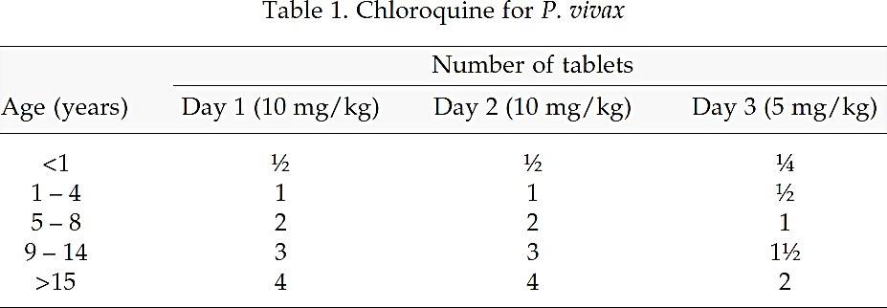
Dose of Chloroquine for P. vivax

Slide 28
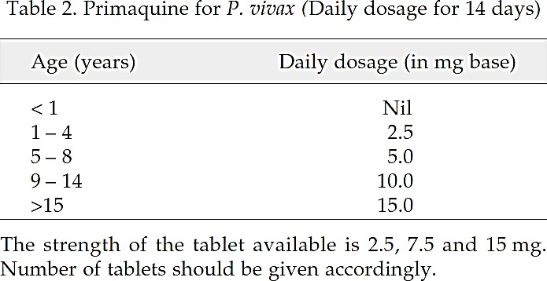
Dose of Primaquine for P. vivax to prevent relapse

Slide 29
Contraindicated in pregnant women, infants and known G6PD deficient patients.
Can lead to hemolysis in G6PD deficiency.
Caution should be exercised before administering Primaquine in areas known to have high prevalence of G6PD deficiency.

Slide 30
Warning symptoms
Patient should be advised to stop Primaquine immediately if he/she develops any of the following symptoms and should report to the doctor immediately:
(i) dark coloured urine
(ii) yellow conjunctiva
(iii) bluish discolouration of lips
(iv) abdominal pain
(v) nausea
(vi) vomiting
(vii) breathlessness etc.

Slide 31
WHO recommended a standard therapy of 15 mg Primaquine daily for 14 days.
In mild G6PD deficient patient, 45 mg Primaquine(7.5 mg/kg) should be prescribed weekly for eight weeks.

Slide 32
Treatment of uncomplicated malaria in pregnancy (earlier recommendation)
P. falciparum
ACT in second and third trimesters
Quinine + Clindamycin in first trimester.
P. vivax
To be treated with Chloroquine in all trimesters .

Slide 33
Recent WHO recommendation
Pregnant women with uncomplicated P. f malaria should be treated with artemether-lumefantrine during the first trimester
Antifolates contraindicated in the first trimester of pregnancy. So, ACTs containing SP are contraindicated during first trimester.
Quinine- poorer outcomes of treatment and challenges of adherence to a seven-day course of treatment.
Ref: WHO Guidelines for malaria - 14 March 2023 - World Health Organization (WHO)

Slide 34
Treatment of mixed infections
Mixed infections with P. falciparum should be treated as falciparum malaria.
Since AS+SP is not effective in vivax malaria, other ACT should be used.
However, anti-relapse treatment with Primaquine can be given for 14 days, if indicated.

Slide 35
Another patient

Slide 36
A 32 year old lady from central Kolkata, admitted with h/o fever for 10 days followed by pain abdomen, vomiting, decreased urinary flow, alteration of consciousness
Investigations: Thrombocytopenia, elevated pancreatic enzymes, hyperbilirubinemia, raised liver enzymes, high urea, creatinine. CT abdomen-pancreatitis
Peripheral blood plenty of P. vivax trophozoites

Slide 37
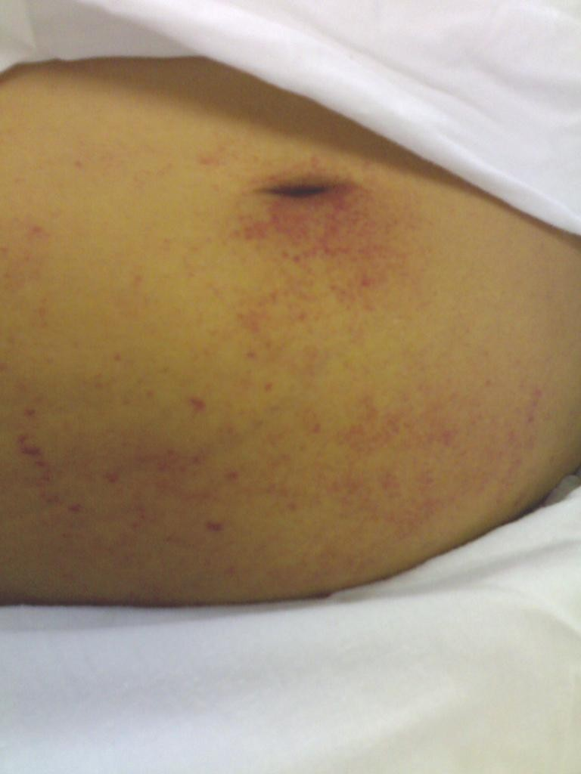

Slide 38
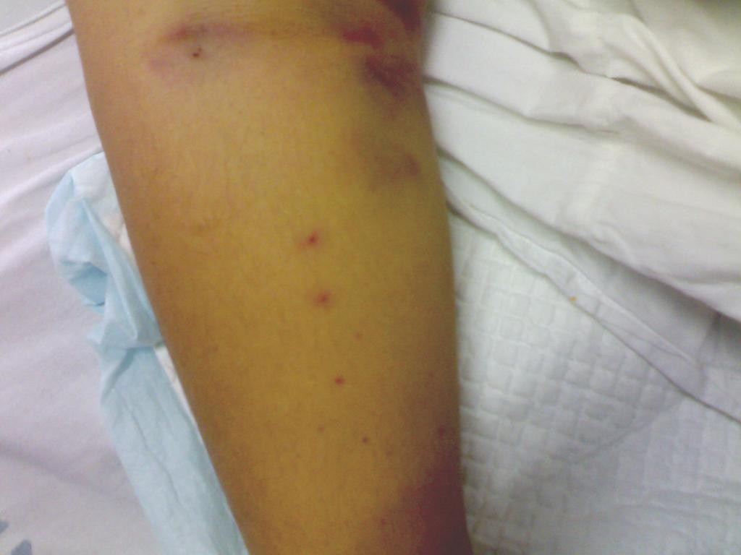

Slide 39
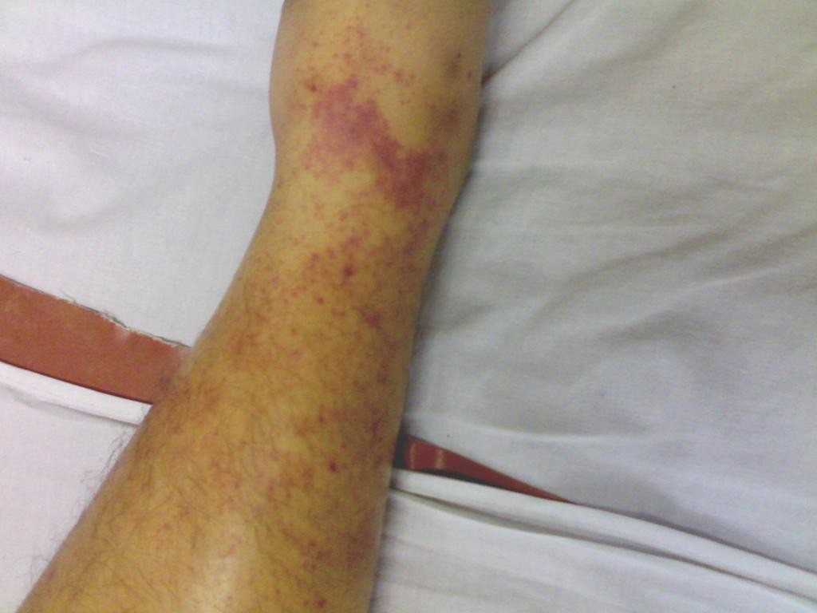

Slide 40
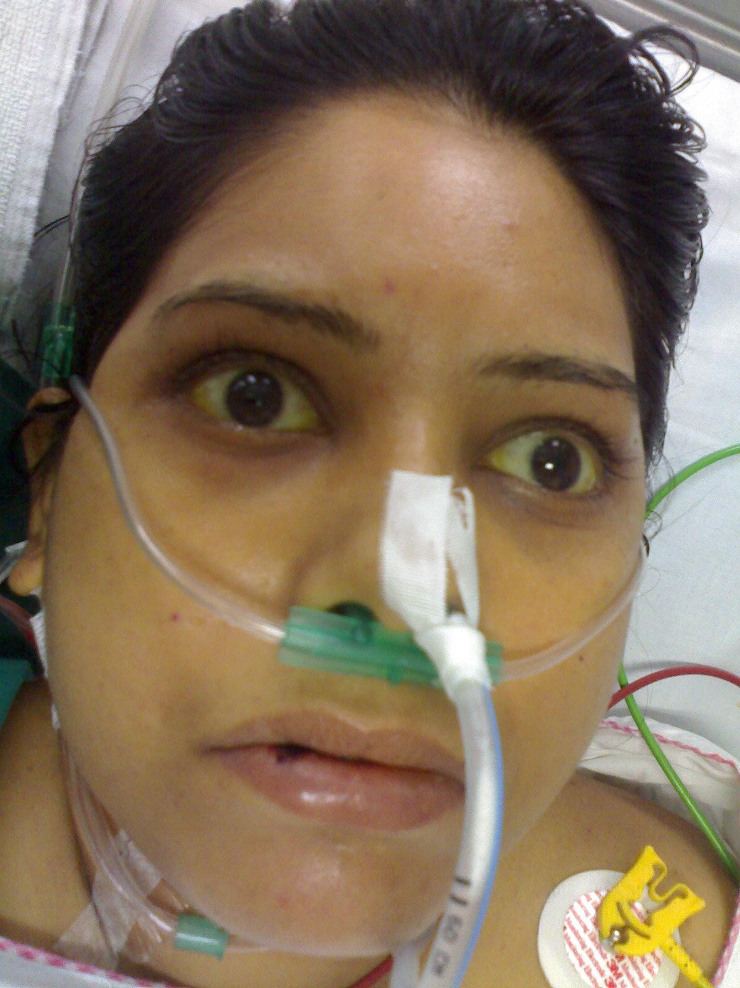

Slide 41
Another patient

Slide 42
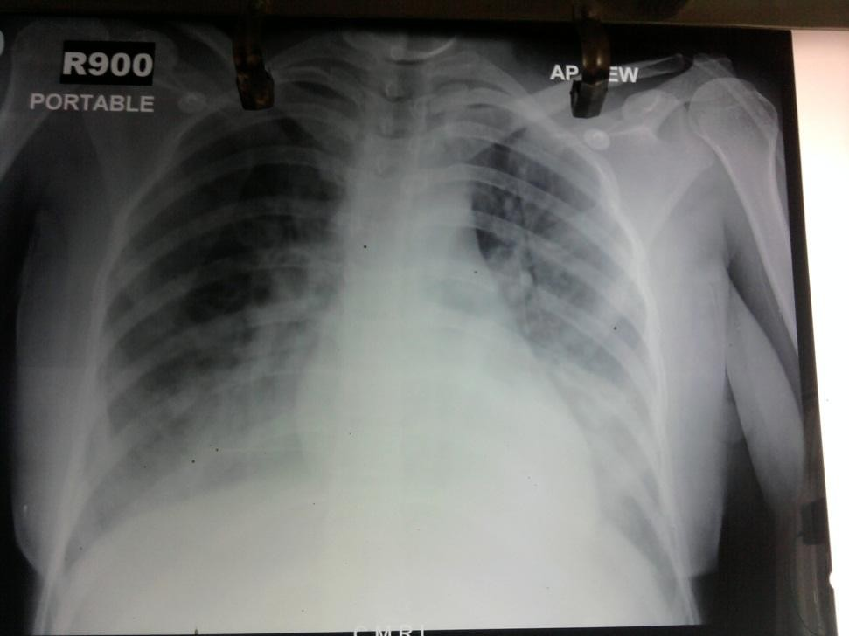
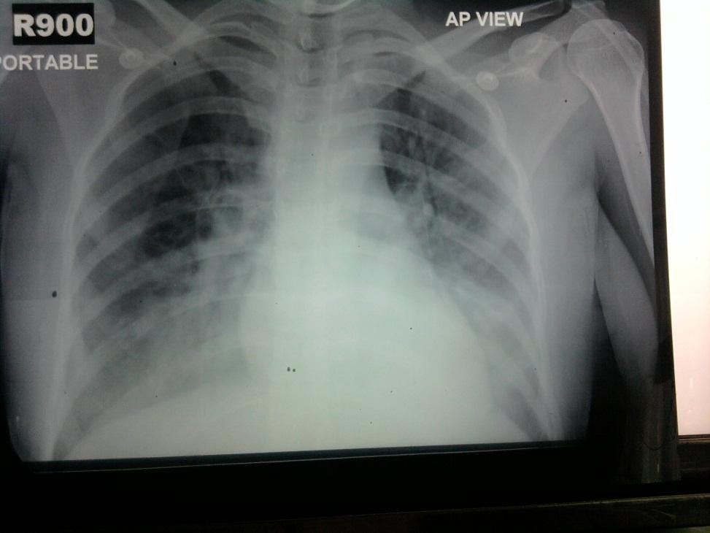

Slide 43
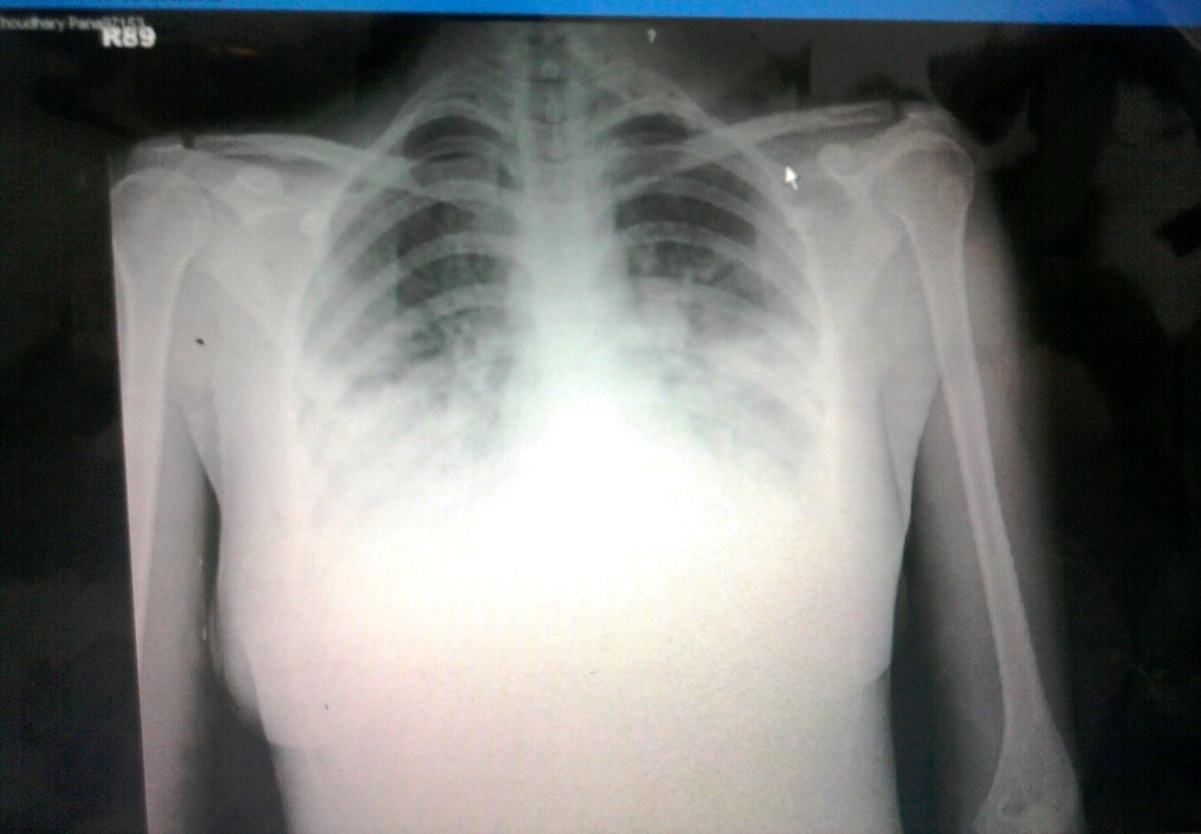

Slide 44
A recent patient
A 69 years old gentleman (on Telmisartan 40 mg and Amlodipin 5 mg) from Bowbazar area was feeling unwell.
No definite history of fever.
He became restless and was taken to ER of a private hospital.
Found to be hypoxic and admitted in ICU
Put on nasal oxygen, IV fluids and antibiotics

Slide 45
COVID 19 and Influenza panel came negative.
Hb- 7.6, TLC- 8120 with 68% Poly, 30% Lympho. Platelet- 80000
Procalcitonin- 0.23
RBS- 117 mg%
Urea 96, creatinine-2.2
Bilirubin – C 2.8, U- 0.9, SGOT/PT- 88/46
Dengue NS1 Ag –negative
Urine, blood and sputum cultures- no growth
P. vivax trophozoites seen in peripheral blood.
P.v LDH -+ve, P.f. HRP2- neg

Slide 46
Initially treated with Chloroquine

Slide 47
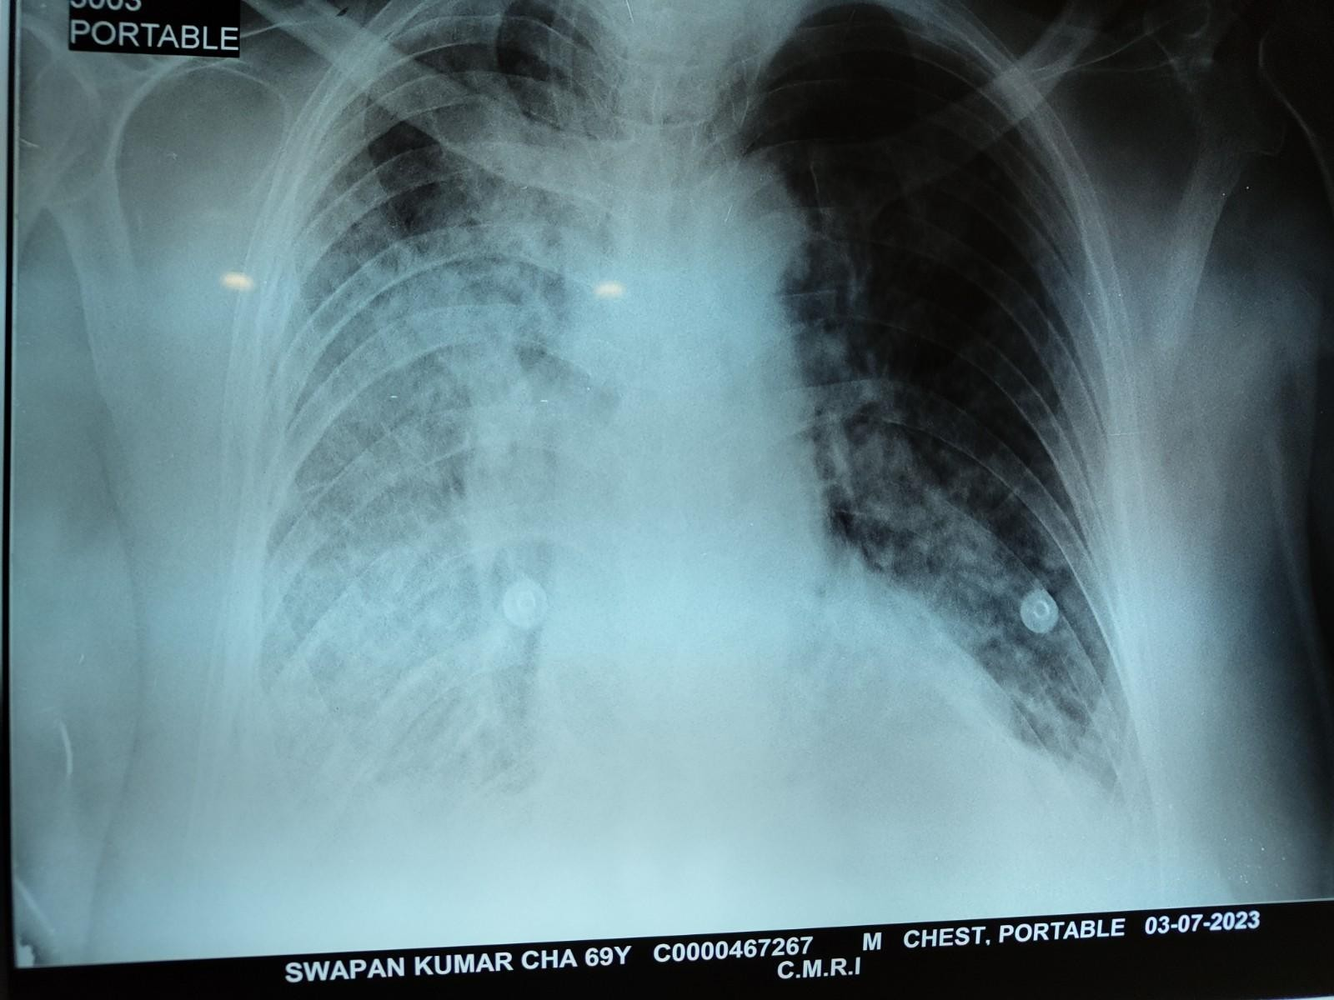
Progressive hypoxia, needed NRBM and pressor support

Slide 48
As the patient became hypotensive and Oxygen requirement increased changed to IV Artesunate

Slide 49
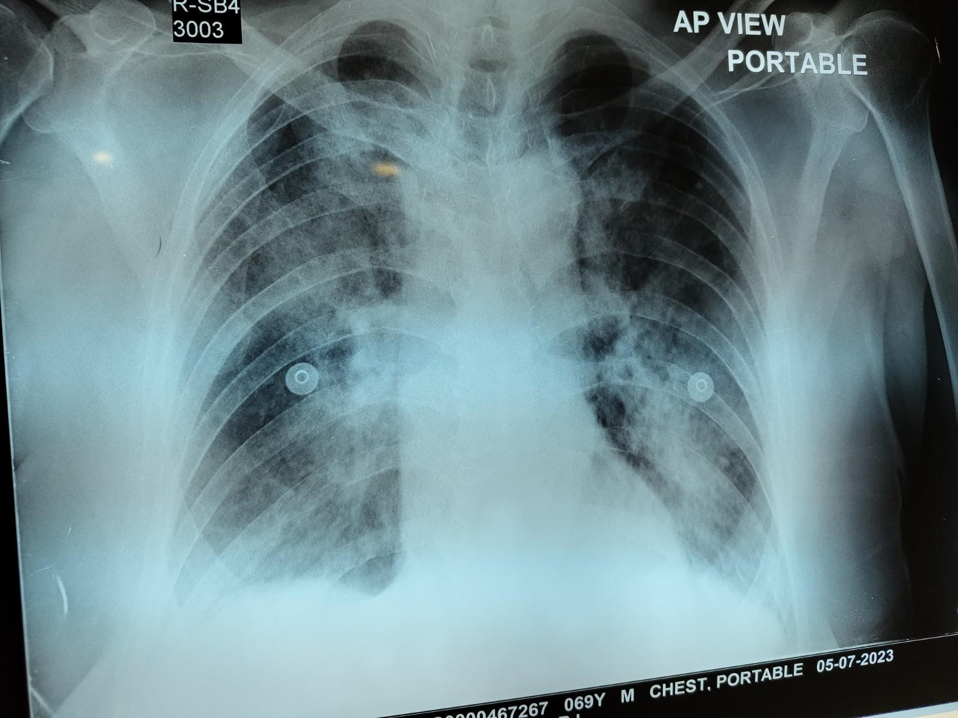

Slide 50
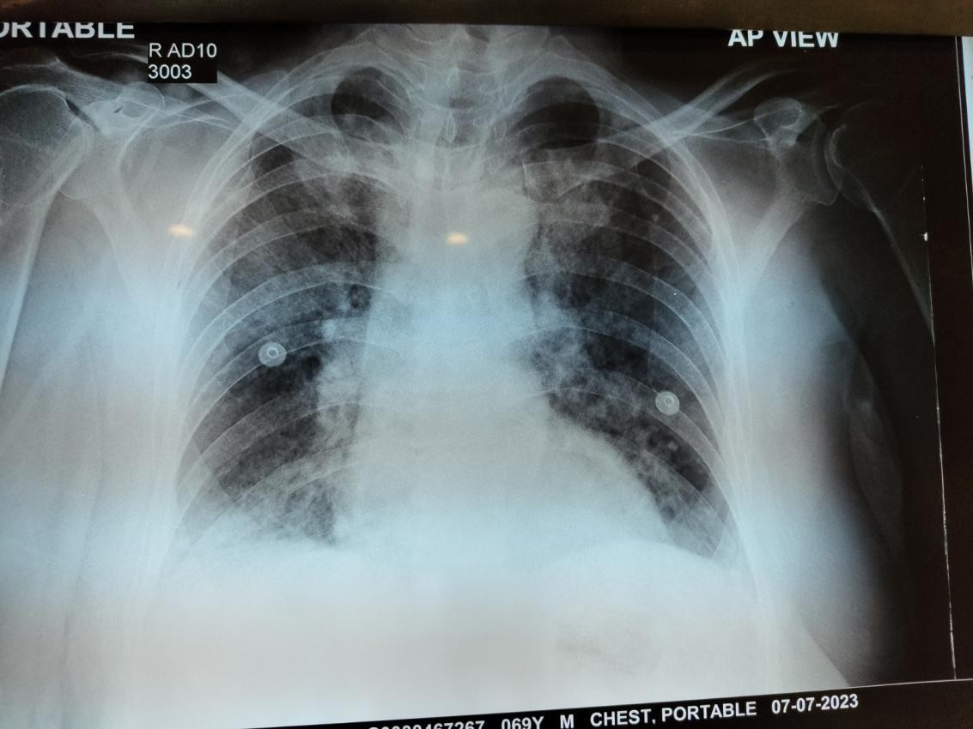
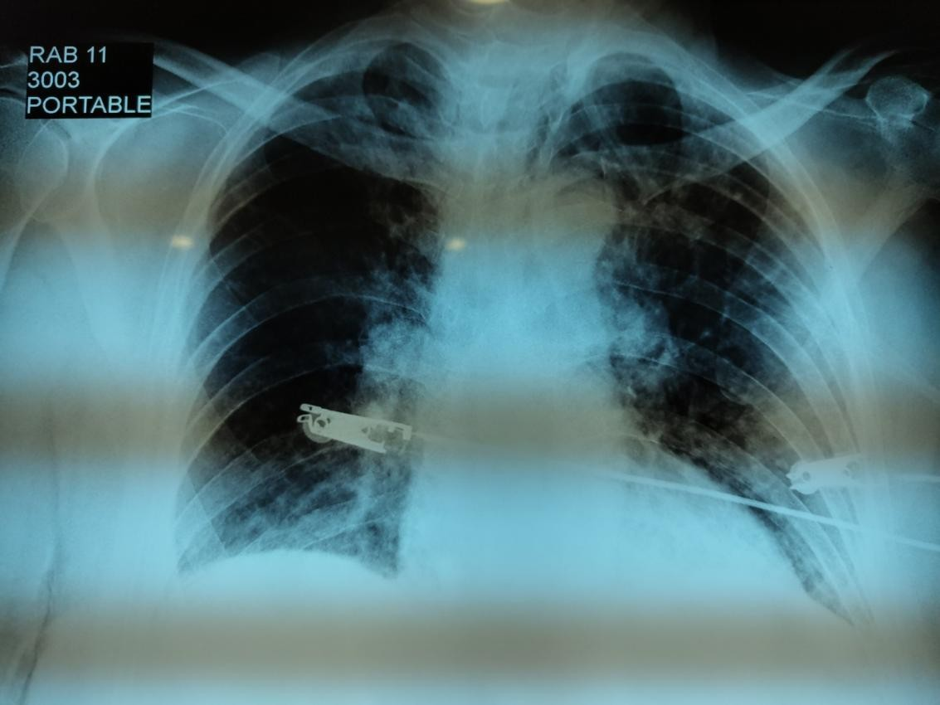
Serial X Rays

Slide 51
Gradually improved
Pressor support and Oxygen gradually withdrawn
Parasite clearance achieved
Followed up with a course of Artemether plus Lumefantrine
Primaquine added

Slide 52
To conclude
Examination of thick and thin blood films is more sensitive than rapid diagnostic tests for diagnosis of malaria
Uncomplicated P. vivax malaria to be treated with CQ + PQ
Uncomplicated P. falciparum malaria is to be treated with ACT
Complicated malaria is to be treated with Inj. Artesunate followed by a course of ACT
Malaria in pregnancy is to be treated similarly , PQ to be avoided

