Slide 1
NAFLD
(Non-alcoholic Fatty liver diseases)
National Programme for Prevention and Control of Non Communicable Diseases

Slide 2
Background
Definition: Non alcoholic fatty liver disease (NAFLD) is the build-up of extra fat in liver cell that is not caused by alcohol. NAFLD may further lead to liver inflammation, liver fibrosis and cirrhosis, and liver cancer
NAFLD can be further classified into two sub-categories:
  Non alcoholic fatty liver (NAFL): fat in your liver but little or no inflammation or liver cell damage
  Non alcoholic steatohepatitis (NASH): inflammation of the liver and liver cell damage in addition to fat in liver
Liver plays a core role in metabolism and evidence suggests that NAFLD has a multi- dimensional association with sub-components of metabolic syndrome (obesity, Type II Diabetes Mellitus dyslipidaemia, insulin resistance and hypertension)
It has been suggested that if NAFLD can be prevented, other NCDs may also be reduced. In view of the NAFLD was included in the NP-NCD programme

Slide 3
Liver Is at the Core
Fatty Liver ‘Core’
Risk of Diabetes and vascular complications.
Risk of future Stroke, HT Heart Disease, atherosclerosis (Hoorn Study)
Chronic Kidney Disease Polycystic Ovarian Disease
Fatty Liver Disease, Gall Stones
and Cancers

Slide 4
Current Scenario of NAFLD
NAFLD is estimated to afflict approximately 1 billion individuals worldwide (may affect 20-30% of the general population all over the world)
Globally, about 2 to 5 % of adults and up to 20 % of obese may develop NASH
In India: NAFLD is emerging as an important cause of liver disease, 9% to 32% of the general population in India with a higher prevalence in those with overweight or obesity and those with diabetes or prediabetes (2/3rd)
There is high prevalence of insulin resistance and nearly half of Indian patients with NAFLD have evidence of full-blown metabolic syndrome
One of the earlier population‐based studies from India that showed a prevalence rate of 8.7% of NAFLD in predominantly non-obese populations from rural West Bengal

Slide 5
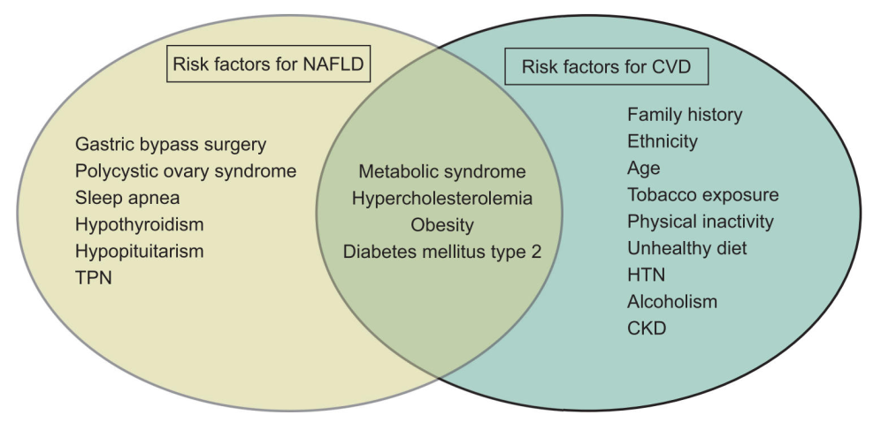
Risk factors of NAFLD

Slide 6
Objectives to prevent and control NAFLD
NAFLD and NP-NCD share same objective of:
Population based and opportunistic screening at all heath care levels
Prevention and control of chronic NCDs
Capacity building for prevention
Early diagnosis, treatment, rehabilitation,
Information Education and Communication / Behavioural Change Communication
Support diagnosis and cost-effective treatment at all level
Operational Research

Slide 7
Community Level activity
Community level: Through Community Based Assessment Checklist (CBAC) form, ASHA will obtain the following details for NAFLD:
Abdominal obesity (waist circumference of >90 cm in men or > 80 cm in women)
Family history of diabetes, hypertension, coronary heart disease, liver diseases, gallstones, and cancers
Health and Wellness Centre Level: MPW / CHO will validate all individuals referred by ASHA by assessing the presence of the following risk factors of NAFLD:
Abdominal obesity (waist circumference of > 90 cm in men or> 80 cm in women)
Personal & Family H/O diabetes, hypertension, heart diseases, and cancers
Obesity (Classification based on BMI>=23kg/m2).
Screening of diabetes, hypertension, and cancers.
Presence of Pedal Oedema
Tele consultation with a medical officer or physical referral to a nearby centre followed by medicine dispense according to a prescription and follow-up

Slide 8
Promotion of healthy life styles
Practice routine, supervised, and monitored physical exercise or yoga sessions, especially targeting individuals aged 30 and above with obesity and type-2 diabetes
  Walking club, walking challenge with prize, fitness events
Involvement of SHG, PRI, ASHAs, and Mahila Arogya Samity (MAS) for implementation
Utilization of dedicated spaces like local clubs and community halls for physical activities, ensuring at least one hour of exercise/practice of Yoga twice a week
Activities include community cooking workshops, localized nutrition education, mobile health apps, and reduction of High in Fat Salt and Sugar (HFSS) food consumption
Engagement of local chefs, community leaders, health workers, and nutritionists and Food Safety Officers for education and capacity building
Anti-tobacco and anti-substance use counselling
Output of all the above activities can be me measured by half-yearly updating of CBAC risk factors scoring

Slide 9
PHC/CHC Level activities
Those suspected with NAFLD:
- Perform LFT and CBC; input data into the app and calculate FIB-4 or NFS score and do risk stratification for advanced liver fibrosis and manage the patient accordingly
- Calculate FIB 4 or NFS score on the application
Low risk for advanced liver fibrosis:
- Refer back to PHC for management of Diabetes, Dyslipidemia, Hypertension, weight reduction
- The patient has to be reassessed after 3 years
High Risk for advanced liver fibrosis:
- Refer patients to the District Hospital or Tertiary care Centre for further management
Indeterminate Risk for advanced liver fibrosis:
- Refer patients to the District Hospital for further evaluation

Slide 10
District Level activities
For a patient with indeterminate risk for advanced liver fibrosis, the doctor will perform a Fibroscan
Low risk for advanced liver fibrosis:
- Refer patients back to PHC for management of Diabetes, Dyslipidemia, Hypertension, weight reduction
- Patient to be reassessed after 3 years
High Risk for advanced liver fibrosis:
- Management of advanced fibrosis
- Screening and treatment of Portal hypertension
- Screening for HCC (Hepato-cellular carcinoma)
- Referral to Tertiary care center for complicated cases or if facilities are not available

Slide 11
Non-invasive tools for fibrosis in NAFLD
 | Components | Cutoff | Sensitivity | Specificity | NPV
NAFLD FIBROSIS SCORE, NFS | Age, BMI, type 2 diabetes, AST, ALT, PLT, albumin | –1·455, 0·676 | 0·80 | 0·66 | 0·98
Fibrosis-4 | AST, ALT, age, PLT | 1·30, 2·67 | 0·84 | 0·74 | 0·98
ELF | Hyaluronic acid, PIIINP, TIMP-1 | 10·3 | 0·80 | 0·90 | 0·99
Fibro Test | α-2-macroglobulin, haptoglobin, apo-A1, bilirubin, GGT, γ-globulin | 0·3, 0·7 | 0·88 | 0·73 | 0·99
FibroScan | Imaging modality | 8·7–9·8 KPa | 0·82 | 0·82 | 0·99
ARFI | Imaging modality | 1·2–1·3 m/s | 0·81 | 0·78 | 0·99
Notes:
AST (SGOT), ALT (SGPT)
Advanced fibrosis categorised as stage 3 in the non-alcoholic steatohepatitis Clinical Research Network classification.
The negative predictive value (NPV) is based on a prevalence of advanced fibrosis of 5%. The diagnostic accuracy data
are derived from Crossan and colleagues.37 NFS=NAFLD Fibrosis Score. BMI=body-mass index. AST=aspartate
aminotransferase. ALT=alanine aminotransferase. PLT=platelet count. ELF=Enhanced Liver Fibrosis test.
PIIINP=amino-terminal propeptide of type III collagen. TIMP-1=metalloproteinase inhibitor 1.
apo-A1=apolipoprotein A1. GGT=glutathione hydrolase 5 proenzyme. ARFI=acoustic radiation force impulse.

Slide 12
NFS – NAFLD Fibrosis score
The NAFLD fibrosis score is used to distinguish between patients with non-alcoholic fatty liver disease who have (F3-F4) and do not have (F0-F2) advanced fibrosis.
The regression formula for prediction of severity of fibrosis is based on 6 variables: age (years), BMI (kg/m2), IFG/diabetes, AST (SGOT)/ALT (SGPT) ratio, platelet count and albumin (g/dl).
2 cut off points were selected to identify the presence (> 0.676) and absence (< -1.455) of significant fibrosis
  Low probability : < -1.455: predictor of absence of significant fibrosis (F0-F2 fibrosis), negative predictive value 93%
  Intermediate probability : Between -1.455 and 0.675: indeterminate score
  High probability : >0.675: predictor of presence of significant fibrosis (F3-F4 fibrosis), positive predictive value of 90%

Slide 13
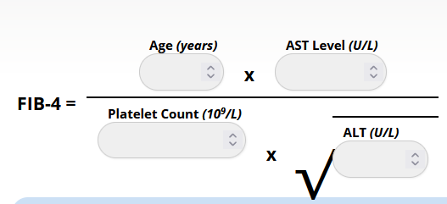
Fibrosis – 4 (FIB-4) score
Interpretation:
  FIB-4 score <1.45 had a negative predictive value of 90% for advanced fibrosis (Ishak fibrosis score 4-6 which includes early bridging fibrosis to cirrhosis)
  FIB-4 >3.25 would have a 97% specificity and a positive predictive value of 65% for advanced fibrosis

Slide 14
Diagnosis & treatment of NAFLD
Obese and others having risk factors may be screened for liver enzymes & evidence of fat accumulation
Serum biomarkers, FIB-4 and NFS:
  Most accurate with high negative predictive values (>90%) for ruling out advanced fibrosis
  Can be used as first-line tools in a primary health care setting
Transient elastography (Fibroscan):
  Non-invasive method for intermediate/high risk persons in FIB-4 / NFS
  normal range is between 2 and 6 kPa and a value of 8 and above is suggestive of significant hepatic fibrosis
  is a specialized ultrasound machine for liver. It measures fibrosis (scarring) and steatosis (fatty change) in liver
Management:
  No specific treatment
  Lifestyle changes, dietary alterations to reduce weight and, possibly, bariatric surgery
  Control diabetes and treat elevated cholesterol levels and hypertension when appropriate

Slide 15
Monitoring and Supervision
The routine monitoring mechanism which is being adopted for NPCDCS will now include the indicators for NAFLD.
Monitoring of the activities of the PBS including the components included for NAFLD through the portal of the CPHC NCD application
The review meetings held regularly with the Districts either through meetings (Online/Offline) or visits by the Officials will also include those parameters or indicators related to NAFLD.

Slide 16
What will People Benefit
As Non-communicable diseases (NCDs) have emerged as one of the most important public health threats in the developing countries, and realising its threat GoI has taken steps to include NAFLD in the public health agenda
The integration of NAFLD into NP-NCD is being undertaken from centre to periphery level through PHC, CHC, district level and state level. NAFLD component of NP-NCD will be prioritized through media plan, sensitization workshops etc .
Healthy behaviours will be promoted to modify lifestyle behaviour change for prevention and control of NAFLD.
“Eat right Campaign” and “Fit India Campaign” which promotes “right eating , right exercising are likely to be utilised for promoting healthy Liver
If implemented, people will benefit towards a healthy life in the long run.

Slide 17


