Slide 1
MANAGING LABOUR
SAFE AND CLEAN CHILD BIRTH

Slide 2
Labour: Initial Management
Rapid evaluation or Rapid Initial Assessment (RIA
Complete history- estimate POG
(both obstetric and medical/ surgical) and examination of records to note important information including medical disorders, obstetric complications and high risk factors.
General and systemic examination – G.C., consciousness, pallor, oedema, cyanosis, jaundice, neck veins, pulse, BP, temperature, respiration, examination of CVS and respiratory system.

Slide 3
Abdominal Examination
  Fundal height, foetal size, liquor volume (corroborate gestational age )
  Lie, presentation, position
  Engagement, head station.
  FHS

Slide 4
P/V Examination during Labour
Cervical dilatation (cm) and effacement
  Membrane / liquor
  Presentation, position, station
  Pelvis and foeto-pelvic relation
  Caput, moulding

Slide 5
P/V Examination during Labour (Cont..)
  Initial assessment
  Then 4 hourly if in active phase (or very near it) at initial assessment and after 6 hours if not in active labour ( if indicated)
  Every hour in 2nd stage.
  When membrane ruptures; and from symptoms and abdominal findings patient appears to be in 2nd stage.
  Any special indication, e.g. foetal distress - to decide intervention

Slide 6
On Completing History and Examination
            Ascertain gestational age
            Identify presentation, engagement, position, foetal life
            Identify medical and obstetric abnormality or complication if any

Slide 7
Diagnosis of Labour

Slide 8
Anticipate labour
If the woman in third trimester of pregnancy has
  Painful intermittent uterine contraction with increasing frequency and intensity
  Show
  Watery vaginal discharge / sudden gush of water

Slide 9
Confirm onset of labour
If there is
  Regular, painful uterine contractions of > 20 secs duration and at least once every 10 mins.
  Progressive cervical dilatation and effacement or
  Cervical dilatation of >/= 4 cms

Slide 10
Stages and Phases of Labour
First Stage:
  Active phase: Cervix ≥ 4 cm : 4-6 hours
  Dilatation rate ≥ 1 cm/ hour
Second Stage: Cervix : 10 cms/fully dilated

Slide 11
Stages and Phases of Labour (Cont..)
If cervix is not dilated at initial examination and pain persists: reexamine after 6 hours.
  If there is effacement and dilatation – diagnose labour.
  If still no cervical change – diagnose false / pre-labour.
If pain subsides – observe for 24 hours.

Slide 12
Labour: General Care

Slide 13
General Care
Ensure good communication, counseling and support by staff
Ensure dignity and privacy
Honour woman’s rights
Ensure mobility in first stage
Allow posture of her choice as far as possible
Encourage breathing techniques
Allow to drink liquids in early labour : ensure nutrition & hydration

Slide 14
General Care
Maintain cleanliness/sterility
  Vulva/perineum
  Hands/gloves
  Birthing area
  Cord tie
  Instruments/consumables

Slide 15
General Care
Encourage to empty bladder
Catheterization only on indication
No routine enema
No need for shaving
Help / provide verbal support for the anxious / fearful and those in pains
Use non pharmacological pain relief as far as possible and use analgesics as needed

Slide 16
Labour : Obstetric Care and Management

Slide 17
Obstetric Care
Careful monitoring of
    Progress of labour
    Foetal wellbeing
    Maternal wellbeing
Early identification of
abnormality/complication
Timely intervention.

Slide 18
Monitoring Progress of labour
Latent phase – Cervical dilatation and
– Effacement
Active phase – Cervical dilatation
– Foetal descent
Second stage – Foetal descent
Increasing frequency and duration of uterine contraction also indicates progress of labour.
Latent phase – Infrequent, short
Active phase – At least 3 in 10 mins, >= 40 secs
Second stage – every 1-2 mins, > 40 secs

Slide 19
Monitoring Foetal wellbeing
Foetal heart rate and regularity
– Count for one minute just after contraction
– Note FHS half hourly in active phase
Colour and amount of liquor
Degree of moulding indirectly provides idea of foetal wellbeing

Slide 20
Monitoring Maternal Wellbeing
Pulse
Temperature
B.P.
General condition and state of hydration
Urine output
Protein and Ketone in urine

Slide 21
Care during Latent Phase
Note
      Pulse : 2 hourly
      Respiration, temperature and B.P.: 4 hourly
      Uterine contraction: 1-2 hourly
      F.H.S.: hourly
      Descent: by abdominal palpation.
      Cervical dilatation and effacement, station of head and character of liquor (if membranes ruptured) at each P/V examination (6 hours after initial assessment)
      Protein and acetone in urine when passed
      DO NOT INDUCE LABOUR UNNECESSARILY

Slide 22
Care during Active Phase
Start plotting on partograph all events of labour once the woman is in active phase. The WHO partograph is modified by excluding the latent phase and beginning plotting at 4 cm cervical dilatation in active phase to make it simpler and easier to use.
Simplified Partograph – Partograph case study and hands-on .

Slide 23
Labour care guideline

Slide 24
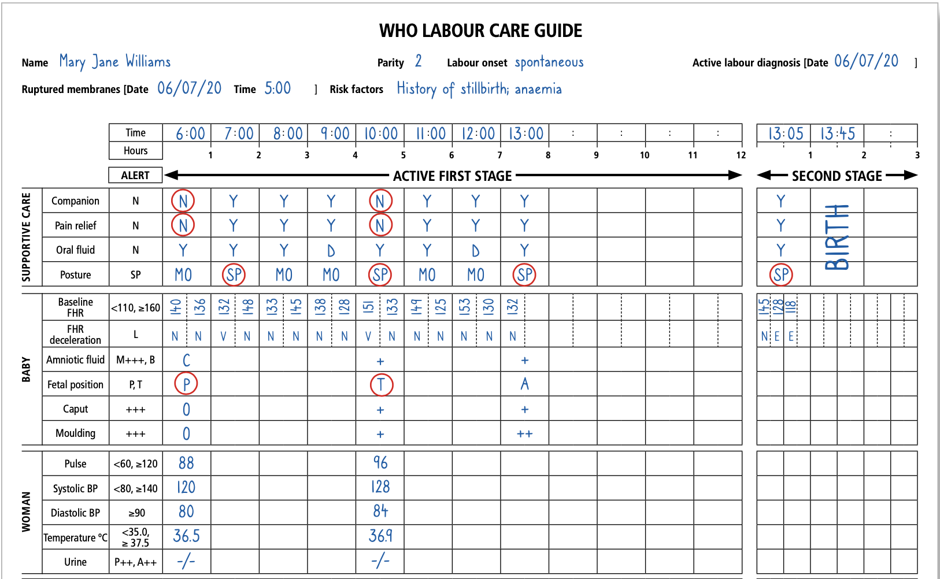
Labour care guideline

Slide 25
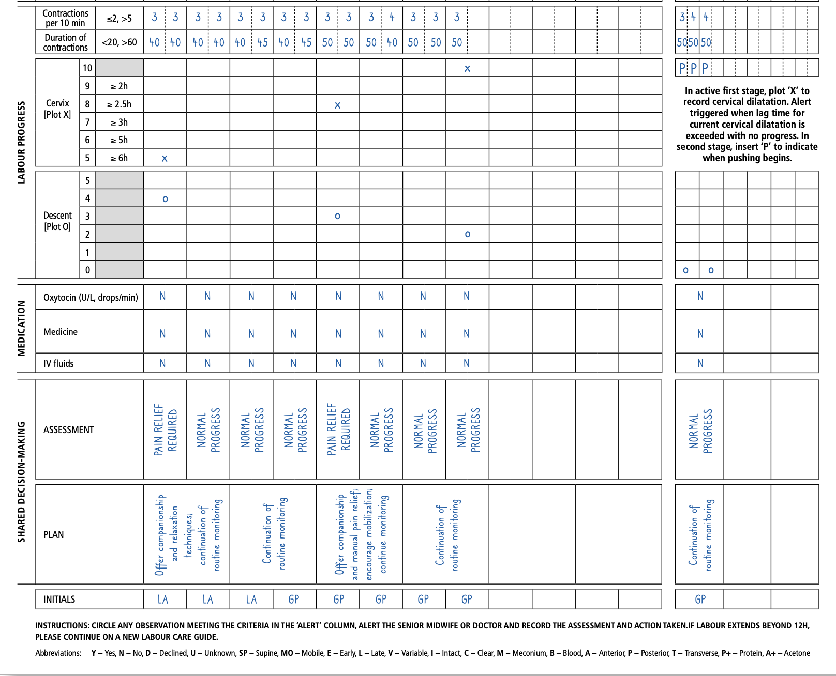
Labour care guideline

Slide 26
Management of second stage of labour
Diagnosis of Second Stage:
Urge to defaecate.
Urge to bear down.
Membranes spontaneously rupture.
Cervix is no longer palpable i.e. fully dilated.

Slide 27
Conduct of Delivery
Shift the patient to the delivery table, if such transfer is needed, when second stage is diagnosed
Monitor FHR every 5-10 minutes.
Put her on the position of her choice – preferably in dorsal or semi-recumbent position.
Maintain cleanliness.
Wash perineal area with an antiseptic solution and use sterile/clean drapes.

Slide 28
SBA training AV on conduction of normal labour
Click

Slide 29
Active Management of third stage of labour

Slide 30
Active Management of third stage of labour (AMTSL)
Inj. Oxytocin 10 units IM after delivery of foetus (within 1 min)(after excluding 2nd foetus).
Deliver placenta by controlled cord traction while raising the uterus gently upward by abdominal hand.
Massage the uterus (after delivery of placenta) to keep it contracted

Slide 31
AMTSL (Cont..)
Inspect the placenta & membranes for completeness
Inspect vagina and perineum for any tears
Repair tears / episiotomy if any

Slide 32
AMTSL (Cont..)
Look for placental separation after delivery of baby
Place the left hand on lower abdomen to detect the contraction of uterus. (After delivery, uterus is at or just below the level of umbilicus.)

Slide 33
  Signs of placental seperation
Uterus becomes contracted, hard and globular
Uterus rises just above umbilicus
Extra vulval lengthening of umbilical cord
A gush of blood may appears
On pushing the uterus up in the abdomen, the cord does not recede back

Slide 34
Oxytocics for third stage management
OXYTOCIN | ERGOMETRINE/ METHYL ERGOMETRINE | PROSTAGLANDIN 15-Methyl PGF2α | MISOPROSTOL
Cheap No contra-indication Safe – no side effects Effective – quick action Less heat labile 10 units IM | Cheapest Important contra- Indications Side effects – sometimes serious Effective Heat labile 0.2 mg IM/IV | Costly Some contra-indications Some side effects Effective Highly heat labile 125-250 mcg IM | Cheap No significant contraindication No significant side-effect Effective Highly heat stable 600 mcg orally

Slide 35
Oxytocics (Cont..)
Oxytocin - first choice (but never give IV bolus)
Misoprostol - has its place
Prostaglandin – effective but costly
Ergometrine/Methyl ergometrine – has contraindications & side effects
Use other oxytocic if oxytocin is not available.
Exclude contraindications if using methyl ergometrine & remain cautious about its side effects
Exclude second foetus before giving oxytocic

Slide 36
Immediate Postpartum Care
Closely monitor for first 6 hours.
  Pulse, respiration, temperature, BP, GC
  Vaginal bleeding.
  Uterine hardness.
@ Every 15 mins. for 2 hours.
@ Every 30 mins. for 2 hours.
@ Every hour for 2 hours.

Slide 37
Immediate Postpartum Care
Massage the uterus every 15 mins. to maintain contraction.
If stable (and there is no contraindication) give her something to drink when she feels thirsty and something to eat when she is hungry.
Keep the baby in skin contact with mother.
Initiate exclusive breast feeding within 1 hour.

Slide 38
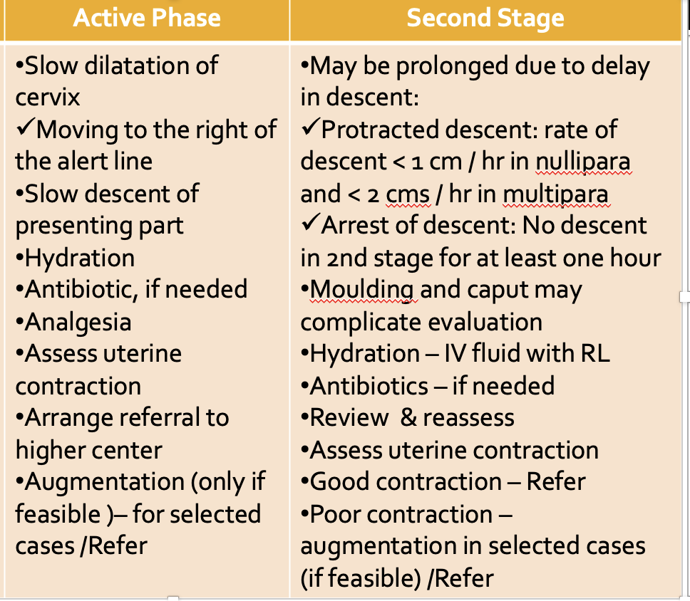
Prolonged Labour
COUNSEL & KEEP THE PATIENT’S RELATIVES INFORMED ABOUT PROGRESS & CONDITION

Slide 39
Thank You

