Slide 1
Infection Prevention & Control

Slide 2
What is infection prevention and control?
Infection prevention and control is:
a scientific approach with
practical solutions designed to prevent harm, caused by infections, to patients and health care workers
grounded in principles of infectious disease, epidemiology, social science and health system strengthening, and
rooted in patient safety and health service quality
Source: WHO Infection Prevention and control web pages;; https://www.who.int/gpsc/ipc/en/
Notes:
Infection prevention and control (IPC) is a scientific approach and practical solution designed to prevent harm caused by infection to patients and health workers. It is grounded in infectious diseases, epidemiology, social science and health system strengthening. IPC occupies a unique position in the field of patient safety and quality universal health coverage since it is relevant to health workers and patients at every single health-care encounter.

Slide 3







Who is at risk of infection?
Everyone
Notes:
Who is at risk of infection?
( Give participants about 10-15 seconds then click and the word everyone will appear)

Slide 4
Benefits of IPC
Protecting yourself
Protecting your family, community & environment
Protecting your patients
WHO2015 Safe & Quality Health Services Package
Notes:
Source: WHO2015 Liberia Safe & Quality Health Services Package
Proper adherence to standard infection prevention and control practices can help to protect you, as the health care worker, your patients and ultimately, your family and community,

Slide 5
Standard precautions
The basic level of IPC precautions, to be used for ALL patients at ALL times regardless of suspected or confirmed status of the patient
Risk assessment is critical for all activities, i.e. assess each health care activity and determine the personal protective equipment (PPE) that is needed for adequate protection
Notes:
Standard precautions are the cornerstone for prevention in all health care settings. They are a set of precautions aiming to protect both HCW and patients from infectious agents. Standard precautions are recommended for care of all patients regardless of their suspected or confirmed diagnosis in any health care setting.
Transmission-based precautions are additional precautions used for patients that are suspected or confirmed to be infected or colonized with certain pathogens for which the mode of transmission is known. They are used in addition to Standard Precautions.
Transmission-based Precautions include:
Contact
Droplet
Airborne
The type of precaution assigned to a patient will depend on the mode of transmission of the suspected or confirmed pathogen. This will be discussed n a later module.
Risk assessment is a concept that every health care worker should be able to do; identifying sources of infection or actions that can lead to infections both for themselves or their patients. It relies on an understanding of “why” IPC is implemented, and not just memorization of “what.”.
All r health care workers should constantly assess risk related to their activities.

Slide 6
Elements of Standard Precautions
  Hand hygiene
  Respiratory hygiene (etiquette)
  PPE according to the risk
  Safe injection practices, sharps management and injury prevention
  Safe handling, cleaning and disinfection of patient care equipment
  Environmental cleaning
  Safe handling and cleaning of soiled linen
  Waste management
Notes:
There are several core elements to Standard precautions. These include
1. Clean your hands
2. Practice respiratory hygiene-cougher your coughs and sneezes
3. Wear protective equipment-according to your risk assessment
4.Handle sharps carefully, use aseptic technique to deliver injections
5.Properly clean and disinfect/sterilize patient care equipment
6. Maintain a clean and disinfected environment
7. Safe handling and cleaning of soiled linen
8. Properly dispose of waste
We will go through all of these in more detail later.

Slide 7
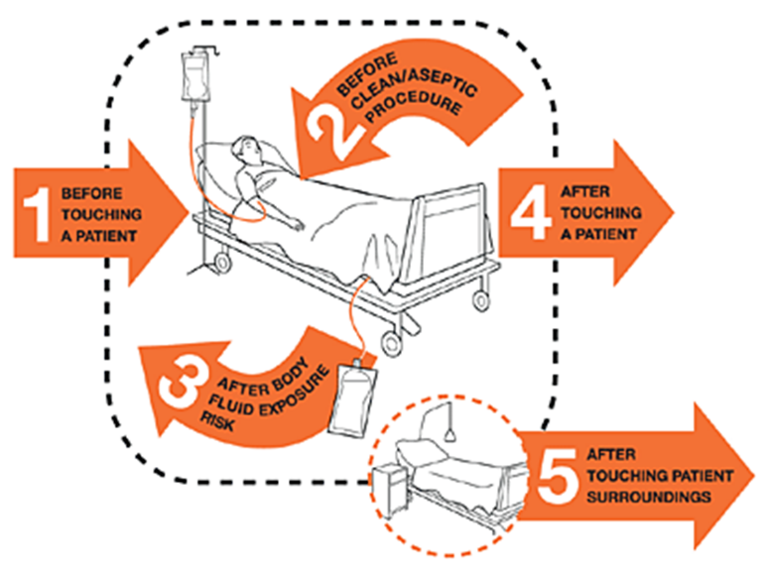
5 moments of Hand Hygiene

Slide 9
Decontamination & Sterilization of Equipment
(Video)-Click

Slide 12
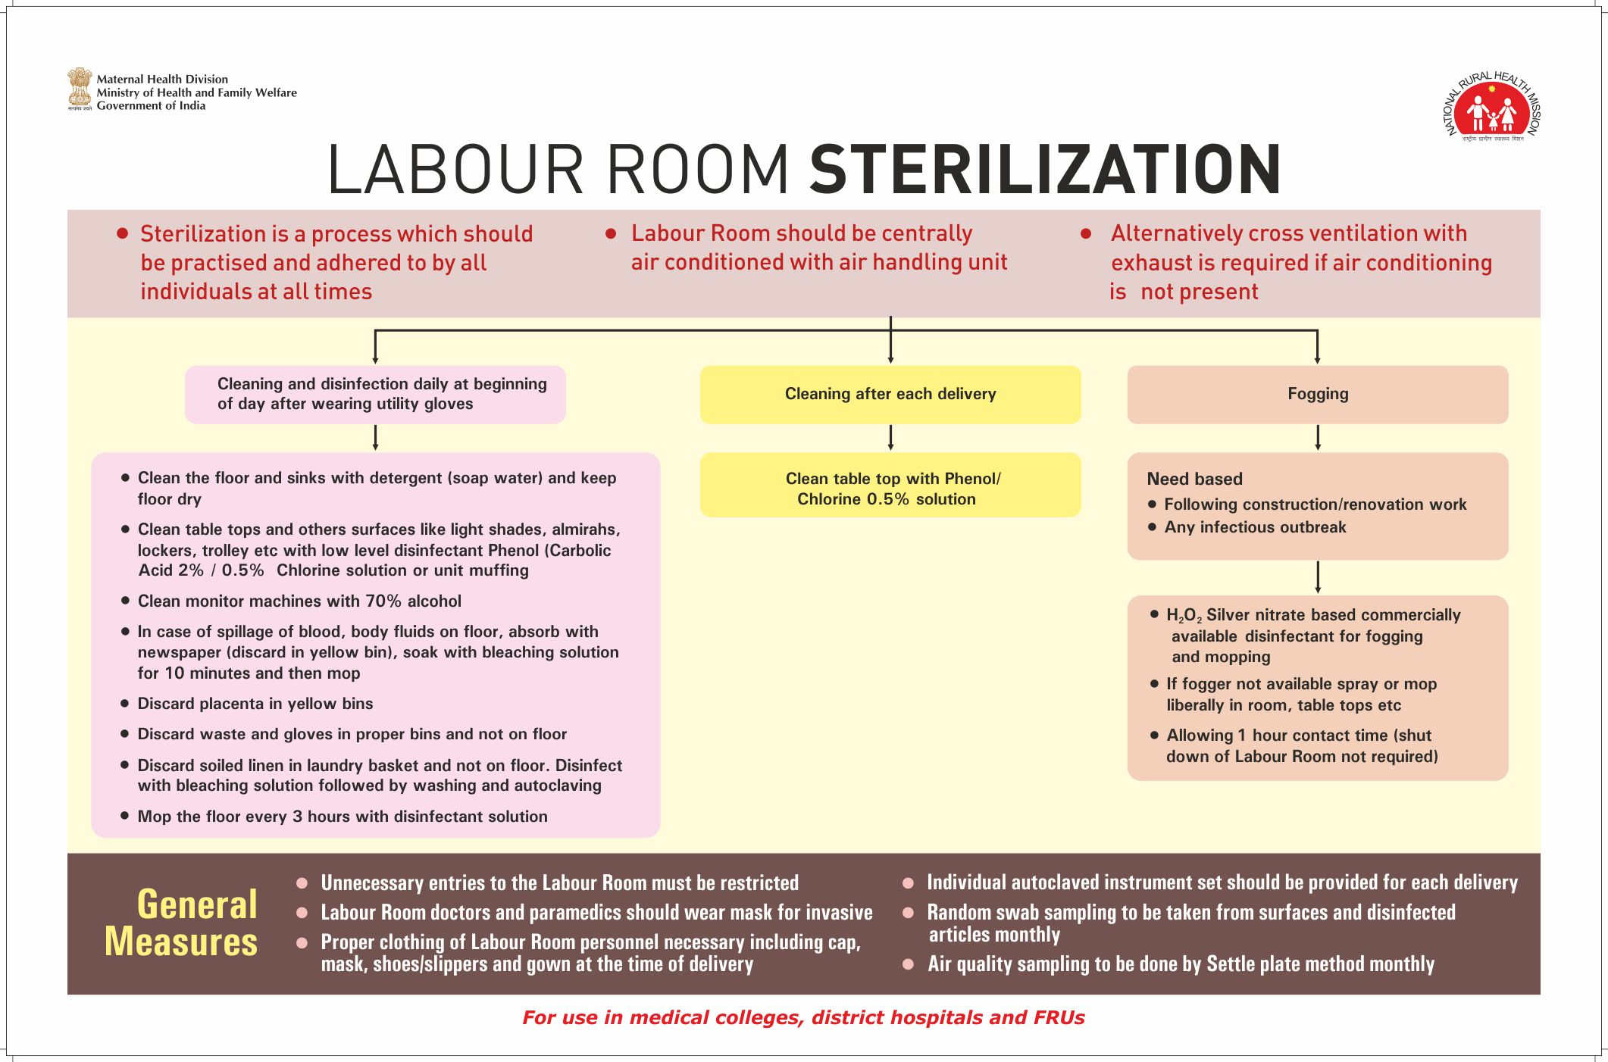

Slide 13
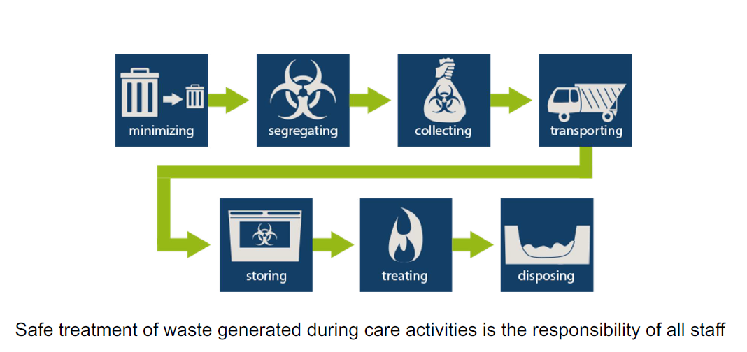
Biomedical Waste Management

Slide 15
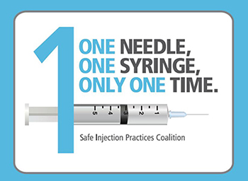
The seven steps to safe injections
1 Clean work space
2 Hand hygiene
3 Sterile safety-engineered syringe
4 Sterile vial of medication and diluent
5 Skin cleaning and antisepsis
6 Appropriate collection of sharps
7 Appropriate waste management
https://www.who.int/infection-prevention/tools/injections/training-education/en/
Notes:
There are 7 steps to giving a safe injection. It is important that anyone giving injections follow these steps, to protect your patient and yourself

Slide 16
Minimize direct unprotected exposure to blood and body fluids
EYE-WEAR | MEDICAL MASK | GOWN | GLOVES | HAND HYGIENE | SCENARIO
Always before and after patient contact, and after contaminated environment | X
If direct contact with blood and body fluids, secretions, excretions, mucous membranes, non-intact skin | X | X
If there is risk of splashes onto the health care worker’s body | X | X | X
If there is a risk of splashes onto the body and face | X | X | X | X | X

Slide 17


Respiratory hygiene/etiquette
Reduces the spread of microorganisms (germs) that cause respiratory infections (colds, flu).
Turn head away from others when coughing/sneezing
Cover the nose and mouth with a tissue.
If tissues are used, discard immediately into the trash
Cough/sneeze into your sleeve if no tissue is available
Clean your hands with soap and water or alcohol based products
Do not spit here and there
Encourage handwashing for patients with respiratory symptoms
Provide masks for patients with respiratory symptoms
Patients with fever + cough or sneezing should be kept at least 1m away from other patients
Image source: https://www.who.int/emergencies/diseases/novel-coronavirus-2019/advice-for-public
Notes:
Some basic measures we can all do ourselves and encourage our patients and family or community members to do are:
Turn your head away from others when coughing/sneezing
Cover your nose/mouth with a tissue-and then immediately dispose of it n the garbage/trash
If there is no tissue available, cough into your sleeve –not your hands!
Always clean your hands with soap and water or alcohol hand sanitizer after coughing, sneezing or blowing your nose.

Slide 18
Cleaning –Linen, Utensils
Linen:
  Wear appropriate PPE for handling and washing linen
  Never carry soiled linen against body; place soiled linen in a leak-proof bag or bucket
  Perform hand hygiene after blood/body fluid exposure and after PPE removal
  Linen contaminated with blood or body fluids to be decontaminated with Sodium Hypochlorite solution and then send to laundry
  Soiled linen should be placed in clearly labelled, leak-proof bags or containers, carefully removing any solid excrement and putting in covered bucket to dispose of in the toilet or latrine
Dishes and eating utensils used by a patient with known or suspected infection
  No special precautions other than standard precautions
  Wear gloves when handling patient trays, dishes and utensils

Slide 19
Environmental Sanitation
Video on sanitation & hygiene

Slide 20
Thank You

