Slide 1
ANAEMIA

Slide 2
Anaemia
◙ Woman is pale, weak, tired, easily fatigued,
◙ Has swelling of body, dizziness
◙ Breathless on exertion or even at rest

Slide 3
Definition
Decrease in concentration of red cells/ haemoglobin (< 11 gm %)
  No Anaemia – Hb % : 11 gm % and above
  Moderate – Hb % : 7 to 10.9 gm %
  Severe – Hb % : < 7 gm %

Slide 4
Initial management
Rapid assessment of vitals
Look for evidence of heart failure
Immediately start treatment of heart failure if present or imminent

Slide 5
Diagnosis
Moderate anaemia
  Fatigue, malaise, tiredness, weakness, dizziness, loss of appetite, mild palpitation / breathlessness on exertion (sometimes)
  Pallor (moderate), glossitis, oedema, puffiness of face
Severe anaemia
  Marked pallor, marked oedema and puffiness of face
  Breathlessness on even mild exertion/even at rest
  If there is C.C.F.: enlarged tender lever, dyspnoea, rales in lung bases

Slide 6
Management: Anaemia
During pregnancy
IFA (Iron Folic Acid) tablets 2 tabs daily
Nutritious diet rich in iron, protein, vitamins
Additional vitamin and protein supplement. Anti helminthic therapy after 1st trimester (mebendazole 100 mg BID for 3 days or albendazole 400 mg single dose) especially in moderate and severe anaemia.
Treat malaria, infection (e.g. UTI) or diarrhoea.

Slide 7
Management: Anaemia during Pregnancy
Treat moderate anaemia in pregnancy up to 2nd trimester.
Refer to higher center if no response in 3 to 4 weeks.
Refer moderate anaemia in 3rd trimester and severe anaemia any time in pregnancy.
Look for and treat CCF or impending CCF in case of severe anaemia before referring.

Slide 8
Management: Anaemia during Labour
Refer severe (Any) and moderate anaemia (3rd) unless delivery is imminent.
Conduct delivery
  In moderate/severe anaemia where delivery is imminent
Refer severe anaemia, even after delivery, for blood transfusion.

Slide 9
Management: Anaemia during Labour
Conduct delivery carefully with continuous monitoring.
Provide analgesia
Closely monitor for cardiac failure
Prop up / semi recumbent position with slight lateral tilt.
Oxygen
Prophylactic forceps/Vacuum extraction if needed
Active management of third stage of labour with oxytocin. Avoid Ergometrine
Repair incision/lacerations promptly & carefully
Closely monitor during & after delivery
Prevent CCF and infection
Treat aggressively if CCF develops or is impending
IFA tablets for 6 months.

Slide 10
INTRAVENOUS IRON
Indications:
  Intolerance to Oral Iron
  Poor Compliance to Oral Iron
  Lack of Response to Oral Iron
  GI Disorders – Malabsorption
  Severe IDA presenting late in pregnancy
  Postpartum Anaemia

Slide 11
Availability
Ampoules: 2.5 ml (50 mg) and 5 ml (100 mg)
Formula to calculate dose:
  Total Dose in mg =
  Body Wt. x (Target Hb – Actual Hb) x 2.4
Followed by 10 mg/kg body weight to replenish stores

Slide 12
Administration
Dilute with 100 ml of 0.9% NaCl
To be infused over 30 minutes
Max. Dose: 200 mg of elemental iron can be given in one dose
Can be given 1 – 3 times per week
A total of 1 gm can be given in 4 – 10 sittings

Slide 13
Contraindications and S/E
Iron overload
Non IDA
Known Hypersensitivity
Hypotension
Headache
Nausea Vomiting
Dizziness Joint pains etc.

Slide 14
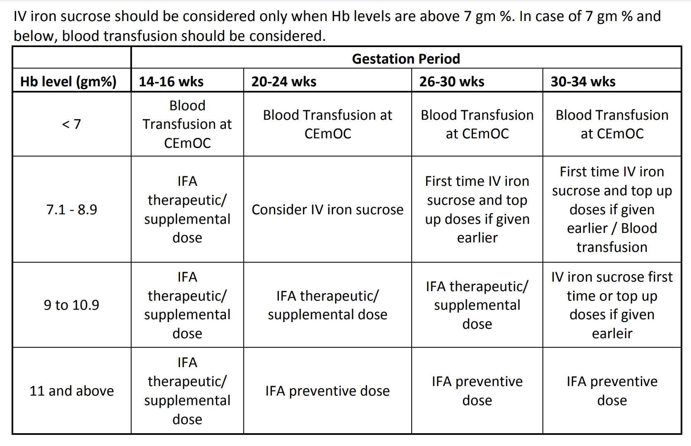
Patient Selection

Slide 15
Treatment of Heart Failure
Prop up / semi recumbent position on her left side
Oxygen (6-8 litre/min)
Inj. Frusemide 40 mg IV; repeat if necessary
Limit IV fluid infusion.
Arrange packed / sedimented red cell transfusion in case of failure due to severe anaemia (in CEmOC)
If heart failure is due to heart disease, also give
  Inj. Morphine 10 mg IM
  Inj. Digoxin 0.5 mg IM

Slide 16
Respiratory Distress during Pregnancy, Childbirth & Puerperium
◙ Difficulty in breathing during
pregnancy/labour or after delivery

Slide 17
Initial management
RIA
Prop up position on left side
Establish an IV line
Oxygen 4-6 L/min
Examine to identify the cause and manage accordingly

Slide 18
CASE 1
Features:
Dyspnoea
Severe pallor
Oedema, cough, rales, enlarged liver
Prominent neck veins
Lethargy, fatigue
Concave/flat nails
Diagnosis: Severe anaemia with heart failure

Slide 19
Management: Severe Anaemia with Heart Failure
Oxygen
Prop up position
Frusemide 40 mg IV, repeat if needed
Refer to higher centre with oxygen and donors for blood transfusion

Slide 20
CASE 2
Features:
Dyspnoea
Evidence of organic heart disease
Irregular heart beat/murmur
Cough, rales
Cyanosis
Oedema
Enlarged liver
Prominent neck veins
Diagnosis: Heart failure due to heart disease

Slide 21
Management: Heart failure due to heart disease
Frusemide 40 mg IV, repeat if needed
Digoxin 0.5 mg IM
Morphine 10 mg IM
Prop up position
Oxygen
Refer to higher centre

Slide 22
CASE 3
Features:
Dyspnoea, fever, cough with expectoration, chest pain
Rapid breathing, rhonchi / rales, consolidation
Diagnosis: Pneumonia

Slide 23
Management : Pneumonia
Oxygen
Prop up position
Bronchodilator (salbutamol/deriphylline)/ nebulization if needed
Erythromycin 500 mg QID/amoxicillin 500 mg TID by mouth
Steam inhalation
Refer to higher centre unless quick improvement

Slide 24
CASE 4
Features:
Dyspnoea, wheezing, cough, rhonchi
Positive history
Diagnosis: Bronchial asthma

Slide 25
Management : Bronchial asthma
Oxygen
Prop up position
Nebulization or
Bronchodilators (salbutamol 4 mg orally 4 hourly/deriphylline 1 amp. IM 8 hourly)
Treat infection if present
Refer to higher centre if no improvement/in severe case

Slide 26
Thank You

