Slide 1
Management of Dengue & other VBD Cases
Operational aspects
TOT for MOs, Superintendents and Programme Officers, 2025
PH&CD Branch, Dept. of H&FW, Govt. of WB

Slide 2
Direction for the trainer using the ppt
It may be so that the trainees are already aware of the basic points of Operational Aspect due to discussion in previous training or meeting.
If time is short, you may discuss only the points in blue font, without repeating all the old points.
The discussion on Operational Aspects would be more lively and effective, if real life examples are given from institutions that have implemented the recommended points.

Slide 3
Operational issues…….1
All dengue cases and suspected dengue cases: Arrange PCV (also called Haematocrit) and Platelet Count reports at least twice a day – in morning and evening with a minm. 8 hours interval. - Where necessary, test for extra time by utilizing CCU/SNCU lab or 24-hour lab service (if available).
C.B.C. test for the fever cases in O.P.D. – as suggested in the Fever Approach Algorithm. Utilize cell counter if available.
Dengue Test Report and PCV & Platelet Report must reach the I.P.D.
early after test is done. - Arrange fast tracking of dengue patient samples (urgent). - Reports of morning/evening samples should be available during morning/evening rounds. Improvise as necessary.

Slide 4
Operational issues…….2
A stock taking is very important now for:
  ELISA machines (both reader & washer) for dengue testing
  Dengue test kits (both NS-1 & IgM)
  Cell counter(s).
Stock taking to be done by the Superintendent/BMOH and Dy. CMOH-II & CMOH and issues need to be resolved early (positively within June).
Cell counters may have such problems:
  No stock of reagents
  No supply of calibration fluid
  Machine problem
  Status unknown since not in use for long.

Slide 5
Operational issues…….3
Top Sheet to be maintained in I.P.D. for every dengue case and suspected dengue case. To be signed by MO, Staff Nurse and Sister IC.
Urine output to be recorded (not eye estimation) in each shift and finally totaled for 24 hours. - Use graduated urinal; if not available, use improvised means to measure e.g. mineral water bottle.
Utilize Top Sheet to
  monitor the cases
  identify cases at risk
  identify cases requiring urgent intervention.
  Nursing Personnel should be trained and mentored to interpret Top Sheets. They should know: (a) which cases or reports to be specially flagged to the Doctor; (b) in which situations the Doctor on call to be alerted.

Slide 6
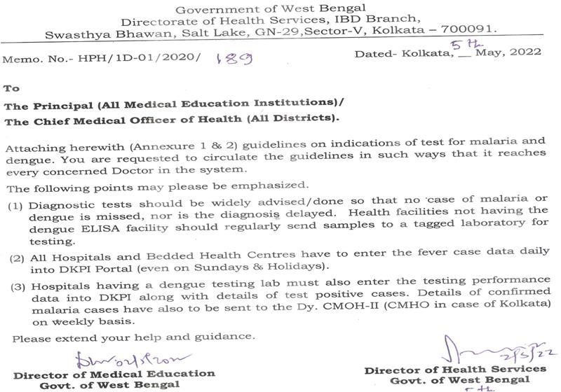
Guideline issued by DHS & DME reg. indication of tests for Dengue & Malaria
The essence is: advise tests widely, not restrictively, to detect/rule out malaria or dengue.

Slide 7
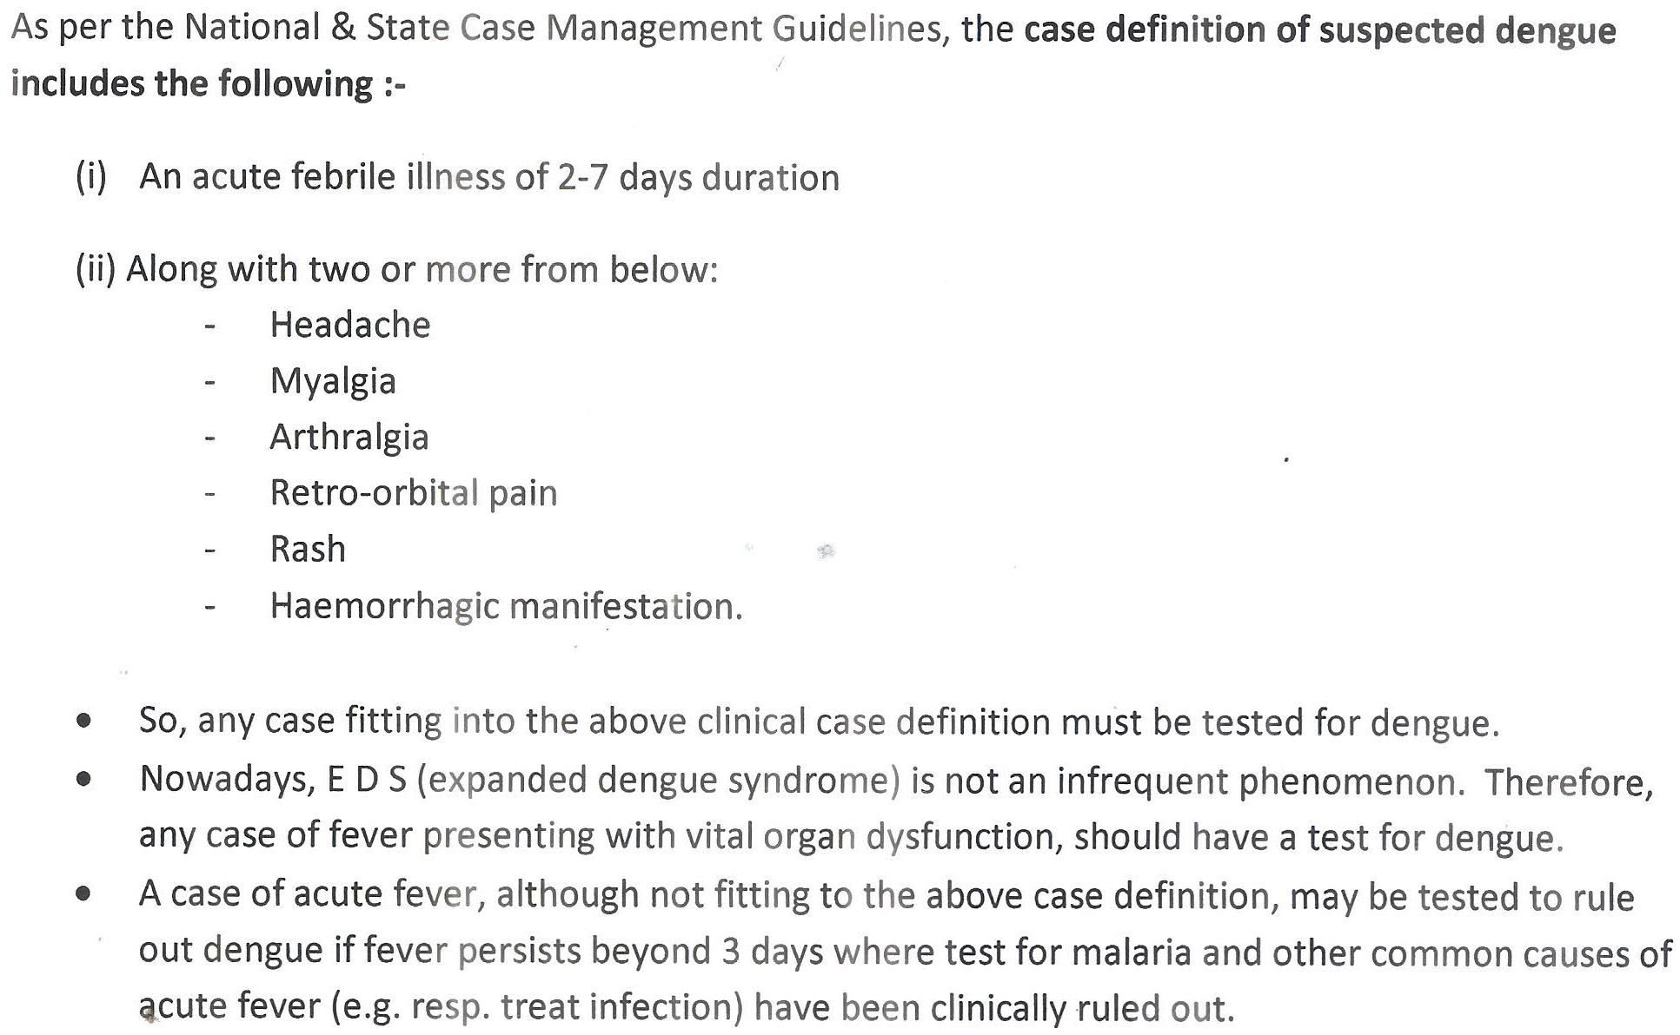
Indications of test for Dengue
2

Slide 8
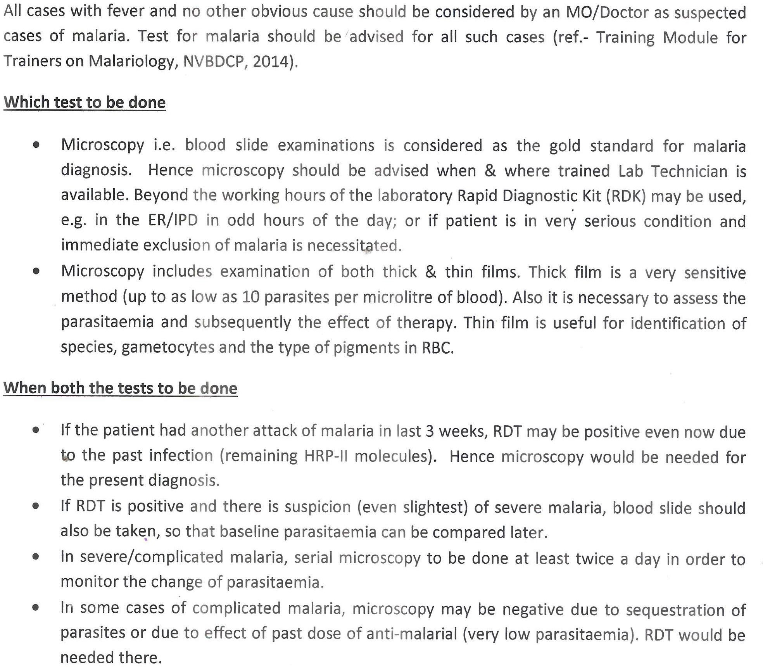
Indications of test for Malaria

Slide 9
Operational issues…….4
Fever Clinics to be opened when fever cases reporting at the OPD starts to rise, or when directed by higher authority.
Hospitals not having dengue testing facility will send daily samples (serum) to identified labs by messenger. - An Excel line list of samples to be sent to the lab in e-mail. - Lab will perform tests and report back within 24 hrs to the sample referring hospital. - Results to be entered in line list and sent back in e-mail.
Lab to upload details of positive cases in the State portal.
Fund support for sample carrier and for lab data entry.
  Case Management fund (NVBDCP) or Operational Costs fund (IDSP) to be utilized.

Slide 10
Operational issues…….5
Get the tests done as indicated.
Co-infection or comorbidities may be there. Vital organ involvement/EDS is also not uncommon. - Utilize existing services & resources to do the necessary investigations.
Superintendents must take care to keep testing equipment functional with logistics available.
Care to be taken to make the reports available fast.
Arrangement for lab tests required on Sundays & holidays during the high transmission season.
Institution level sensitization sessions must be done in batches for all concerned (not only Doctors & Nurses).

Slide 11
Operational issues…….6
District & Inst. Level Training must be in an effective mode. - Develop the capacity of Doctors & Nurses for triaging and interpretation of monitoring parameters.
Give charges to Dy/Asst. Superintendents and NS/DNS-s for different aspects or different wards/units for fever/dengue care system.
If death occurs in a dengue patient, inform the BMOH/Superintendent immediately >> Dy. CMOH-II >> SPO / OSD-VBD (phone: 83730 87377/ 98301 14103).
- Mail the scanned treatment records at an early date to: idsp.wb@gmail.com and entomologist.ibd@gmail.com.
Discuss the points in these slides with all concerned Doctors &
Staff of your district/institution.

Slide 12
Operational issues…….7A
Further points to be discussed with Superintendents, BMOHs, MO-s, SR-s and Jr. Doctors
Follow the points mentioned in DHS letter no. HHM/1H-Singly/146 dated 08 July 2025: - Maintain a system for detailed hand-over between the MO-s taking care of beds, at the time of change of shifts. Also, the bed nos. of the critical or very sick cases are to be recorded in a Handover Book kept in the Ward. - In certain patients, only morning & evening visits by the BIC are not enough. When a bolus of IV fluid is given or one dose of some special drug is administered, follow up may be necessary after 1 or 2 hours or so, to decide repeat dosing (e.g. ASV etc.) or to fine-tune the further management (e.g. dengue shock, post-CS with sepsis etc.). - The necessary arrangement must be put in place by the Superintendent for such repeated follow-ups.

Slide 13
Operational issues…….7B
Superintendent should utilize the MOs & Nurses trained at state/district level to bring improved practices into being.
Not only Splst. Physicians or Paediatricians, but Specialists of other disciplines and GDMO-s, who perform ER/ general on-call duty must be sensitized on triaging and basic management of dengue.
Superintendent must take a daily morning brief of the severe or complicated cases currently admitted; he/she should visit such cases and track their overall management. - Please be aware of the criteria of severe dengue and make others aware.
Doctors please follow the state guidelines on empirical therapy and diagnostics of suspected Scrub Typhus.
Please take special care not to miss Severe Form of Malaria.
End

