Slide 1

Screening & Management of Cervical Cancer

Slide 2
Burden of Cervical Cancer
Second most common cancer among women in India –incidence of around 15/1,00,000¹
Annually, around 97,000 women are diagnosed with cervical cancer of which around 60,000 die¹
Incidence is higher in India as compared to developed countries.
Peak age at diagnosis is 55-59 years.
A considerable proportion of women report in late stages of disease.
1: Bray F, Ferlay J, Soerjomataram I, Siegel RL, Torre LA, Jemal A. Global cancer statistics 2018: GLOBOCAN estimates of incidence and mortality worldwide for 36 cancers in 185 countries. CA Cancer J Clin. 2018;68(6):394–424.

Slide 3
Risk Factors for Cervical Cancer
Human papillomavirus (HPV) infection
Smoking
Young age at first sexual activity
Multiple sexual partners
Unprotected sex or poor sexual hygiene
Early marriage
Early childbirth- in women younger than 17
Frequent child birth
Weakened immune system such as HIV/AIDS

Slide 4
Common Signs & Symptoms of Cervical Cancer
In early stages, there may be no signs & symptoms.
By the time symptoms appear, disease may have already spread.
Common symptoms are:
Vaginal bleeding between periods Postmenopausal bleeding Bleeding after sexual intercourse Foul smelling vaginal discharge Unusual vaginal discharge tinged with blood | In advanced disease: Backache Lower abdominal pain Fatigue/extreme tiredness Unexplained weight loss Pain in legs Involuntary passage of urine and stool

Slide 5
Natural History of Cervical Cancer
Normal
Normal
Infection
Clearance > 90%
Infection
Infection
HPV Infection
HPV Infection
HPV Infection
Progression 10%
Progression 10%
Regression 70%
Progression 10%
Regression 70%
Regression 70%
Pre-cancer (LSIL)
Pre-cancer (LSIL)
Pre-cancer (LSIL)
Progression 30%
Progression 30%
Regression 30%
Progression 30%
Regression 30%
Regression 30%
Pre-cancer (HSIL)
Pre-cancer (HSIL)
Pre-cancer (HSIL)
HPV: Human Papilloma Virus
LSIL: Low grade Squamous Intraepithelial Lesion
HSIL: High grade Intraepithelial Lesion
Invasion
Invasion
Cervical Cancer

Slide 6
Why Screening for Cervical Cancer
Cervical cancer is suitable for screening because it fulfills the following criteria:
Sufficient burden of disease to pose a serious public health problem
Identifiable and treatable long precancerous phase
Simple, non-invasive tests
Effective treatments are available
normal
cervix
High risk HPV
infection
Persistent
infection
Low grade
CIN
High grade
CIN
Invasive
cancer
VIA detection range
Pap Smear detection range
HPV Test detection range

Slide 7
Cervical Cancer Screening

Slide 8
Cervical Cancer Screening - VIA
Visual inspection of the uterine cervix, after application of 3 - 5% acetic acid (VIA).
VIA can be performed by any trained paramedic & not necessarily only by a doctor.
The results of VlA are immediately available (categorized as per colour changes on cervix) and do not require any laboratory or specialist support.
Inclusion criteria: Any woman aged 30 years and above and not meeting any of the exclusion criteria should be screened at all screening centres.
Exclusion criteria:
  Menstruation
  Pregnancy
  Within 12 weeks of delivery / abortion
  Previous history of treatment for Cancer Cervix

Slide 9
Mechanism of action of VIA
Mechanism of action:
3 -5% acetic acid causes reversible coagulation of the proteins within the cells.
After application of acetic acid, normal squamous epithelium (of vagina) appears pink, columnar epithelium of uterus appears red (reflection of light from the underlying stroma, which is rich in blood vessels).
In conditions like inflammation, benign and malignant growth, the epithelium contains a lot of cellular proteins as a result of increased nuclear activity, thereby giving a dramatic dense white patch (VIA positive).
If there is a white patch, its density, margin and the relationship to the SCJ (squamo-columnar junction) should be noted.

Slide 10
Procedure for VIA
Procedure should be explained to the woman and consent should be taken.
The woman should lie down on her back with legs folded (lithotomy position not required)
Insert the speculum gently and expose the cervix. Note any abnormal discharge, bleeding or growth in the cervix
Apply adequate amount of acetic acid to the cervix using the cotton swabs & wait for 1 minute.
Identify the Squamo-Columnar Junction(SCJ) as the line joining the pink smooth squamous epithelium with the red velvet like columnar epithelium. Look for aceto-white patches
All the aceto-white patches are not considered positive
If there are no aceto-white patches in the ecto-cervix, then the test is negative
If there is a aceto-white patch, its density, margin and the relationship to the SCJ should be noted

Slide 11
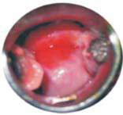
Interpretation of VIA
VIA showing Aceto-whitening
Normal Cervix

Slide 12
Categorization of VIA Results
S. No. | VIA Category | Description
1 | Negative | No aceto-white lesions Transparent lesions or faint patchy lesions without definite margins Nabothian cysts becoming aceto-white Faint line like aceto-whitening at the junction of columnar and squamous epithelium
2 | Positive | Aceto-white lesions far away from the transformation zone Distinct, opaque aceto-white area Margin should be well defined, may or may not be raised Abnormality close to the squamo-columnar junction in the transformation zone and not far away from the os.
3 | Invasive Cancer | Obvious growth or ulcer in the cervix. Aceto-white area may not be visible because of bleeding.

Slide 13
Diagnosis of Pre-cancerous & cancerous lesions

Slide 14
Diagnosis of Precancerous and Cancerous Lesions of Uterine Cervix
Further testing required if screening test is positive; or in case of clinical suspicion.
Colposcopy:
  Colposcope is used to examine the vagina and blood vessels after application of dilute acetic acid to highlight abnormal areas for biopsy
  High sensitivity of 85% and specificity of 70% for the detection of pre-cancer/cancer
  Swede score is a useful model for scoring colposcopy findings:
Criteria | 0 | 1 | 2
Aceto uptake | Zero or transparent | Thin, milky | Distinct stearin-like
Margin & surface | Zero or diffuse | Sharp but irregular, jagged, geographical, satellites | Sharp & even, difference in surface levels including ‘cuffing’
Vessels | Fine, regular | Absent | Coarse or atypical vessels
Lesion size | <5mm | 5-15 mm or spanning 2 quadrants | >15 mm or spanning 3-4 quadrants or endocervically undefined
Iodine staining | Brown | Faintly or patchy yellow | Distinct Yellow
A total score of <5: biopsy not required; 5-7 biopsy for diagnosis; 7: see & treat

Slide 15
Diagnosis of Precancerous and Cancerous Lesions of Uterine Cervix
Biopsy:
  Biopsy under colposcopic guidance if abnormal cells on Pap test/abnormal areas on VIA
  A sample of tissue is cut from the cervix using punch biopsy forceps
  The pathologist will report on the degree of premalignant changes/cervical intraepithelial neoplasm (CIN 1,2 or 3)
  If cancer is diagnosed, the histopathologic type and grade of the cancer is reported
  Punch biopsy removes only a small amount of tissue and can be done at OPD, Cervical cone biopsy involves removal of a larger cone-shaped sample of cervical tissue & higher centre is required.

Slide 16
Diagnosis of Precancerous and Cancerous Lesions of Uterine Cervix
Endocervical Curettage:
  Curette is used to gently scrape cells & tissue from the endocervical canal.
  Done during colposcopy.
  Required if the lesion is suspected to be present in endocervix & is not visible on colposcopic exam.
If biopsy indicates the Invasive Cervical Cancer, additional tests may be required:
  CT Scan
  MRI
  PET/PET-CT Scan
  Cystoscopy
  Proctoscopy/Sigmoidoscopy

Slide 17
Management of Pre-cancerous lesions

Slide 18
Management of women positive on screening: Screen & Treat
All VIA positive women will be evaluated by Gynecologist/Lady Medical Officer at the nearest health care facility:
‘Screen & Treat’ Approach: for CIN
Treating the lesion in the same sitting when VIA is done
Use of VIA with cryotherapy/thermo-coagulation
Treatment based on screening test and not on a histologically confirmed diagnosis of CIN
Advantages:
  Reduces loss to follow-up & time lag
  High treatment rates
Drawback:
  Lack of diagnostic step – Over-treatment & high false positive
  No tissue sample available for histopathological examination at a later time

Slide 19
Management of women positive on screening: Screen & Treat
Screen-positive women eligible for cryotherapy/thermo-coagulation if:
  Entire lesion is visible on ectocervix.
  Lesion is not extending to the endocervical canal or to vagina.
  Lesion is occupying less than 75% of the ectocervix.
  There should be no evidence or suspicion of cancer or glandular abnormality.

Slide 20
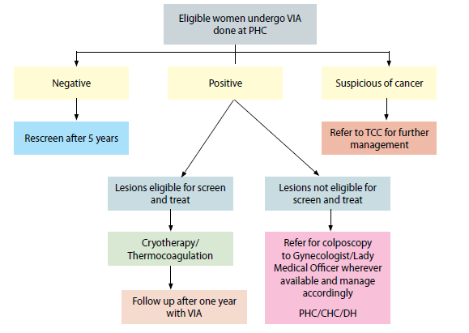
Management of women positive on screening: Screen & Treat

Slide 21
Management of women positive on screening: See & Treat
It may even by carried out in a single visit following VIA screening as results are immediately available facilitating immediate colposcopy and treatment with LEEP/Cryotherapy
Different from Single Visit ‘Screen & Treat’ approach wherein triaging procedures such as colposcopy & biopsy are not done The overtreatment rate should be periodically audited and an overtreatment rate of less than 10% should be set as a standard requirement which is consistent with the recommendation of the Cochrane.
The “see and treat” LEEP might be appropriate in order to minimize the possibility of occult invasive lesion going unrecognized
Information regarding the chance of overtreatment and the benefit of immediate LEEP should be discussed during patient’s counseling.
The most common complication following LEEP is perioperative hemorrhage.
Notes:
The incidence of hemorrhage complication following treatment of CIN should be less than 5% and the admission rate owing to treatment complication should be less than 2%.

Slide 22
Treatment of Cervical pre-cancerous lesions by Ablative methods
Treatment involves treatment of the entire transformation zone (TZ) and not limited to the abnormal area on cervix only.
A treatment depth of at least 6-7 mm should be achieved
The treatment methods:
  Ablative methods that involves destruction of the entire TZ
  Excision methods where the entire TZ is removed
The ablative methods of treatment are:
  Cryotherapy
  Thermo-coagulation (Thermal ablation)
  Electrocoagulation
  Laser vaporization
Notes:
The incidence of hemorrhage complication following treatment of CIN should be less than 5% and the admission rate owing to treatment complication should be less than 2%.

Slide 23
Lesions eligible for treatment by Ablative methods
Entire lesion should be visible on ectocervix.
Lesion should not extend to the endocervical canal or to vagina.
Lesion should occupy less than 75% of the ectocervix.
There should be no evidence or suspicion of cancer or glandular abnormality.
Woman should be non pregnant, should not have no evidence of pelvic inflammatory disease at time of treatment and should not be menstruating at time of treatment.
Notes:
The incidence of hemorrhage complication following treatment of CIN should be less than 5% and the admission rate owing to treatment complication should be less than 2%.

Slide 24
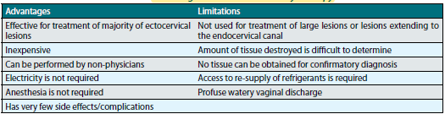
Advantages & Limitations of Ablative methods
Cryotherapy:
Notes:
The incidence of hemorrhage complication following treatment of CIN should be less than 5% and the admission rate owing to treatment complication should be less than 2%.

Slide 25
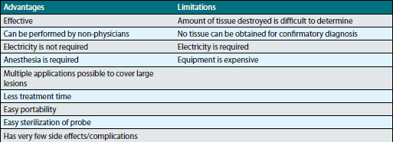
Advantages & Limitations of Ablative methods
Thermo-coagulation:
Notes:
The incidence of hemorrhage complication following treatment of CIN should be less than 5% and the admission rate owing to treatment complication should be less than 2%.

Slide 26
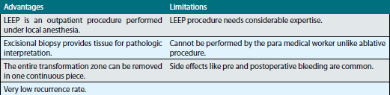
Excisional methods: LEEP
Contraindications of LEEP
Advantages & Limitations of LEEP:
Pregnancy Acute infection Obvious clinical carcinoma | Postpartum period until 12 weeks of delivery Uncontrolled hypertension/bleeding disorder/severe anaemia
Notes:
The incidence of hemorrhage complication following treatment of CIN should be less than 5% and the admission rate owing to treatment complication should be less than 2%.

Slide 27
Algorithm for Screening and management of Cervical Cancer
Visual examination using acetic acid (VIA)
VIA Negative
VIA Positive
Repeat VIA after 5 yrs
Refer to Gynaecologist/Lady Medical officer wherever available PHC/CHC/DH
Lesions eligible for cryotherapy*
Lesions not eligible for cryotherapy
Cryotherapy
Biopsy (naked eye/colposcopic guided)
Follow-up after one year with VIA
Low grade (CIN 1)
High grade (CIN 2& 3)
Cancer
LEEP
Refer to TCC
Note: The accuracy of VIA decreases in postmenopausal women. However, in facilities where there are no resources for Pap, women may be screened using VIA till 65 years of age. LEEP: Loop Electrosurgical Excision Procedure

Slide 28
Thank You

