Slide 1
Chikungunya

Slide 2
What is this Tongue Twister ?
It is CHIKUNGUNYA
To be pronounced as [chick’-en-GUN-yah]
It is not written as CHICKEN GUINEA
Nothing to do with chicken eating
More specifically as ‘that which bends up’
Refers to the stooped posture of the patient

Slide 3
Agent & Mode of Infection
Chikungunya Virus, in the family of Togaviradae, genus Alphavirus
Chikungunya is spread by the bite of an Aedes mosquito, primarily Aedes Agypti
Human beings are the major source or Reservoir (its not a contagious disease)
Aedes Agypti moquito bites during day time.

Slide 4
Signs and Symptoms
Resembles like Dengue Fever
Incubation Period: 1- 12 days
Chikungunya means ‘that which controls or bends up ‘
Severe and sometimes persistent joint pain (arthritis)
Fever, headache, nausea, vomiting and rash
Rarely life threatening and almost self limiting

Slide 5
Blessed are we !!
This is not a Dengue epidemic !
This is not the SARS which stole all the show !!
This is not Bird-Flu hitting Indian economy !!!
This is not the Plague Epidemic which threatened to sweep our country !!!!
Above all, it is not like HIV or Hepatitis-B !!!!!
This is a self limiting, non fatal Viral illness.

Slide 6
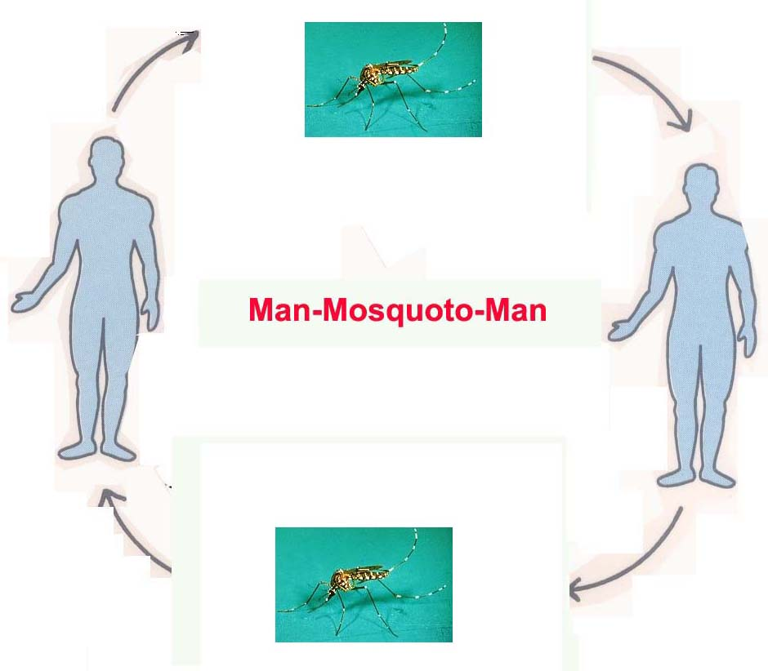
Transmission Cycle

Slide 7
Diagnosis
Case Definition: Public health authorities should be alerted to small clusters of disease (Fever & Arthralgia or Arthritis) associated with a travel returning from an endemic area or an increase in the number of Hospitalization for fever with Arthralgia or Arthritis occurring in a localized area in a short time period.
Suspected Case: A patient with acute onset of fever > 38.5º C (101º F) and severe arthralgia or arthritis not explained by other medical conditions and residing or having visited epidemic or endemic areas within 2 weeks prior to onset of symptoms.
Confirmed Case: A clinically suspect case with any of the following Chikungunya specific tests:
Virus isolation.
Detection of viral RNA by RT-PCR.
Detection of IgM in a single serum sample of acute/convalescent patient
4-fold increase in Chikungunya specific antibody (2-3 wks apart)

Slide 8
Chikungunya IgM Testing SSHL
North Bengal MCH, Siliguri
Murshidabad MCH, Berhampur
School of Tropical Medicine, Kolkata
SSKM, Kolkata
R.G.Kar MCH, Kolkata
Midnapore MCH, Paschim Midnapore
Jalpaiguri GMCH, Jalpaiguri
MJN MCH, Coochbehar
Balurghat DH, Dakhin Dinajpur
Barasat GMCH, N 24P gs
Howrah DH, Howrah
Imambara DH, Hooghly
Bankura Sammilani MCH, Bankura
Suri DH, Birbhum
Asansol DH, Paschim Burdwan

Slide 9
Management
There are no specific drugs to cure the disease.
There is no commercial Chikungunya vaccine at present.
Treatment of Chikungunya is supportive.
Acutely infected patients need to be protected against mosquito to bites to prevent further disease spread both at home, in the community and in the health care facility.
Because Chikungunya will place a large burden on the community including all levels of the health care system, well established protocols and plans need to be developed in advance to assist in the triage, care and rehabilitation of patients.

Slide 10
Prognosis
Recovery from the disease varies by age.
Younger patients recover within 5 to 15 days;
Middle-aged patients recover in 1 to 2.5 months.
Recovery is longer for the elderly.
The severity of the disease as well as its duration is less in younger patients and pregnant women.
Pedal edema (swelling of legs) is observed in many patients, the cause of which remains obscure as it is not related to any Cardiovascular, Renal or Hepatic abnormalities.

Slide 11
Disease Burden
The disease has tremendous socio-economic impact
Attendance drop, productivity decline, daily wagers lose their wage
Mosquito breed in wide variety of man-made container.
Lack of awareness and public health infrastructure promotes uncontrolled breeding

Slide 12
Prevention & Control
Source reduction
Eliminate all potential vector breeding near domestic and peri- domestic area
Use of Larvicides
Biological control
Track, Test and Treat
Personal Prophylactic Measures:
  Use of mosquito repellent creams, liquids, coils, mats etc.
  Wearing of full sleeve shirts and full pants with socks
  Use of bed-nets for sleeping infants and young children during day time to prevent mosquito bite

Slide 13
Thank You

