Slide 1
Malaria

Slide 2
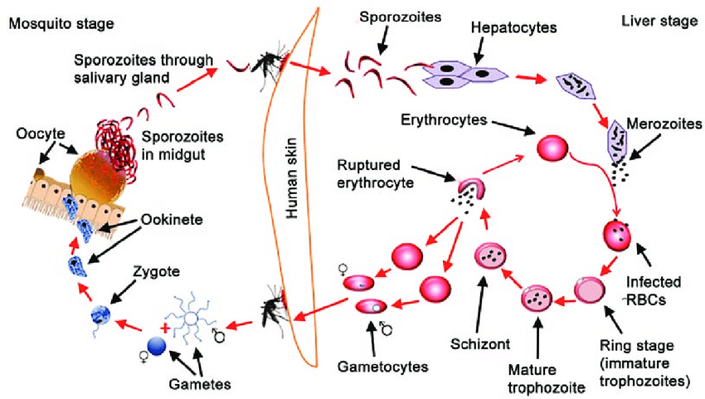
Malaria transmission cycle

Slide 3
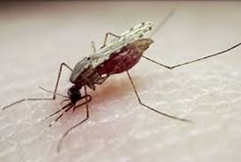
Malaria Vectors in India
Anopheline mosquitoes are found in all parts of India from the sea level up to an altitude of 2000-2500 metres. Out of 58 species of anophelines in India, 9 species are proven vectors of malaria.
Principal vectors (6)
  Anopheles culicifacies
  An. fluviatilis
  An. minimus
  An. philippinensis
  An. dirus
  An. stephensi
Secondary vectors (3)
  An. annularis
  An. varuna
  An. sundaicus

Slide 4
Which parasite caused the case?
P. vivax
P. falciparum
P. ovale
P. malariae

Slide 5
Probable Malaria
A suspected malaria case is a patient with fever in an endemic area during transmission season, or who has recently visited an endemic area, without any other obvious cause of fever like:
Cough and other signs of respiratory infection
Running nose and other signs of cold
Diarrhoea
Pelvic inflammation indicated by severe low back ache, with or without vaginal discharge and urinary symptoms
Skin rash suggestive of eruptive illness
Burning micturition
Skin infections e.g. boils, abscess, infected wounds
Painful swelling of joints
Ear discharge

Slide 6
Confirmed Malaria
A confirmed malaria case (or infection) is one in which the parasite has been detected by a diagnostic test i.e. microscopy, rapid diagnostic test or molecular diagnostic test.

Slide 7
Microscopy
Microscopy is the gold standard for malaria diagnosis.

Slide 8
Guideline issued by DHS & DME: Maria diagnosis protocol, West Bengal
Memo no.: HFW-27039/44/2024-CD SEC-Dept. of H&FW/395 Date 20.05.2024
At OPD of Hospitals: Blood Slide, report by same sitting (Except at fever clinic during transmission season use RD Kit)
At IPD & Emergency:
  During laboratory hours- Blood Slide
  During Non-laboratory hours & newly admitted very suspected Malaria by RD Kit
By all ASHA
At all Sub-centre:
  With microscopic facility: Blood Slide
  Without microscopic facility: RD Kit
At UPHC: Blood Slide where Laboratory Technician is posted otherwise RD Kit
At Urban Health & Wellness Centre: RD Kit
Microscopy is the gold standard for malaria diagnosis.

Slide 9
Recommended criteria for selection of RD Kit
For Pf: Sensitivity and Specificity should be minimum 95% at parasite density level of 200 asexual parasites/ul of blood
For Pv:
  Sensitivity: ≥75% at density of 200 parasites/ul
  Specificity: ≥ 90%
Type of RDT- Only Histidine-Rich Protein 2 (HRP2) and Parasite lactate dehydrogenase (pLDH) based RDTs to be used and not aldolase based ones
If Pf found positive in last 4-6 weeks earlier, then for diagnosis of malaria will be done by Blood slides only and not by RD Kit

Slide 10
Treatment of uncomplicated Vivax Malaria
Age group | Day 1 |  | Day 2 |  | Day 3 |  | Day 4 - 14
 | CQ (150 mg base) | PQ (2.5 mg) | CQ (150 mg base) | PQ (2.5 mg) | CQ (150 mg base) | PQ (2.5 mg) | PQ (2.5 mg)
Less than 1 year | ¹/₂ | 0 | ¹/₂ | 0 | ¹/₄ | 0 | 0
1 -4 years | 1 | 1 | 1 | 1 | ¹/₂ | 1 | 1
5-8 years | 2 | 2 | 2 | 2 | 1 | 2 | 2
9-14 years | 3 | 4 | 3 | 4 | 1¹/₂ | 4 | 4
15 years or more | 4 | 6 | 4 | 6 | 2 | 6 | 6
Chloroquine: 25 mg/kg body weight divided over three days (i.e. 10 mg/kg on day 1, 2 and 5 mg/kg on day 3.
Primaquine: 0.25 mg/kg body weight daily for 14 days.
Primaquine is contraindicated in infants, pregnant women and individuals with G6PD deficiency.
14-days regimen of Primaquine should be given under supervision.
Patients given primaquine must be instructed to stop primaquine if they develop high colouration of urine or blue colouration of lips and report immediately to the MO. Primaquine should be stopped in such cases.

Slide 11
Treatment of P. falciparum cases
Age group (in years) | Day - 1 |  | Day - 2 |  | Day - 3
 | AS | SP | AS | PQ | AS
0-1 | 1 Tablet (25 mg) | 1 tablet (250 mg + 12.5 mg) | 1 tablet (25 mg) | Nil | 1 tablet (25 mg)
1-4 | 1 tablet (50 mg) | 1 tablet (500 mg + 25 mg) | 1 tablet (50 mg) | 1 tablet (7.5 mg base) | 1 tablet (50 mg)
5-8 | 1 tablet (100 mg) | 1 tablet (750 mg + 37.5 mg) | 1 tablet (100 mg) | 2 tablets (7.5 mg base each) | 1 tablet (100 mg)
9-14 | 1 tablet (150 mg) | 2 tablets (500 mg +25 mg each) | 1 tablet (150 mg) | 4 tablets (7.5 mg base each) | 1 tablet (150 mg)
15 & above | 1 tablet (200 mg) | 2 tablets (750 mg + 37.5 mg each) | 1 tablet (200 mg) | 6 tablets (7.5 mg base each) | 1 tablet (200 mg)
SP is not to be given to children below 5 months of age and they should be treated with an alternate ACT
Pregnant women
  1st Trimester: Quinine salt 10mg/kg 3 times daily for 7 days. Quinine may induce hypoglycemia; pregnant women should not start taking quinine on an empty stomach and should eat regularly, while on quinine treatment.
  2nd and 3rd Trimester: ACT-SP as per dosage schedule given above
However, any ACT treatment failure should be treated with quinine plus tetracycline/doxycycline/clindamycin for 7 days. Resistance should be suspected if in spite of full treatment with ACT and with no history of vomiting or diarrhoea, there is no clinical or parasitological response in the patient after 72 hours.

Slide 12
Patient with known Glucose-6-phosphate dehydrogenase deficiency
In the light of changing epidemiology worldwide and more aggressive targets for malaria control and elimination, WHO now recommends addition of primaquine to chloroquine for radical cure of P. vivax in all settings
Test for G6PD level is not mandatory for giving PQ to patients
Patient should be advised to stop primaquine immediately if he/she develops any of the following symptoms and should report to the doctor immediately: (i) dark coloured urine (ii) yellow conjunctiva (iii) bluish discoloration of lips (iv) abdominal pain (v) nausea (vi) vomiting (vii) breathlessness, etc. Fortunately, primaquine is eliminated rapidly; so haemolysis is self-limiting, once the drug is stopped
In people with known G6PD deficiency, consider preventing relapse by giving primaquine base at 0.75 mg/kg body weight once a week for 8 weeks, with close medical supervision for potential primaquine-induced haemolysis

Slide 13
Instructions on drug intake
The first oral dose in malaria treatment should always be consumed in the presence of the health care provider. Wait for 15 minutes after taking the dose. If there is no vomiting, the remaining part of the blister pack is given to the patient/caretaker to take home with the following instructions clearly:
The patient should complete the full treatment
If the treatment is not completed as prescribed, the disease may recur, in a more serious form which may be more difficult to treat
Bed nets should be used by the patient to prevent the spread of malaria
If the patient vomits within the 15 minutes under observation of the health care provider after taking the first dose of the drug, he/she should be allowed to rest for 15 minutes and then the dose is repeated by opening a new blister pack and discarding what remains of the previous blister pack. If the patient vomits again, the case should be considered as a case of severe malaria and managed accordingly.

Slide 14
Treatment of mixed infections with P. vivax and P. falciparum
All mixed infections should be treated with a full course of ACT-SP for 3 days and primaquine 0.25 mg/kg bw daily for 14 days (2nd day onwards).

Slide 15
Treatment of P. ovale and P. malariae
Treatment for P. ovale malaria is the same as that for P. vivax
Treatment for P. malariae is same as that for P. falciparum.

Slide 16
Severe malaria (1/2)
Impaired consciousness
Generalized weakness so that the person is unable to sit, stand or walk without assistance
Multiple convulsions- more than two episodes within 24 hours
Acidosis- Severe acidosis manifests clinically as respiratory distress (rapid, deep, laboured breathing).
Hypoglycaemia- Blood or plasma glucose < 2.2 mmol/L (< 40 mg/dL)
Severe anaemia- Haemoglobin % < 5 g/dL
Renal impairment- Creatinine > 265 gmol/L (3mg/dL) or blood urea > 20 mmol/L
Febrile convulsions, repeated vomiting and dehydration are common in children if the temperature is high due to any cause and therefore, not necessarily indicative of severe malaria.
However, such symptoms could be due to severe malaria and there should be no delay in transferring these children to a health facility fully equipped for diagnosis and management of severe malaria cases.

Slide 17
Severe malaria (2/2)
Jaundice- Plasma or serum bilirubin > 3 mg/dL
Pulmonary oedema with chest in-drawing and crepitation on auscultation
Significant bleeding- recurrent or prolonged bleeding from the nose, gums or venepuncture sites; haematemesis or malaena
Shock- Compensated shock is defined as capillary refill > 3s or temperature gradient on leg (mid to proximal limb), but no hypertension. Decompensated shock is defined as systolic blood pressure < 70 mm Hg in children or < 80 mm Hg in adults, with evidence of impaired perfusion (cool peripheries or prolonged capillary refill)
Hyperparasitaemia- P. falciparum parasitaemia > 10%

Slide 18
Criteria for referral
Persistence of fever even 48 hours after initiating treatment
Continuous vomiting and inability to retain oral drugs
Headache continuing to increase
Severe dehydration, seen as dry, parched skin or sunken face
Feeling too weak to walk
Change in sensorium e.g. confusion, drowsiness, blurring of vision, photophobia, disorientation
Convulsions
Bleeding and clotting disorders
Suspicion of severe anaemia
Jaundice
Hypothermia

Slide 19
Anti-malarial for severe malaria cases
Artesunate: 2.4 mg/ kg body weight i.v. or i.m. given on admission, then at 12 hrs. and 24 hrs., then once a day till patient can take oral medication. Children weighing < 20 kg should receive a higher dose of artesunate (3 mg/kg bw per dose).
Quinine: 20 mg quinine salt/kg on admission (i.v. infusion in 5% dextrose/dextrose saline over a period of 4 hours) followed by maintenance dose of 10 mg/kg 8 hourly; infusion rate should not exceed 5 mg/kg per hour. Loading dose of 20 mg/kg should not be given, if the patient has already received quinine. NEVER GIVE BOLUS INJECTION OF QUININE. If parenteral quinine therapy needs to be continued beyond 48 hours, dose should be reduced to 7 mg/kg 8 hourly.
  For Pf: Follow-up treatment with ACT-SP for 3 days + PQ single dose, irrespective of the duration of parenteral therapy.
  For Pv: Primaquine should be given for 14 days for preventing relapse after the patient recovers from acute illness and can tolerate primaquine.
Blood smears (thick and thin smears) are crucial for monitoring the parasite density and response to treatment. They should be performed on admission and repeated every 12-24 hours until parasite clearance is confirmed, especially in cases of severe malaria

Slide 20
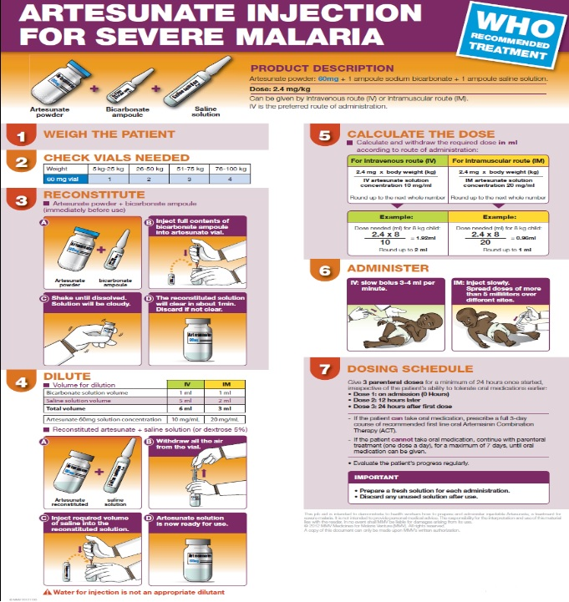

Slide 22
Treatment of severe malaria during pregnancy
Women in the second and third trimesters of pregnancy are more likely to have severe malaria than other adults.
Parenteral artesunate is the treatment of choice in all trimesters.
Treatment must not be delayed.
If artesunate is not available, intramuscular artemether should be given, and if this is unavailable, then parenteral quinine should be started immediately until artesunate is obtained.

Slide 23
Treatment of severe P. vivax malaria
Prompt effective treatment and case management should be the same as for severe P. falciparum malaria. A full course of radical treatment with primaquine should be given after recovery.

Slide 24
Treatment of Asymptomatic Cases
Asymptomatic malaria infections detected by microscopy only will be considered as asymptomatic cases. Appropriate treatment according to the species should be given to these cases as per the national drug policy.

Slide 25
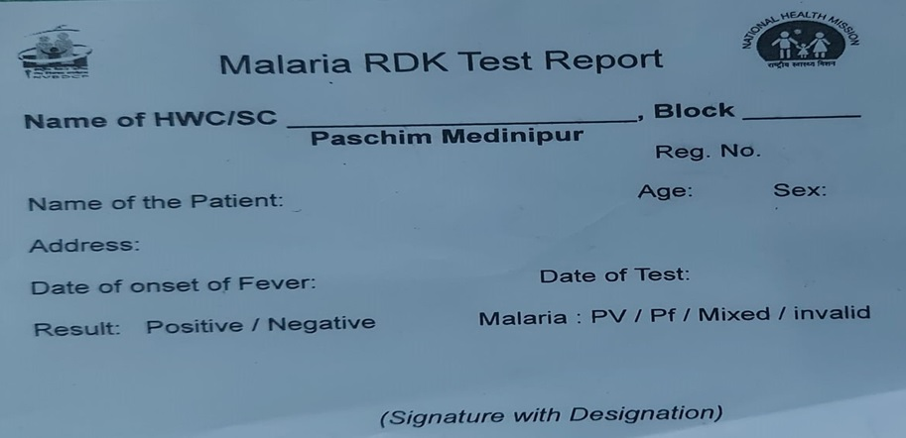
RDT reporting

Slide 26
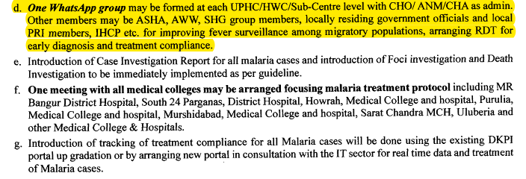
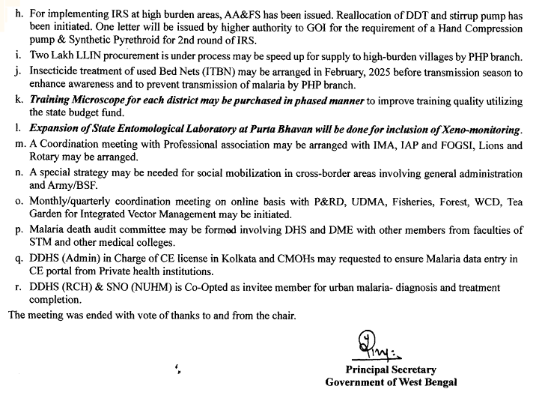
Minutes of the 4th State Level Task Force on Malaria Elimination Programme, held on 12/09/2024 Circulated vide Memo No. HFW-27039/13/2021-CD SEC/ Dept of H& FW/578, dated- 29/11/2024
One WhatsApp group has been formed at each UPHC/HWC/Sub-Centre level.
Members are local PRI members, CHO, ANM, CHA ASHA, AWW, SHG group members, locally residing government officials and IHCP etc.
Purpose:
  Immediate information of all fever cases
  Tracking of all migratory populations
  Arrange RDT for early diagnosis
  Immediate complete treatment of positive cases to prevent transmission.

Slide 27
ASHA Blood slide collection/ RD Kit testing guideline
Memo No: HFW-27039/44/2025-CD/ 159 Dated: 26/05/2025
The test should preferably be not less than 0.6% of the population during low transmission season (From November to March) and not less than 1% of the population during high transmission season (From April to October)
So, the ASHA may be allowed Blood Slide collection for malaria testing/ Rapid Diagnostic Kit test maximum 1% of the population during low transmission and 1.5% of the population during high transmission season amongst her assigned population.
During outbreak situation, fever survey to be carried out by ASHA for population irrespective of fever in her area as per instruction of her higher authority
They can claim ASHA incentive after certification from CHO/ ANM/ CHA of the HWC/ Sub-centre/ UPHC/ UHWC.
The claim will be only for Suspected Malaria cases, which excludes the following conditions.
Cough and other signs of respiratory infection
Running nose and other signs of cold
Diarrhoea
Pelvic inflammation indicated by severe low back ache, with or without vaginal discharge and urinary symptoms
Skin rash suggestive of eruptive illness
Burning micturition
Skin infections e.g. boils, abscess, infected wounds
Painful swelling of joints
Ear discharge

Slide 28
LLINs
LLINs have proven to be a practical and cost-effective intervention against malaria, and are highly effective against vector mosquitoes which bite indoors at night. They provide not only a physical barrier against the mosquito bites but also kill the mosquitoes or shorten their life span so that they cannot transmit malaria infection. However, for best effectiveness in the community, coverage of population at risk with LLINs must be as close to 100% as possible with high utilization rate (> 80%).
LLINs are designed for field use for a minimum of 3 years but their effective life can vary depending on conditions of usage and maintenance, underscoring the need for ongoing field monitoring.
They are more sustainable than conventional ITNs which require repeated treatments. In addition to distribution to targeted high risk villages aiming for complete population coverage, additional LLINs should be given to pregnant women in high-risk areas and to special groups such as children in tribal schools and hostels.
Lifespan of LLINs is average 3 years

Slide 29
Insecticide treated bed nets (ITBNs) for high case load areas
(State Budget fund)
No of District/HD | No of Block | No of Sub-Centres (No) | Population Coverage | Total ITBN (No) | Total Fund (Rs.)
14 | 40 | 75 | 4,24,592 | 2,12,313 | 53.2 Lakh
Significant benefits:
Active involvement of the community for treating bed nets
Community ownership on use of bed nets

Slide 30
Protective measures
Man-mosquito contact can be reduced by use of mosquito nets while sleeping or by use of mosquito coils or mats.
Mosquito repellents applied to skin give protection for 3 - 6 hours and are particularly useful for troops engaged in sentry duties and for those going outdoors from dusk to dawn for any other reason.
Full sleeve shirts and trousers offer better protection from mosquito bites.
Mosquito coils and mats usually take about 30 minutes to reach their maximum effectiveness and should be accordingly before the mosquitoes become active in the evenings.
Community participation through IEC could improve peridomestic sanitation in urban areas targeting nuisance mosquitoes as well as disease vectors.
Indoor Residual Spray
Larval control

Slide 31
National Framework for Malaria Elimination in India 2016-2030
Overview: Encouraged by the success achieved in malaria control in recent years, the vision of India’s malaria control programme has been now shifted to sustained malaria elimination to contribute more effectively to improved health and quality of life of the people. The National Framework for malaria elimination in India 2016-2030 was launched in February 2016.
Vision: Eliminate malaria nationally and contribute to improved health, quality of life and alleviation of poverty.
Goals:
  In line with the WHO Global Technical Strategy (GTS) for Malaria 2016-2030 and the Asia Pacific Leaders Malaria Alliance Malaria Elimination Roadmap, the goals of the National Framework for Malaria Elimination in India 2016-2030 are:
  Eliminate malaria (zero indigenous cases) throughout the entire country by 2030; and
  Maintain malaria-free status in areas where malaria transmission has been interrupted and prevent re-introduction of malaria.
Objectives: The National framework for malaria elimination in India has formulated the following objectives: • a position to plan action for malaria elimination right now, the high burden States will need to reduce the malaria burden first before proceeding towards elimination. Therefore, States and UTs have been categorized into phases, based on their API as primary criterion with due consideration given to ABER and SPR as secondary criteria.

Slide 32
Targets
By 2024
All States and UTs and their districts have reduced API to less than 1 case per 1000 population at risk, sustain zero deaths due to malaria and establish fully functional malaria surveillance to track, investigate and respond to each case.
31 States/UTs have interrupted transmission of malaria and zero indigenous cases and deaths attained.
5 States/UTs which were under Category 3 (intensified control phase) in 2014 have entered into elimination phase.
By 2027
Indigenous transmission of malaria interrupted, and the entire country has no indigenous cases and no deaths due to malaria
By 2030
The entire country sustained status of zero indigenous cases and deaths due to malaria for 3 consecutive years; and India has initiated the processes for certification of malaria elimination status

Slide 33
Surveillance
Surveillance is defined as ongoing, systematic collection, analysis and interpretation of disease-specific data for use in planning, implementing and evaluating the public health practice.
Surveillance is carried out at different levels of the health care system (e.g. health facility-based, community-based), and using different detection systems (e.g. case-based, active, passive), and through sentinel sites and surveys. Malaria surveillance is based on active case detection (ACD) and passive case detection (PCD).
ACD is carried out by trained community level health care workers (MPHW/ANM) through fortnightly house-to-house visits and testing people with current or recent fever and chills in past 14 days with bivalent antigen detecting RDTs. If the RDT result is positive, treatment appropriate to the plasmodium species is initiated.
PCD is the detection of malaria cases among people who go at their own initiative to a health volunteer (ASHA) or health facility (subcentre, PHC etc.) to get treatment, usually for a febrile illness.
The surveillance activities given below are in the perspective of states. However, states have to further stratify and categorise their districts, PHCs and subcentres for the appropriate surveillance activities.

Slide 34
Indicators of Malaria
ABER= (No. of slide examined+ RDK Tested) X 100
Population under surveillance
API= (No. of Slide positive + RDK positive) X 1000
Population under surveillance
TPR= (No. of slide positive + RDK positive) X 100
No. of slide examined + RDK, tested
Pf%= (No. pf. Positive in slide + RDK positive) X 100
No. of total positive in slide + RDK positive
TFR= (No. of Pf positive in slide + RDK) X 100
No Slide examined + RDK Tested

Slide 35
World Malaria Day 2024- 25th April
World Maria Day was observed on 25/04/2025. The theme was “Malaria Ends with Us: Reinvest, Reimagine, Reignite”
Anti Malaria Month is observed in June for aware generation

Slide 36
Thank you

