Slide 1
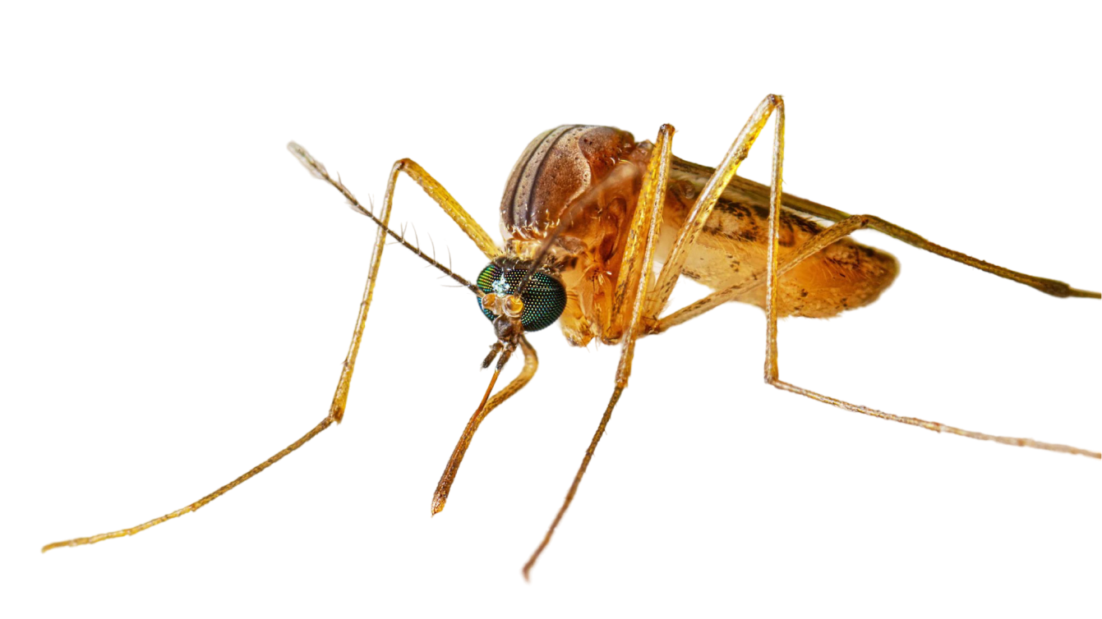
Acute Encephalitis Syndrome (AES) &
Japanese Encephalitis (JE)

Slide 2
Acute Encephalitis Syndrome
Acute Encephalitis Syndrome (AES) is a group of neurological conditions characterized by inflammation of the brain, leading to fever, seizures, altered mental status, and coma.
It is caused by viral, bacterial, parasitic or toxic agents with Japanese Encephalitis Virus (JEV) being the most common cause in Asia.
Japanese Encephalitis is one type of AES which is a viral disease transmitted by bites of female mosquitoes mainly belonging to Culex species

Slide 3
Causes of AES
AES
JE
Non-JE Viral
WNE (West Nile Encephalitis in North America)
Parastic (Malaria)
Protozoal (Amoebic)
Spirochetal (Syphilis)
Trypanosomiasis
TBM
Bacterial
Fungal (Cryptococcal)
Toxin
Chemicals (No fever)
Unknown Cause
Scrub typhus
Arbovirus
(Arthopod is vector)
VEE (Venezuelan Horses)
Tick Borne Encephalitis & others
Dawson Encephalitis
Entero-Viral Encephalitis
Toxoplasmosis
Dengue
Herpes
Varicella
Single Stranded RNA Virus of Flaviviridae family (Mosquito is vector)
Not Found in India
Coxsackie A & B Echo
Others
Polio Non-polio

Slide 4
Case definition of JE
Acute onset of fever, not more than 5-7 days duration.
Change in mental status with/without:
New onset of seizures (excluding febrile seizures)
Other early clinical findings-- may include irritability, somnolence or abnormal behaviour greater than that seen with usual febrile illness.

Slide 5
Case Classification of AES
Suspected cases: Fever, drowsiness, unconsciousness, convulsions and others suspected by field level health workers.
Probable JE: A suspected case that occurs in close geographic and temporal relationship to laboratory-confirmed case of JE, in the context of an outbreak
Laboratory-confirmed JE: A probable cases that has been confirmed as JE by laboratory investigations

Slide 6
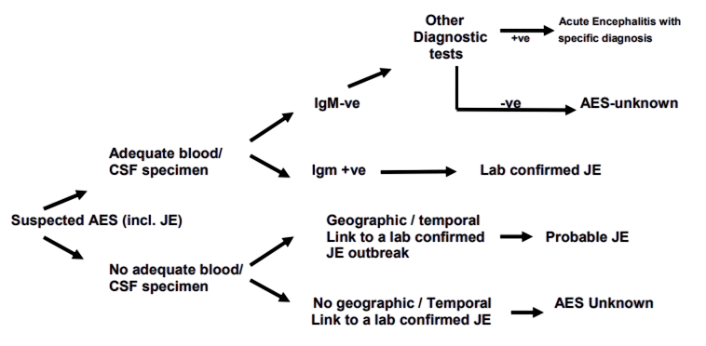
Case Classification of AES

Slide 7
Investigations to confirm diagnosis
IgM ELISA in serum and CSF
RTPCR
Culture
Now available in our setup

Slide 8
Japanese Encephalitis (JE)
Japanese Encephalitis (JE) is a mosquito-borne viral infection that affects the brain and can cause severe neurological complications.
It is caused by the Japanese Encephalitis Virus (JEV), a flavivirus transmitted primarily by Culex mosquitoes.

Slide 9
Case definition of JE
Clinical Criteria (JE Suspected Case):
Any AES case occurring in a JE-endemic area
High-grade fever with neurological symptoms (seizures, altered mental status, paralysis, or coma)
Stiff neck, abnormal movements, or focal neurological deficits
Epidemiological Criteria:
Transmission: Spread by Culex mosquitoes
Seasonality: Peaks in monsoon/post-monsoon
Age Group: Primarily affects children <15 years, but adults can also be affected

Slide 10
Case definition of JE
Laboratory Criteria (JE Confirmation):
IgM ELISA Test: JE-specific IgM antibodies in CSF or serum
RT-PCR: Detection of JEV RNA (rarely done)
Virus Isolation: Rare but confirmatory

Slide 11
Transmission Cycle of JE
Mosquitoes acquire JEV from infected pigs/birds → Transmit to humans
Humans are dead-end hosts (cannot spread further)
Risk Factors: Rice fields, pig farming, poor sanitation, seasonal outbreaks (monsoon & post-monsoon)

Slide 12
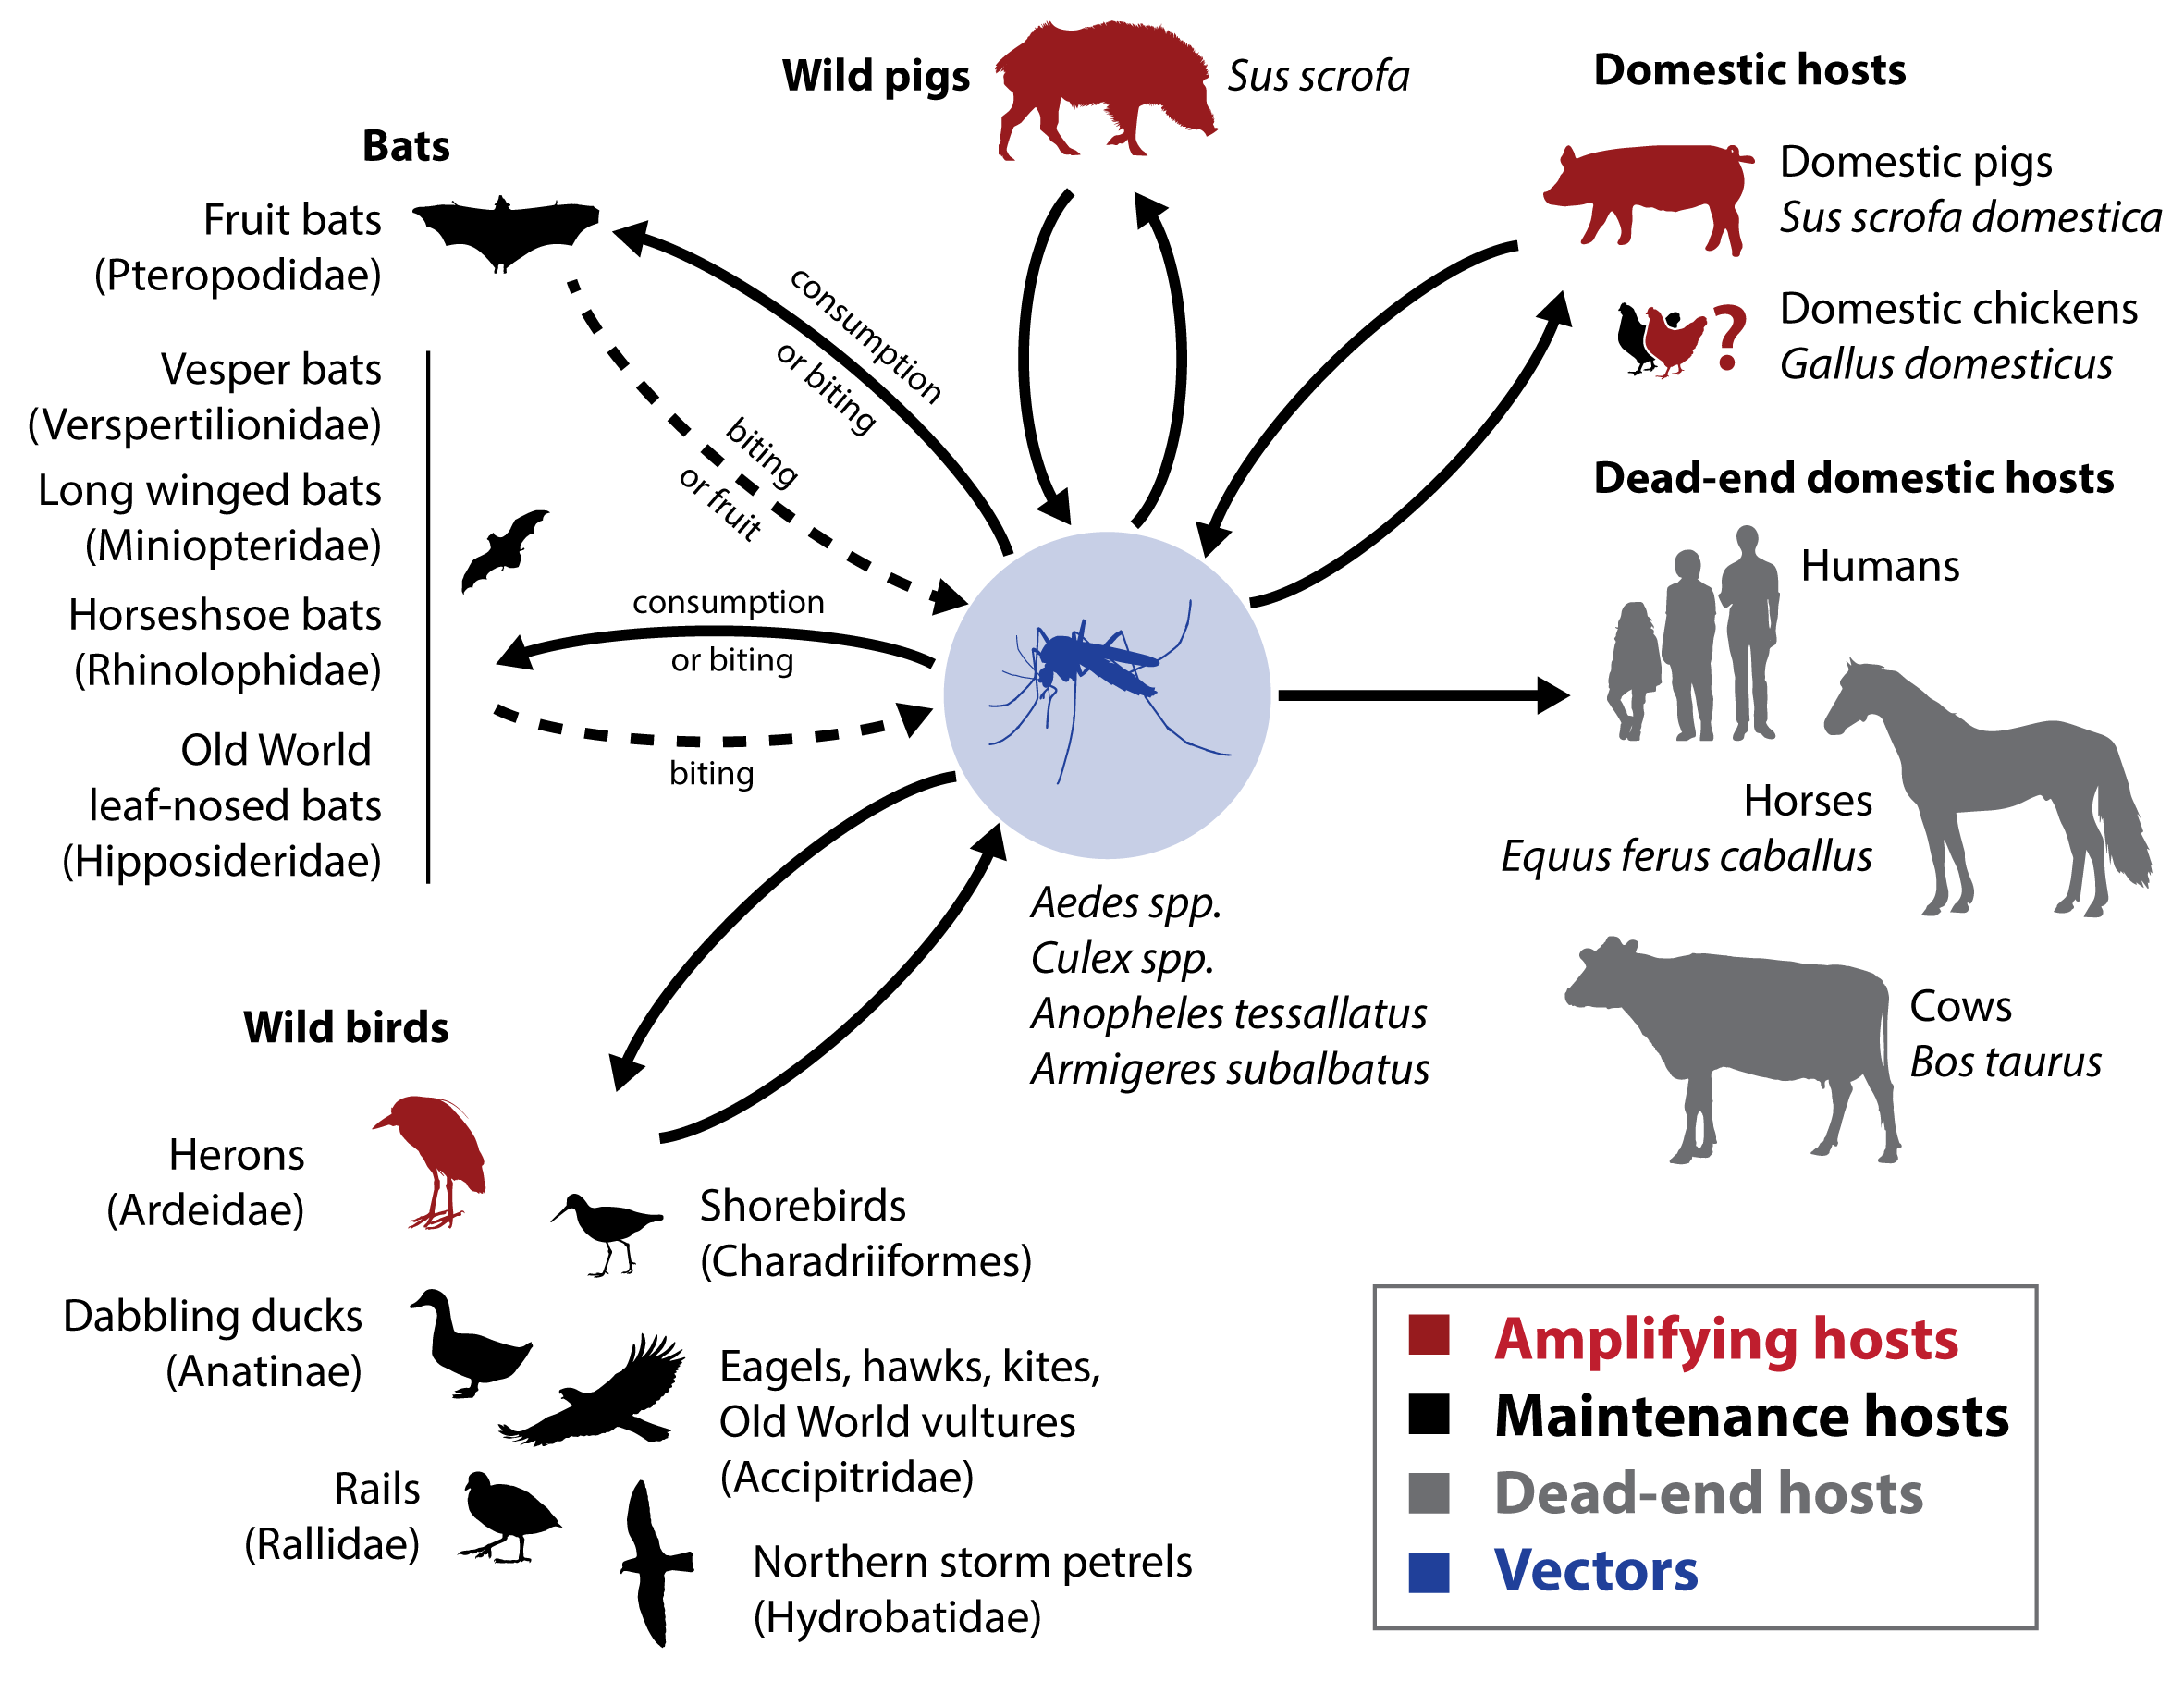
Japanese Encephalitis disease spread

Slide 13
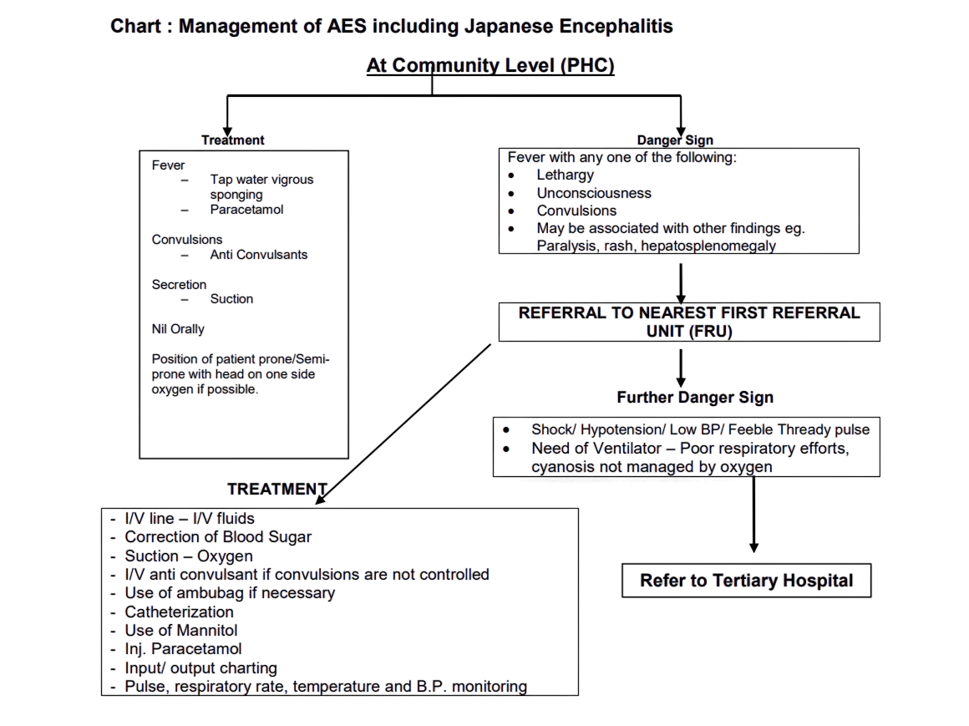
Management of AES including JE

Slide 14
Key Points in management of AES including JE
Exclude other CNS causes like meningitis or cerebral malaria requiring specific treatment.
Treatment varies based on patient condition upon arrival.
Initial steps: Assess airway patency, manage high fever, altered mental status, or seizures.
Same treatment applies at PHC, CHC, and district/tertiary hospitals.
Referral to higher centers only if necessary, ensuring all available treatment is provided first.
Delays in transportation increase mortality rates.
Essential facility requirements: Oxygen, Ambu bag, IV cannula, and necessary medications.
Pre-arranged training in endemic areas is crucial, except for ventilatory support.

Slide 15
Essential Treatment Protocols for Patient Management
Management of Airways and Breathing.
Management of Circulation.
Control of Convulsion and Intracranial pressure
Control of Temperature
Fluid and Electrolytes and Calories/ Nutrition
General management
Specific treatment of any for treatable cause
Investigations, Samples Collection & Transportation
Reporting of a case
Rehabilitation.

Slide 16
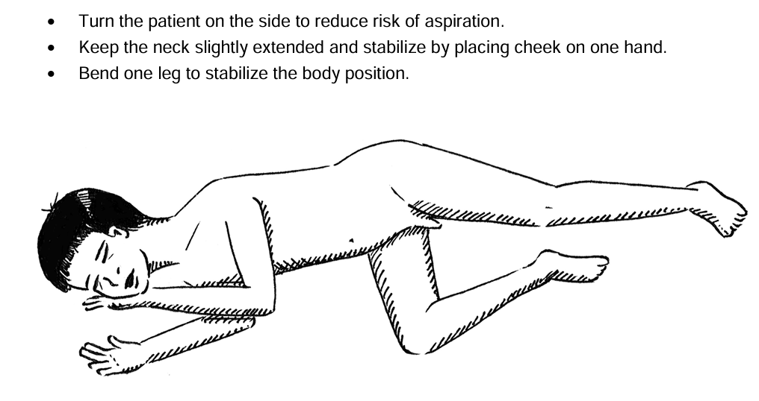
Position of the Patient

Slide 17
Management in Tertiary Level Hospitals
Hypoxia is alleviated by intubation, positive pressure ventilation, and ensuring an arterial Pao2 of 65 mm Hg or better.
Hypotension is treated in a stepwise fashion by first volume infusion with isotonic fluids to normovolemia, next vasopressors and finally treatment is directed at reducing ICP in an effort to maintain CPP greater than 50.
Brainstem involvement may necessitate intubation & mechanical ventilation.
Cardiac arrest requires resuscitation measures.
SIADH (Syndrome of Inappropriate Anti Diuretic Hormone) is treated with Hypertonic saline.

Slide 18
Equipment and Drugs at various Levels – (1/2)
Essential equipment at the PHC level:
Air way Sizes 0 and 1
Mucus sucker
Rubber feeding tube of various sizes
5 ml & 2 ml Syringes with needles
Thermometer,
Adhesive tape
Enema set
Oxygen
Essential Drugs at the PHC level:
Syrup / Injection Paracetamol,
Diazepam rectal solution/ Syp. Diazepam/ Inj. Diazepam/ Diazepam Suppository.
Suspension Valproate,
Glucose powder
Tab/Inj Frusemide
Inj Paraldehyde
I/V fluids

Slide 19
Equipment and Drugs at various Levels – (2/2)
Essential equipment at the CHC level Hospital:
Air way Sizes,
Mucus Sucker,
Rubber feeding tube size 14,
5 ml Syringe,
Thermometer,
Adhesive tape,
IV cannula, 22 to 24 ,
Ambu Bag,
Foley's Catheters of various sizes
Lumbar Puncture sets
Provision for Cerebrospinal fluid analysis.
Enema set
Essential Drugs at the CHC level Hospital:
Syrup Paracetamol,
Rectal solution or Syrup Diazepam,
Suspension Valproate,
Syrup Chloral hydrate,
Inj Diazepam,
Inj Phenytoin,
IV fluids N/2, N/5 with 5 % Dextrose, 10% Dextrose,
Normal saline,
Inj Dexamethasone,
Inj Mannitol 20 %,
Inj Frusemide,
Oral Glycerol
Inj Dopamine
Inj Phenobarbitone.
Vitamins
Syrup / Tab Haloperidol
Syrup Chloral Hydrate
Inj Paraldehyde
Inj. Ampicillin
Inj. Chloramphenicol.
Inj Ceftriaxone.

Slide 20
Strategies for Prevention & Control of Japanese Encephalitis (JE)
Vaccination (Primary Prevention):
  JE Vaccination is the most effective prevention method
Vector Control Measures:
  Eliminate stagnant water (breeding sites)
  Fogging & insecticide spraying in endemic areas
  Use mosquito nets, repellents, and protective clothing
Public Health Interventions:
  Strengthening JE surveillance & outbreak response
  Timely reporting of cases & early warning systems
  Community awareness campaigns on mosquito control & vaccination
Environmental & Agricultural Management:
  Reducing human-mosquito-pig contact
  Safe pig farming practices (relocation away from residential areas)
  Proper waste disposal & water management

Slide 21
Strategies for Prevention & Control of Japanese Encephalitis (JE)
Strengthening Healthcare Infrastructure:
  Improving Diagnosis & Treatment Facilities
  Equipping hospitals with ICU, ventilators, & essential drugs
  Training healthcare workers in AES/JE management
  Rapid referral systems to tertiary care centers
  Personal Protective Measures:
  Preventing mosquito bites
  Wearing long-sleeved clothes & using insect repellents
  Sleeping under insecticide-treated mosquito nets (ITNs)
Community Awareness & Education:
  Engaging communities in JE prevention
  Educating about JE symptoms, vaccination, and mosquito control
  Encouraging early medical consultation for suspected cases

Slide 22
AES & JE in India – Key Statistics
Endemic States: UP, Bihar, Assam, West Bengal, Odisa, Tamil Nadu
Annual AES Cases in India: ~10,000 reported cases
Annual AES Cases in West Bengal: ~1,000 reported cases
JE Contribution to AES Cases: 5–35%

Slide 23
Conclusion
AES is a serious neurological condition with multiple causes
JE is a major cause in Asia, but bacterial & toxic causes also exist
Early diagnosis & supportive treatment are crucial for survival
Vaccination, mosquito control & public health interventions are essential
Preventive measures can reduce the burden of AES & JE in endemic regions

