Slide 1
Dengue with co-morbidities

Slide 2
First patient
A 27 years old primigravida in 37 weeks of pregnancy is having fever for 6 days.
Dengue IgM came as positive
Today her platelet count is 23,000/µl of blood
How will you manage ?

Slide 3
Issues
Where to admit? To be admitted in medicine ward of hospital with availability of urgent transfusion facilities
Need for expert help - Gynaecologist and Paediatrician should be available as and when necessary
Low PCV -Haemodilution in pregnancy- PCV may be low- has to be kept in mind while interpreting of PCV report

Slide 4
Issues contd.)
Fluid- if needed, is to be given carefully- ascites will cause abdominal discomfort- already distended by gravid uterus
Imminent labour or C/S - platelet count is to be kept above 50,000/l- if needed platelet transfusion just before procedure

Slide 5
Ideal Approach
Conservative medical and obstetrical management is the treatment of choice.
Labour should be deferred as far as practicable, preferably till recovery from dengue.
Outcome seemed to correlate with the gestational age at which dengue infection was acquired.
Pregnancies complicated by dengue infection require close monitoring for potential maternal and foetal complications.
Timely referral to higher centres

Slide 6
Another patient
A patient had undergone PTCA with drug eluting stent 2 months ago. He is on dual antiplatelets.
He has been diagnosed with dengue
On 6th day of illness, the platelet count is 45000/ µl of blood
What are you going to do?

Slide 7
Thrombotic risk stratification
High thrombotic risk - among others, patients with recently implanted DES ⩽3months or BMS/angioplasty ⩽1 month, complex interventions (e.g. left main or bifurcation stenting) and use of multiple stents (especially if small stents and/or long stents).
Low thrombotic risk - among others, patients with implanted DES >3 months or BMS/angioplasty >1 month.

Slide 8
Antiplatelet management in post PCI patient
Aditya W, Yap J, Chlebicki P, Chan C W H and Tan J W C. Management of anti-thrombotic therapy in patients with recent percutaneous coronary intervention and acute dengue infection: A case series. Proceedings of Singapore Healthcare 2019, Vol. 28(4) 284–287

Slide 9
Pediatric Case
7 years old, 25 kg, diagnosed patient of Beta thalassemia Major. Patient has fever D-4, pain abdomen, lethargy.
HR – 126/min, RR- 36/min, BP – 88/68 mmHg.
Dengue – Dengue Ns1 Positive
What will you do ?
What are the challenges of management of severe dengue in thalassemia patients ?

Slide 10
Challenges
Lack of haemo-concentration does not exclude plasma leakage.
Also, most of the time cannot take HCT as guide of fluid titration
Monitor for other signs of plasma leakage such as pleural effusion and ascites.
Chest radiograph and abdominal ultrasound can aid diagnosis.
Clinicians in endemic regions should have a high index of suspicion when assessing patients with fever in known thalassemia patient .
Severe dengue, especially severe liver involvement, may occur.

Slide 11
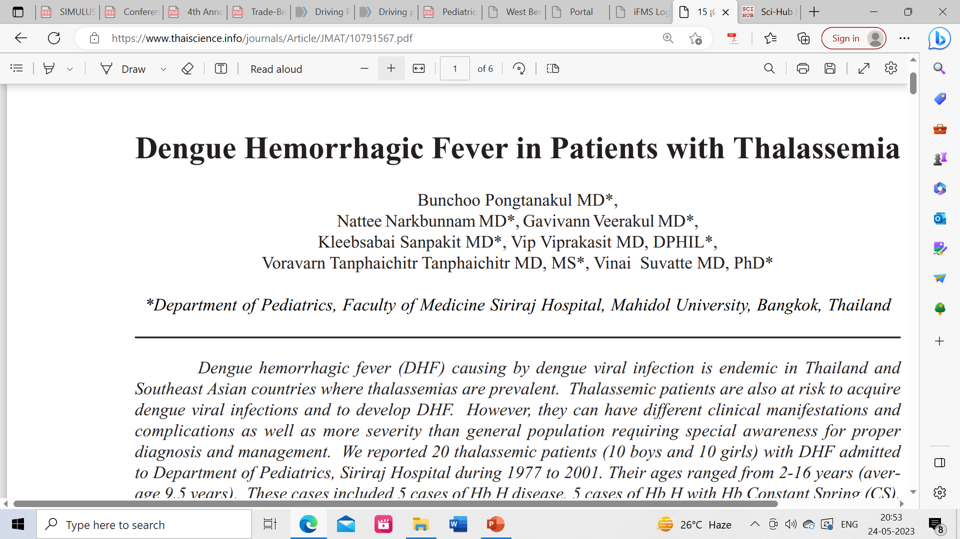
Only one out of 20 thalassemic patients had hemoconcentration where most of the patients had anemia
Severe anemia can cause hemodynamic compromised and lead to hypoxemia, hypotension and shock. Prolonged shock further results in organ damage and poor outcome
Appropriate blood component should be prepared in advance and the packed red cell should be promptly transfused in patients with anemic symptoms

Slide 12
To conclude
All patients with fever to be assessed for the possibility of Dengue
Dengue Ns1Ag in first five days and IgM antibody 5 days onwards by ELISA method gives diagnosis
Most important parameter is Haematocrit, Platelet count is next in importance
Fluid management is the cornerstone for therapy
Comorbidities and coinfections are to be appropriately addressed
Opinion of other experts to be taken as and when necessary

