Slide 1
Scrub typhus

Slide 2
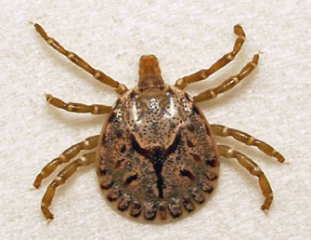
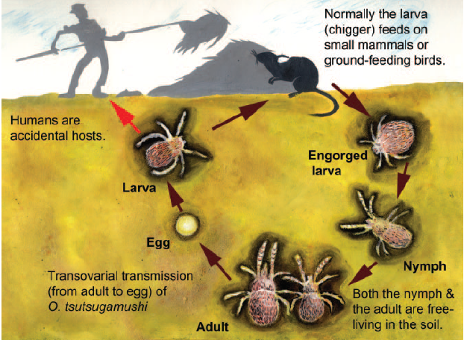
Scrub typhus
Caused by Orientia (formerly Rickettsia) tsutsugamushi, is an acute infectious disease of variable severity.
Transmitted to humans and rodents by some species of trombiculid mites (“chiggers”, Leptotrombidium deliense and others).
Humans acquire the disease from the bite of an infected chigger.

Slide 3
Clinical features
Initially, like a variety of febrile illnesses
Incubation period 6 - 21 days after initial bite.
Presentations:
Fever reaching in first week 40-40.5º C
    Headache
    Myalgia with/out muscular twitching
    Cough first week; pneumonitis in second week
    Apathy, stupor, convulsions, coma

Slide 4
Symptoms & signs
High grade fever for more than 7 days
Maculopapular rash
Lymphadenopathy
Definite myalgia
Dry cough
Hepatomegaly/hepatitis with jaundice
Mark of mite bite i.e. eschar (one should carefully look for eschar, even in covered body parts including axilla, buttock, groin etc)
Encephalitis or meningo-encephalitis
Signs of vital organ involvement such as liver, kidney, lung and heart
Haemorrhagic manifestations
Either SI. No. 1 with any two of the other criteria are present;
or
SI. No. 1 with any one of No. 7, 8, 9 or 10 are present.

Slide 5
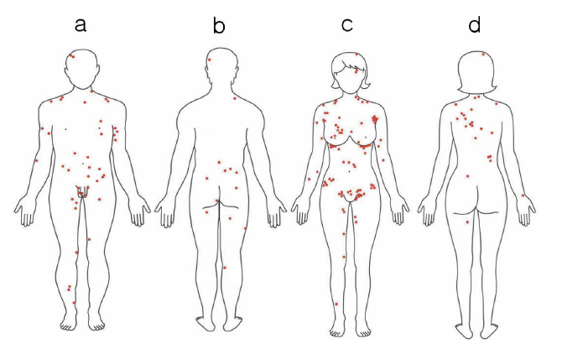
Findings….
Lesion at site of bite, then red spotted rash (eschar) on trunk, often extending to arms and legs in ~ 50%
Regional lymphadenopathy
Conjunctival suffusion
Maculopapular rash
Sites that manifest an eschar in scrub typhus patients: (a) male front, (b) male back, (c) female front, (d) female back

Slide 6
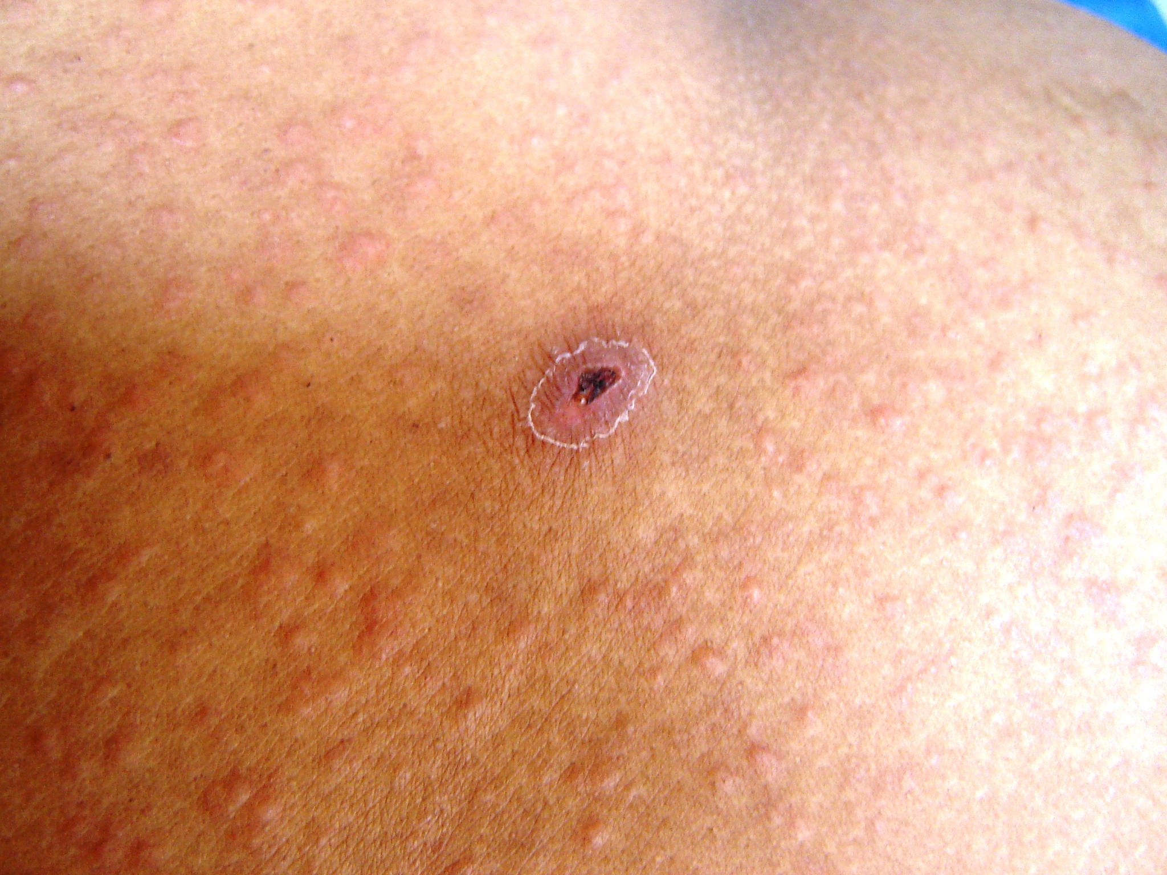
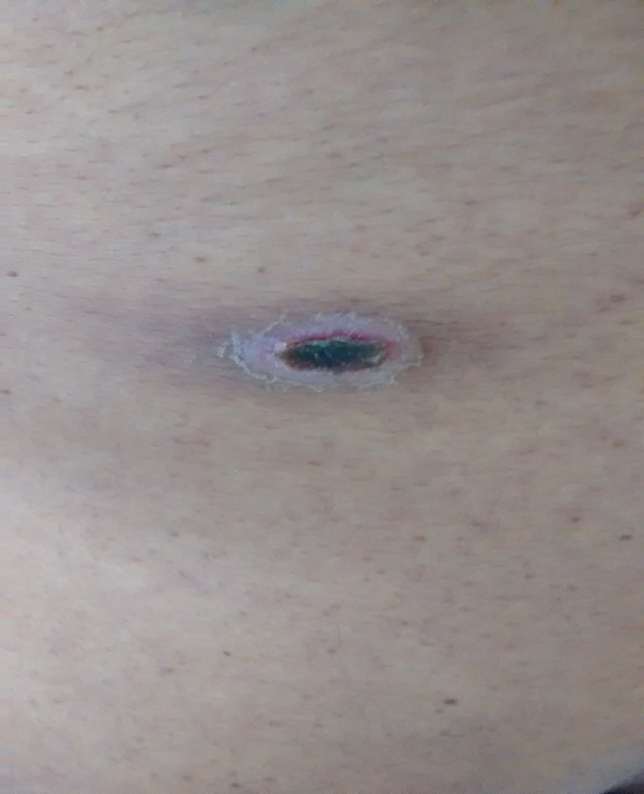

Slide 7
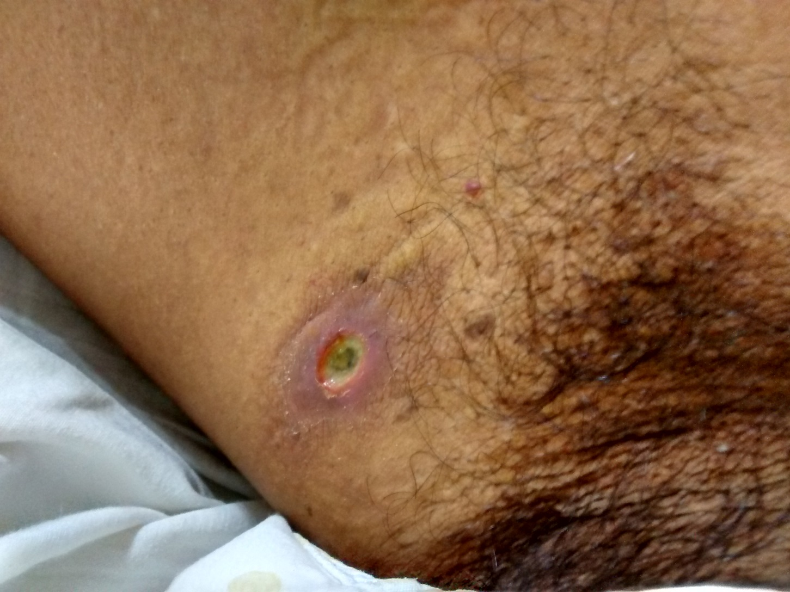
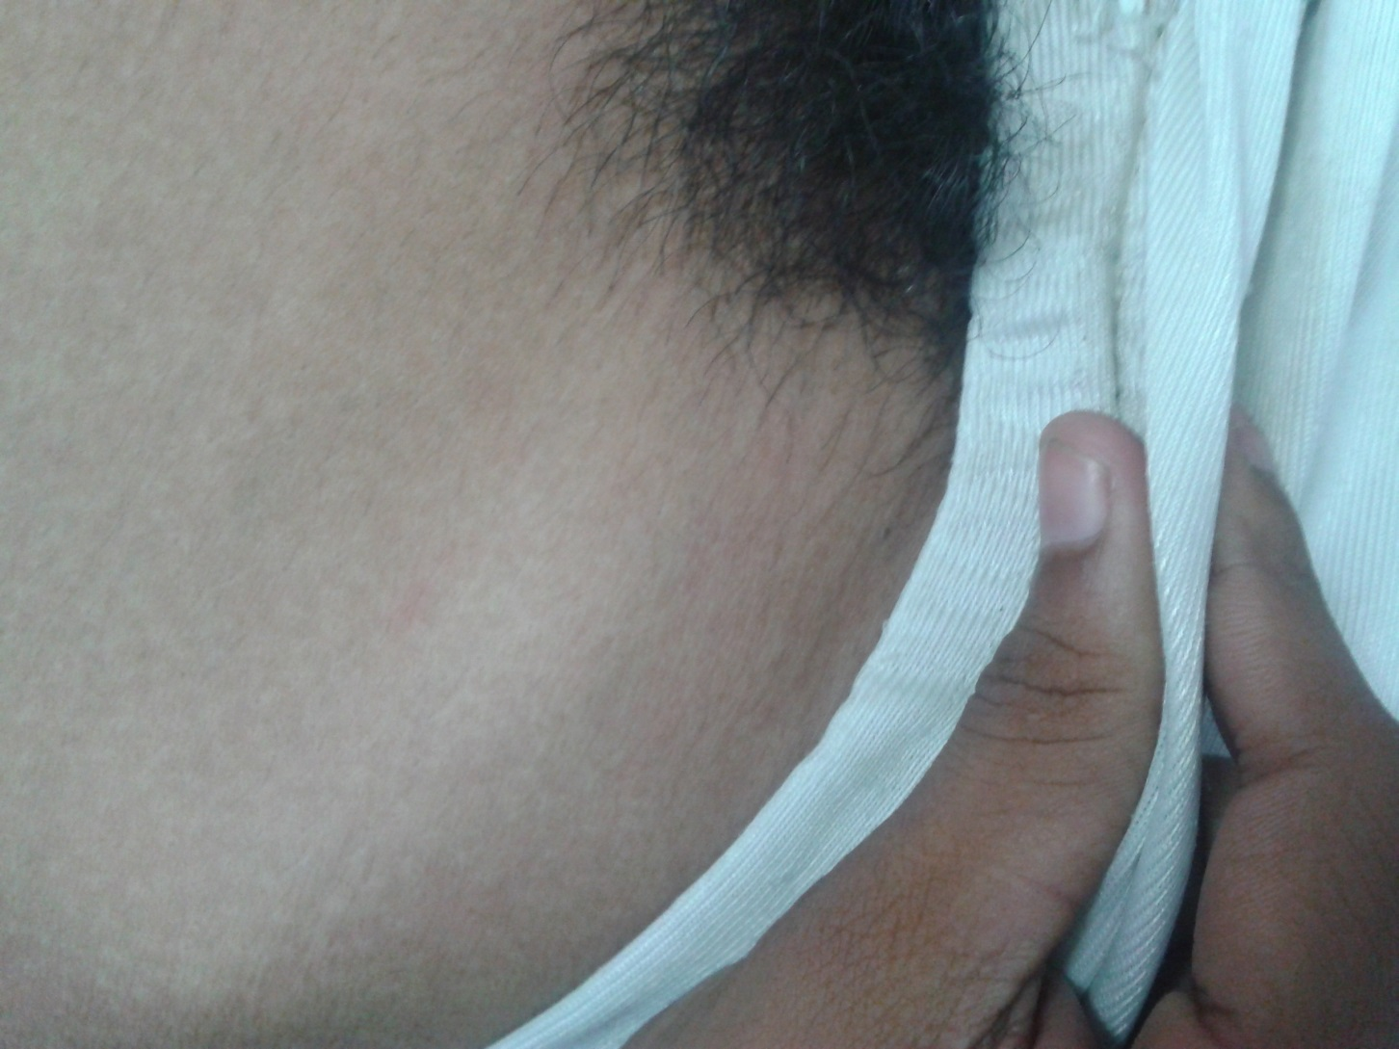

Slide 8
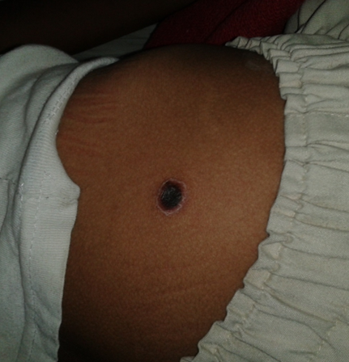
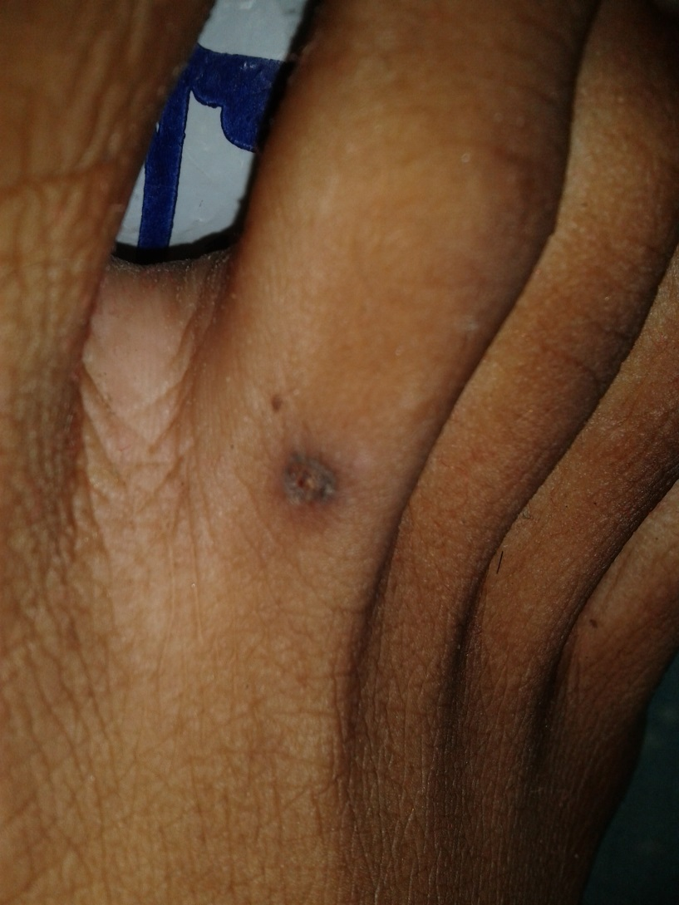
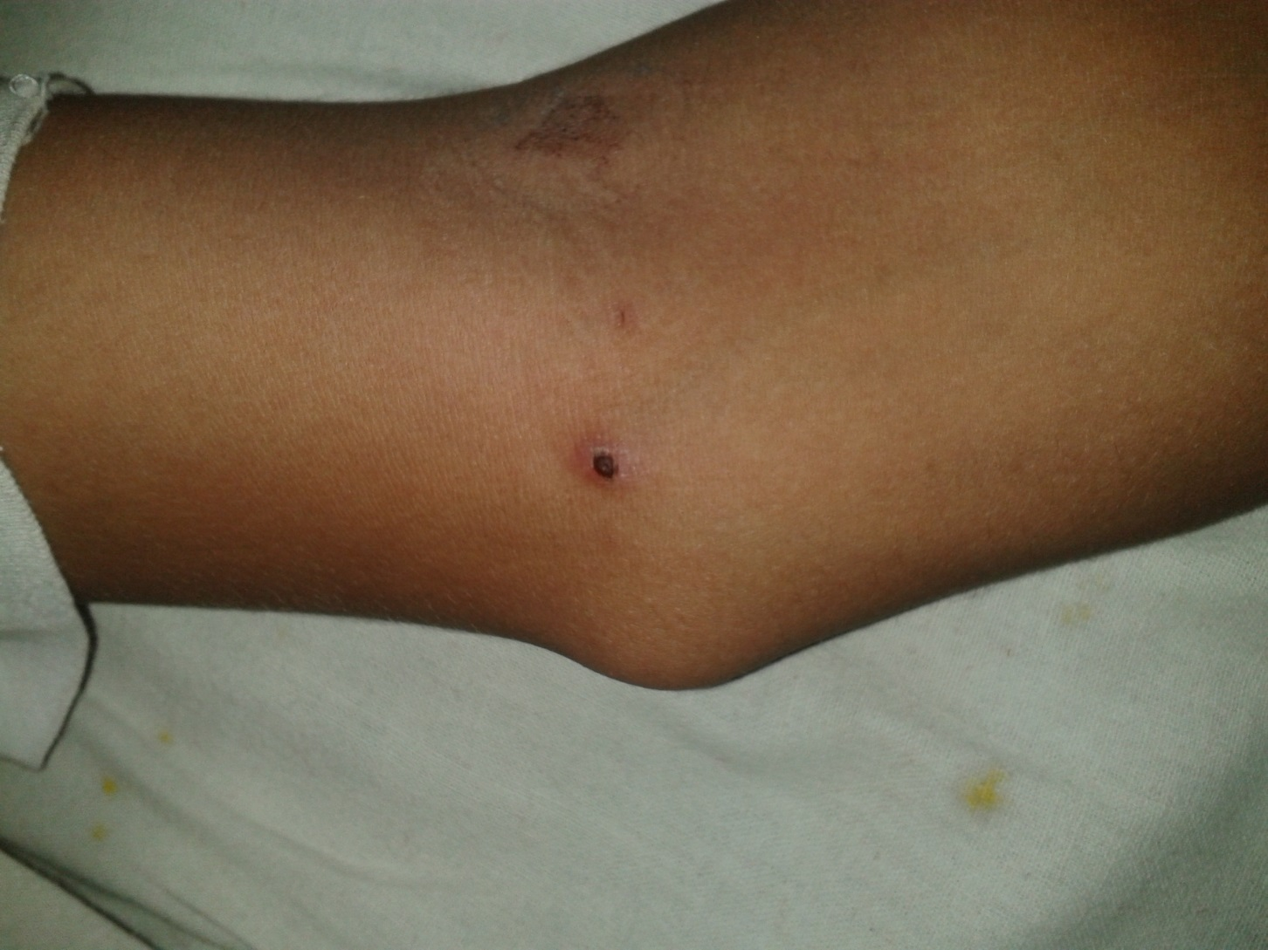

Slide 9
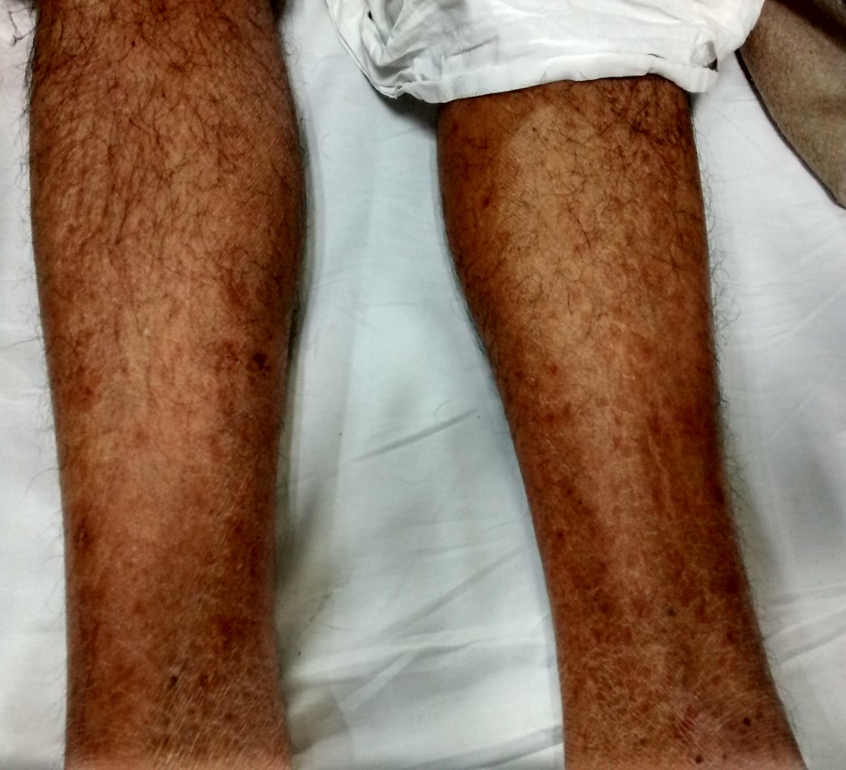
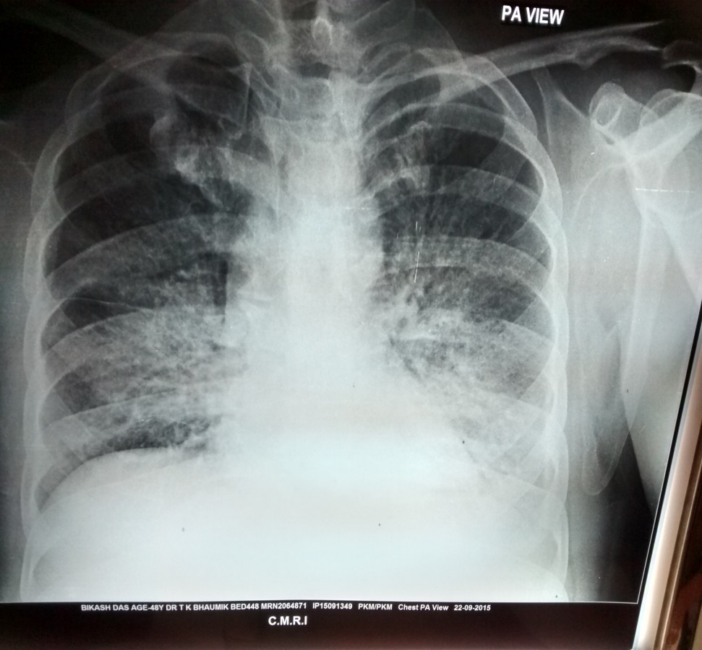

Slide 10
Whom to test for Scrub Typhus?
Acute Febrile Illness patients may be advised test for scrub typhus in our system, if they meet the following criteria:
There is no localizing sign to diagnose diseases like UTI, RTI etc.
Before sending sample for test of scrub typhus, other common causes of acute fever – including malaria, dengue and enteric fever have been excluded,

Slide 11
Scrub Typhus Testing SSHL
SL. No. | Name of the Unit
1 | Alipurduar DH
2 | Falakata SSH
3 | Coochbehar GMCH
4 | Tufanganj SDH
5 | Mathabhanga SDH
6 | Jalpaiguri GMCH
7 | North Bengal MCH
8 | Darjeeling DH
9 | Kurseong SDH
10 | Raiganj GMCH
11 | Islampur SDH
12 | Balurghat DG
13 | Gangarampur SDH
14 | Malda MCH
15 | Murshidab ad MCH
16 | Krishnanagar DH
17 | CoM&JNM, Kalyani
18 | Barasat GMCH
19 | Basirhat DH
20 | CoM&SD MCH
21 | SSKM & IPGMER
22 | R.G.Kar MCH
23 | MCH Kolkata
24 | Dr.B.C. Roy PGIPS
SL. No. | Name of the Unit
25 | NRS MCH & Buffer Stock
26 | Calcutta National MCH
27 | ID& BG Hospital
28 | School of Tropical Medicine
29 | M.R. Bangur DH
30 | Baruipur SDH
31 | Diamond Harbour GMCH
32 | Canning SDH
33 | Rampurhat GMCH
34 | Suri DH
35 | Bolpur SDH
36 | Bardhaman MCH
37 | Asansol DH
38 | Bankura Sammilani MCH
39 | Bishnupur DH
40 | Medinipur MCH
41 | Tamralipta GMCH
42 | Nandigram DH
43 | Contai SDH
44 | Purulia GMCH
45 | Imambara DH
46 | Prafulla Chandra Roy GMCH
47 | Howrah DH

Slide 12
Diagnosis of Scrub typhus
Weil-Felix test:
Demonstrates agglutinins to Proteus vulgaris strain OX19, OX2 and Proteus mirabilis OXK.
Lacks high sensitivity and specificity
Still useful and inexpensive diagnostic tool.
Only after 5-7 days of onset of fever.
Titre of 1:80 -possible infection.
IgM and IgG ELISA: Significant IgM antibody titre is observed at the end of 1st week, whereas IgG antibodies appear at end of 2nd week.
Cut-off value is optical density of 0.5.
Polymerase chain reaction (PCR)

Slide 13
Independent risk factors for development of severe illness
Age of >50 years
Longer duration of illness (>7 days)
Residence in a rural area and
Absence of eschar

Slide 14
In fever cases of 5 days or more duration, where malaria, dengue and typhoid have been ruled out, following drugs should be administered when scrub typhus is considered.
Treatment in uncomplicated cases
Adults
Doxycycline 200 mg/ day in two divided doses for individuals kg for duration of 7 days. Patients should be advised to swallow capsules with plenty of fluid during meals while sitting or standing.
Or
Azithromycin 500 mg in a single oral dose for 5 days.

Slide 15
Treatment in uncomplicated cases
Children:
Doxycycline @4.5 mg/kg body weight/day in two divided doses for children below 45 kg
Or
Azithromycin in a single dose of 10 mg/ kg body weight/day for 5 days
Pregnant Woman:
Azithromycin 500 mg/day for 5 days is the drug of choice as Doxycycline is contraindicated

Slide 16
At secondary and tertiary care
In complicated cases:
i) Intravenous Doxycycline (wherever available) 100 mg twice daily in 100 ml normal saline to be administered as infusion over half an hour initially, followed by oral therapy to complete 7-15 days of therapy.
Or
ii) Intravenous Azithromycin in the dose of 500 mg IV in 250 ml normal saline over 1 hour once daily for 1-2 days followed by oral therapy to complete 5 days of therapy.

Slide 17
At secondary and tertiary care contd…
Or
iii) Intravenous Chloramphenicol 50-100 mg/kg/day in 6 hourly (divided) doses to be administered as infusion over 1 hour initially, followed by oral doses to complete 7-15 days of therapy.
iv) Management of the individual complications should be done as per the existing practices.
Doxycycline and/or Chloramphenicol resistant strains have been seen in South-East Asia. These strains are sensitive to Azithromycin."

Slide 18
Scrub Typhus- Prevention and Control
The easiest way to prevent scrub typhus is to avoid bushy areas or regions with dense vegetation that are damp or water-logged.
Wear clothing & shoes that covers the legs properly so that the chiggers cannot come in direct contact with your skin.
Always wash your arms and legs thoroughly after any outdoor/ agricultural activity.
Try applying organic insect repellants on your clothes or skin before you head out of the house.
If you are travelling to parks or gardens with a baby, always ensure that they are in the stroller. Cover the stroller with mosquito nets for protection.
Make sure that there are no rodents like mice or rats in your home.

Slide 19
To summarise
Scrub typhus should be suspected in all patients presenting with fever for more than 5 days where malaria, dengue and typhoid fever have been excluded.
The IgM antibody appears in the blood at the end of first week of illness.
Complications include involvement of the lung, liver, kidney, heart, CNS etc.
In suspected cases, empirical treatment is to be initiated before waiting for confirmation of diagnosis.
Doxycycline and Azithromycin are drugs of choice with chloramphenicol being an alternative.

Slide 20
Thank You

