Slide 1
General management including fluid therapy

Slide 2
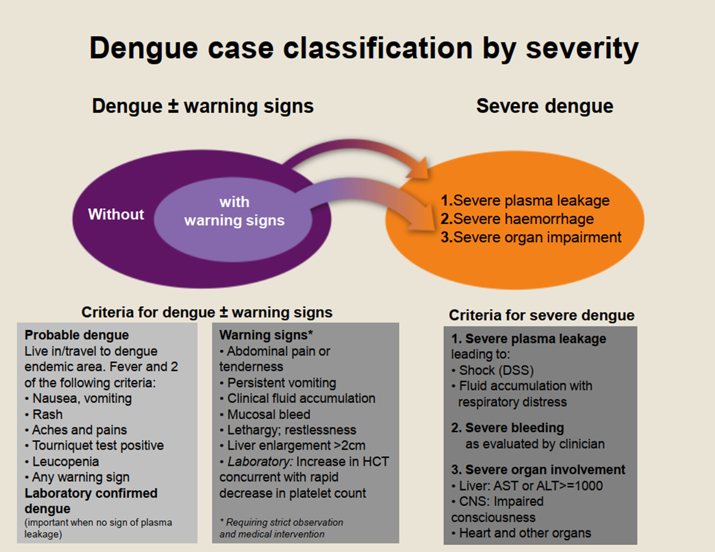

Slide 3
Approach to clinical management

Slide 4
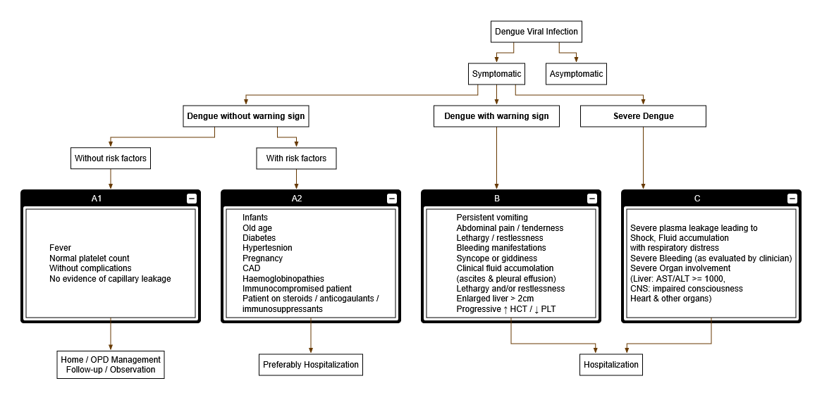

Slide 5
Clinical Management
General management of Dengue Fever (DF):
Management is symptomatic and supportive
Bed rest during the acute phase.
Cold/ tepid sponging to keep temperature below 38.5° C.
Paracetamol preferable as antipyretic & analgesic:
Encourage oral intake of at least 5 glasses of other fluids (with electrolytes) in addition to normal daily intake of plain fluid. Small frequent sips for those with nausea and anorexia.
Monitor for development of complications till 48 hours after being afebrile.

Slide 6
Fluids to be Taken | Fluids to be Avoided
Fruit Juices Coconut Water Rice Water Barley Water Oral Rehydration Solution Soup | Commercial carbonated drinks (cold drinks) Drinks that exceed the isotonic level (5% sugar)
What should be Done | What should not be Done
Adequate bed rest | Do not take NSAIDs like aspirin, or steroids
Adequate fluid intake | Do not take combination of paracetamol with NSAIDs
Take paracetamol Tepid Sponging | Antibiotics not necessary unless there is bacterial infection
Look for mosquito breeding places in and around the home and eliminate them

Slide 7
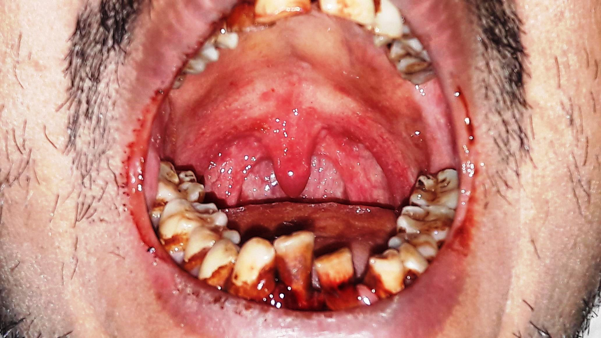
A patient- 6 days of illness-IgM +ve

Slide 8
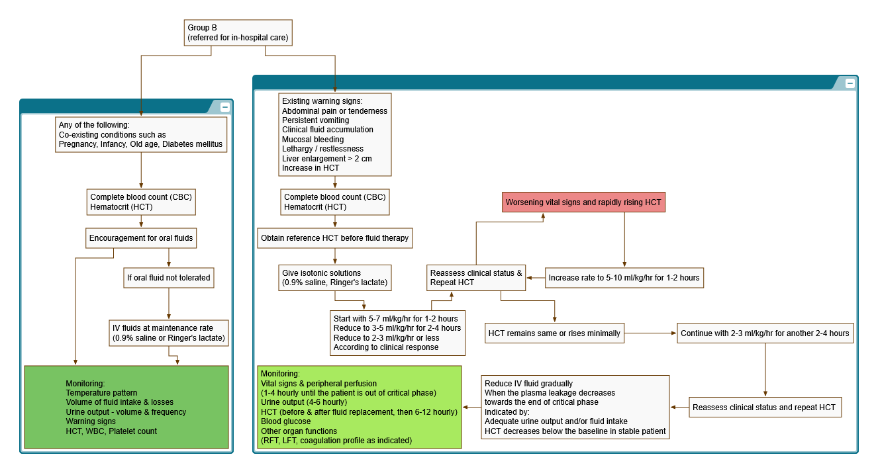
For existing warning signs,
Refer to next slide

Slide 10
The maintenance fluid should be calculated using the Holliday-Segar formula as follows:
Maintenance Fluid Therapy
Body weight in kg | Maintenance volume for 24 hours
<10kg | 100ml/kg
10-20 | 1000+50 ml / kg body weight exceeding 10 kg 1000 + 50 x ( body weight in kg – 10)ml
More than 20 kg | 1500+20 ml / kg body weight exceeding 20 kg 1500 + 20 x ( body weight in kg – 20)ml
The fluid infusion should be just sufficient to maintain effective circulation during the period of plasma leakage
One should keep a watch for urine output, liver size and signs of pulmonary oedema. Hypervolemia is a common complication.
Normally intravenous fluids are not required beyond 36 to 48 hrs.
Normally change should not be drastic. During any changes look for signs of under and over hydration.
ONE ML is equal to 15 DROPS. In case of micro drip system, one ml is equal to 60 drops.

Slide 11
Overweight/ obese patients
For overweight/obese patients calculate normal maintenance fluid based on ideal body weight (IBW), using the following formula:
Female | Male
45.5 kg + 0.91(height – 152.4cm) or | 50.0 kg + 0.91(height – 152.4 cm) or
45.5 kg + 2.3 kg for each inch over 5 ft | 50 kg + 2.3 kg for each inch over 5 ft

Slide 12
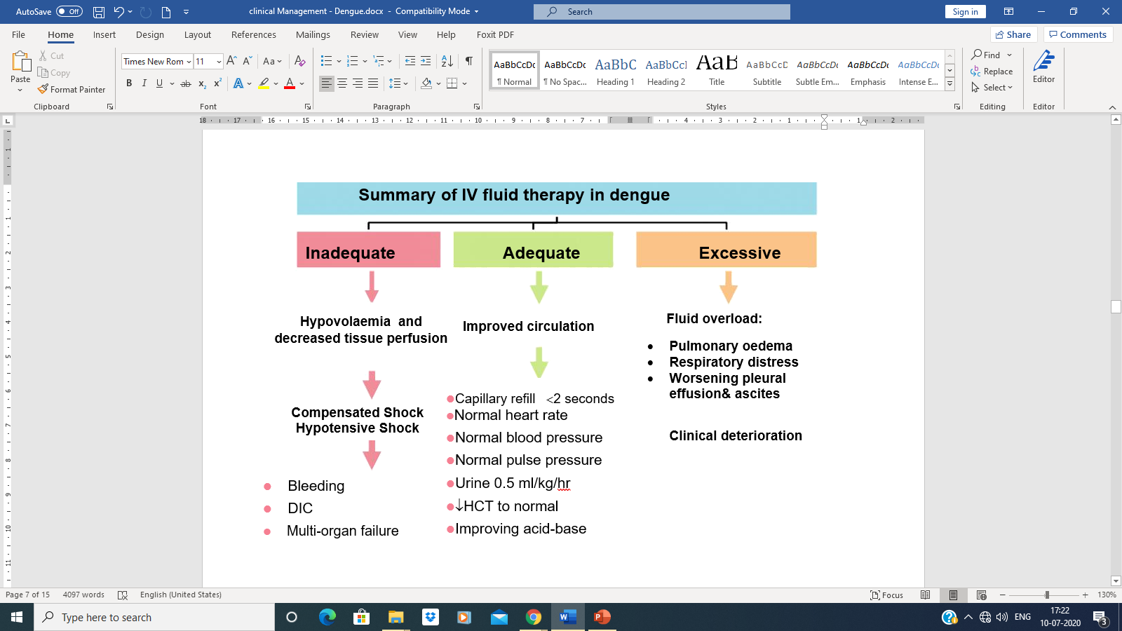
IV Fluid Therapy
Fluid therapy should be promptly started to prevent hypotensive shock !

Slide 13
Choice of IV Fluid
IV Fluids to be Given | IV Fluids to be Avoided
Use isotonic iso-osmolar solutions (normal saline, Ringer’s lactate, balanced crystalloid) Colloids are preferred if the blood pressure has to be restored urgently | Hypotonic solution, e.g. 0.45% saline, even during the febrile phase. Dextrose containing solutions, but may be used in hypoglycaemia with close blood glucose monitoring.
Colloids are used in case of-
Hypotensive shock
Repeated shock – 2nd or 3rd shock and onwards
After >20 to 30 ml/kg of crystalloids
If Hct does not decrease after crystalloid administration in shock
DOSE: Limited to 30 to 50 ml/kg/day

Slide 14
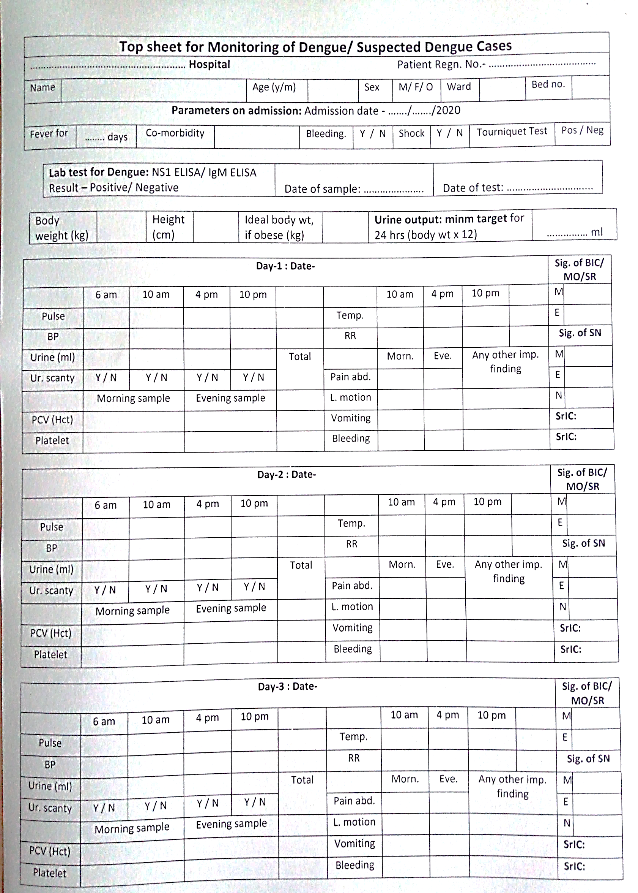
Top Sheet

Slide 15
What are the essential things to do in hospital?
Fluid and other management
Monitoring- top sheet is not a mere show piece, but it’s for assessing deterioration of patient’s condition asap and taking immediate corrective measures
Spending time in bed side can save many valuable lives

Slide 16
Another patient
A 32 years old woman was having fever for 5 days
Her LMP was 3 weeks ago
For last 2 days she is again noticing bleeding P/V
Today she collapsed in the bathroom
She has been brought to ER
Her extremities are very cold
Pulse very feeble. BP is 100/85 mm of Hg
What has happened?
What will you do ?

Slide 18
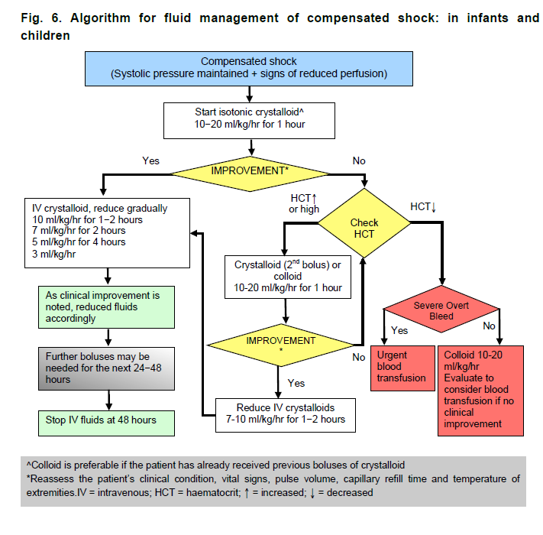

Slide 19
When to start and stop intravenous fluid therapy
Febrile phase Limit IV fluids. Early IV therapy may lead to fluid overload especially with non-isotonic IV fluid
Critical phase IV fluids are usually required for 24–48 hours NOTE: For patients who present with shock, IV therapy should be <48 hours
Recovery phase IV fluids should be stopped so that extravasated fluids can be reabsorbed
Capillary refill ≤2 seconds
Normal heart rate
Normal blood pressure
Normal pulse pressure
Urine ≥ 0.5 ml/kg/hr
HCT to normal
Improving acid-base
Adequate fluid therapy

Slide 20
Last patient
A 35 years old lady was having fever for 4 days
On day 5, she complained of pain abdomen, started vomiting repeatedly, was feeling very unwell and was admitted in a local hospital
She was given some IV fluids and antiemetics
Next day she became very sick, not responding well to commands. BP was dropping
She was taken to another hospital in late night
At the ER, her BP was almost unrecordable

Slide 21
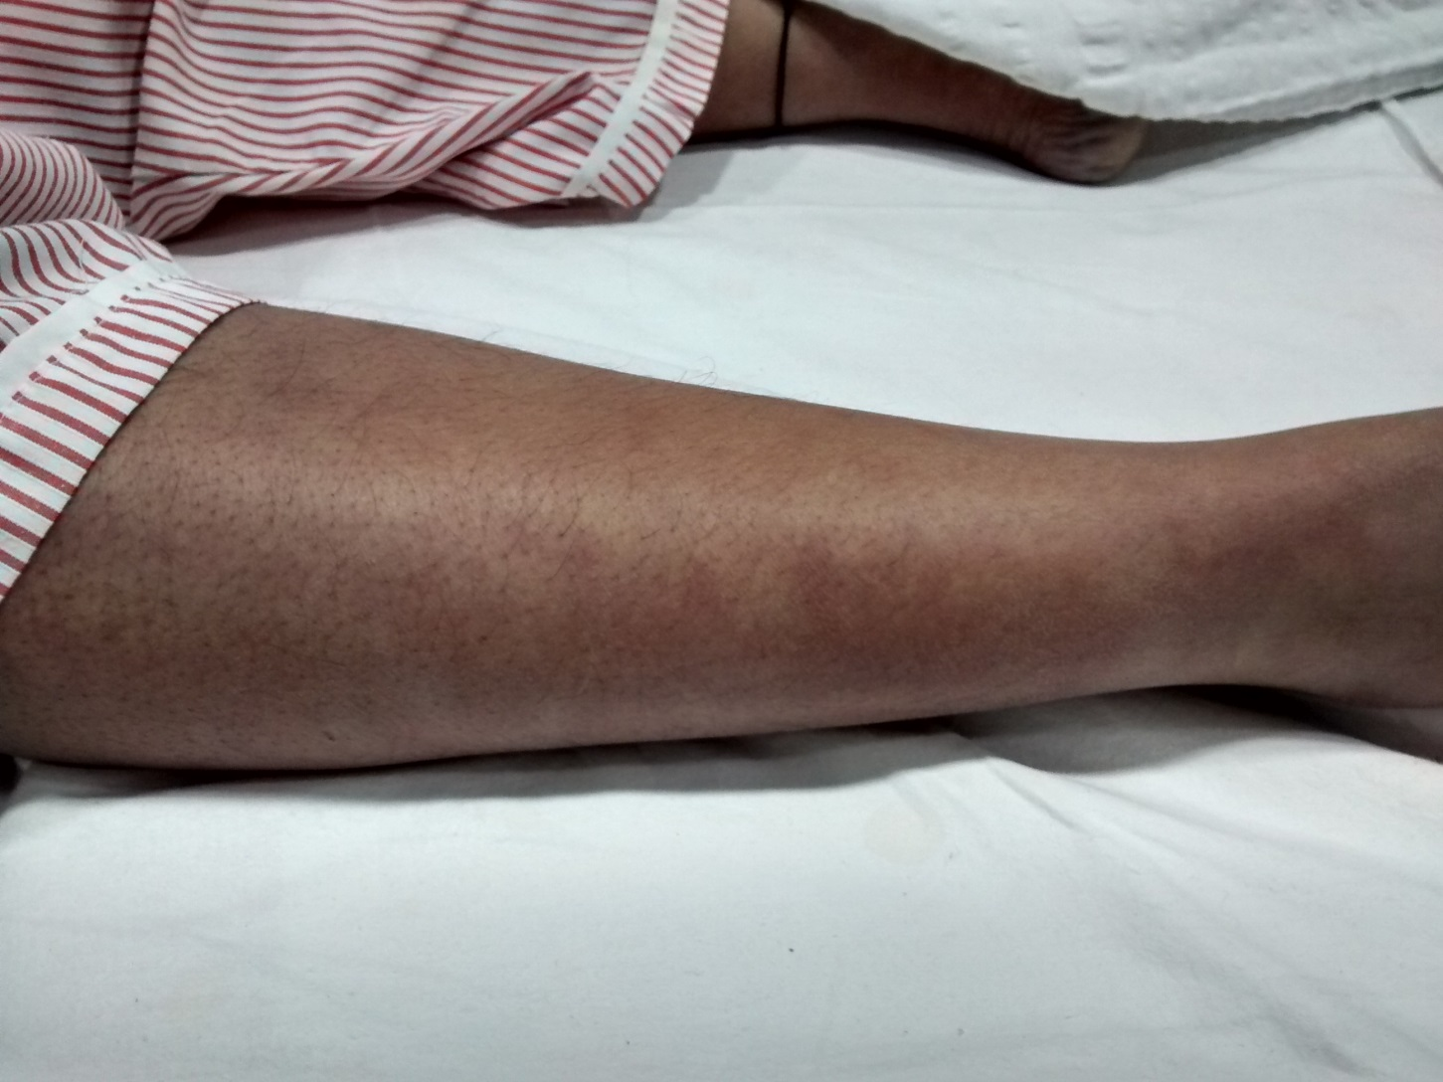

Slide 22
She was given Oxygen
IV fluids in jet
She started deteriorating very rapidly

Slide 23

Reports after admission
Hb- 14.3 gm%
PCV-42
WBC- 3000/$µ$l
Platelet count – 38000 /$µ$l
Random glucose - 108 mg%
Sodium - 136 meq/l
Potassium - 4.8 meq/l
Urea- 43 mg%
Creatinine - 0.91 mg%
Bilirubin - 1.97 mg%
Conjugated Bilirubin - 1.08 mg%
SGOT- 1900 IU/ml
SGPT - 1429 IU/ml

Slide 24
Give crystalloid/colloid bolus @ 20 ml/kg for 15 minutes
10-20 ml/kg/hr for 1 hour

Slide 25
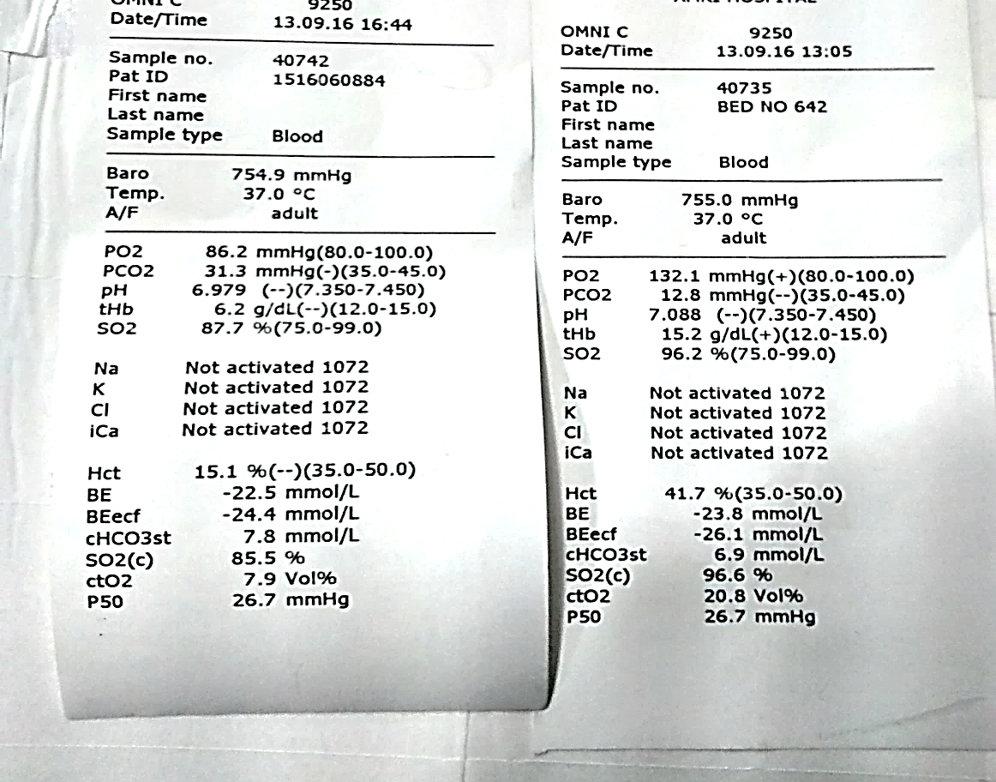


Slide 26
Management of severe bleeding
Indications for blood transfusion
Loss of blood (overt blood)—10% or more of total blood volume
Refractory shock despite adequate fluid administration, and declining Hct
Replacement volume should be 10 ml/kg body weight at a time and coagulogram should be done.
If fluid overload is present, packed cell transfusion is to be given.

Slide 27
Management of severe bleeding
Indications for platelet transfusion
Prophylactic platelet transfusion at levels of <10,000/cmm in the absence of bleeding manifestations.
Haemorrhage
Prolonged shock with coagulopathy and abnormal coagulogram.
In case of systemic bleeding, platelet transfusion may be needed in addition to red cell transfusion (Whole fresh blood transfusion doesn’t have any role in managing thrombocytopenia)

Slide 28
Discharge criteria | The admitted patients who have recovered from acute dengue infection with visible clinical improvement - having no fever for at least 24 - 48 hours(preferably 48 hours) - normal blood pressure, no respiratory distress from pleural effusion or ascites, - improvement in clinical status (general well-being, return of appetite, adequate urine output, no respiratory distress), - persistent platelet count >50,000/cu.mm May be discharged from hospital

