Slide 1
DENGUE
Epidemiological Updates
& Laboratory Diagnosis
Prof. (Dr.) Munmun Das (Sarkar)
Medical Superintendent cum Vice Principal
Coordinator, Medical Education Unit
Nodal Officer, NOHPPCZ, ERC,
School of Tropical Medicine, Kolkata

Slide 2
Introduction
A major public health concern globally
Most rapidly spreading mosquito- borne viral disease of mankind - the most important arboviral disease
Endemic in more than 100 countries of Africa, America, Eastern Mediterranean, South-East Asia and Western Pacific.
About 50-100 million new dengue infections occur every year with a steady increase in the number of countries reporting the disease (WHO)
Poses significant socioeconomic & disease burden in many tropical & subtropical regions
Notes:
One of the most important mosquito-borne viral disease. The most important arboviral disease as over 50% of the world’s population live in areas where they are at risk of the disease & approximately 50% live in dengue endemic countries.
A history of symptoms compatible with dengue can be traced back to the Chin Dynasty of 265–420 AD.
Estimates of the global incidence of dengue infections per year have ranged between 50 million and 200 million;
a common cause of illness seen in primary care settings in tropical and subtropical countries - with a 30-fold increase in global incidence over the last five decades.

Slide 3
Heightened transmission & Global emergency
Rapid and unplanned urbanization, dense population, inadequate public health infrastructure, delayed access to medical care & global travel /population mobility
Climate change, altered precipitation patterns, increased humidity, drought & elevated temperatures
The expanding range of mosquito vector
Co-circulation of multiple DENV serotypes & inadequate vector control
Co-circulation DENV, chikungunya virus and Zika virus - transmitted by Aedes mosquitoes - difficult to detect & control outbreaks
Antibodies produced may cross-react - affect diagnostic interpretation of serological tests
Notes:
A combination of environmental, social and climatic factors has contributed to the Heightened transmission & Global emergency
Climate change, ……………………- favour the breeding and propagation of mosquitoes
The expanding range of mosquito vector - risk of transmission in new areas
Co-circulation of multiple …………vector control - severe dengue cases & increased mortality rates associated with secondary infections.
Co-circulation DENV, chikungunya virus and Zika virus ……….., overlapping geographical distributions, clinical manifestations, which makes it difficult to detect and control outbreaks

Slide 4
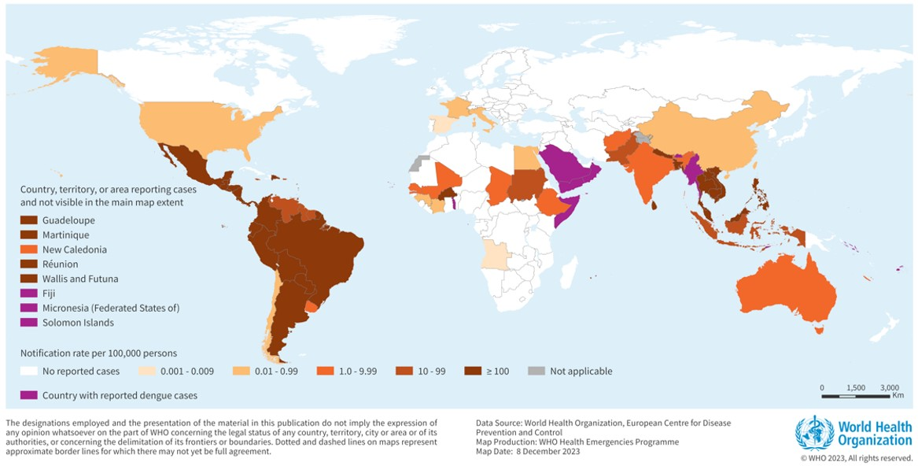
Countries/territories/areas reporting dengue cases (November 2022- November 2023)

Slide 5
Epidemiological update (West Bengal)
The disease has a seasonal pattern; the cases peak after the monsoons.
An upsurge in the cases of dengue/DHF has been observed in India - during the period July – November, every year
NVBDCP reported: 44585, 193245, 233251, 10100 and 31290 Laboratory confirmed cases in 2020, 2021, 2022, 2023 & 2024 respectively.
In India, all serotypes are circulating (DENV-2 & DENV- 3 most common).
In West Bengal, DENV-2 - common in the Northern part &
DENV-2 & 3 - common in the Southern part

Slide 6
Infection with different serotypes (West Bengal)
Year | DENV-1 (%) | DENV-2 (%) | DENV-3 (%) | DENV-4 (%) | MIXED (%) | Comparative infection rate
2023 | 2.35 | 55.86 | 32.16 | 1.04 | 8.59 | 2>3>M>1>4
2024 | 12.05 | 56.84 | 21.87 | 1.38 | 7.86 | 2>3>1>M>4
2025 (till May) | 14.3 | 85.7 | 0 | 0 | 0
Notes:
DEN-2 is the predominant circulating Serotype in our State.

Slide 7
2024: Dengue cases - Age & Sex distribution
Age sub-group | (%) | Age group | (%) | Sex distribution
< 1 yr | 0.8 | Paediatric | 18.1 | Male – 58.51% Female – 41.47% Others – 0.02%
1-5 yrs | 6.3
6-10 yrs | 5.4
11-15 yrs | 5.7
16-30 yrs | 34.0 | Young adult | 34
31-45 yrs | 24.6 | Adult – middle aged | 40.5
46-60 yrs | 15.9
60-75 yrs | 6.3 | Elderly | 7.4
> 75 yrs | 1.1

Slide 8
Clinical Profile of Dengue Serotypes in India
Feature / Symptoms | DENV-1 | DENV-2 | DENV-3 | DENV-4
Bleeding Manifestations | Less frequent | Common and often severe | Moderate | Rare
Shock Syndrome (DSS) | Infrequent | Common in secondary infections | Reported in outbreaks | Very rare
Neurological Symptoms | Rare | More common (encephalopathy, convulsion) | Occasionally reported | Very rare
Platelet Drop | Gradual | Rapid and steep | Moderate | Mild
Severity of Illness | Mild to moderate | High – often leads to severe dengue | Variable – can be severe in outbreaks | Usually mild
Notes:
DEN-2 is clearly the worst serotype in Indian context.
We need to give the due effort to prevent it, otherwise clinical complications will do occur

Slide 9
Dengue virus
There are four distinct dengue virus serotypes, all of which originate from the family Flaviviridae and genus Flavivirus.
The serotypes are termed DENV-1, DENV-2, DENV-3, and DENV-4,
infection with any one virus results in lifelong immunity to that specific serotype.
Each of the four serotypes has been individually found to be responsible for dengue epidemics and associated with more severe dengue.
Notes:
our immune systems are good at remembering when they have seen an infection before. Once we develop antibodies to a pathogen, memory immune cells mean that our body can quickly trigger them again when we encounter the pathogen a second time. But, Subsequent infections with a different serotype can be so much worse, the pre-existing antibodies to one serotype bind to the virus particles from the new serotype that is infecting us, but fail to neutralise them. The process is k/a antibody-dependent enhancement (ADE).

Slide 10
Dengue Virus
Single stranded RNA virus
Genus flaviviridae.
Spherical, Diameter - 50 nm approx.
Composed of:
Nucleocapsid- composed of following:
1. Viral genome
2. Capsid protein (C)
Viral envelope- Contains two types of viral proteins - envelope (E) protein & membrane (M) protein - responsible for controlling the entry of virus into the human cell.
Notes:
Positive sense, Icosahedral symmetry, Viral envelope- surrounds the nucleocapsid. . It is composed of lipid bilayer. Throughout the lipid bilayer, two types of viral proteins are present. These are envelope (E) protein and membrane (M) protein. These two proteins are responsible for controlling the entry of virus into the human cell.

Slide 11
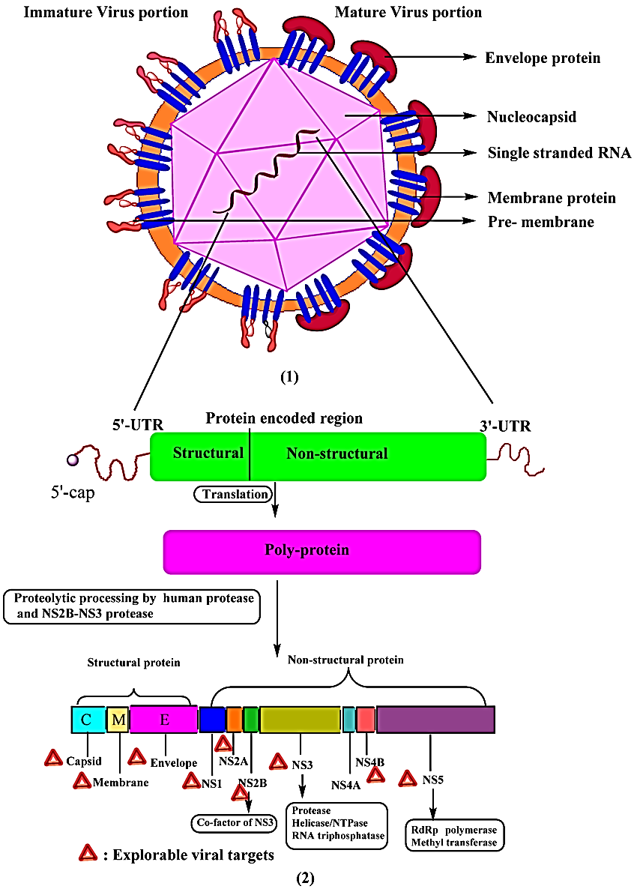
Dengue virus
Ten (10) proteins.
03 structural: Capsid protein (C),
Membrane protein (M),
Envelope protein (E)
07 non-structural: NS1, NS2A, NS2B, NS3, NS4A, NS4B, NS5
NS1 protein - involved in viral RNA replication, expressed on the surface of infected cells, without forming part of the virion.
- interacts with the host immune system, evoke T cell responses & activate complement.
Notes:
Patients have measurable levels of NS1 protein in the blood, which is used for diagnosis of the infection.
Levels of secreted NS1 in plasma positively correlate with viral titers.
In secondary dengue (& DHF) - levels of NS1 is higher - imply the role for NS1 in the formation of circulating immune complexes in causing severe dengue.
Higher levels of viral load has been seen in DHF than DF in many studies. Viral burden is the key determinant of disease severity

Slide 12
Viral load & NS1 antigen & disease
In dengue virus infection, patients have measurable levels of NS1 protein in the blood, which is used for diagnosis of the infection.
Levels of secreted NS1 in plasma positively correlate with viral titers.
In secondary dengue (& DHF) - levels of NS1 is higher - imply the role for NS1 in the formation of circulating immune complexes in causing severe dengue.
Higher levels of viral load has been seen in DHF than DF in many studies.
Viral burden may be a key determinant of disease severity
- degree of viral load correlate with measurements of disease severity such as amount of pleural effusion and thrombocytopenia .

Slide 13
Pathogenesis
Binds to specific antibodies
& form immune complexes
DENV enter through bite of the
Aedes aegypti / albopictus
→
activation of complement
& coagulation systems
→ Release of
complement breakdown
products (C3a, C5a)
Monocytes (APC)
induce release of TNF-α,
Interleukins-1b,-2,-6,-8,
Interferon gamma,
RANTES
(from activated T cells)
proliferate in the
monocyte-phagocyte system
enters the circulation
(the first viremia)
increased
vascular permeability,
vasodilation, congestion,
extravasation of plasma proteins
& blood components
Colonizese in RE system &
lymphoid tissue,
replicates in mononuclear cells,
Macrophages & Kupffer cells
Inhibits leukocyte &
platelet production
in bone marrow
→ leukopenia &
Thrombocytopenia
(→dysfunction & depletion
of coagulation factors)
enters the circulation again
(the second viremia)
hemoconcentration
hemorrhage & shock
(DHF/DSS)
Notes:
The pathogenesis of dengue involves a complex interaction between virus and host factors.
colonizes the reticuloendothelial system and lymphoid tissue, replicates to a certain extent in peripheral blood mononuclear cells, macrophages in tissues, and Kupffer cells in the liver , and enters the circulation again, causing a second viremia.

Slide 14
Pathogenesis of DHF/DSS.
All four serotypes are capable of causing severe disease.
Host & viral factors, both play essential role - secondary DENV
Various mechanisms - pathogenesis of severe dengue, includes:
Antibody-dependent enhancement or ADE,
T-cell mediated immunopathology(inappropriate memory T-cell response)
Complement activation by virus-antibody complexes
Cytokine abundance.
viral virulence variation
Notes:
viral virulence variation due to secondary DENV

Slide 15
Transmission of DENV
The vectors: Mosquito Aedes aegypti & Aedes albopictus, respectively.
Aedes aegypti – lives indoors, breed in water-ﬁlled containers, day-biting - feed preferentially on human blood, found in almost all continents (mainly tropical and subtropical areas)
Aedes albopictus - a more aggressive day-time biter, exophilic - commonly living outdoors, but still feeds almost exclusively on humans
Transmission - two cycles: sylvatic and human
Notes:
The sylvatic cycle is ecologically and evolutionarily distinct from the human transmission cycle. This is maintained by non-human primates or by a monkey-Aedes-monkey cycle in the sylvatic environments of Southeast Asia, West Africa, peninsular Malaysia, and eastern Senegal.
sylvatic (transmission in wild animals)
(Carrington and Simmons2014), (Thavara et al. 2001), (Ponlawat andHarrington 2005; Delatte et al. 2010). (Chen and Vasilakis 2011).

Slide 16
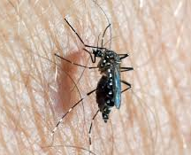
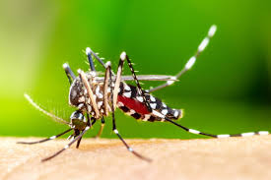
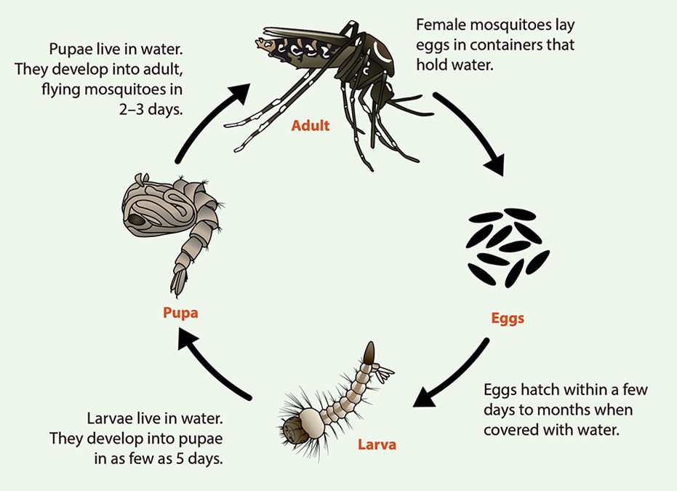
Aedes mosquito
Identification(Key External Features)
Size and Color: small (4-7mm) and dark, often with a brownish-black appearance.
Legs: Distinctive white bands or markings on the legs, particularly at the joints.
Thorax: A harp-shaped pattern of silver or white scales on the dorsal surface
Abdomen: White or silver scales
Sitting posture: rest & bite hunched over- making upside-down V.

Slide 17
Laboratory diagnosis
DENV is found in serum, plasma, or circulating blood cells or tissue during the ﬁrst 1 to 5-7 days of infection.
Diagnostic modalities:-
Direct methods:-
Virus or viral RNA isolation, (NS-1) antigen detection, quantification (viral load), Viral culture
Indirect methods: -
Demonstration of anti-dengue antibodies (IgM) & (IgG)
Notes:
Sample- blood (and serum/plasma)
The NS1 and IgM diagnostics are not fully reliable because of cross-reactivity with other ﬂaviviruses (e.g., Zika virus)

Slide 18
Laboratory diagnostic methods
During the early stages of the disease (first 5 days), virus isolation, nucleic acid or NS-1 antigen detection can be used to diagnose the infection.
Virus or viral RNA isolation or quantification (viral load) - by nucleic acid amplification tests (NAAT) / by RT-PCR / or by conventional PCR
(NS-1) antigen – by ELISA or immune chromatographic rapid card tests/ dot blot assay.
Virus isolation in cell culture – in C6/36 mosquito cell lines (obtained from A albopictus)

Slide 19
Laboratory diagnostic methods
At the end of the acute phase(from 6th day) of infection, serology (demonstration of anti-dengue immunoglobulin M (IgM) antibodies is the method of choice for diagnosis.
The serological tests:–
Hemagglutination-inhibition (HI)
Complement ﬁxation(CF)
Neutralization test (NT)
IgM capture enzyme-linked immunosorbent assay (MAC-ELISA)
Indirect IgG ELISA. (detectable at low level by the end of first week)

Slide 20
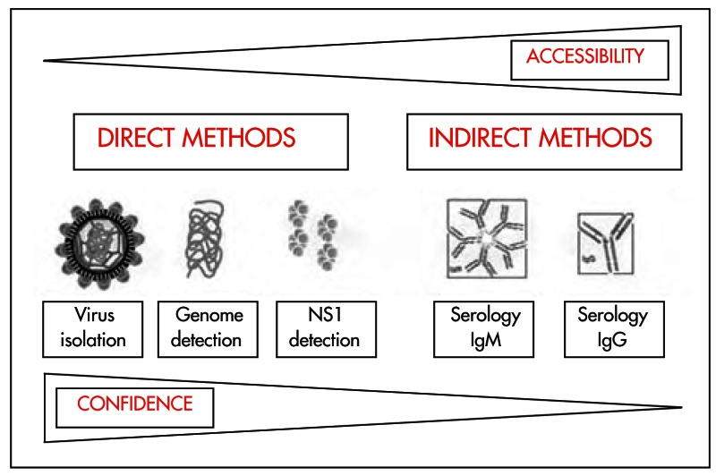
Comparison of diagnostic tests according to their accessibility and confidence.

Slide 21
Choice of laboratory diagnostic methods
A range of laboratory diagnostic methods has been developed to support patient management and disease control.
The choice of diagnostic method depends on:-
The purpose for which the testing is done (e.g. clinical diagnosis, epidemiological survey, vaccine development),
The type of laboratory facilities and technical expertise available,
Costs
The time of sample collection - The diagnostic approach is time-sensitive, as different markers are detectable at different phases of the illness.

Slide 22
Evaluation of a diagnostic test
Sensitivity: is a measure of how well a test can identify true positives.
Specificity: is a measure of how well a test can identify true negatives.
Virus isolation and nucleic acid detection are more labour-intensive and costly but are also more specific than antibody detection using serologic methods.
Whereas, rapid tests may compromise sensitivity and specificity for the ease of performance, speed and cost.
There is usually a trade-off between sensitivity and specificity
Notes:
For all testing, both diagnostic and screening, there is usually a trade-off between sensitivity and specificity, such that higher sensitivities will mean lower specificities and vice versa.

Slide 23
1. NS1 Antigen Detection
Detects non-structural protein 1 of dengue virus
Positive from day 0 to day 5, declines rapidly thereafter
Preferred test in the early phase
Available as ELISA or Rapid Diagnostic Test (RDT)

Slide 24
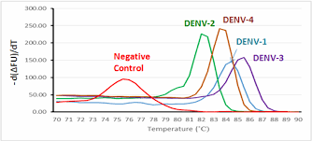
2. Nucleic acid detection assays
Detects viral RNA
High specificity, used in early acute phase (0–5 days)
With excellent performance characteristics may identify dengue viral RNA within 24–48 hours.
These tests require expensive equipment and reagents.
Tests must observe strict quality control procedures & performed by experienced technicians
Notes:
- Mostly used in reference labs or research settings

Slide 25
Virus isolation in cell culture
Inoculation of C6/36 mosquito cell lines (obtained from A albopictus)
Samples to be frozen to preserve the viability of the virus during transport from the patient to the laboratory.
(at 4–8°C - less than 24 hours)
(at −70°C longer periods)
The isolation and identification in cell cultures takes several days.
Dengue viruses can be isolated from serum, plasma, or leucocytes - also from postmortem specimens such as liver, lung, spleen, lymph nodes, thymus, cerebrospinal fluid, or pleural/ascitic fluid.

Slide 26
3. IgM ELISA
Positive from day 5-6 onwards
Used for confirmation in later stages
4. IgG ELISA
Appears later, end of first week
useful in seroprevalence studies
distinguishing primary vs secondary infection

Slide 27
Antibody response to infection
Primary immune response
a slow increase of IgM antibody,
detectable in 50% of patients by days 3-5 after onset of illness,
increasing to 80% by day 5 & 99% by day 10
Becomes undetectable after 2-3 months.
IgG – detectable - low level - end of first week, increase later & remain for longer period.
Secondary dengue infection:
IgG - dominant Ig, detectable at high levels, even in the acute phase.
rise rapidly & react broadly against many flaviviruses.
Persists for 10 months - to life.
IgM - significantly lower in early convalescent stage & may be undetectable in some cases.
IgM/IgG antibody ratio - distinguish primary & secondary infection
Notes:
Differs according to the immune status of the host .
persons who have not previously been infected with a flavivirus or immunized with a flavivirus vaccine (e.g. for yellow fever, Japanese encephalitis, tick-borne encephalitis),
DENV, chikungunya virus and Zika virus – Cross reaction

Slide 28
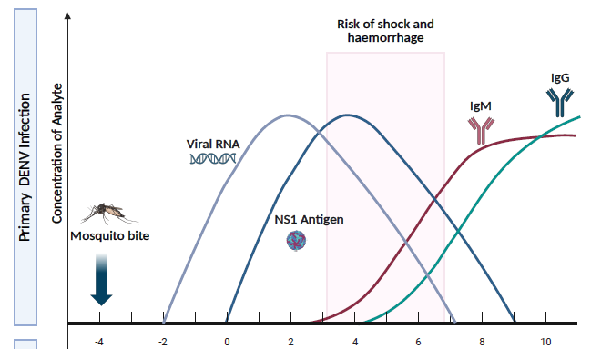
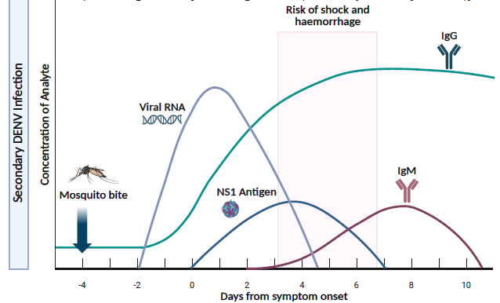
Progression of diagnostic markers in primary and secondary DENV infections in relation to days from symptom onset
Laboratory testing
for dengue virus:
interim guidance,
April 2025, WHO

Slide 29
Period of dengue viral infection and tests done
From onset of Illness to 5 days Virus isolation (up to 4th day) Nucleic Acid Detection (up to 4th day) NS1 Antigen Detection (up to 5th day) For confirmation of dengue infection, Government of India (GOI) recommends use of ELISA test for NS1.
From 6th Day onwards Antibody Detection Primary antibody to appear → IgM Secondary antibody to appear → IgG
Notes:
NS1 and RT-PCR are most sensitive in early phase; confirm dengue infection
IgM peaks by day 6–10; IgG appears later (especially in secondary infections)

Slide 30
5. Additional Laboratory Findings
(Non-specific but supportive)
Parameter | Typical Finding in Dengue
CBC | Leukopenia Thrombocytopenia
Hematocrit | May be elevated (plasma leakage) Haemoconcentration
LFT | Mild elevation in AST/ALT in severe cases
Coagulation Profile | Impaired platelet functions, Prolonged PT/APTT in severe cases
mild albuminuria, occult fecal blood

Slide 31

As there is no specific treatment for dengue,
Early treatment attention & appropriate clinical management help to prevent the progression to severe dengue and deaths.
Timely diagnosis & identification of warning signs are key elements to achieve this.
Notes:
Timely diagnosis of dengue cases, identification of warning signs for severe dengue, and appropriate clinical management are key elements of care to prevent the progression to severe dengue and deaths.

Slide 32
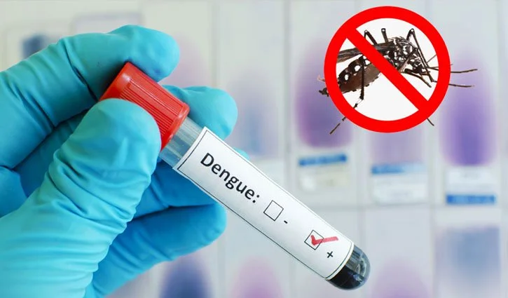
Thank You

