Slide 1
Dengue Case Management: Pediatric Age Group
Dr. Anupam Sinha
Asst. Professor, Pediatrics
TGMCH

Slide 2
CASE 1
9 year old girl child presented with
H/o Fever for 7 days - High grade, intermittent 3-4 times a day
Associated with loose stool & vomiting, transient rash
No h/o convulsions, joint pain, bleeding manifestations
Possible Diagnosis??

Slide 3
Syndromic approach
Undifferentiated fever
Typhoid
Malaria
Dengue
Leptospirosis
Fever with thrombo-cytopenia
Dengue
Scrub typhus
Malaria
Leptospirosis
Meningococcemia
Fever with ARDS
Scrub typhus
H1N1
Malaria
Dengue
Fever with encephalopathy
Viral encephalitis
(Herpes, JE)
Scrub typhus
Cerebral malaria
Fever with MODS
Scrub typhus
Bacterial sepsis
Dengue
Malaria
Viral hepatitis
Best practice statement

Slide 4
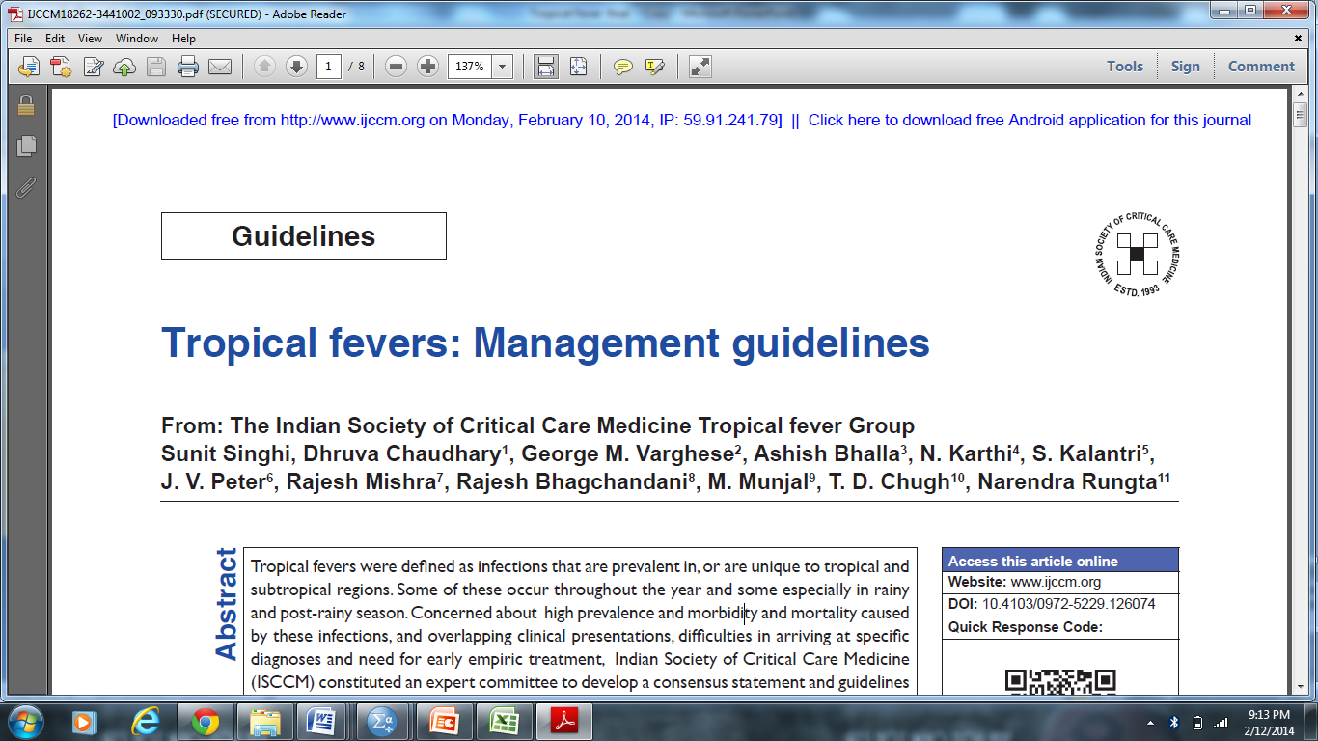
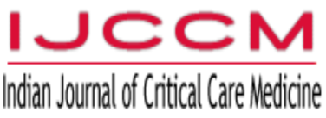
Tropical fevers
Definition_2021
Essential
1. Fever > 38⁰C for at least 48 hours duration with onset <14 days
2. No localizing signs (eg. Pneumonia/bronchiolitis, acute diarrheal illness, UTI, meningitis, skin/soft tissue abscess etc.)
3. Clinical and/or laboratory evidence of one or more organ system involvement (hematological, respiratory, circulatory, renal, hepatic)
Desirable
4. One or more systemic features such as edema, rash, hepatomegaly and/or splenomegaly, encephalopathy
5. A seasonal trend in incidence
Best practice statement
2014

Slide 5
Bench to bedside
Challenges
Most infections cluster during monsoon /post-monsoon
Clinical presentation is overlapping;
more so, when they present with organ failures
Atypical presentation is not uncommon
A few cases of co-infections
Clinical presentation

Slide 6
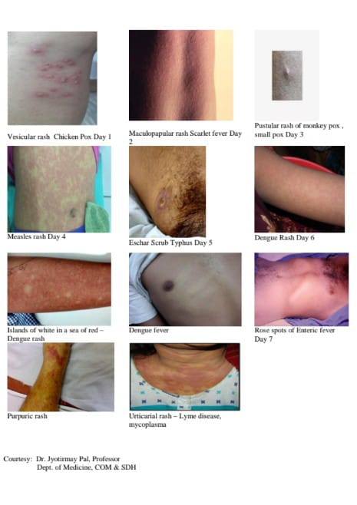

Slide 7
Case 2
7 year old girl child presented to our Emergency with h/o
1: Fever for 5 days
2:Respiratory distress 1 day
Associated with vomiting, pain abdomen, transient rash
Pedal oedema 2 days

Slide 8
On Presentation
assessment:
Airway: maintained
Breathing:RR-44/min,
Spo2:84%with o2@4lit/min,
Decreased air entry in Lt lower axilla
Exposure :nothing significant
Disability:Gcs:15/15,Cbg:88
Circulation - 136/min,
Peripheral Pulse - low volume , periphery cold,
BP -82/50 mmHg

Slide 9
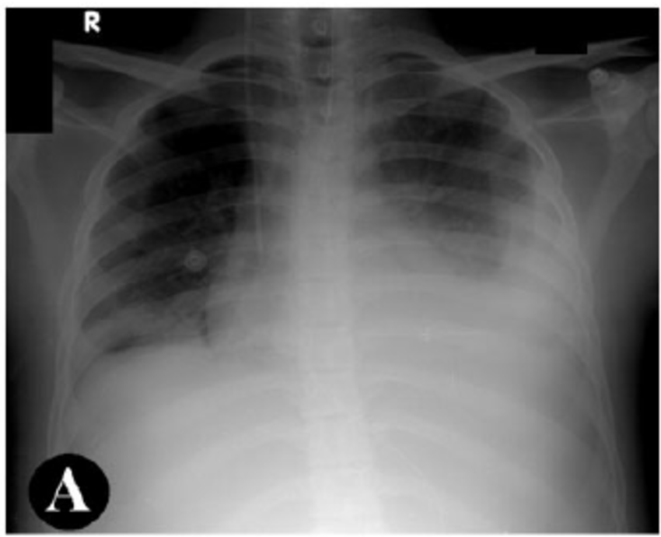
Initial Reports
CBC:Hb- 9.4gm/dl,
TC- 5420/cumm (N55,L42),
PLT-20000/cumm
CRP-36gm/dl,
Urea-112 mg/dl, Creatinine -1.5 mg/dl
MPDA – Negative
T.bil-0.3mg/dl,SGPT-86,SGOT-152,ALP-92,
ALB-2.3
PT:>34sec,aPTT:>80sec
Dr Mihir

Slide 10
Possibilities ??
Scrub Typhus
Severe Dengue
Pneumonia with MODS
Severe malaria
Leptospira
Vasculitis group

Slide 11
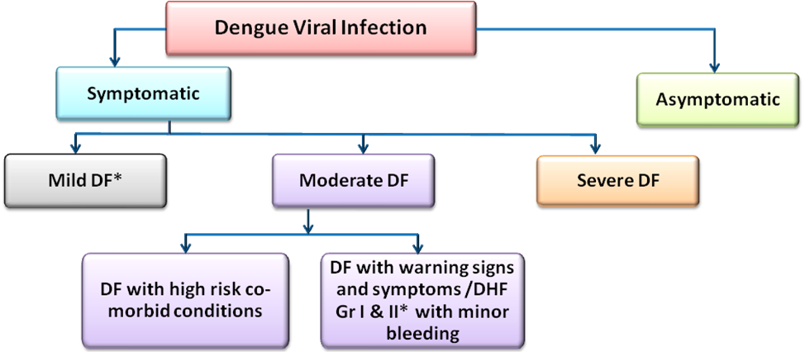
Dengue case classification
A. Undifferentiated DF
B. F̽ever without complication like bleeding, hypotension and organ involvement
C. Without evidence of capillary leakage
Infants
Old age
Diabetes
Hypertension
Pregnancy
CAD
Hemoglobinopathies
Immunocompromized patient
Patient on steroids, anticoagulants or immunosuppressants.
A. DF with warning signs and
symptoms
Recurrent vomiting
Abdominal pain/ tenderness
General weakness/ letharginess/ restless
Minor bleeding
Mild pleural effusion/ ascites
Hepatomegaly
Increased Hct
B. DHF Gr I & II with minor
bleeds
A. DF with significant
A. Severe plasma leak
B. (i) DHF with significant hemorrhage with or without shock
(ii) DHF III & IV̽ (DSS) with shock with or without significant hemorrhage
C. Severe organ involvement (Expanded Dengue Syndrome)
D. Metabolites and electrolytes abnormalities
Home Management
Close Monitoring and possibly Hospitalization
Tertiary level care

Slide 12
DENGUE IN NEONATES
Is it common? Rare
How does it occur?
1. Vertical transmission
- In late third trimester of pregnancy
- Consider dengue incubation period
2. Vector transmission?
Observe the baby born to a mother with dengue infection for a minimum period of two weeks after birth

Slide 13
Features of Dengue in neonates
Full spectrum of disease can occur
Fever, skin rash
Bleeding manifestation:
- Purpura - Nose bleeding
- Gi bleeding - Pulmonary haemorrhage
- Intracranial bleeding
Hepatic & Multi-organ failure
Maternal Dengue near term: May be an important clue
Anaemia, leucopenia, thrombocytopenia
Close D/D –Neonatal sepsis, Congenital Infection
Strong clinical Suspicion required for Diagnosis

Slide 14
Dengue in infants
Most susceptible: Babies between 4 to 9 months
Severe dengue is common
NS1Ag may be missed before 6 months of age due to presence of maternal antibody
Convulsions and hepatic dysfunction more commonly affect infants
Dengue in infants can be severe (DHF/ DSS/ their complications) in primary infection .
Complications of fluid overload were found more often in the infants
Mortality in this age group is 4 times higher

Slide 15
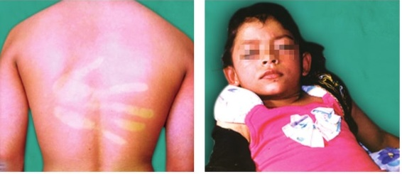
Clinical features of DF in infants
“Flu” like features:
High fever
Running nose
Cough
Conjunctival congestion
Vomiting, nausea, anorexia
Irritability / excessive cry
Diarrhoea like Presentation
Bleeding gum, nose, easy bruisability – common.
Positive tourniquet test - infants - sensitivity of 33%, specificity of 76%
Measly look + blanchable erythematous flush /skin rash

Slide 16
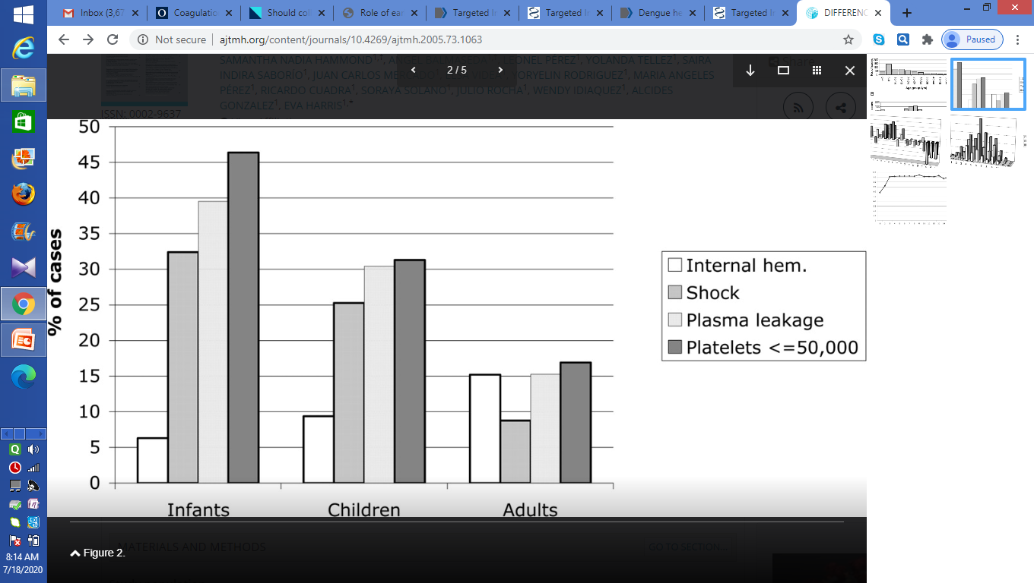
DIFFERENCES IN DENGUE SEVERITY IN INFANTS, CHILDREN, AND ADULTS

Slide 17
Clinical features of DF in toddlers and older children
Abrupt onset high fever
Headache
Pain in orbits
Extreme myalgia, arthralgia ( “Break bone fever”)
Vomiting, pain abdomen
Sore throat
Skin rash
Minor bleeding – nose/gum/easy bruisability

Slide 18
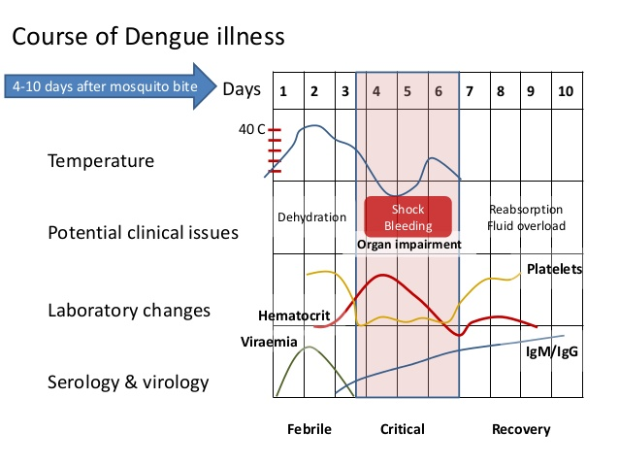
Course of Dengue illness

Slide 19
Case 3
5 year old boy, 35 kg, D-3 high grade fever, Appetite slight decreased, urine - 7 times in last 24 hrs.
HR – 90/min, BP – 108/70 mmHg
Dengue NS1 antigen positive
Platelet – 1.2 lack, Hb – 11.8gm%, PCV - 35
Parents are anxious,
Patient admitted -
IVF – 0.45% DNS @ 3ml/kg/hr ….so 105ml/hr…2520 ml/24hr
What do you think about fluid ?
Is there any complication of excess fluid in febrile phase ?

Slide 20
Actual Body weight Vs Ideal Body Weight ??
5 YEARS - 35 Kg
For obese and overweight patients calculation of fluid should be done on basis of ideal body weight
Male | Female
50kg + 0.91 (height – 152.4cm) | 45.5kg + 0.91 (height – 152.4cm)
Height in cm - 100 | Height in cm - 95

Slide 21
Admission criteria
History | -Infancy or old age -DF with warning signs and symptoms
Findings through further Investigations | Rapid fall of platelet count Rising haematocrit Pleural effusion, Ascites or asymptomatic gall-bladder thickening (in USG) Evidence of organ involvement Hypotension
Social circumstances | -Living alone -Living far from health facility; -No reliable means of transport

Slide 22
Febrile Phase
DO NOT Push unnecessary fluid in Febrile Phase.
Will increase hydrostatic pressure and if patients advance to critical phase - increase the leak.
What should be done ?
Adequate bed rest
Adequate fluid intake : Daily intake plus 5% Deficit (50ml/kg/day)
Note: Plain water alone may cause electrolyte imbalance . Oral rehydration solution (ORS) or barley/rice water/coconut water
Paracetamol - every 6 hours (maximum 4 doses per day)
Tepid sponging

Slide 23
Fluids to be Taken | Fluids to be Avoided
Fruit Juices Coconut Water Rice Water Barley Water Oral Rehydration Solution Soup | Commercial carbonated drinks (cold drinks) Drinks that exceed the isotonic level (5% sugar)
What should be Done | What should not be Done
Adequate bed rest | Do not take NSAIDs like aspirin, or steroids
Adequate fluid intake | Do not take combination of paracetamol with NSAIDs
Take paracetamol Tepid Sponging | Antibiotics not necessary unless there is bacterial infection
Look for mosquito breeding places in and around the home and eliminate them

Slide 24
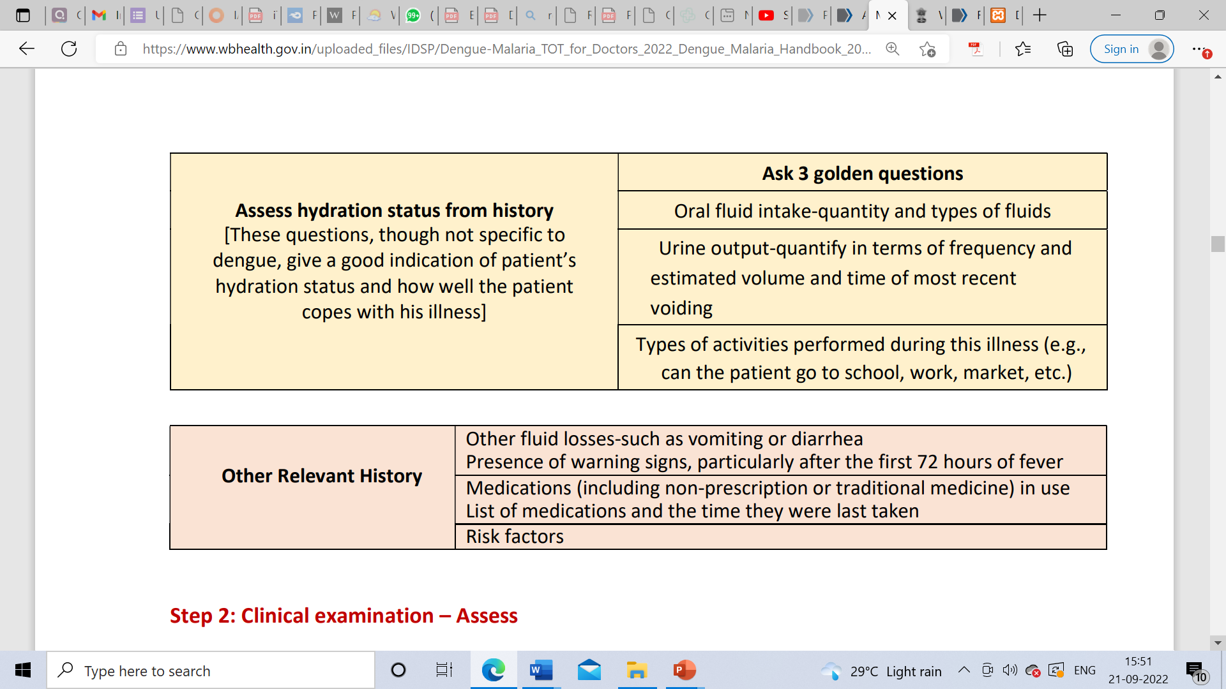

Slide 25
Case -4
A 9 months old male child. Wt 7 kg.
H/o Fever 3 days up to 102-103◦ F – 3 spikes/day. Decreased apatite , nauseating, irritable. Taking water and breast milk only.
Urine passed 4 times in last 24hrs.
HR – 130/min, BP – 88/60 mmHg, CRT – 3sec
No hemorrhage, no sign of shock
Erythematous skin rash on D-2 –
Dengue NS1 Antigen Positive .
  Will you admit the child ?
  Will you start Fluid ?
  What Fluid ?

Slide 26
Choice of IV Fluid
IV Fluids to be Given | IV Fluids to be Avoided
Use isotonic iso-osmolar solutions (normal saline, Ringer’s lactate) Colloids are preferred if the blood pressure has to be restored urgently | Hypotonic solution, e.g. 0.45% saline, even during the febrile phase. Dextrose containing solutions, but may be used in hypoglycaemia with close blood glucose monitoring.
NS
Good 1st choice
Excess Cl in Nacl can cause hyperchloremic Met Acidosis
RL
Has lower Na 131, Cl 114
Not good in hyponatremia
Not good in liver dysfunction

Slide 27
The maintenance fluid should be calculated using the Holliday-Segar formula as follows:
Maintenance Fluid Therapy
Body weight in kg | Maintenance volume for 24 hours
<10kg | 100ml/kg
10-20 | 1000+50 ml / kg body weight exceeding 10 kg 1000 + 50 x ( body weight in kg – 10)ml
More than 20 kg | 1500+20 ml / kg body weight exceeding 20 kg 1500 + 20 x ( body weight in kg – 20)ml
The fluid infusion should be just sufficient to maintain effective circulation during the period of plasma leakage
One should keep a watch for urine output, liver size and signs of pulmonary oedema. Hypervolemia is a common complication.
Normally intravenous fluids are not required beyond 36 to 48 hrs.
Normally change should not be drastic. During any changes look for signs of under and over hydration.
ONE ML is equal to 15 DROPS. In case of micro drip system, one ml is equal to 60 drops.

Slide 28
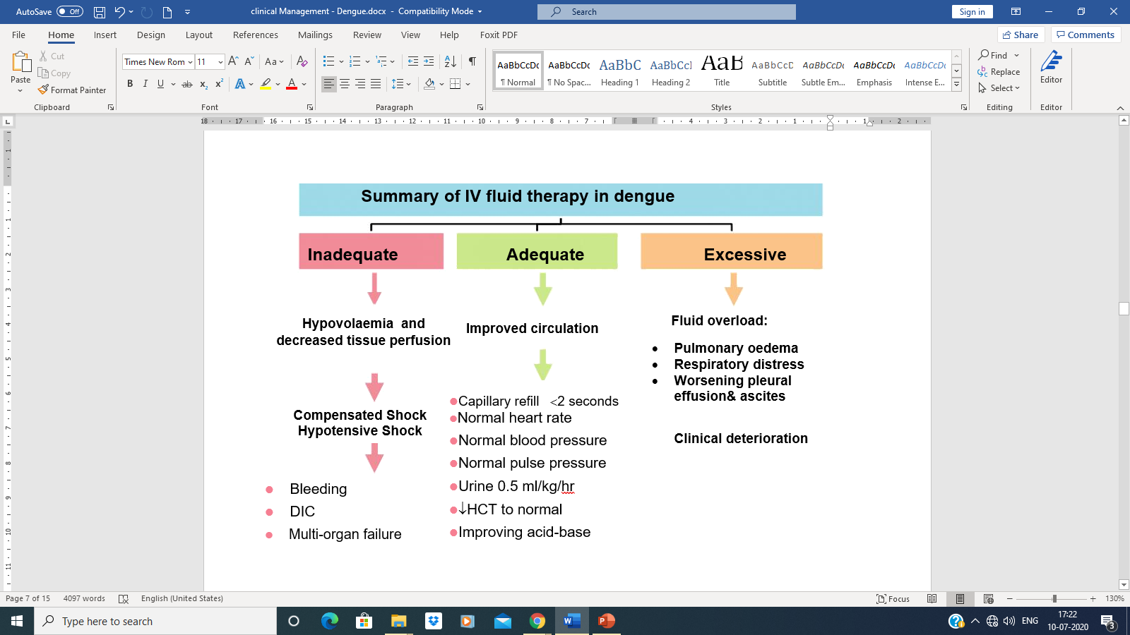
IV Fluid Therapy
Fluid therapy should be promptly started to prevent hypotensive shock !

Slide 29
Management of Dengue =
Rational Use of Fluid

Slide 30
Case - 5
A 5 Yr old boy was having fever for 5 days with mayalgia and pain abdomen, skin rash, Conjunctival congestion.
Today he started having bleeding from gums.
He was also having edema of hands, feet and Mild respiratory distress.
HR- 106/min, RR- 36/min, BP- 96/68 mmHg Urine passed 4 times in last 24 hrs.
Dengue IgM positive

Slide 31
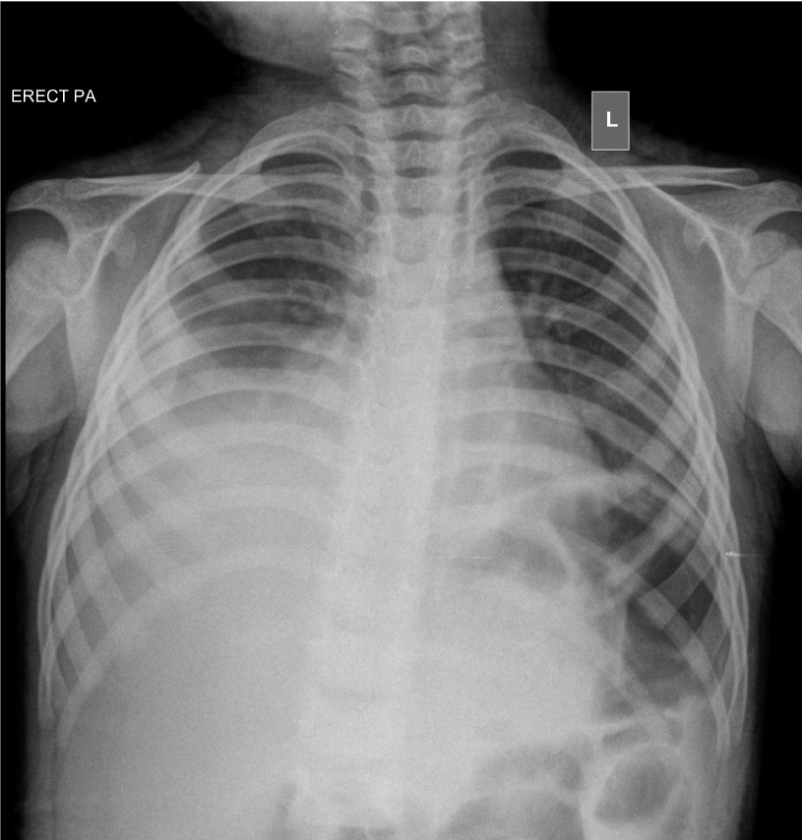
Investigations:
In all cases of children:
CBC:
TLC – 3500/cmm, N- 30%, L – 66%,
Platelet – 65,000/cmm,
Hb – 14gm%, HCT - 41
LFT – SGPT/SGOT – 124/156 U/L
Patient in compensated Shock
Will you start Fluid ?
What Fluid ? Rate ? Monitoring ?

Slide 32
Circulation
Normal heart rates by age
  Newborn-3months:85-205/min (140)
  3months-2 years:100-190/min (130)
  2-10years:60-140/min (80)
  >10years: 60-100/min (75)
Normal urine output
  Infants-young children: 1-2 ml/kg/hr
  Older children-adolescents: 0.5-1ml/kg/hr
Least acceptable systolic BP
Birth -1 month - 60 mm of Hg
1m- 1yr - 70 mm of Hg
Systolic BP (97th percentile) =
90 mm of Hg + 2 x age in years
MAP (50th percentile) = 1.5 x age in years + 55

Slide 33
Features of Compensated Shock
Tachycardia without fever during defervescene – the earliest clinical sign
Low pulse volume
Quiet Tachypnoea – increased respiration rate but without effort
Signs of peripheral vasoconstriction –
Cold extremities
Prolonged CRT
Raised diastolic BP
Narrow pulse pressure (<20 mm of Hg)

Slide 34
Clinically stable and no change in HCT
Clinically stable
No or minimal change of HCT
Yes
Adequate fluid intake and Urine output
HCT decreased to baseline
Clinically stable
No
Shock
Increase fluid to 7 to 10 -20 ml/kg/hr for 1-2 hrs
Reduce fluid and switch over to Oral fluid
Go to Management of DSS
Recheck HCT
Reassess Clinically
Reduce Fluid in Stepwise manner.
Reassess at each step
10 ml/kg/hr for 1-2 hrs
7 ml/kg/hr for 2-4 hrs
5 ml/kg/hr for 2-4 hrs
Yes
Patient Improving ?
No

Slide 35
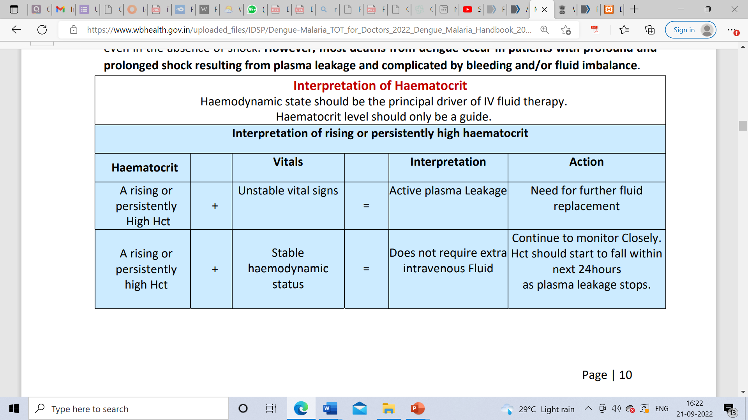
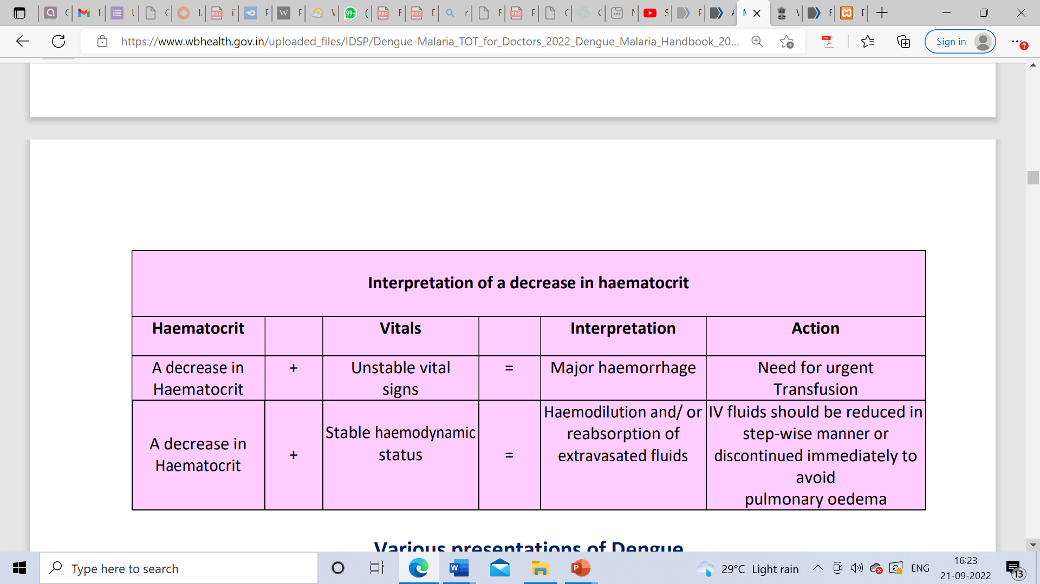

Slide 36
Case - 6
6 year old child.
High fever for 5 days and irritability. Fever decreased from yesterday night.
Mother states child was unwell and had taking less amount. Had rash on D3. Started swelling of limbs and face for 1 day.
Rapid breathing and cold limbs. Child was admitted in primary health center . She was started on IV fluid( 0.45%NaCl) and referred.
Drowsy
HR – 154/Min
Pulse - thready
CRT – 4 SEC
Temp – Cold extrimities
BP- 76/60
Interpretation – Decompensated Shock

Slide 37
Indications for Pediatric Intensive Care Unit Admission
Severe plasma leakage with hypoperfusion and hypotension
Fluid accumulation with respiratory distress
Severe bleeding
Severe organ impairment: Myocardial dysfunction
Acute kidney injury
CNS dysfunction (altered consciousness and seizures)
Hepatic dysfunction (ALT/AST >1,000 IU)
HLH

Slide 38
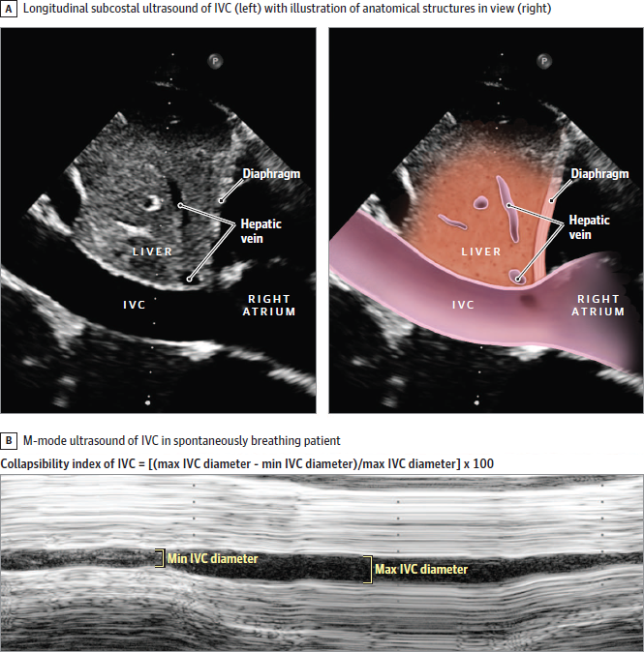
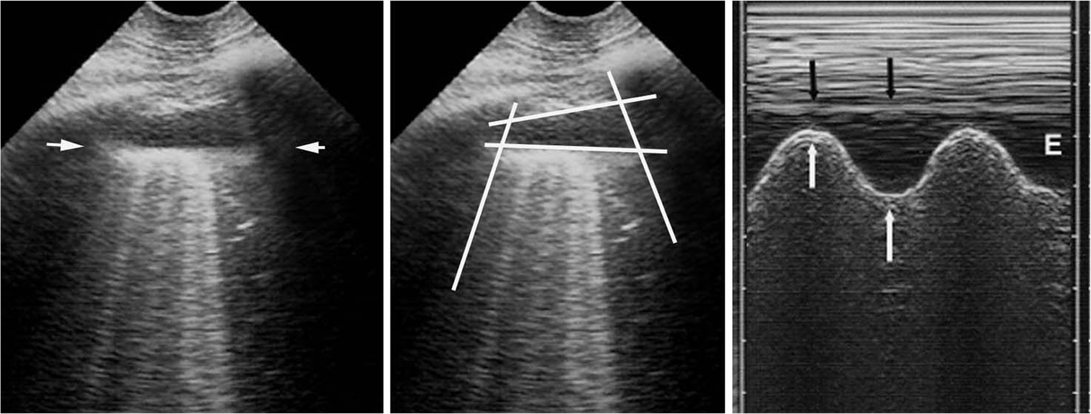
Role of Ultrasound
IVC Collapsibility >50%
Pleural Effusion

Slide 39
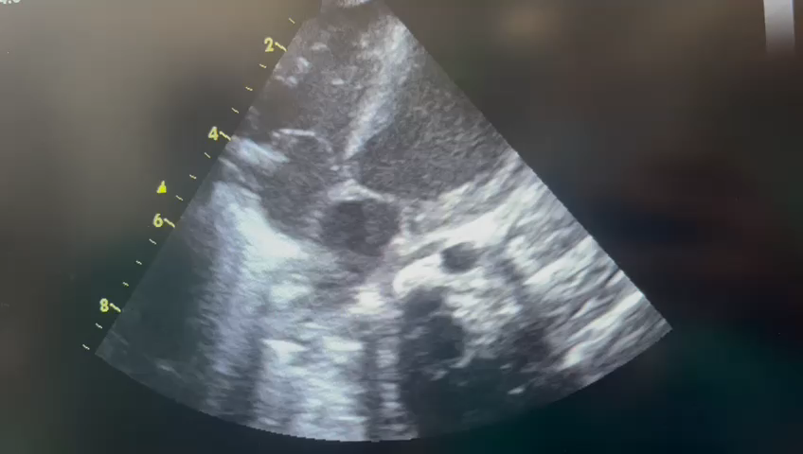
Functional Echo – eye balling

Slide 40
Dengue shock syndrome (compensated or hypotensive)
Signs of poor peripheral perfusion, hypotension
Rapid Volume replacement 10-20 ml/kg
Crystalloid 20ml/kg for hypotensive shock
10ml/kg for compensated shock
Improved
No improvement
Start IV therapy by Crystalloid
Titrate the flow from 10-7 ml/kg/hr for 2-4 hrs
5-3 ml/kg/hr for 2-4 hrs
3-1.5 ml/kg/hr for 2-4 hrs
Repeat 10-20 ml/kg bolus over 30 mins
Further improvement of vitals
Discontinue IV after 24-48 hrs
Discontinue IV after 24-48 hrs

Slide 41
No improvement
Start IV therapy by Crystalloid
Titrate the flow from 10-7 ml/kg/hr for 2-4 hrs
7-5 ml/kg/hr for 2-4 hrs
5-3 ml/kg/hr for 2-4 hrs
3 – 1.5 ml/kg/hr
Repeat 10-20 ml/kg bolus over 30 mins
No improvement
HCT rise 20% or HCT >45%
No improvement
HCT falls
Improvement
10-20 ml/kg bolus over 1 hr preferably colloid
Suspect Bleeding
Blood Transfusion
Whole blood @ 10ml/kg
PRBC @ 5ml/kg
Further improvement of vitals
Discontinue IV after 24-48 hrs
No Improvement
Look for myocardial dysfunction , Correct Acidosis, Hypoglycaemia and electrolyte abnormalities
Electrocardiography
IV inotropes with fluid replacement therapy

Slide 42
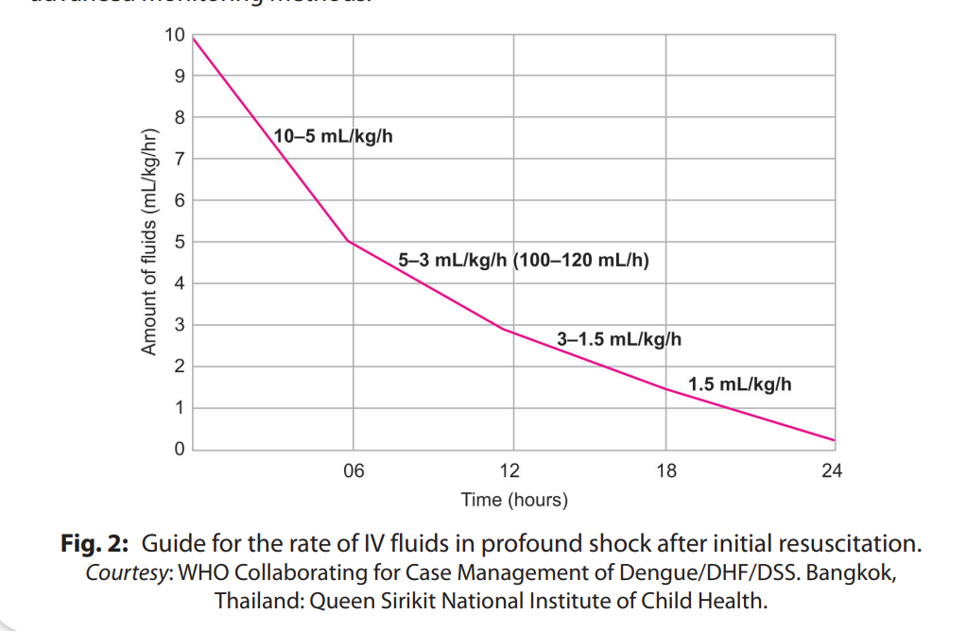

Slide 43
Colloids
5% Albumin | best choice
Dextran 40 | impact on blood group cross matching & coagulation Allergic reactions Osmotic renal injury in hypovolemic patients
Gelatin polymer (polygeline) | Allergic reactions lesser than dextrans
Colloids are used in case of-
Hypotensive shock
Repeated shock – 2nd or 3rd shock and onwards
After >20 to 30 ml/kg of crystalloids
If Hct does not decrease after crystalloid administration in shock
DOSE: Limited to 30 to 50 ml/kg/day

Slide 44
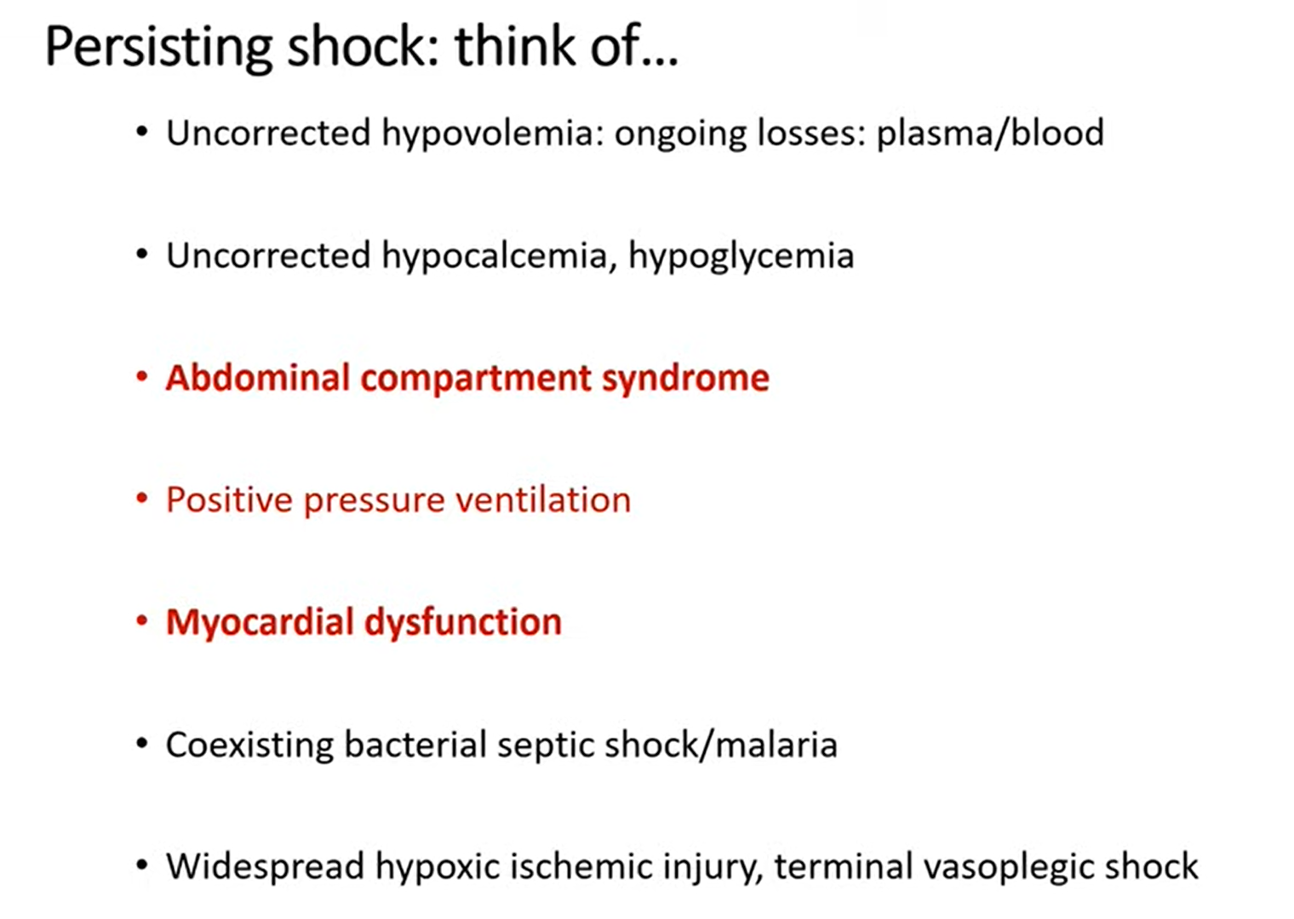

Slide 45
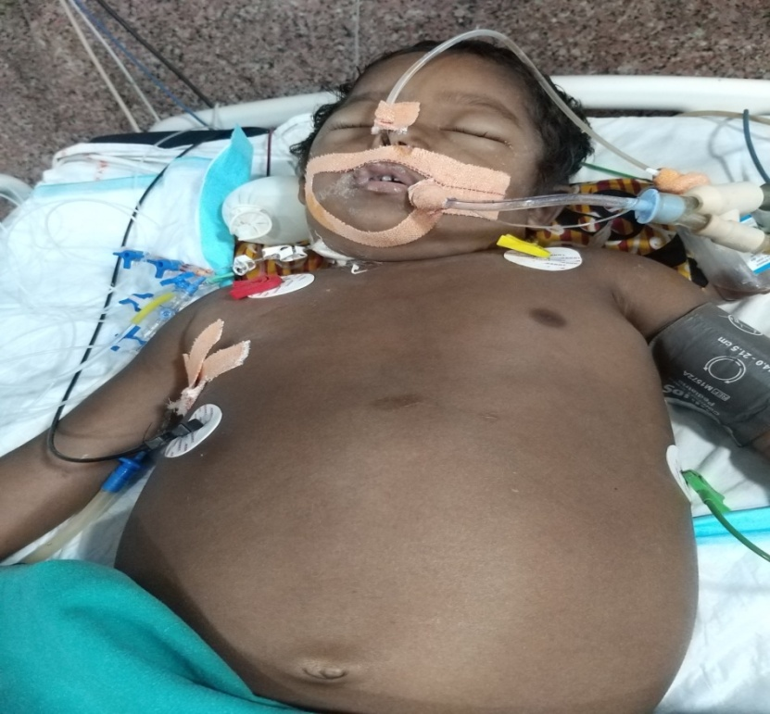
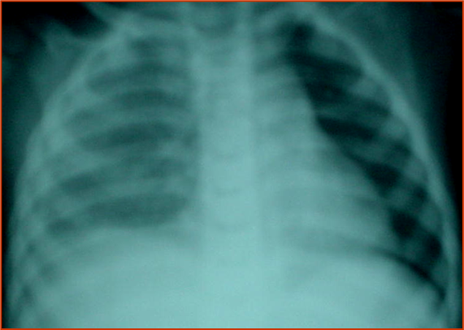
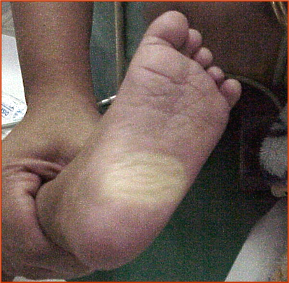
Severe Dengue shock: Initially responded to 10ml/kg/hr for 6hrs Then urine output became a trickle, pulses hard to feel…HCT stable
Options:
Dial up fluid rates
Add Albumin
OR…
Consider Compartment syndromes

Slide 46
Compartment syndromes in severe dengue with fluid overload
Plasma leak in the abdomen can lead to tense ascitic fluid collections and raised intra-abdominal pressures (IAP) resulting in abd compartment syndrome (ACS) with organ failure
ACS can develop rapidly during large‑volume fluid therapy and further exacerbate shock and oliguria prompting even more fluid infusion and further IAP increase.
While extensively reported in trauma and burns, dengue‑associated ACS has been infrequently reported and is quite likely to be under-recognized.
Proactive monitoring of IAP in SD receiving > 30 ml/kg in the first 2–3 h can prompt earlier recognition and control of IAP.

Slide 47
Abdominal Compartment syndrome
Diagnosis |  | Management of Abdominal Compartment
Monitoring IAP through Foley catheter Institute medical measures if IAP >10 mmHg/cmH2O Monitor for progression to ACS: Worsening circulatory parameters, hypoxemia, oliguria, and worsening acidosis |  | In established ACS Slow controlled drainage is important as rapid decompression has a high risk of hemodynamic instability and haemorrhage. Medical measures to reduce IAP: Fluid restriction (colloids preferred), consideration of diuretic (furosemide), sedation, gastrointestinal decompression, minimize PEEP as tolerated if patient is on MV

Slide 48
Dengue is a Dynamic Disease

Slide 49
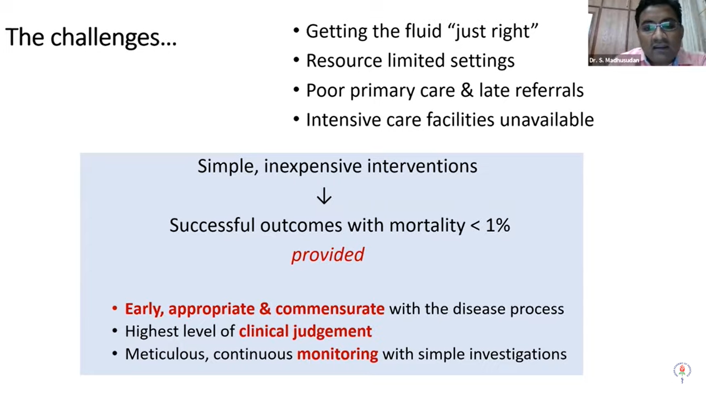

Slide 50
Key Message
Practise Syndromic approach of management of FEVER
Neonates and Infants are high risk group
Meticulous monitoring and Judicious fluid management is the key
Understand the dynamicity of disease
In critically ill children with dengue adhere to bundle of care.

Slide 51
Thank You

